Slide 1
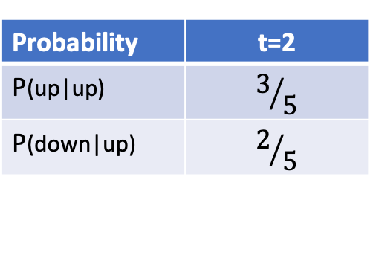
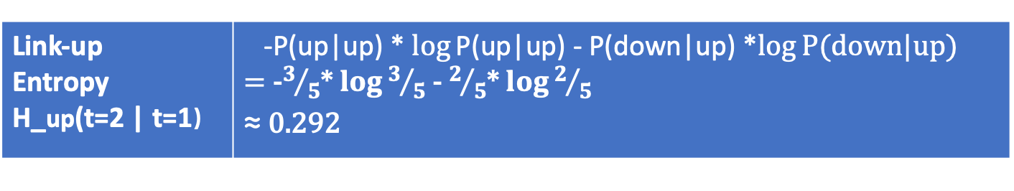
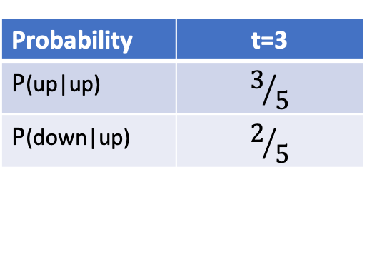
1
t=1
1
t=2
1
t=3
Graph snapshot
2
3
2
3
2
3
4
5
4
5
4
5
Subset of edges used to compute Link-up entropy
1
1
1
2
3
2
3
2
3
4
5
4
5
4
5
Edges | t=1
Total edges | 10
Up edges | 5
Down edges | 5
Probability | t=2
P(up|up) | $$3/5$$
P(down|up) | $$2/5$$
Probability | t=3
P(up|up) | $$3/5$$
P(down|up) | $$2/5$$
Link-up Entropy H_up(t=2 | t=1） | -P(up|up) * $\log{\text{P}\text{(}\text{up}\text{|}\text{up}\text{)}}$ - P(down|up) *$\log{\text{P}\text{(}\text{down}\text{|}\text{up}\text{)}}$ = -$3/5$* $\log{3/5}$ - $2/5$* $\log{2/5}$ ≈ 0.292
Legend:
--- edge disappeared
— edge appeared
Δ = 3

Slide 2
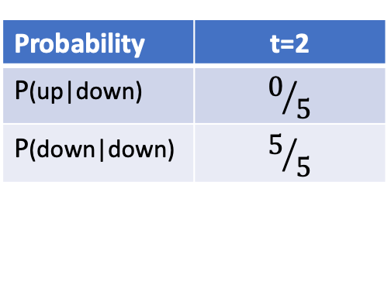
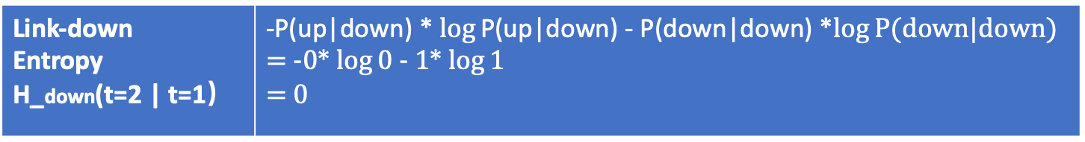
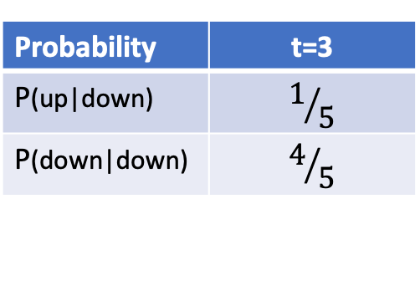
1
t=1
1
t=2
1
t=3
Graph snapshot
2
3
2
3
2
3
4
5
4
5
4
5
1
1
1
Subset of edges used to compute link down entropy
2
3
2
3
2
3
4
5
4
5
4
5
Edges | t=1
Total edges | 10
Up edges | 5
Down edges | 5
Probability | t=2
P(up|down) | $$0/5$$
P(down|down) | $$5/5$$
Probability | t=3
P(up|down) | $$1/5$$
P(down|down) | $$4/5$$
Legend:
--- edge disappeared
— edge appeared
Δ = 3
Link-down Entropy H_down(t=2 | t=1） | -P(up|down) * $\log{\text{P}\text{(}\text{up}\text{|}\text{down}\text{)}}$ - P(down|down) *$\log{\text{P}\text{(}\text{down}\text{|}\text{down}\text{)}}$ = -0* $\log{\text{0}}$ - 1* $\log{\text{1}}$ = 0

Slide 3



T=1
T=k+1
A
After K time steps
E
E
A
D
C
C
D
B
B
Legend:
Link disappeared
Link reappeared
transmission range
Notes:
MANET simple demo

Slide 4
Packet 1 | Sent using direct transmission
Source | A
Destination | E
Location t=1 | A
Packet 1 | Sent using direct transmission
Source | A
Destination | E
Location t=k | E
t=1
t=k+1
After k time steps
E
A
A
E
D
C
B
Legend:
C
D
Link disappeared
B
Link reappeared
transmission range
Notes:
direct transmission

Slide 5
Packet 1 | Sent using flooding
Source | A
Destination | E
Location t=1 | A
Packet 1 Copy | Sent using flooding
Source | A
Destination | E
Location t=k+1 | E
t=1
t=k+1
After k time steps
E
A
E
A
C
D
B
Packet 1 Copy | Sent using flooding
Source | A
Destination | E
Location t=3 | C
C
D
Packet 1 Copy | Sent using flooding
Source | A
Destination | E
Location t=2 | B
B
Packet 1 Copy | Sent using flooding
Source | A
Destination | E
Location t=k | D
Multiple copies made and sent to all neighbors
Notes:
Flooding

Slide 6


