Slide 1
Chapter 10
Transaction Management and Concurrency Control

Slide 2
Learning Objectives
In this chapter, you will learn:
About database transactions and their properties
What concurrency control is and what role it plays in maintaining the database’s integrity
What locking methods are and how they work
How stamping methods are used for concurrency control
How optimistic methods are used for concurrency control
How database recovery management is used to maintain database integrity

Slide 3
Learning Objectives
In this chapter, you will learn:
How stamping methods are used for concurrency control
How optimistic methods are used for concurrency control
How database recovery management is used to maintain database integrity

Slide 4
What is a Transaction?
Logical unit of work that must be entirely completed or aborted
Consists of:
SELECT statement
Series of related UPDATE statements
Series of INSERT statements
Combination of SELECT, UPDATE, and INSERT statements

Slide 5
What is a Transaction?
Consistent database state: All data integrity constraints are satisfied
Must begin with the database in a known consistent state to ensure consistency
Formed by two or more database requests
Database requests: Equivalent of a single SQL statement in an application program or transaction

Slide 6
Evaluating Transaction Results
Not all transactions update database
SQL code represents a transaction because it accesses a database
Improper or incomplete transactions can have devastating effect on database integrity
Users can define enforceable constraints based on business rules
Other integrity rules are automatically enforced by the DBMS

Slide 7
Transaction Properties
Atomicity
All operations of a transaction must be completed
If not, the transaction is aborted
Consistency
Permanence of database’s consistent state
Isolation
Data used during transaction cannot be used by second transaction until the first is completed
Durability
Ensures that once transactions are committed, they cannot be undone or lost
Serializability
Ensures that the schedule for the concurrent execution of several transactions should yield consistent results

Slide 8
Transaction Management with SQL
SQL statements that provide transaction support
COMMIT
ROLLBACK
Transaction sequence must continue until:
COMMIT statement is reached
ROLLBACK statement is reached
End of program is reached
Program is abnormally terminated

Slide 9
The Transaction Log
Keeps track of all transactions that update the database
DBMS uses the information stored in a log for:
Recovery requirement triggered by a ROLLBACK statement
A program’s abnormal termination
A system failure

Slide 10
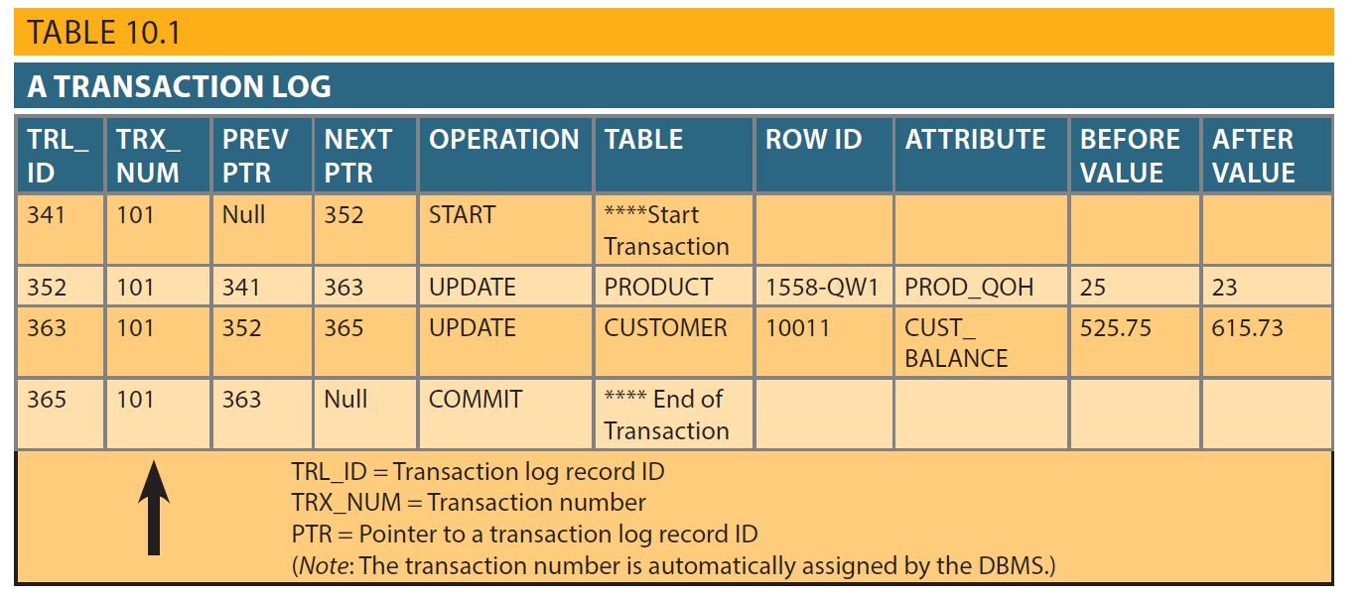
Table 10.1 – A Transaction Log

Slide 11
Concurrency Control
Coordination of the simultaneous transactions execution in a multiuser database system
Objective - Ensures serializability of transactions in a multiuser database environment

Slide 12
Problems in Concurrency Control
Lost update
Occurs in two concurrent transactions when:
Same data element is updated
One of the updates is lost
Uncommitted data
Occurs when:
Two transactions are executed concurrently
First transaction is rolled back after the second transaction has already accessed uncommitted data
Inconsistent retrievals
Occurs when a transaction accesses data before and after one or more other transactions finish working with such data

Slide 13
Transaction Schedule
Schedule: A schedule S of n transactions is a sequential ordering of the operations of the n transactions subject to the constraint that, for each transaction T that participates in S, if operation i is performed before operation j in T, the operation i will be performed before j in S.
A serial schedule
A schedule is serial if, for every transaction T participating in the schedule, all the operations of T are executed consecutively in the schedule; otherwise, it is non-serial.

Slide 14
Transaction Schedule
Serializable Schedule: A schedule S of n transactions is serializable if it is equivalent to some serial schedule of the same n transactions.
Examples: assume x=10
Ex1. T1: (a1) read x, (a2) x=x+2, (a3) write x; T2: (b1) read x, (b2) x+5, (b3) write x 1st schedule: T1 → T2 2nd schedule: a1,a2,b1,b2,a3,b3 end

Slide 15
The Scheduler
Establishes the order in which the operations are executed within concurrent transactions
Interleaves the execution of database operations to ensure serializability and isolation of transactions
Based on concurrent control algorithms to determine the appropriate order
Creates serialization schedule
Serializable schedule: Interleaved execution of transactions yields the same results as the serial execution of the transactions

Slide 16
Concurrency Control with Locking Methods
Locking methods - Facilitate isolation of data items used in concurrently executing transactions
Lock: Guarantees exclusive use of a data item to a current transaction
Pessimistic locking: Use of locks based on the assumption that conflict between transactions is likely
Lock manager: Responsible for assigning and policing the locks used by the transactions

Slide 17
Lock Granularity
Indicates the level of lock use
Levels of locking
Database-level lock
Table-level lock
Page-level lock
Page or diskpage: Directly addressable section of a disk
Row-level lock
Field-level lock

Slide 18
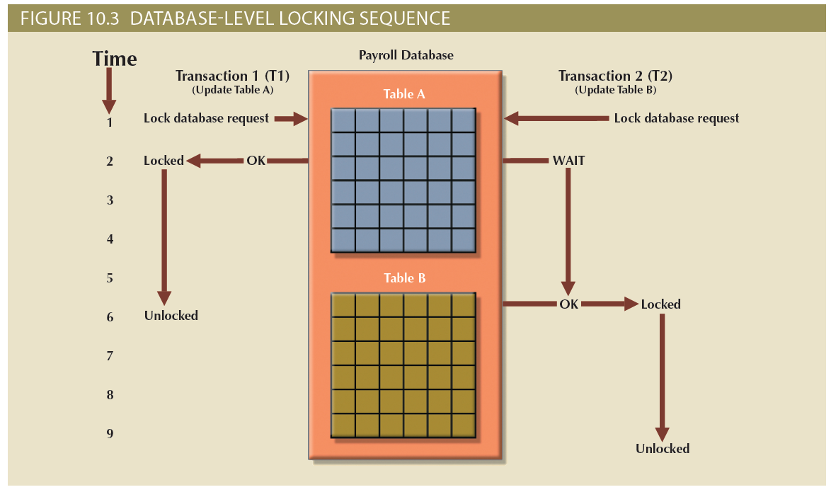
Figure 10.3 - Database-Level Locking Sequence

Slide 19
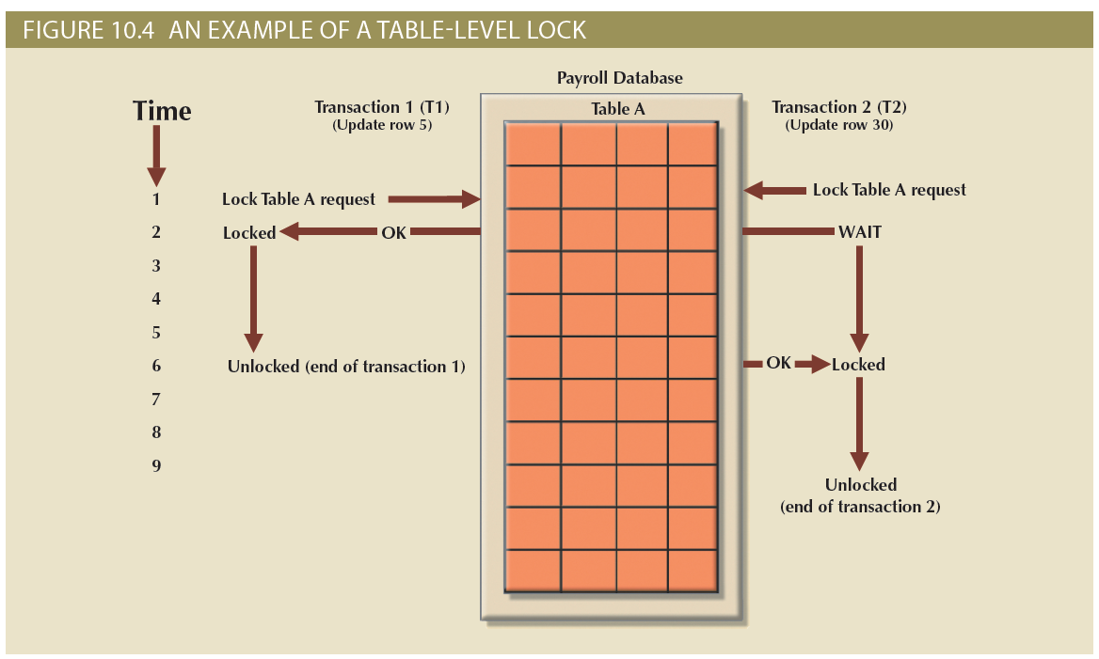
Figure 10.4 - An Example of a Table-Level Lock

Slide 20
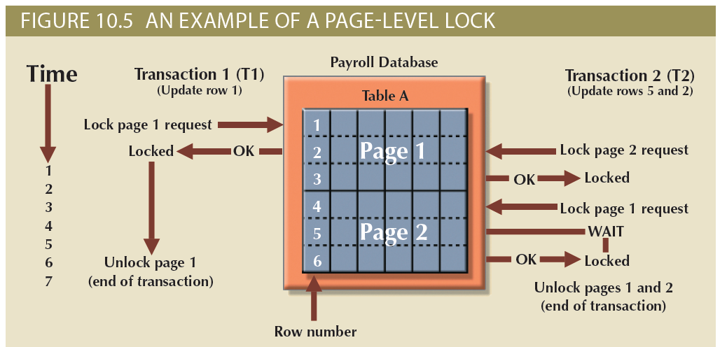
Figure 10.5 - An Example of a Page-Level Lock

Slide 21
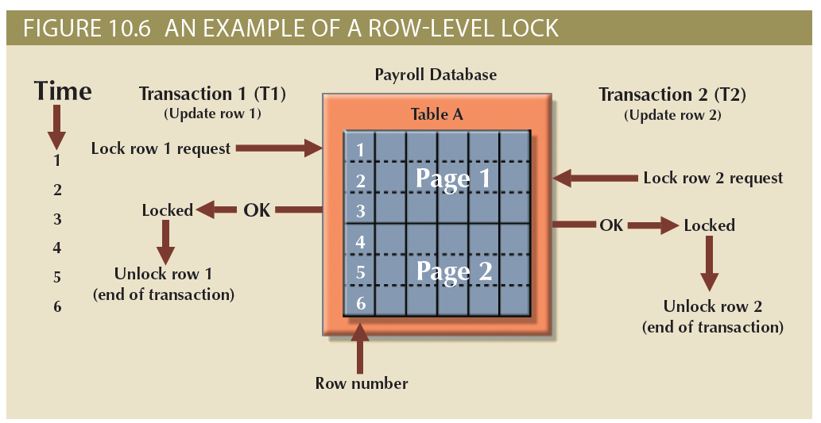
Figure 10.6 - An Example of a Row-Level Lock

Slide 22
Lock Types
Binary lock
Has two states, locked (1) and unlocked (0)
Exclusive lock
Exists when access is reserved for the transaction that locked the object
Shared lock
Exists when concurrent transactions are granted read access on the basis of a common lock
If an object is locked by a transaction, no other transaction can use that object
If an object is unlocked, any transaction can lock the object for its use

Slide 23
Problems in Using Locks
Resulting transaction schedule might not be serializable
Schedule might create deadlocks

Slide 24
Two-Phase Locking (2PL)
Defines how transactions acquire and relinquish locks
Guarantees serializability but does not prevent deadlocks
Phases
Growing phase - Transaction acquires all required locks without unlocking any data
Shrinking phase - Transaction releases all locks and cannot obtain any new lock

Slide 25
Two-Phase Locking (2PL)
Governing rules
Two transactions cannot have conflicting locks
No unlock operation can precede a lock operation in the same transaction
No data are affected until all locks are obtained

Slide 26
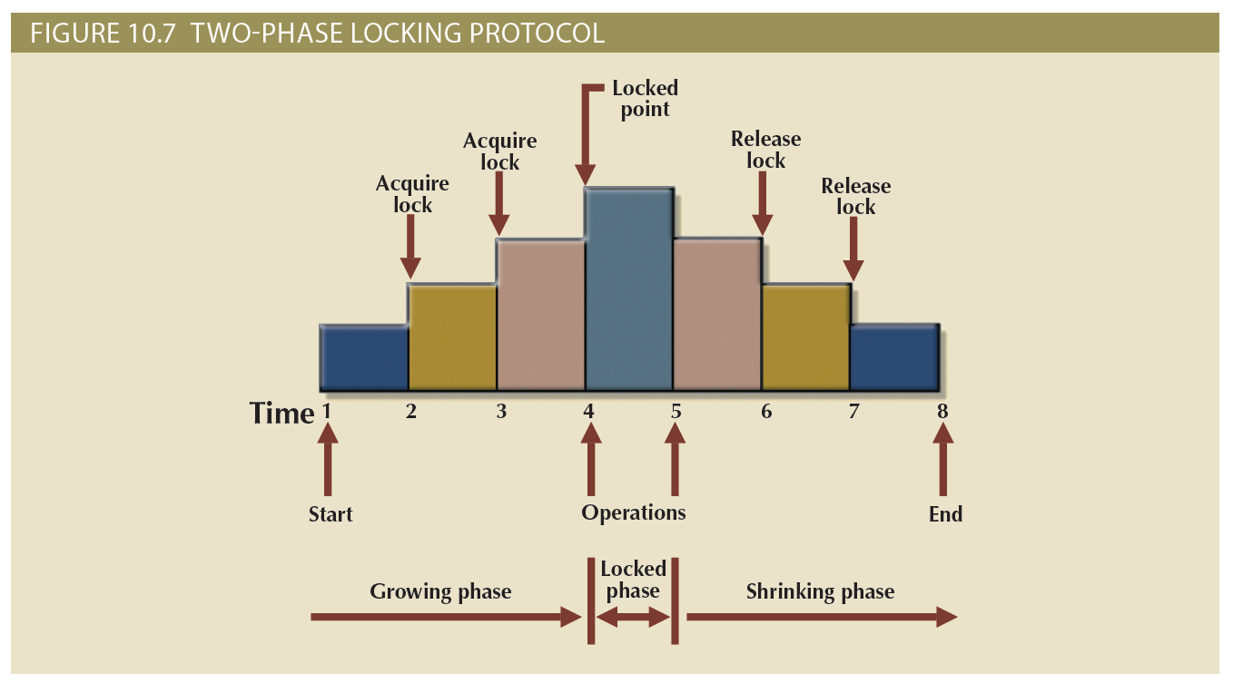
Figure 10.7 - Two-Phase Locking Protocol

Slide 27
Deadlocks
Occurs when two transactions wait indefinitely for each other to unlock data
Known as deadly embrace
Control techniques
Deadlock prevention
Deadlock detection
Deadlock avoidance
Choice of deadlock control method depends on database environment

Slide 28
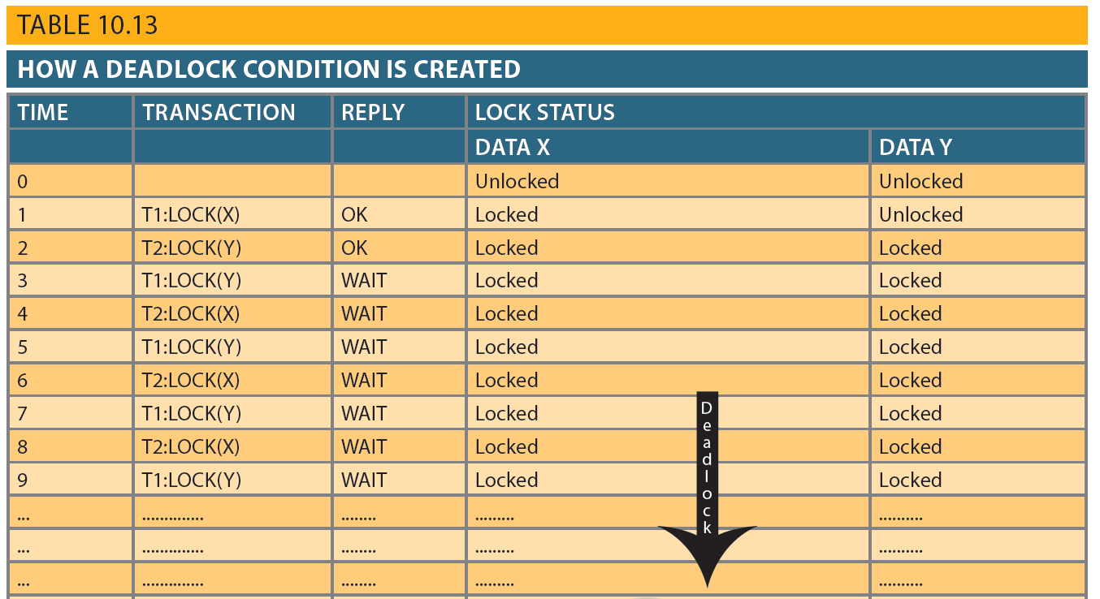
Table 10.13 - How a Deadlock Condition is Created

Slide 29
Time Stamping
Assigns global, unique time stamp to each transaction
Produces explicit order in which transactions are submitted to DBMS
Properties
Uniqueness: Ensures no equal time stamp values exist
Monotonicity: Ensures time stamp values always increases

Slide 30
Time Stamping
Disadvantages
Each value stored in the database requires two additional stamp fields
Increases memory needs
Increases the database’s processing overhead
Demands a lot of system resources

Slide 31
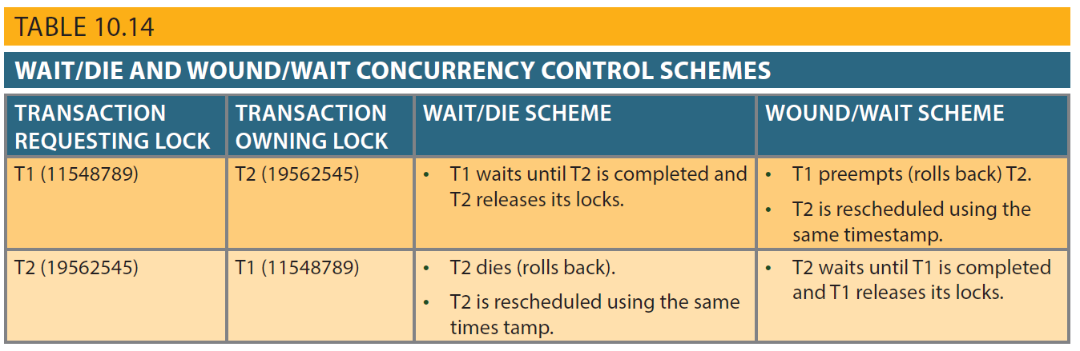
Table 10.14 - Wait/Die and Wound/Wait Concurrency Control Schemes

Slide 32
Concurrency Control with Optimistic Methods
Optimistic approach: Based on the assumption that the majority of database operations do not conflict
Does not require locking or time stamping techniques
Transaction is executed without restrictions until it is committed

Slide 33
Phases of Optimistic Approach
Read
Transaction:
Reads the database
Executes the needed computations
Makes the updates to a private copy of the database values
Validation
Transaction is validated to ensure that the changes made will not affect the integrity and consistency of the database
Write
Changes are permanently applied to the database

Slide 34
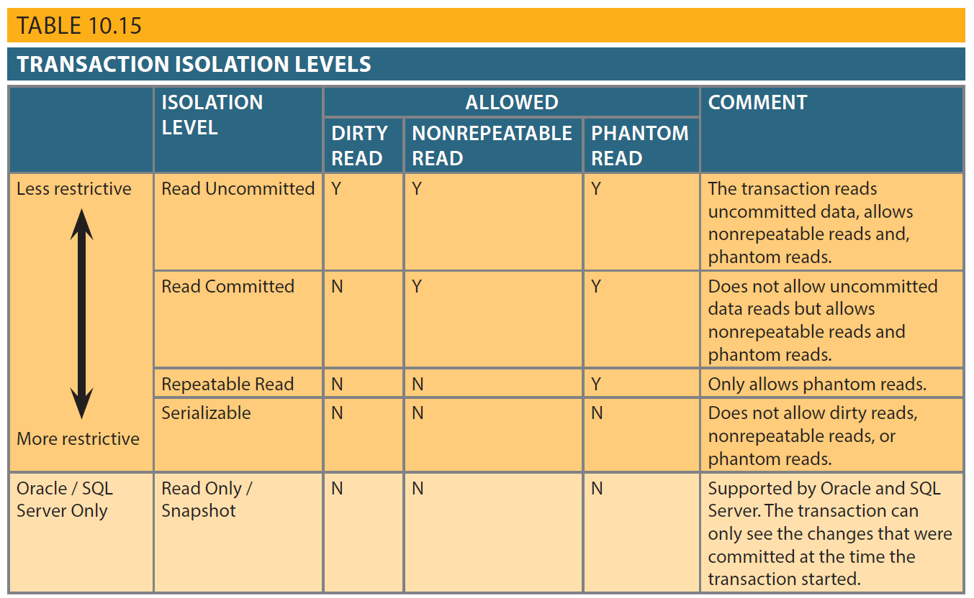
Table 10.15 - Transaction Isolation Levels

Slide 35
Database Recovery Management
Database recovery: Restores database from a given state to a previously consistent state
Recovery transactions are based on the atomic transaction property
Atomic transaction property: All portions of a transaction must be treated as a single logical unit of work
If transaction operation cannot be completed:
Transaction must be aborted
Changes to database must be rolled back

Slide 36
Concepts that Affect Transaction Recovery
Write-ahead log protocol
Redundant transaction logs
Buffers
Ensures that transaction logs are always written before the data are updated
Ensure that a physical disk failure will not impair the DBMS’s ability to recover data
Temporary storage areas in a primary memory
Checkpoints
Allows DBMS to write all its updated buffers in memory to disk

Slide 37
Techniques Used in Transaction Recovery Procedures
Deferred-write technique or deferred update
Write-through technique or immediate update
Only transaction log is updated
Database is immediately updated by transaction operations during transaction’s execution

Slide 38
Recovery Process in Deferred-Write Technique
Identify the last check point in the transaction log
If transaction was committed before the last check point
Nothing needs to be done
If transaction was committed after the last check point
Transaction log is used to redo the transaction
If transaction had a ROLLBACK operation after the last check point
Nothing needs to be done

Slide 39
Recovery Process in Write-Through Technique
Identify the last checkpoint in the transaction log
If transaction was committed before the last check point
Nothing needs to be done
If transaction was committed after the last checkpoint
Transaction must be redone
If transaction had a ROLLBACK operation after the last check point
Transaction log is used to ROLLBACK the operations

