Slide 1
Poverty
Ibm descriptive analytics
JOHANNA HERAMIA MAICA BELCHEZ RENZO TADEO

Slide 2
Poverty
Inability to provide for the basic requirements of minimum survival – such as food, housing, clothing, medical care and education
- randolf s. david

Slide 3
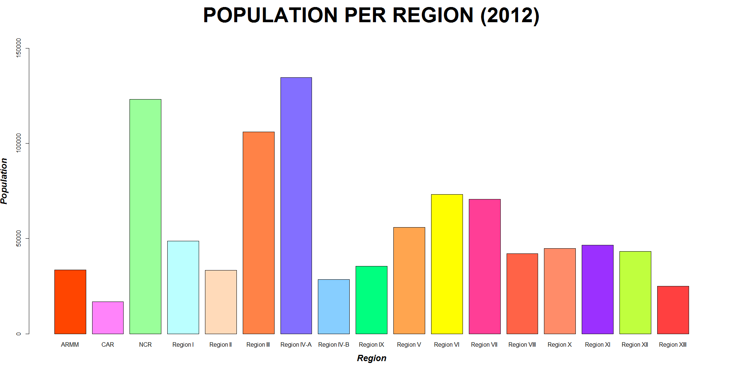

Slide 4
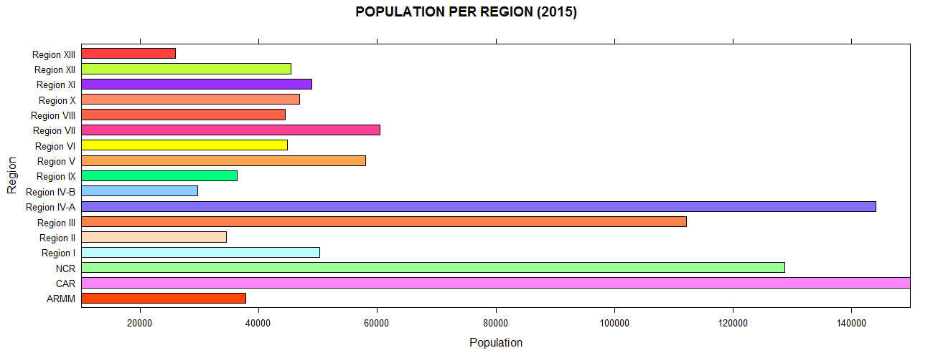

Slide 5
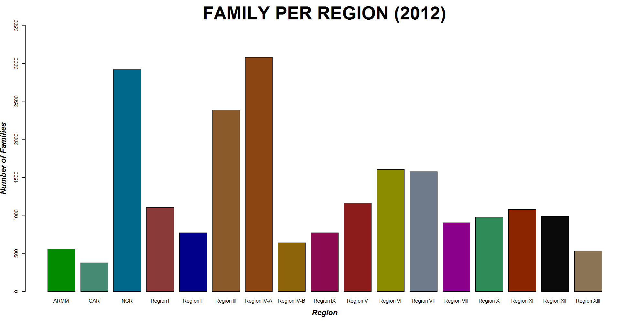

Slide 6
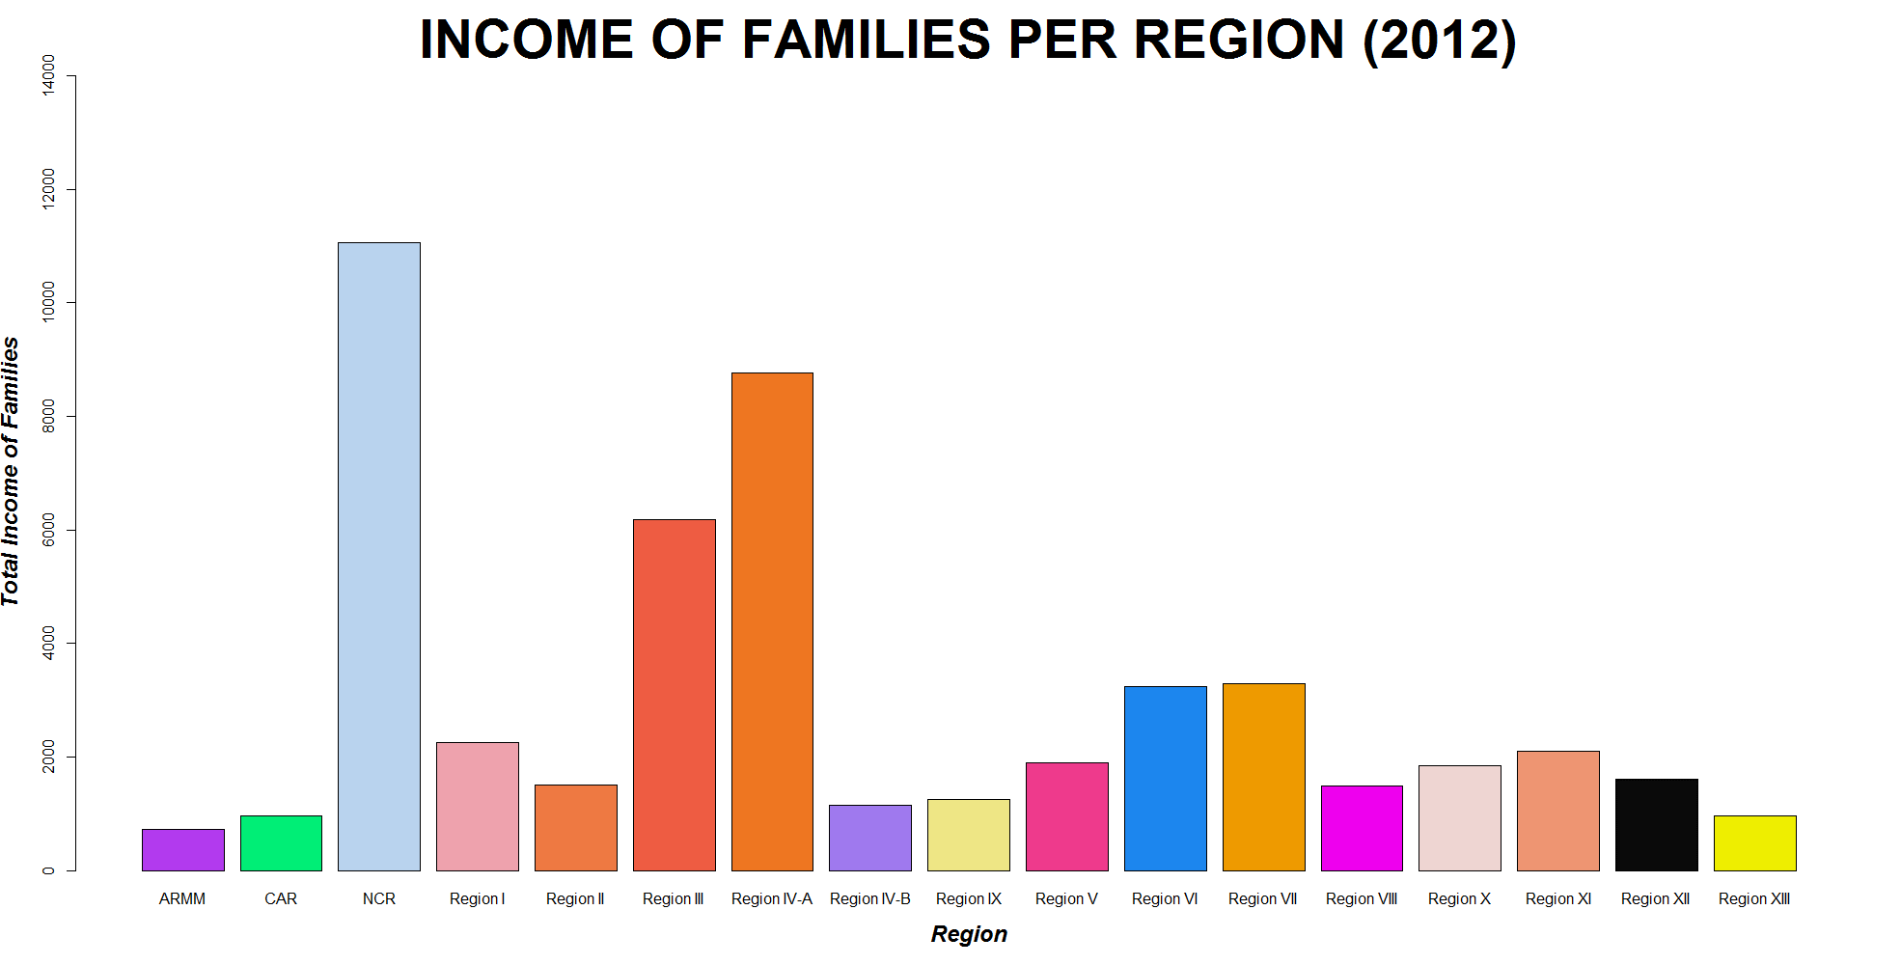

Slide 7
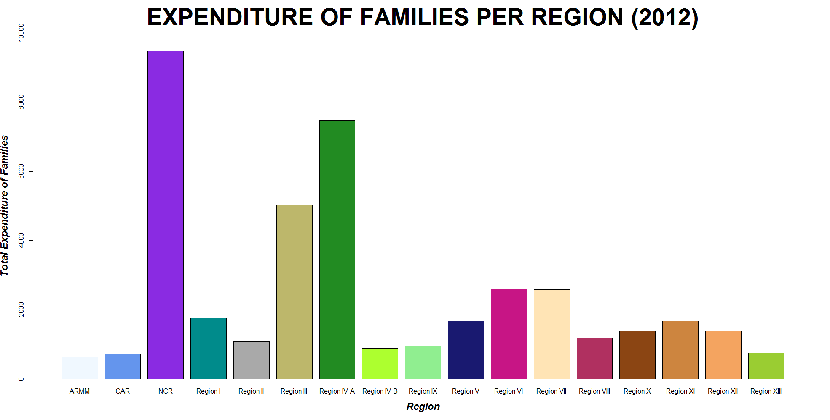

Slide 8
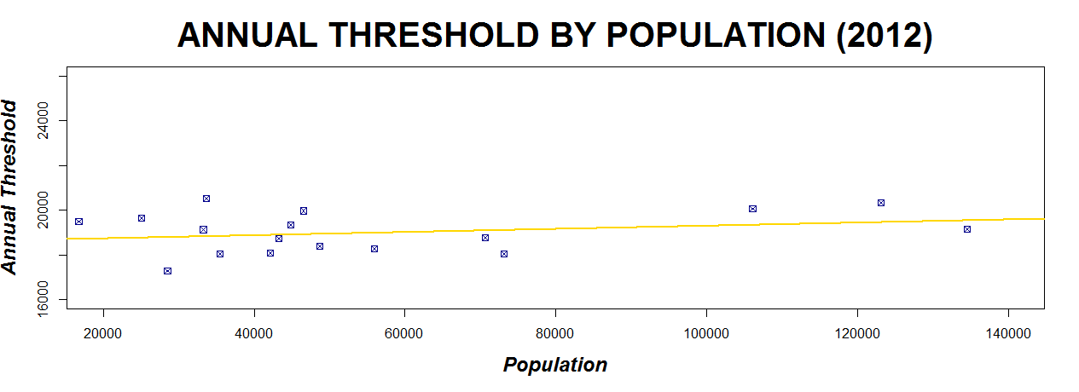

Slide 9
Family Members | Occupation | Annual Income
Father | Farmer | ₱ 15, 000.00
Mother | Housewife | -
Daughter A | Maid | 18, 000.00
Son A | Laborer | ₱ 36, 000.00
Son B | Unemployed | -
Daughter B | Student | -
Grandmother | Unemployed | -
TOTAL ANNUAL FAMILY INCOME: |  | ₱ 69, 000.00

Slide 10
Total Annual Family Income
No. of Family Members
PHP 69,000.00
7
=
POOR
Annual Per Capita Income
=
PHP 9,857.14
PHP 9,857.14
<
PHP 20,344.00

Slide 11
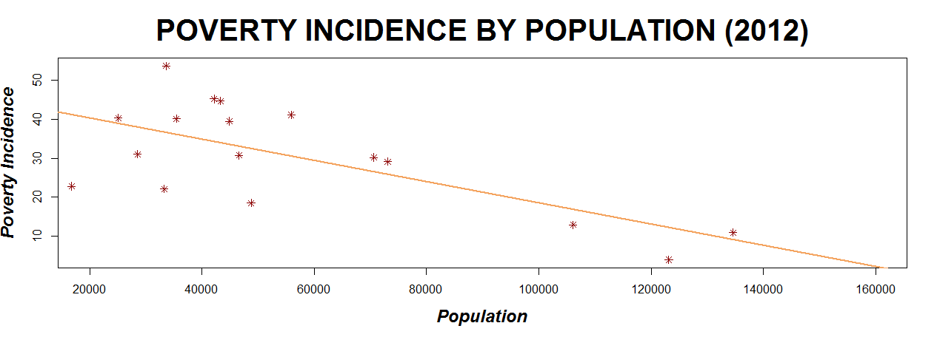

Slide 12
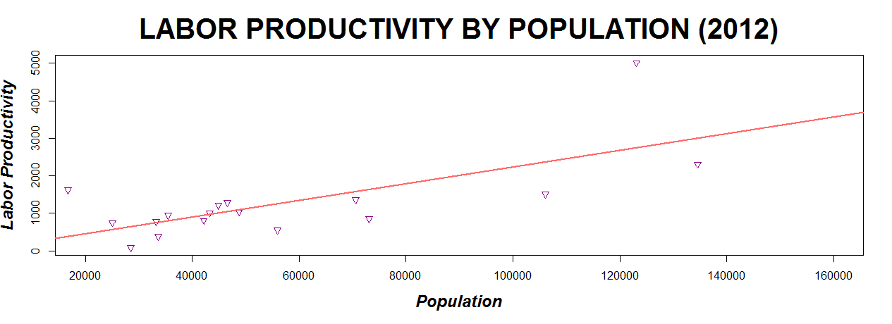

Slide 13
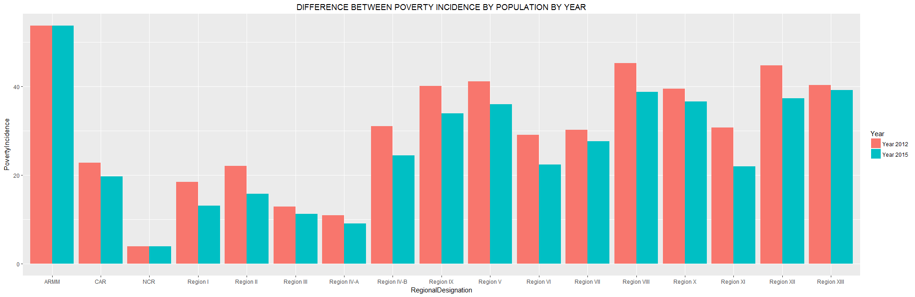

Slide 14
conclusion

