Slide 1
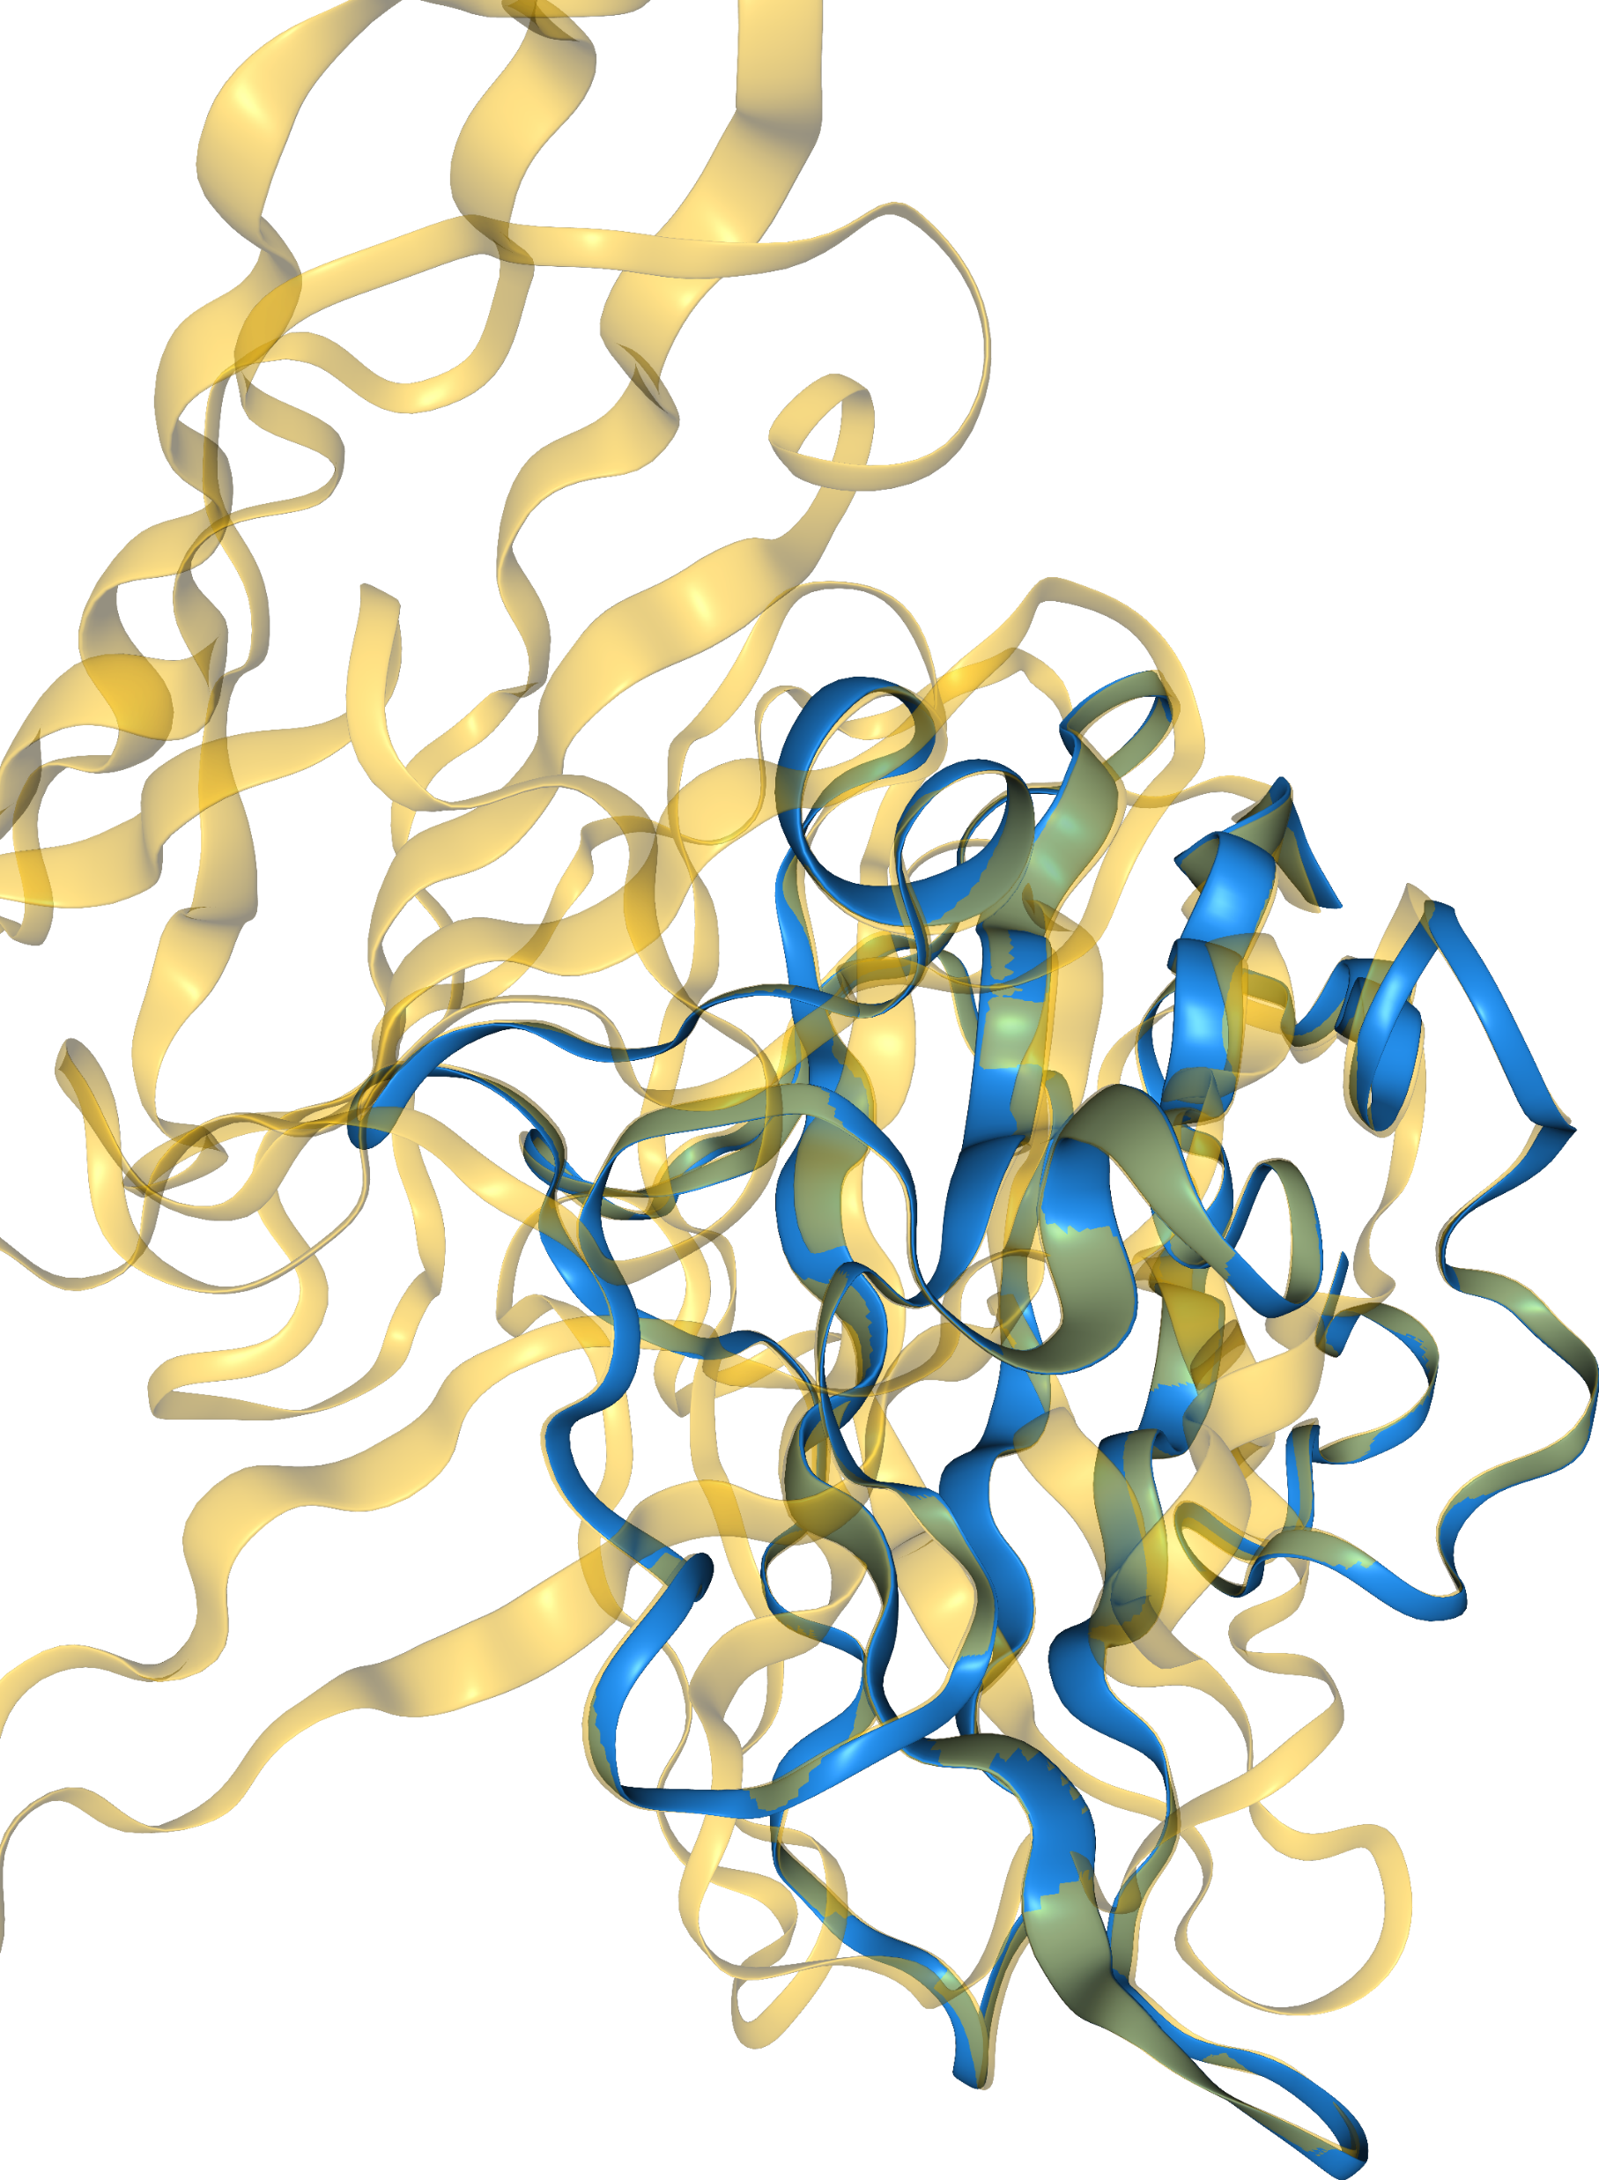
Dissecting Protein Design Methods for Nipah Glycoprotein Binders
Leads: Kieran Lamb, Jamie Herzig & Haley Stone
Group: Sreenu Vattipally, Lohith Venkatachala & Bavishya Tata

Slide 2
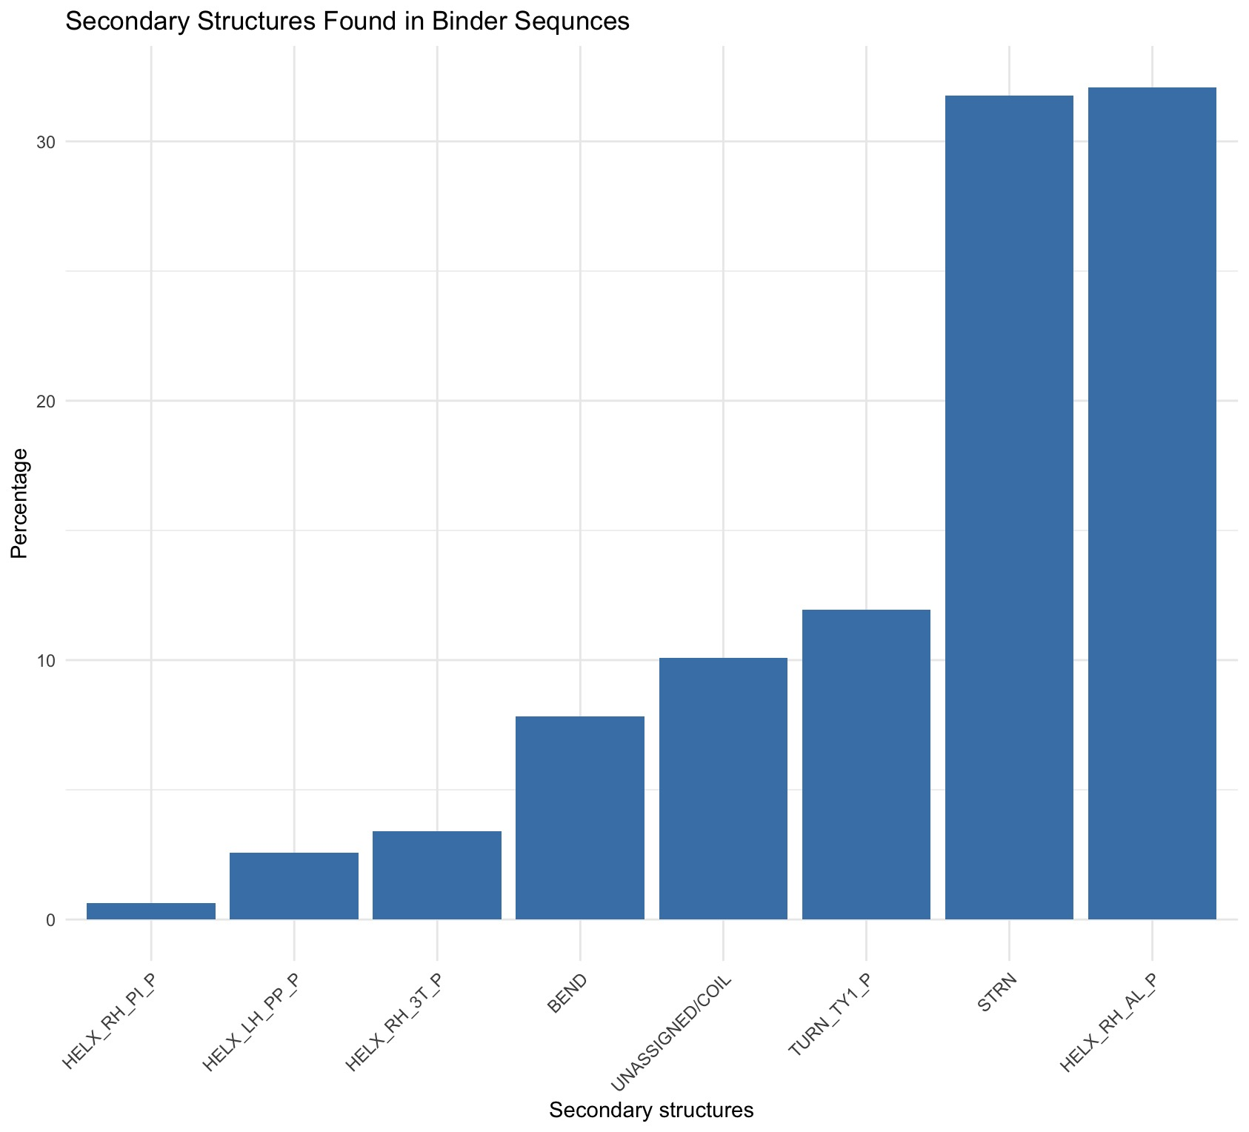
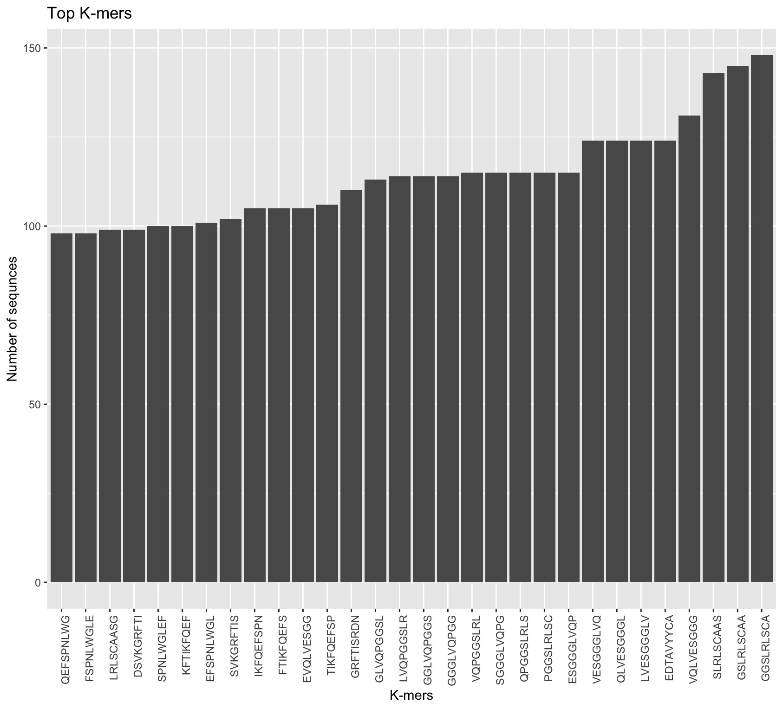
Secondary structures of binder proteins
Kmer frequency of binders

Slide 3
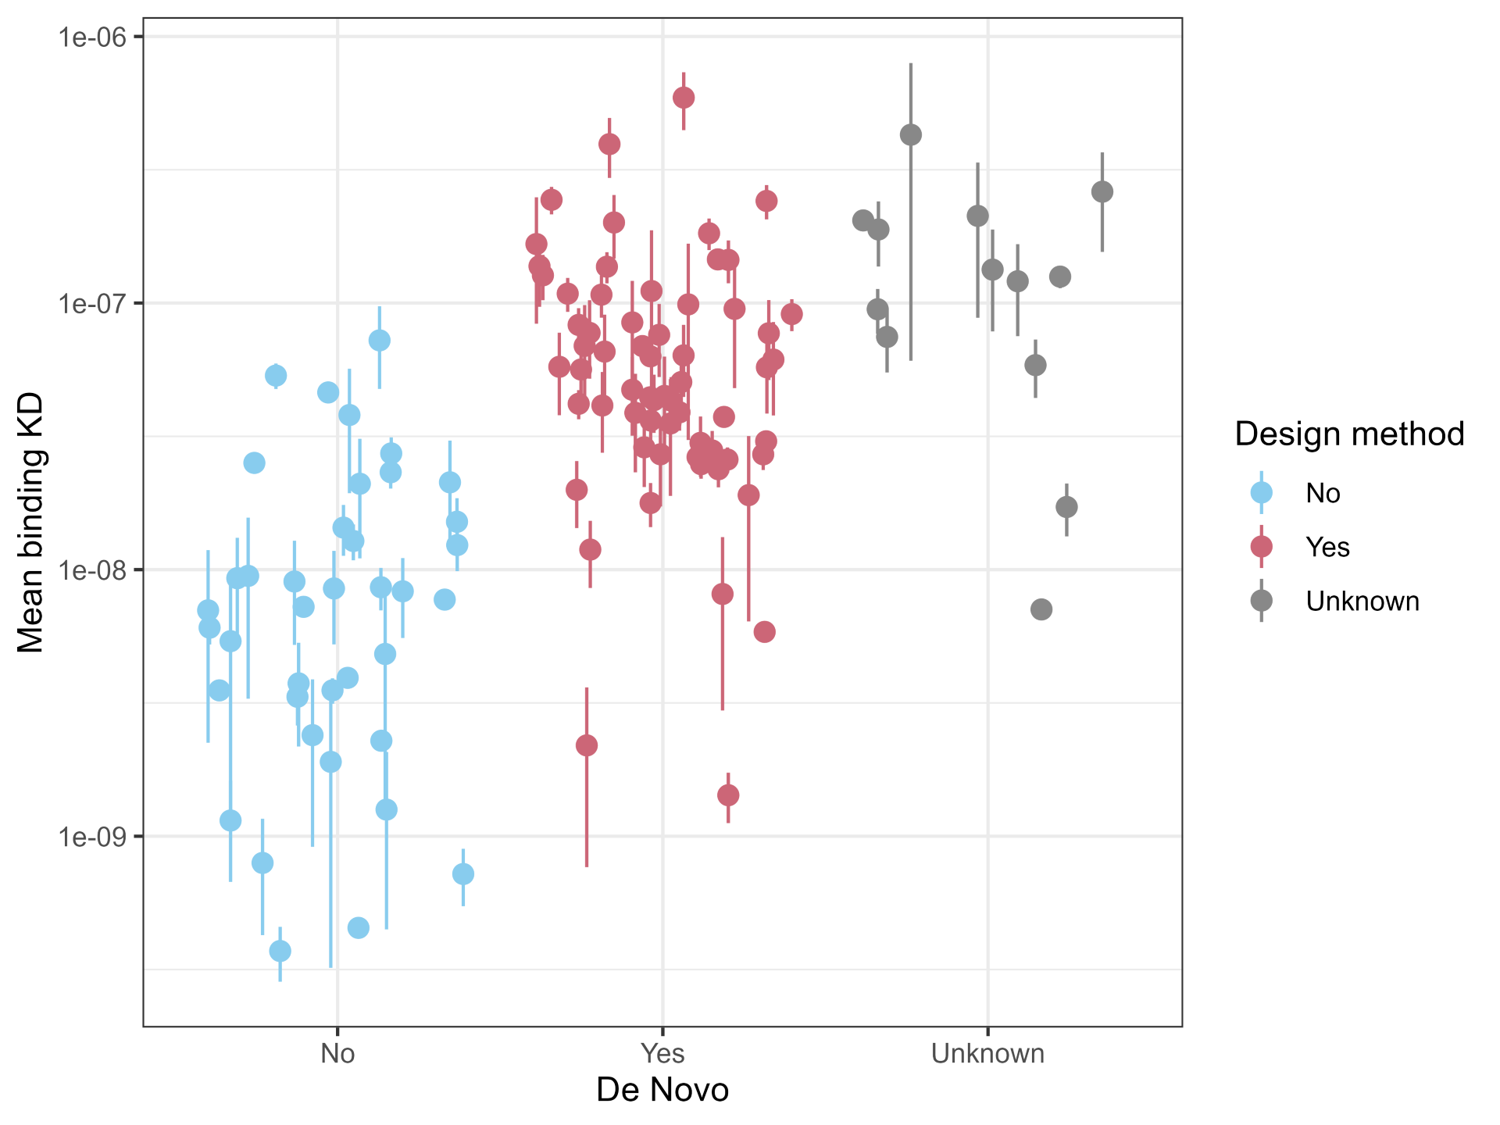
Methods
Dataset
115 experimentally binding Nipah glycoprotein binder designs
De novo status retained to compare template-derived vs de novo designs
Representations compared
MMseqs2 sequence clusters
Alignment-free k-mer tree
PLM embedding tree
FoldMason structural tree

Slide 4
Trees
Alignment-free k-mer tree
Captures broad sequence-composition similarity
De novo and template-derived binders are only partly separated
Many structurally distinct binders remain grouped together by sequence composition
PLM embedding tree
Organises binders using learned sequence features
Shows stronger agreement with the structural tree than the k-mer tree
Suggests PLM embeddings capture some structure-like information from sequence alone
FoldMason structural tree
Groups binders by predicted structural similarity
Shows clearer separation between de novo and template-derived designs
Reveals finer structural families that are missed by simple sequence clustering

Slide 5
Trees
Alignment-free k-mer tree
Captures broad sequence-composition similarity
De novo and template-derived binders are only partly separated
Many structurally distinct binders remain grouped together by sequence composition
PLM embedding tree
Organises binders using learned sequence features
Shows stronger agreement with the structural tree than the k-mer tree
Suggests PLM embeddings capture some structure-like information from sequence alone
FoldMason structural tree
Groups binders by predicted structural similarity
Shows clearer separation between de novo and template-derived designs
Reveals finer structural families that are missed by simple sequence clustering

Slide 6
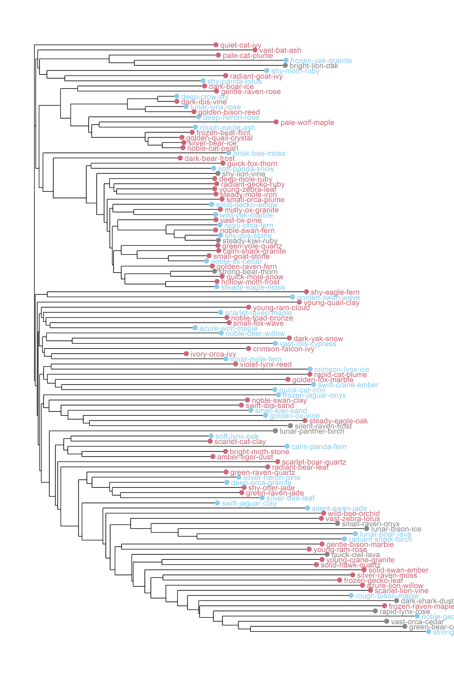
Trees
Alignment-free k-mer tree
Captures broad sequence-composition similarity
De novo and template-derived binders are only partly separated
Many structurally distinct binders remain grouped together by sequence composition
PLM embedding tree
Organises binders using learned sequence features
Shows stronger agreement with the structural tree than the k-mer tree
Suggests PLM embeddings capture some structure-like information from sequence alone
FoldMason structural tree
Groups binders by predicted structural similarity
Shows clearer separation between de novo and template-derived designs
Reveals finer structural families that are missed by simple sequence clustering

Slide 7
MMSeqs Sequences
Clustering at 80% identity / 80% coverage produced 82 clusters from 115
One dominant cluster: 25 binders
Only 5 clusters contained more than one binder
77 / 82 clusters were singletons
Top 5 clusters captured 38 / 115 binders

Slide 8
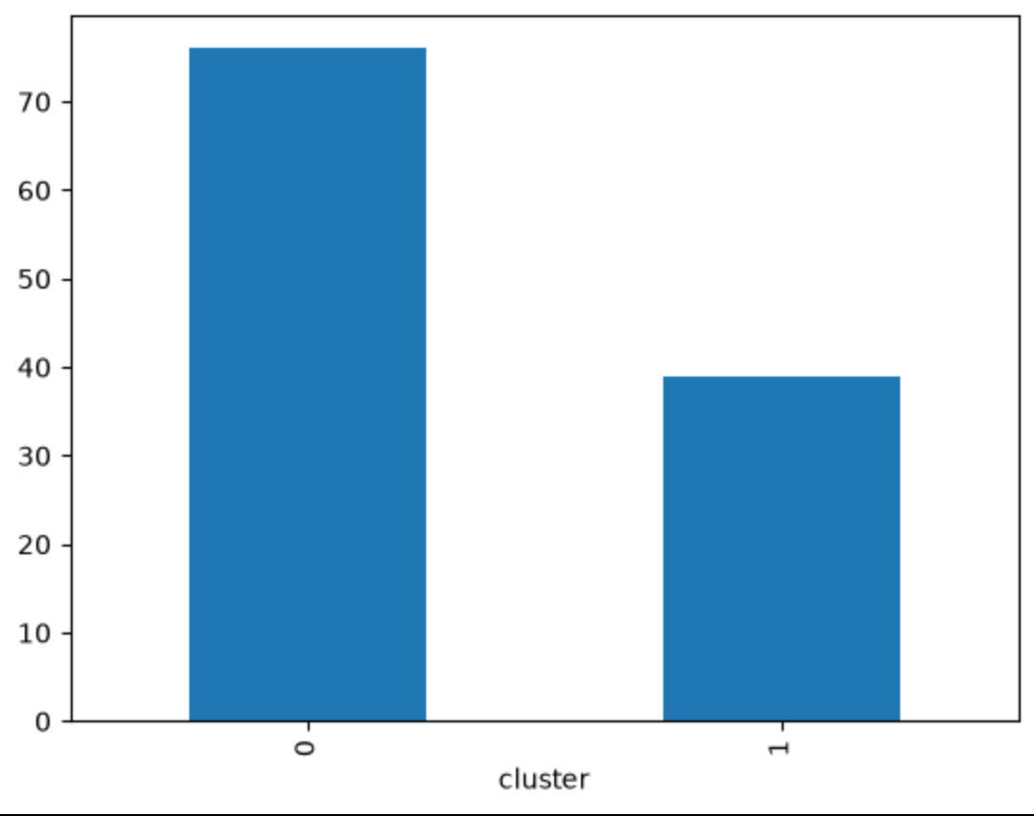
Clustering of Nipah binding sequence
Sequences were encoded into high-dimensional PLM embeddings, capturing structural and chemical features.
A blind K-Means algorithm (k=2) successfully identified a binary structural divergence within the binder population.
The data was cross referenced with denovo vs scaffold metadata
Cluster 0 had 75 population count whereas the cluster 1 had 39 which is less diversified than Cluster 0
Denovo vs scaffold metadata

Slide 9
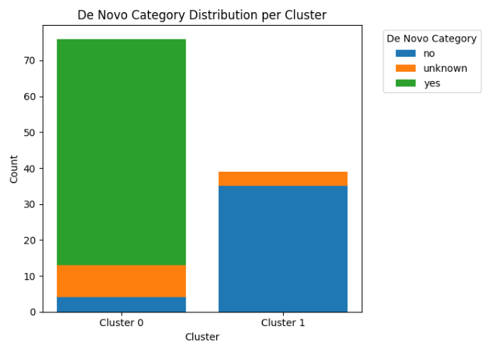
Cluster identity by sequence origin
Cluster 0 is almost entirely composed of de novo designs. The algorithm naturally gravitated most of the sequences into this cluster, and carry the "yes" label for de novo origin. The few natural scaffolds and unknowns are the outliers.
Likely sequences with atypical structural features that pull them toward this neighbourhood despite their origin.
Cluster 1 is a pure natural sequence cluster. Every single de novo design was excluded; 90% are confirmed natural scaffolds, suggesting Cluster 1 occupies a distinct region of embedding space that is fundamentally incompatible with generative designs.
Template
Unknown
Denovo

Slide 10
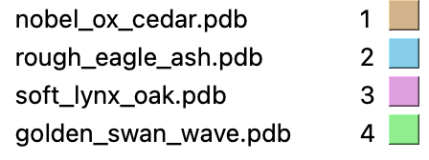
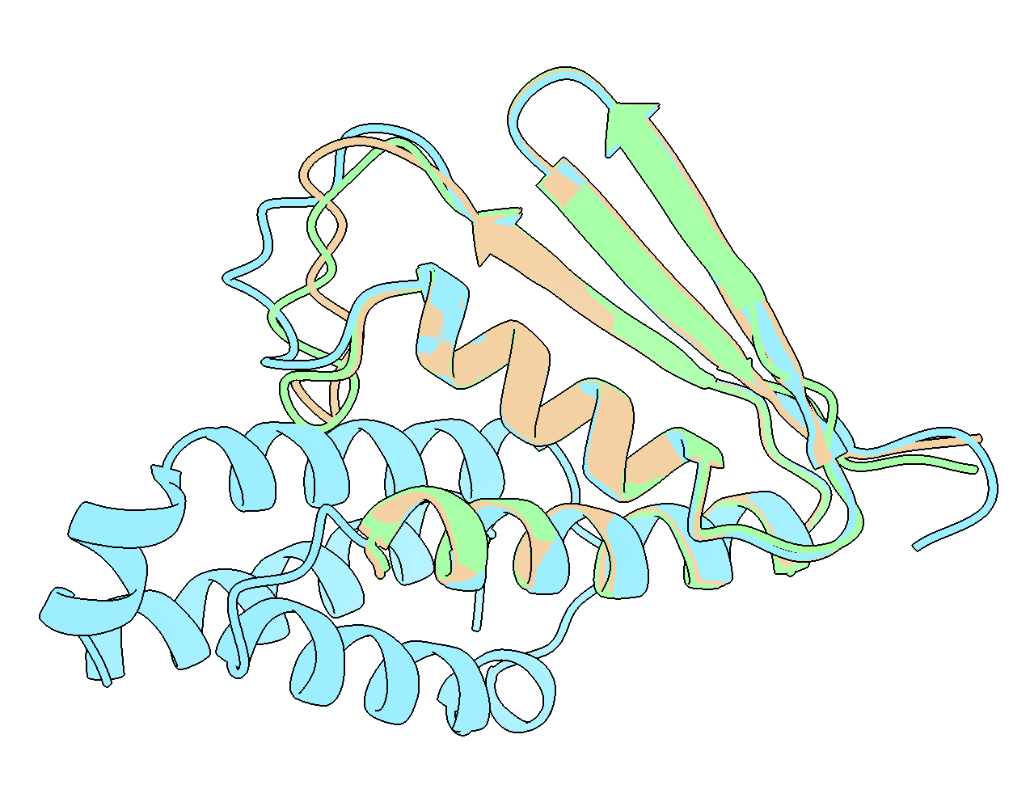
The Cluster 0 Outliers
The 4 template structures in cluster 0 appear structurally almost identical.
All structures diverge slightly at a disordered loop.
Structure 2 has an extended set of alpha helices that are clearly unnecessary for binding.
The high degree of similarity between the structures suggest that a technique like inverse folding was used.
Use a template structure while diverging significantly at the sequence level.
Not a traditional “template” at the sequence level but evidence of structural template usage.
All structures diverge here
Extension Alpha helices

Slide 11
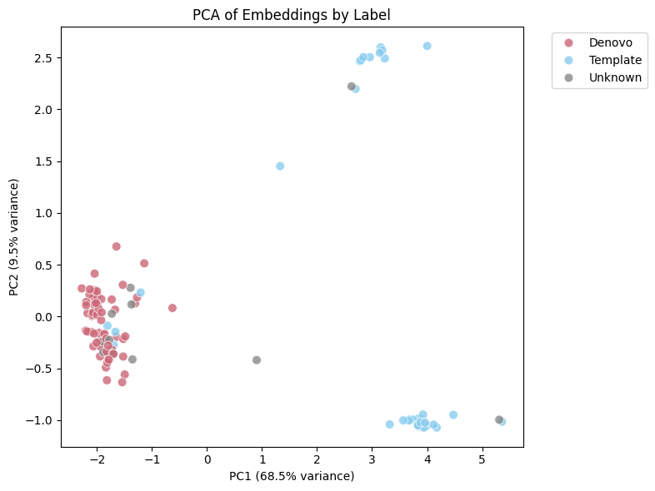
Visualising the embedding space
PCA reduction of embeddings show that Denovo structures cluster strongly together.
They inhabit a distinct area of the embedding space relative to the Template structures.
The exceptions here are our prior ouliers.
Template structures split into two distinct clades.
Indicates multiple templates may have been used.
Unknowns appear predominantly denovo.

Slide 12
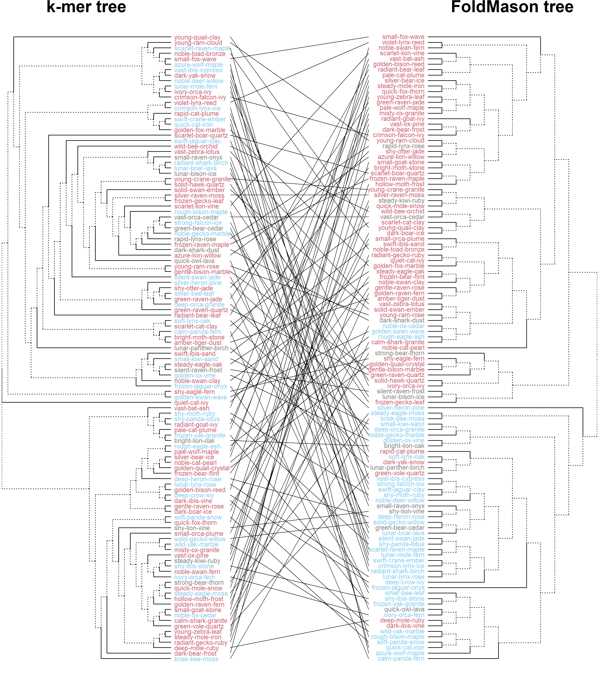
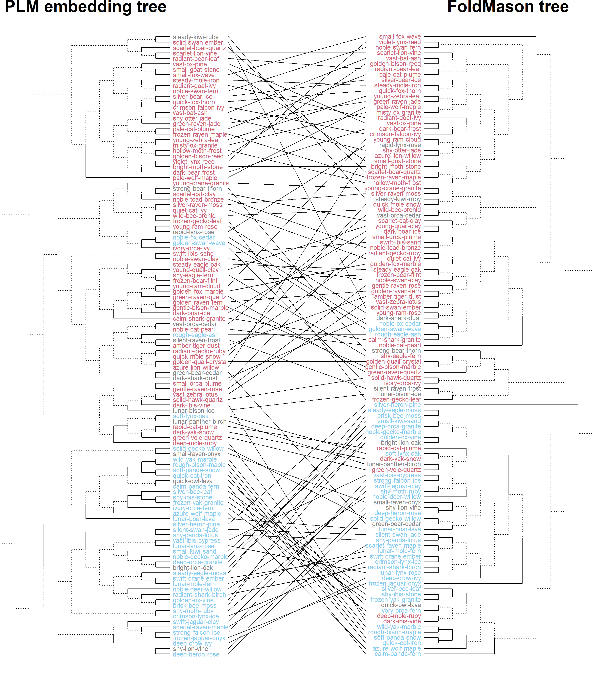
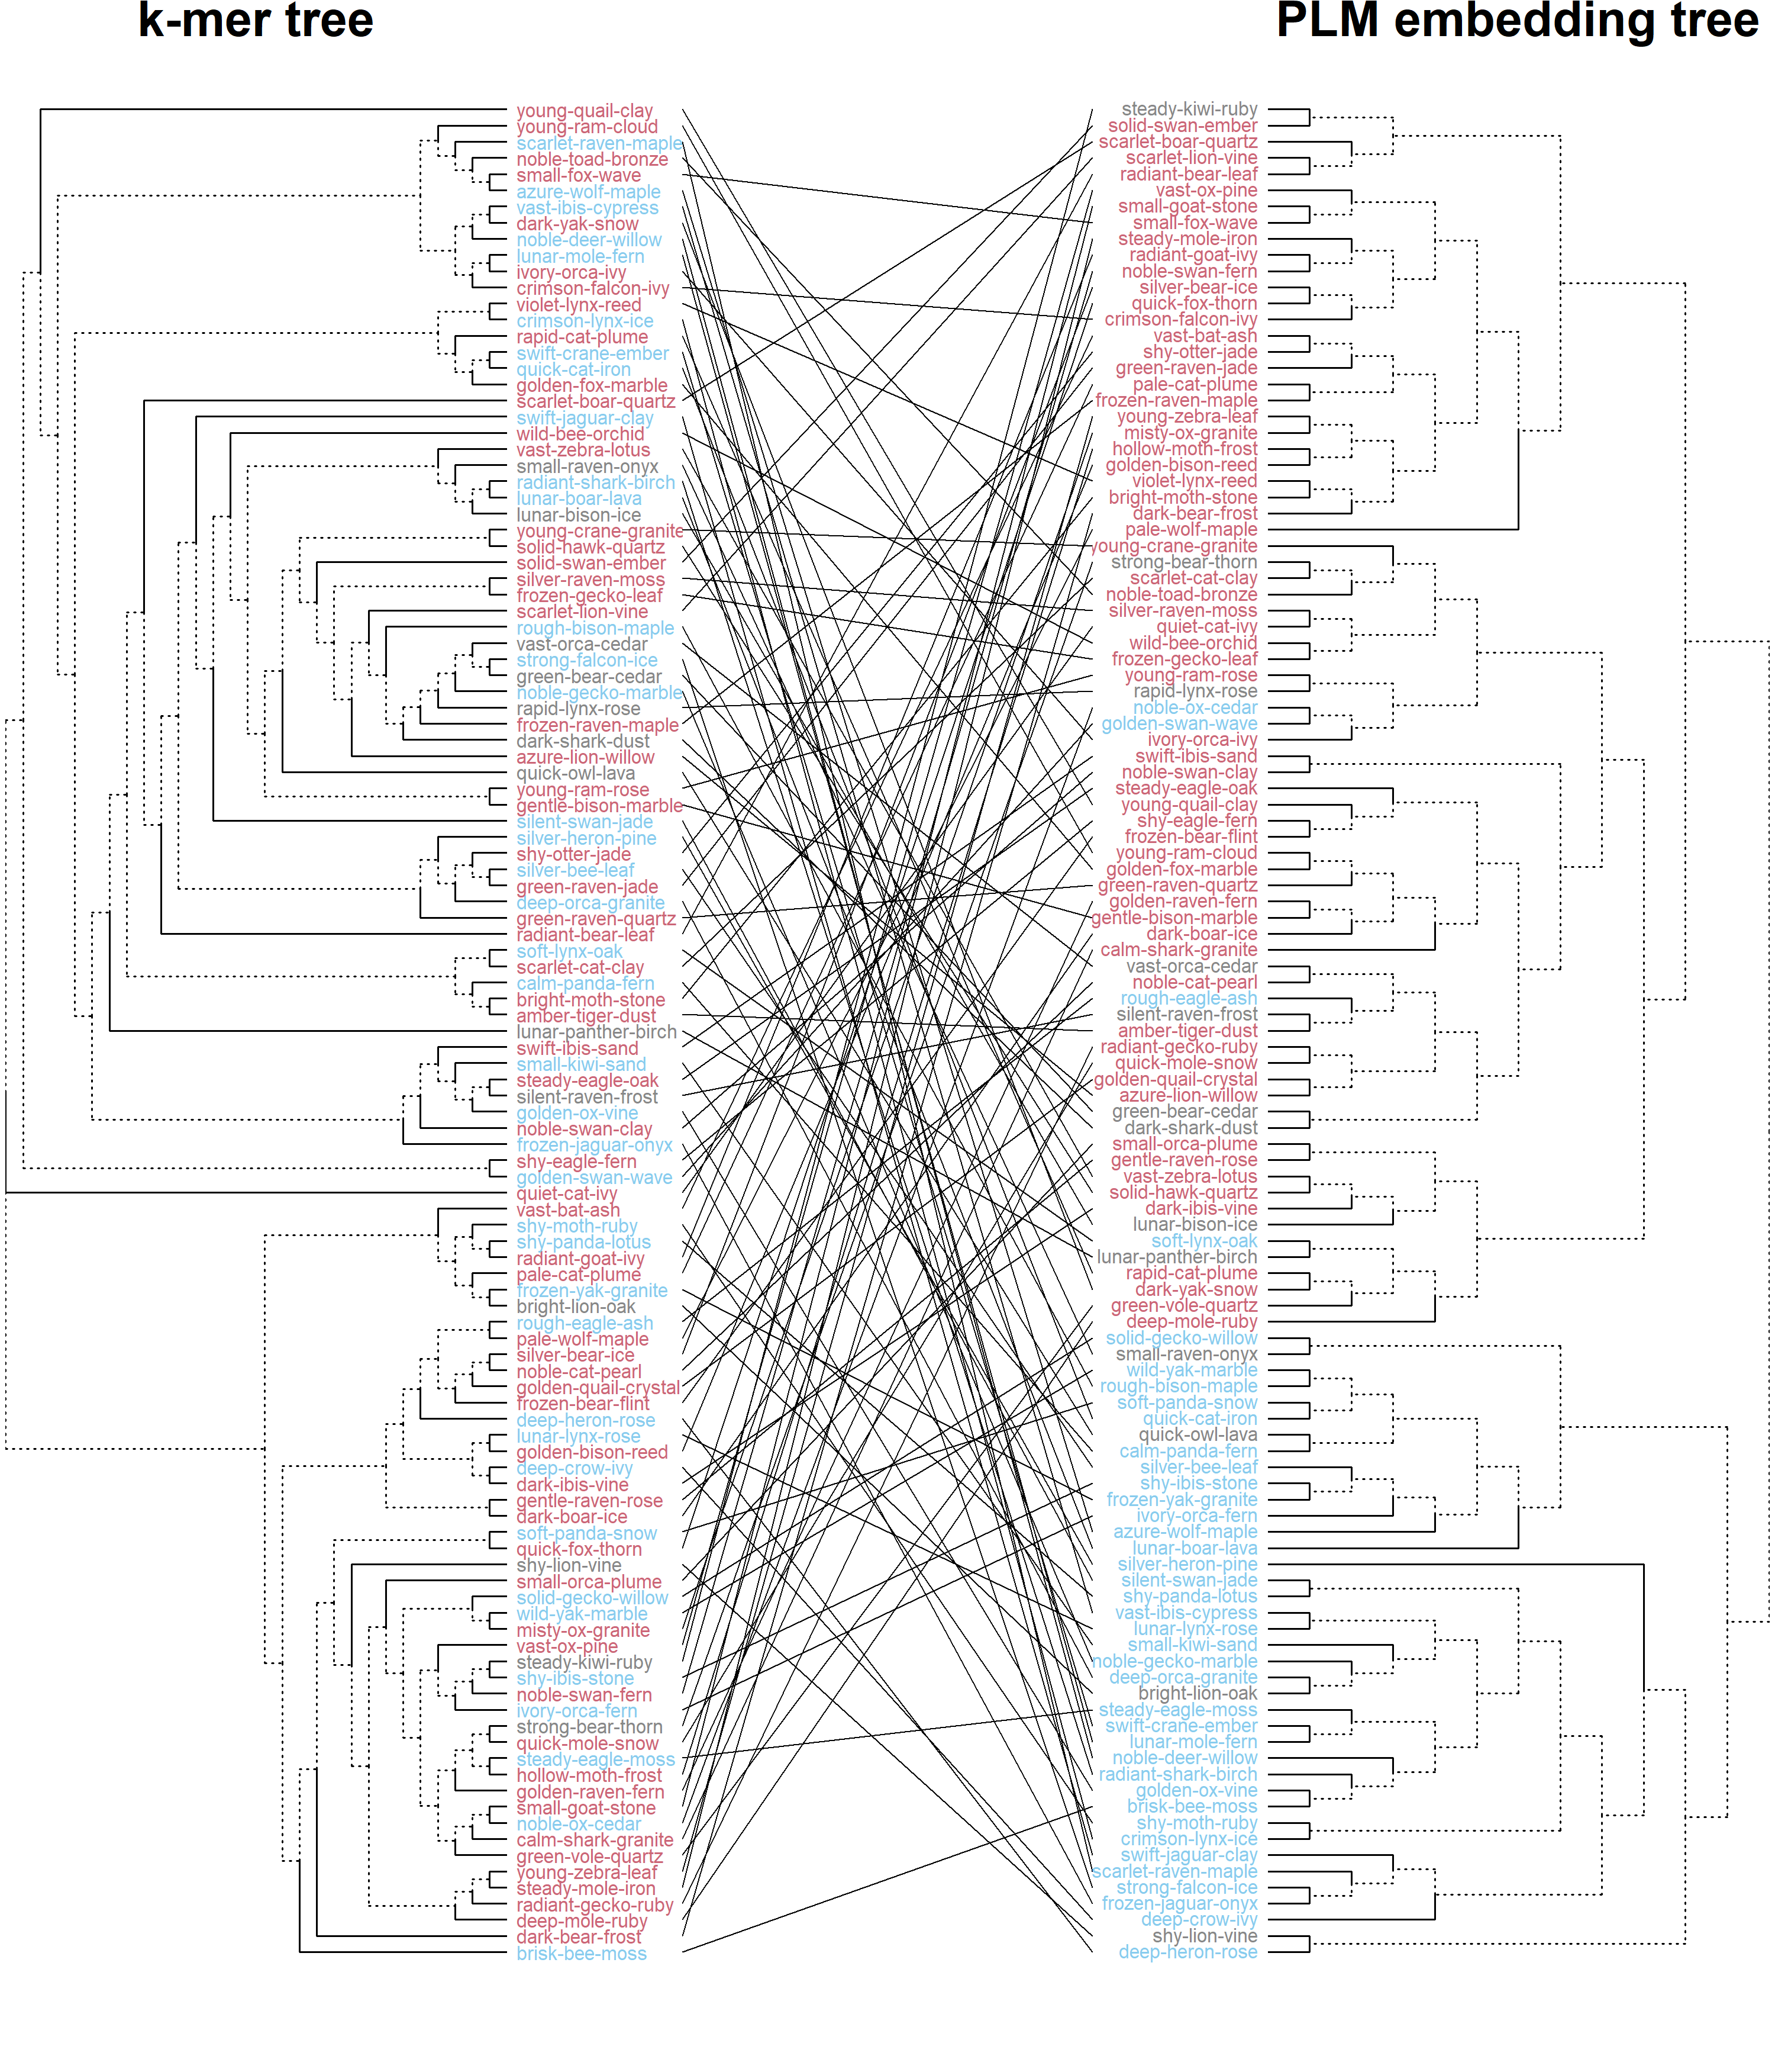
Tanglegrams

Slide 13
Alignment-free vs structural vs PLM tree comparison
Structural, alignment-free, and PLM trees were each cut into k = 10 clusters
Cluster overlap was compared across representations
Alignment-free clustering collapsed most binders into one group: 84/115
Structural clustering was more balanced: largest cluster 21/115
PLM embeddings recover more structure-like organisation than k-mer sequence composition

Slide 14
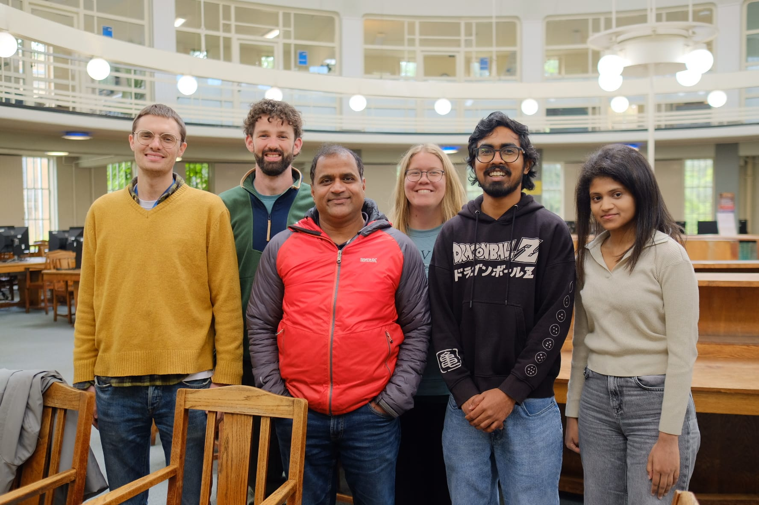

Thankkkksssss
GitHub

