Slide 1


Blind-O-Matt-Ic
Jeff Choate

Slide 2
Blind-O-Matt-ic - Motivation
We “Children of the Light”™ face a never ending battle against the Sun.
We enjoy the natural light during mornings and late afternoon
We despise being blinded by the Sun as it progresses through the sky
We are forever arguing about and opening and closing the blinds
It is slow (not Speed-IT worthy) to expect engineers to get up and open and close the blinds manually - we more important tasks at hand!
I have been interested in exploring robotics and motor controls
Bill wants an automated way to blind Matt at his desk.
If the “Ping-Pong Sensor” project from last hack-a-thon could win the whole shebang, why not give this a shot?

Slide 3
Blind-O-Matt-ic - Proposal
Create an automated system for opening and closing the blinds automatically
System must not harm the existing installation or violate terms of lease in any way
Completely temporarily installed and fully removable
Would like to have a manual management system (through the web) so engineers can control the blinds remotely
Would like to use some sensor technology to allow the blinds to become “smart” and open and close blinds autonomously

Slide 4
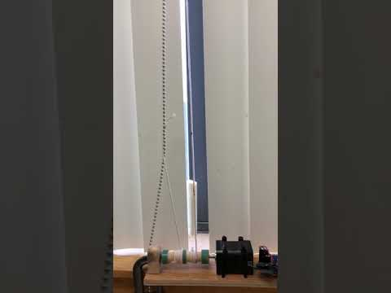
Blind-O-Matt-ic

Slide 5
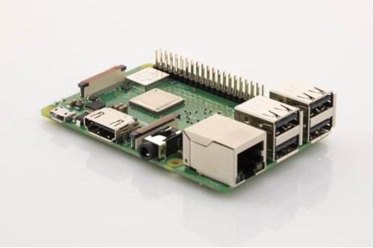
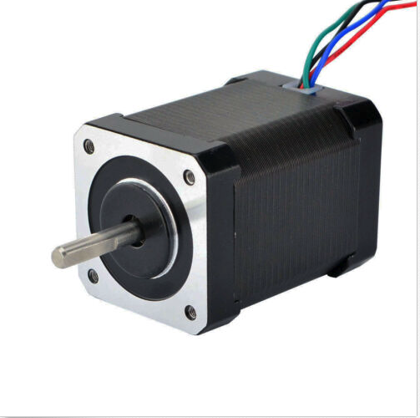
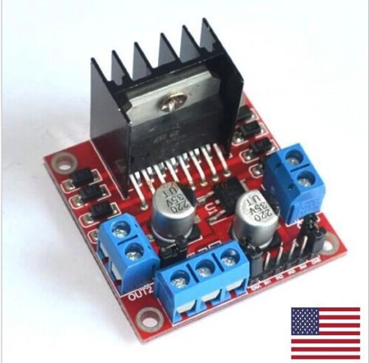
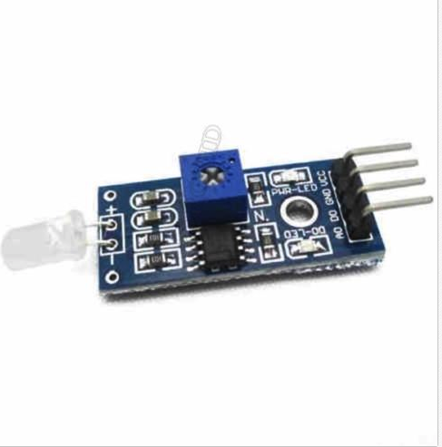

Blind-O-Matt-ic - Materials
Not knowing what I was venturing into, I used a quick Google search for “stepper motor”, and came up with several ideas. Next came a quick shopping spree on eBay!
10 Volt Stepper Motor - $10.00.
Dual H-bridge motor controller - $3.50
Analog-Digital Photo-Electric Sensor - $2.00
Raspberry Pi (Amazon) - $38.00
Vintage Power Supply (circa moon-landing era) - $Priceless.

Slide 6
Blind-O-Matt-ic - Stepper Motors
Brushless DC motor where the axle rotation is broken into a series of steps that are precisely controlled by the motor.
Stepper motors have magnets on the inside that make up the rotor, and the coils are on the outside making up the stator - opposite from a DC motor
Magnets are divided up into what look like teeth that have corresponding teeth in the windings. Each tooth represents a step.
There is a pair of electromagnets for each phase. 2 pairs in my motor.
By energizing opposing electromagnets in each pair, the rotor will move by a step
Each phase is held at ½ step behind the other to get precise control of steps.

Slide 7
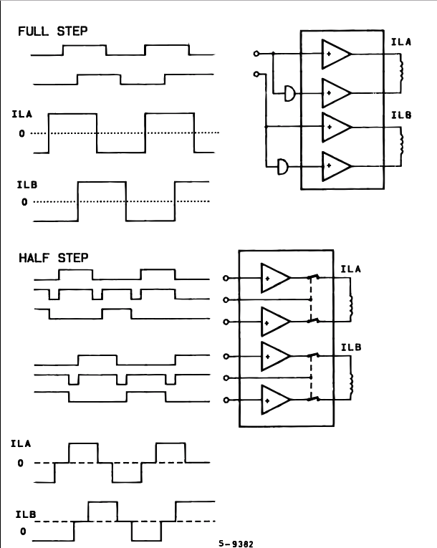
Blind-O-Matt-ic - Stepper Motors (cont.)
My step motor has 4 GPIO inputs from the raspberry PI corresponding to the 4 wires of the stepper motor (2 wires per pair)
GPIO from raspberry pi will drive a logical high to the H-Bridge which then translates that and applies the operational voltage to the corresponding electromagnet.
Subsequently logical low is driven to remove voltage from the magnet.
Operational voltage is 10V for my motor, logical voltage from GPIO is 3.3V (or 5V). You cannot drive the motor with the logical voltage from the Pi.

Slide 8
Blind-O-Matt-ic - Raspberry Pi
Very ubiquitous development platform
I have fair amount of experience with it, but mostly for software projects (Mame, XBMC, Tor router, wireless access point, etc.)
Have done some things with GPIO at previous job mostly using Beagle Bones.
Provides a complete computer with full Debian linux running
Allowed me to develop application(s) in Python, Web interface done with Flask to call the Python functions directly
Large security risk - The GPIO access requires root access on the Pi, so I needed to run root scripts from the web browser - not recommended, but Flask makes it easy to do!
I was steered towards Django, but I opted for Flask (time!)

Slide 9
Blind-O-Matt-ic - Raspberry Pi (cont)
Not too many resources required for the project
Linux (obviously)
Python
Network connectivity (only required for web access) not necessary for autonomous operation
5V power supply (microUSB standard power)
4 GPIO (OUT) pins to drive the H-Bridge stepper controller
1 GPIO (IN) pin for photo sensor pickup
1 3.3V power pin to power photo sensor
1 Common ground pin to connect everything together.
Same ground used for H-Bridge, photo sensor, and PI. (no ground on motor)

Slide 10
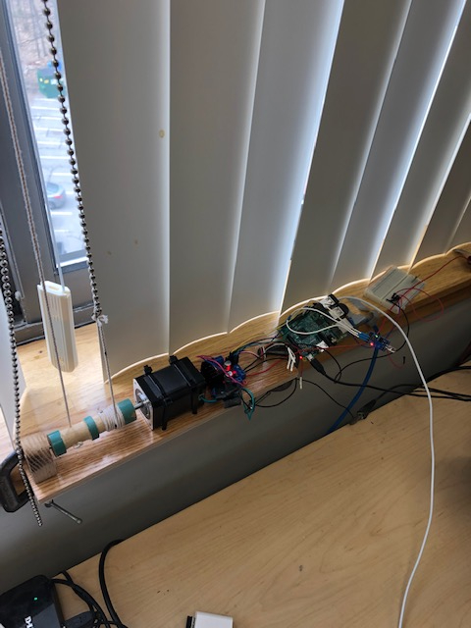
Blind-O-Matt-ic - Installed System
Blinds
Original Drive Chain - unharmed in the making of this device.
Stepper motor secured to base with zip-ties, base secured to sill with C-clamps
Breadboard for voltage, groung interconnections.
LM393 Photo sensor.
Dual spooled axle, string wound in opposing directions, tied to drive chain.
Raspberry Pi
L298N Dual H Bridge Stepper Motor Driver Controller

Slide 11

Blind-O-Matt-ic - Interfaces
Basic CLI interface used to open, close, or change set state of blinds
blindomatic.py [--action=(open, close)] [--state=(OPEN, CLOSED)]
Rudimentary Web Based Interface
Photo Sensitive autonomous control
No user intervention
Runs as process on Pi. Monitors GPIO pin for state change.
Takes appropriate action on State Change.

Slide 12
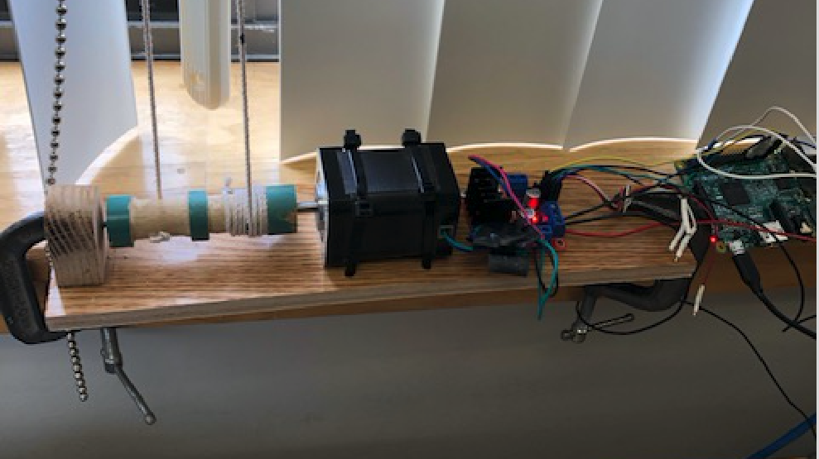
Blind-O-Matt-ic - Results
Success
Wired and controlled stepper motor, and integrated it with the existing blind/shade system
No smoke or fires - at all!! All components worked properly and continue to.
Created a command line interface to allow management of the system
Added state to the system so it wouldn’t try to open already opened blinds.
Implemented a web page for remote manual operation.
Shows the current state of the blinds and will operate through button click
Integrated a photo sensor for the autonomous operation of the blinds
Light levels are adjusted using potentiometer on the sensor. We read sensor and act on that.
Controller system doubles as engineering workstation - Raspberry Pi provides a complete workspace that can be used in place of my Mac!
Cons:
Too noisy - need some sound insulation.
Would be better if we could integrate directly into closing mechanism - string is kind of kludgey.

Slide 13
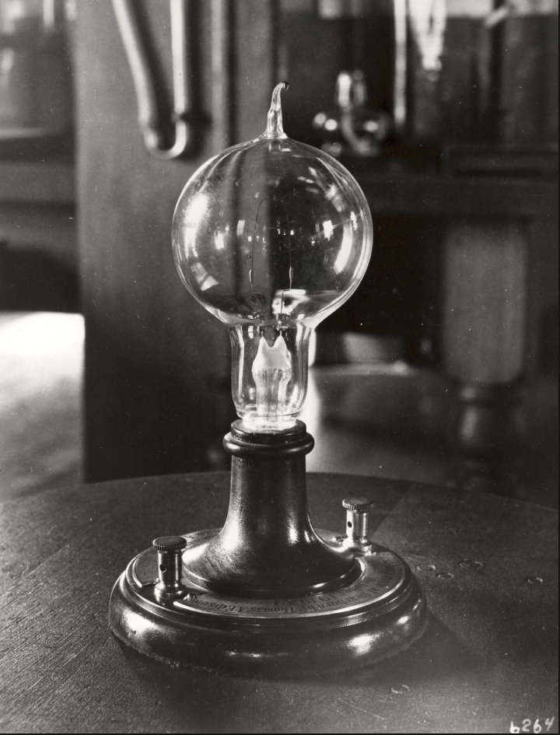
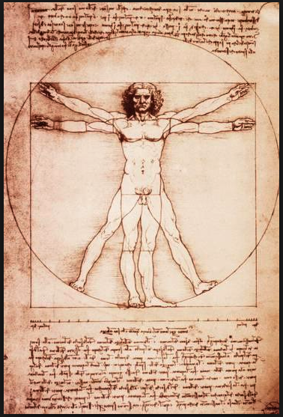
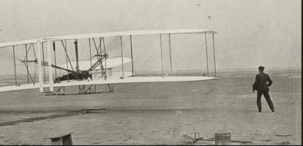
Blind-O-Matt-ic - Final Thoughts
DaVinci
Edison
Wright Brothers
Jeff Choate (?)

