Slide 1
“optical document recognition”
Recognizing text from photographed documents
Joon Hyuck choi

Slide 2
Contents
What is Optical Character Recognition (OCR)?
Project Overview
Live Demo
What I’ve Learned

Slide 3
Contents
What is Optical Character Recognition (OCR)?
Project Overview
Live Demo
What I’ve Learned

Slide 4
1. What is Optical Character Recognition?
Definition: the conversion of images of typed, handwritten or printed text into machine-encoded text, whether from a scanned document, photo of a document, or scene-photo. (Wikipedia)
Steps:
Pre-process: De-skew → De-speckle → Binarisation → Line removal
Character Recognition: Matrix matching, Feature extraction (K-NN), etc.
Post-process: Constrain with a lexicon, preserve original layout, etc.

Slide 5
Contents
What is Optical Character Recognition (OCR)?
Project Overview
Live Demo
What I’ve Learned

Slide 6
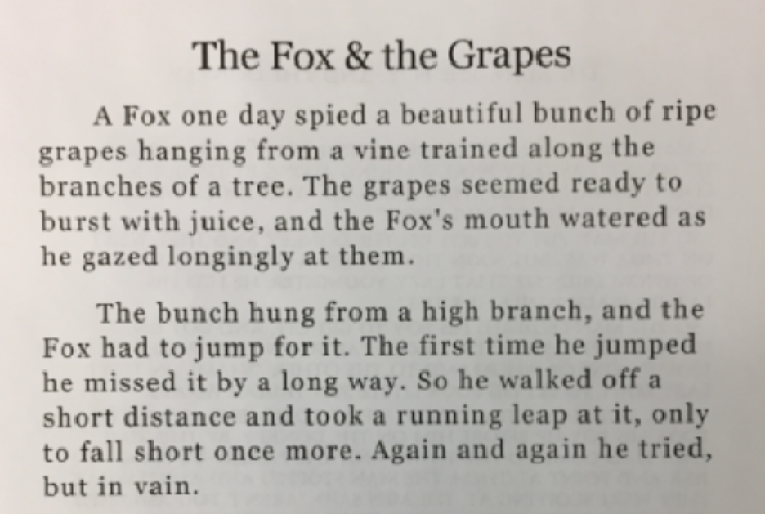
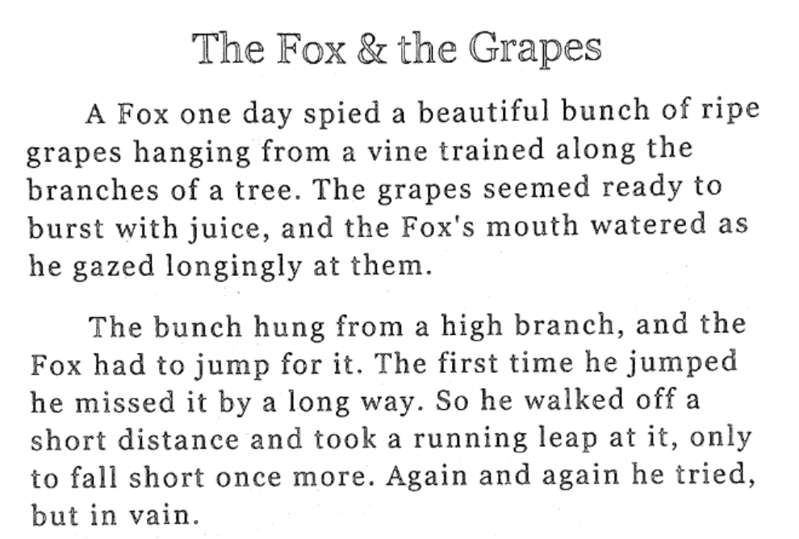
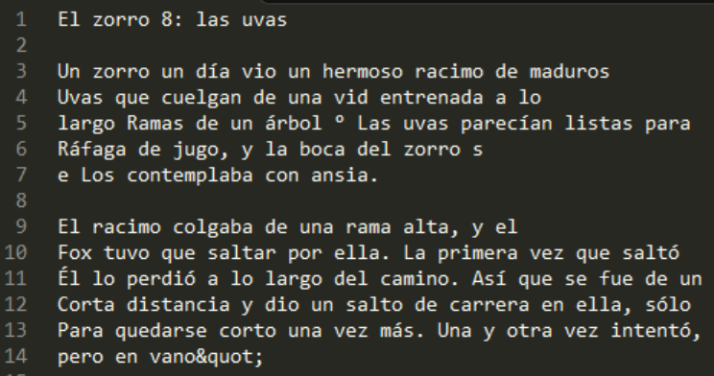
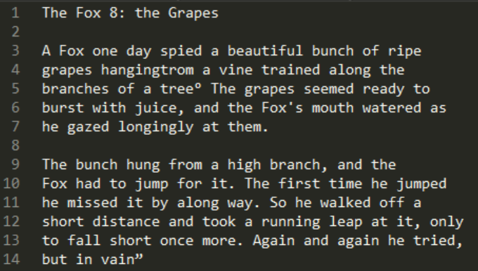
2. Project overview
Programming Language: Python
External Libraries: OpenCV (image processing), Tesseract (OCR),
Google Cloud Translation API
Goal:
Take a photo of a document and covert it to a scan (OpenCV)
Recognize text from the scan and output a text file (Tesseract)
Translate output text into different languages specified by users

Slide 7
Contents
What is Optical Character Recognition (OCR)?
Project Overview
Live Demo
What I’ve Learned

Slide 8
Contents
What is Optical Character Recognition (OCR)?
Project Overview
Live Demo
What I’ve Learned

Slide 9
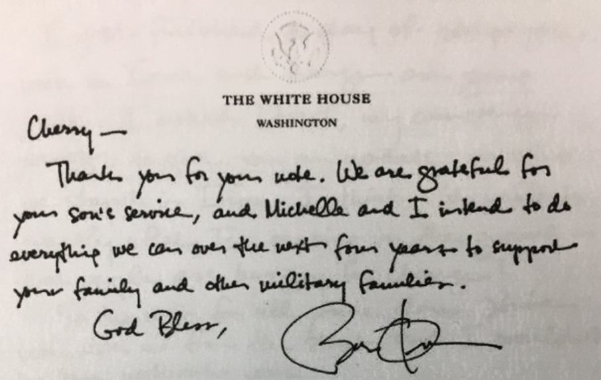
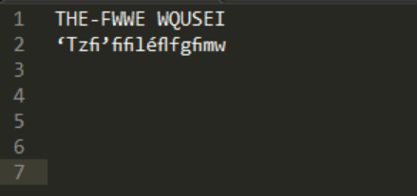
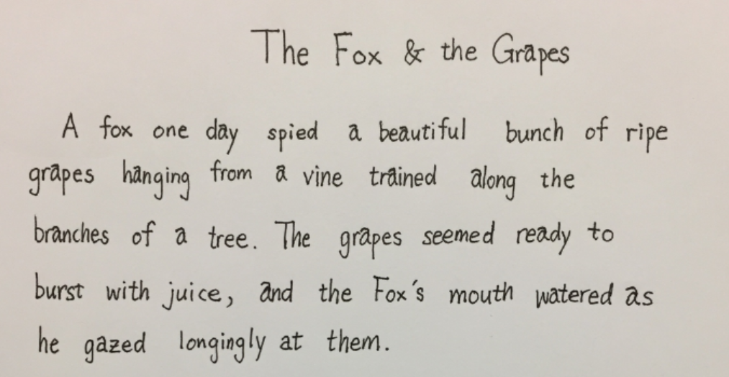
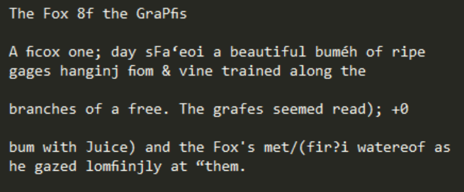
4. What I’ve learned
Preprocessing is important
De-speckling crucial in improving performance
Ex. (l + ‘ ) could be mistaken for an i
OCR is hard
Even with the Tesseract library, performance on handwritten documents was bad

Slide 10
THANK YOU!

