Slide 1
SVM-KNN Discriminative Nearest Neighbor Classification for Visual Category Recognition
Hao Zhang, Alex Berg, Michael Maire, Jitendra Malik

Slide 2
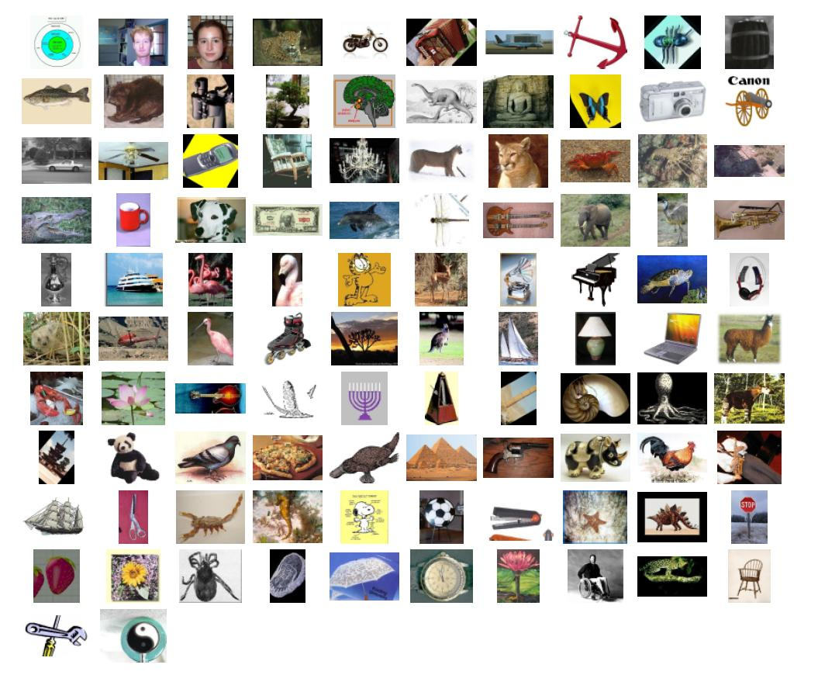
Multi-class Image Classification
Caltech 101

Slide 3
Vanilla Approach
For each image, select interest points
Extract features from patches around all interest points
Compute the distance between images
  Hack a distance metric for the features
Use the pair-wise distances between the test and database images in a learning algorithm
  KNN-SVM

Slide 4
KNN-SVM
For each test image
  Select the K nearest neighbors
  If all K neighbors are one class, done
  Else, train an SVM using only those K points
    DAGSVM
Too slow to compute K nearest neighbors
  Use a simpler distance metric to select N neighbors

Slide 5
Features - Texture
Compute texons by using some filter bank
X² distance between texons
Marginal distance
  Sum of responses for all histograms, then computed X²

Slide 6


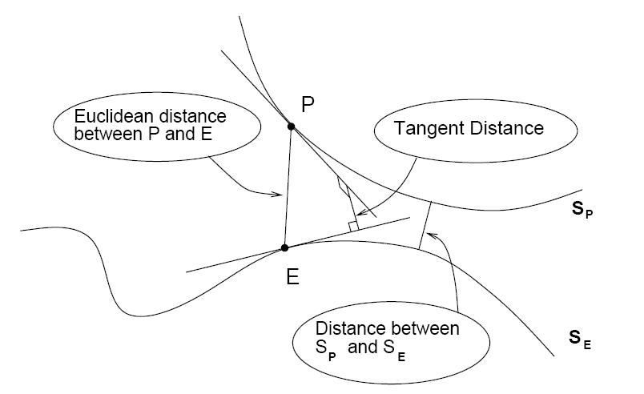
Features - Tangent Distance
Each image along with its transformations forms a linear subspace

Slide 7
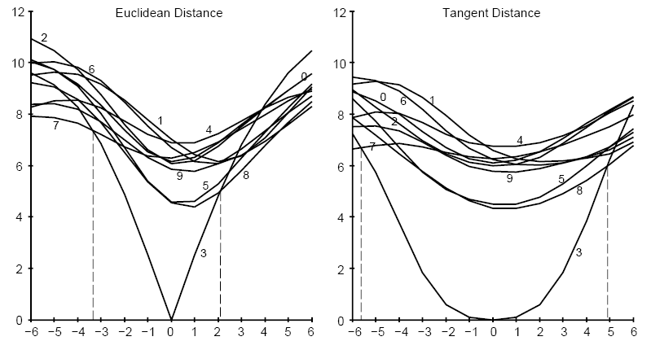
Comparison

Slide 8
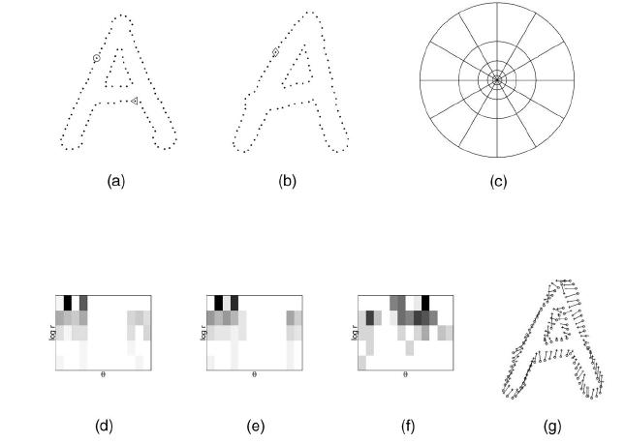
Features - Shape Context

Slide 9

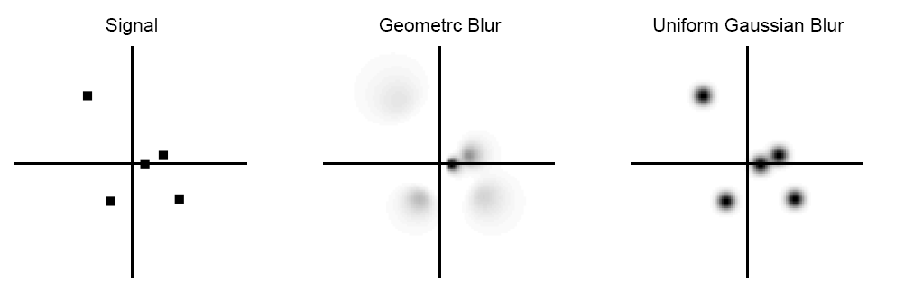
Features – Geometric Blur

Slide 10
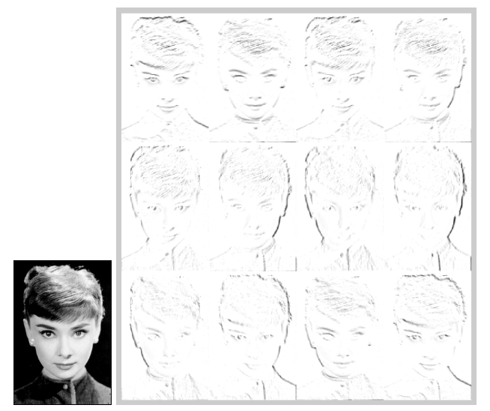
Geometric Blur

Slide 11
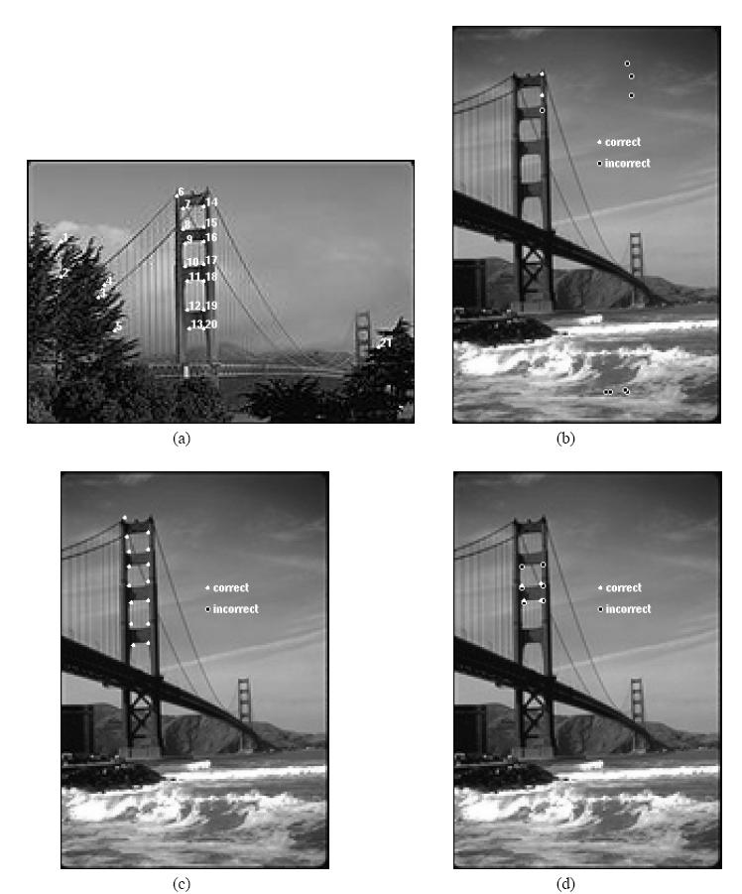
Geometric Blur

Slide 12
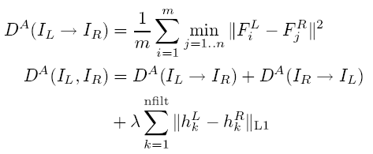
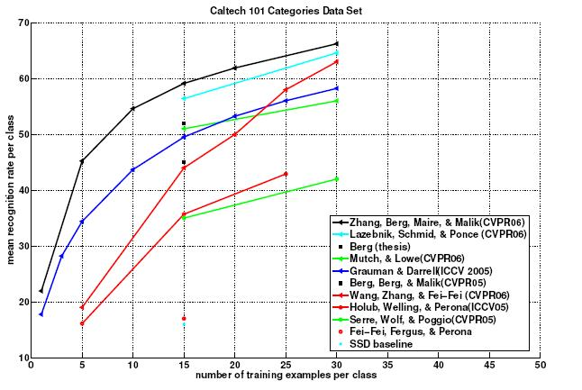
KNN-SVN Results
How is K chosen?

Slide 13

Learning Distance Metrics
Frome, Singer, Malik
Classification just by distances is too rough
Learn a distance metric for every examplar image
  Each image is divided into patches
  Set of features has its own distance metric
  Learn a weighing of the different patches

Slide 14



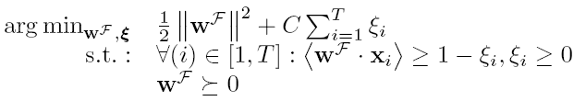
Training
Use triplets of images (Focal,I_{dissimilar},I_{similar})
  Dissimilar and similar have to follow

Slide 15
Beyond Bags of Features: Spatial Pyramid Matching for Recognizing Natural Scene Categories
S. Lazebnik, C. Schmid, J. Ponce

Slide 16
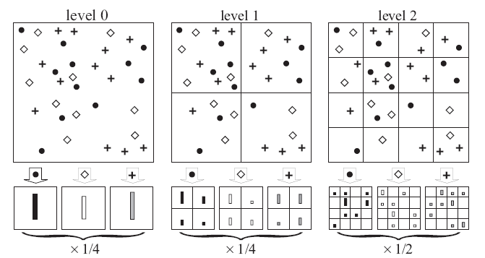
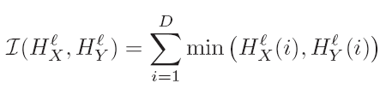
Bags of Features with Pyramids

Slide 17
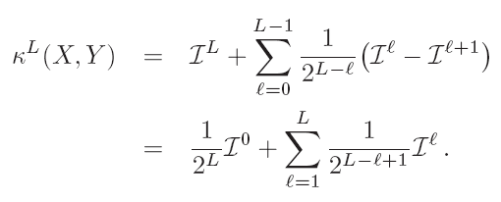
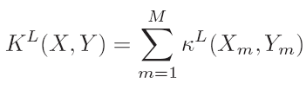
Intersection of Histograms
Compute features on a random set of images
Use kmeans to extract 200-400 clusters

Slide 18
Features
Weak Features
  Oriented edge points, Gist
Strong Features
  SIFT

Slide 19
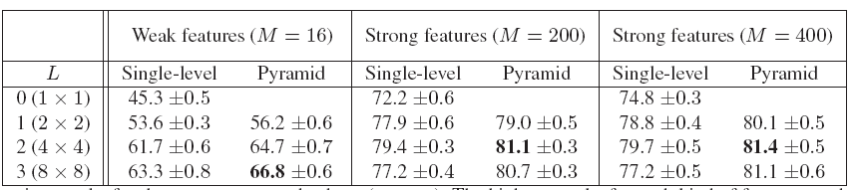
Results on scenes

Slide 20
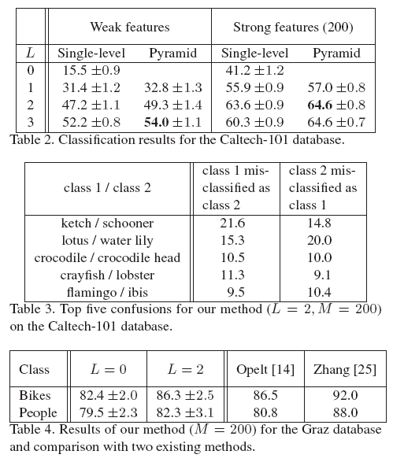
Results on Caltech 101 and Graz

Slide 21
Lessons Learned
Use dense regular grid instead of interest points
Latent Dirichlet Analysis negatively affects classification
  Unsupervised dimensionality reduction
  Explain scene with topics
Pyramids only improve by 1-2%
  Robust against wrong pyramid level

