Slide 1



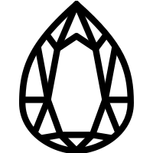


Gem Knights
< Formal elements break down >
Jae Rim Choi

Slide 2
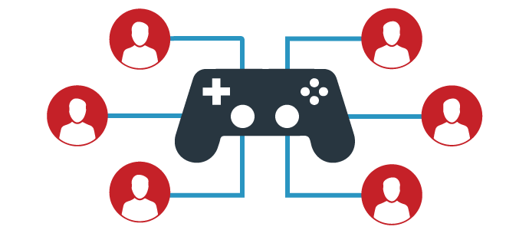
Brief Overview
EX
“Gem Knight” is a competitive online multiplayer game that will allow people to “join in” and play till the round is over. We are hoping to target the game at young teens around the ages of 13 to 20 and young adults, that enjoys dungeon crawler, tactical, competitive and cooperative team games.

Slide 3
What is “Gem Knights” what is the story?
ST
“Knights, blessed with the power from Gem gods, are out to claim the dungeon as their own. Use the power bestowed, to summon up strength and weaken competing players. Collect reward coins by defeating monsters, buy upgrades, and eliminate all opposing parties.”
What Kind of game is it?
Turn tile based game that is focused competition amongst players

Slide 4
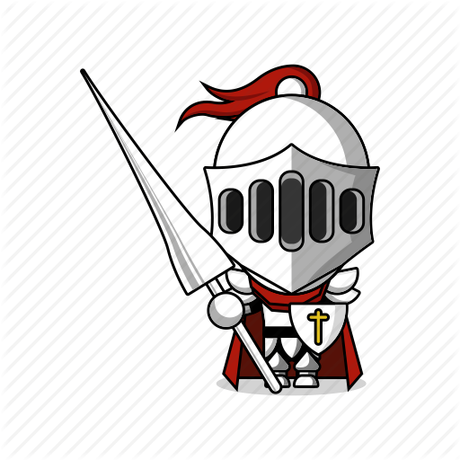
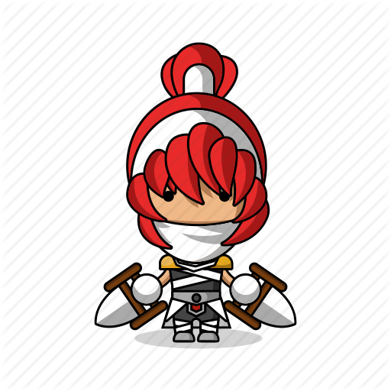
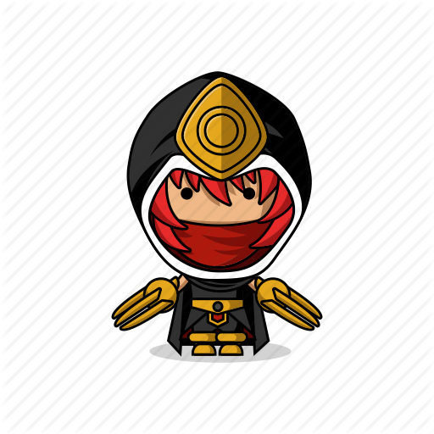
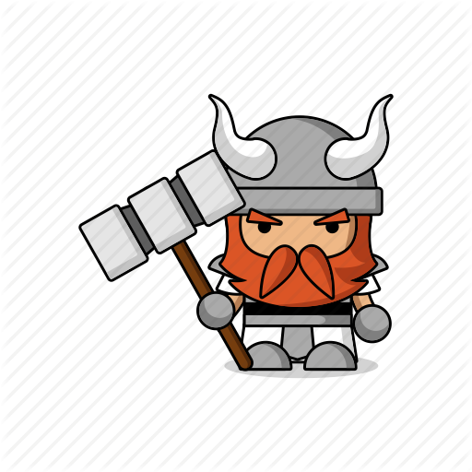
Players
fe
How many players are required?
Least 2 players
What is the max number of players in this game?
Up to 4 players max
Do all players have uniform rules?
Yes, everyone plays a champion with same skills
Interaction Pattern? (Can become...)
Multi player vs. Game / player vs. player / multilateral competition / team competition

Slide 5
Objectives
fe
Hit enemy monster to obtain reward coins equal to that of damage.
Buy upgrades to make the champion stronger
Attack / Speed / Health / Healing Skill
Build your character such that you are the last man standing at the end of the game
Winner claims the dungeon
Categorization of Objectives
Capture
Race
Outwit

Slide 6




Procedures
fe
Beginning of the game:
Every player have 10 coins place them into HP / ATTACK / SPEED / HEAL
Exchange rate: <skill : cost> limit at start
HP 1 for 1 -
Healing 1 for 2 2
Speed 1 for 2 2
Attack 1 for 2 2
During Normal Play Cycle:
Cycle: Player -> Enemy -> Player -> Enemy ...
Player with highest goes 1st followed by others
CONTINUED

Slide 7

Turn Based System
fe
Player Turn
Player can do 1 of 7 actions
Normal Actions
Before or after normal action is done player can move 1 tile in any direction
Attack / Defend / Move / Heal
Special Actions
Summon / Sacrifice / Purchase
Enemy turn
Throw dice
1 of 4 action pattern
Move + Attack
Attack + Move
Attack + Wait
Counter (Reflects ½ damage back to player)

Slide 8
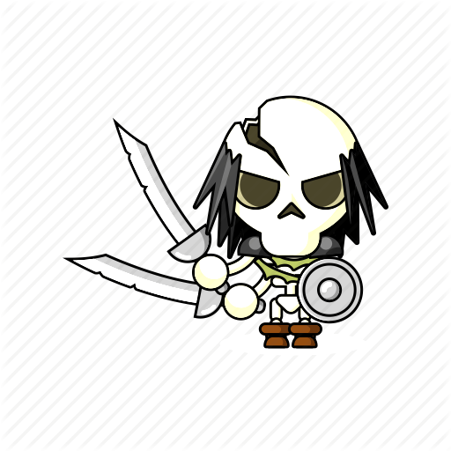
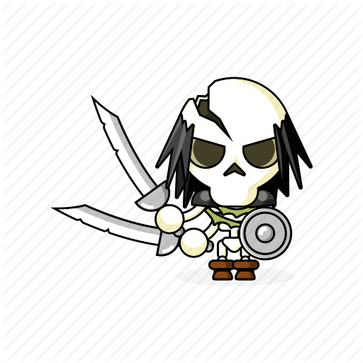
Rules
Resources
fe
Player cannot go out of bounce
Player can go only once per turn
When “Summon” is called no one else can cast another summon skill for two turns
Player cannot move to an enemy position and vise versa
When using normal skills players are allowed to move 1 step before or after the normal action
When using special skills players are NOT allowed to move
Player receives reward coins based on his/her attack damage, but not more than the enemy’s hit points
Player can attack each other doing ONLY 1/2/3 damage (on other stages)
Death means losing a turn
Limited number of enemies
Limited reward coins
3 Terrain stages

Slide 9
Conflict
Boundaries
fe
Game vs Player
Player vs Player
Deciding on how to build the character such that the champion is best suited for upcoming battle.
Deciding when is the best time to fall back and heal.
Deciding when is the best time to engage the enemy.
Deciding when to cast summon to increase damage or decrease the opposing player’s defense?
Deciding which stats to increase and decrease when using sacrifice skill.
Deciding on which is more advantageous position on the grid.
When to buy the upgrades in the beginning or end.
Which trophies yield best stats and which to get to prevent other from becoming too powerful.
How to time the attack so that player gets the last hit bonus on the boss.
When should there be a treaty between players.
Grid edges
Agreement between players
Emotional feeling of not wanting to attack player

Slide 10



Outcome
fe
LAST MAN STANDING ON THE FINAL STAGE
the VICTOR will claim the dungeon as their own!

Slide 11
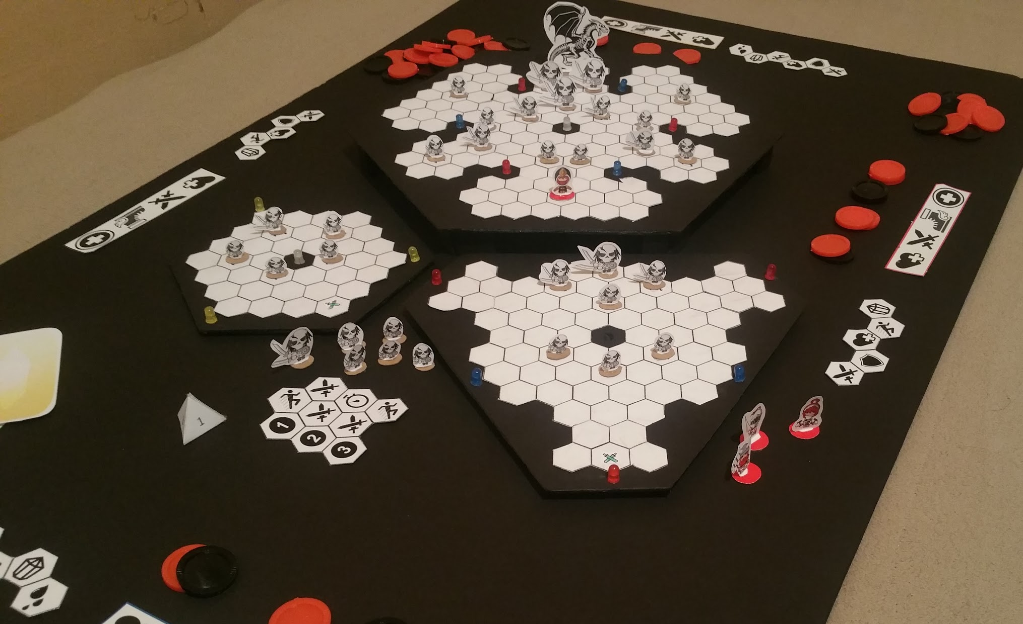
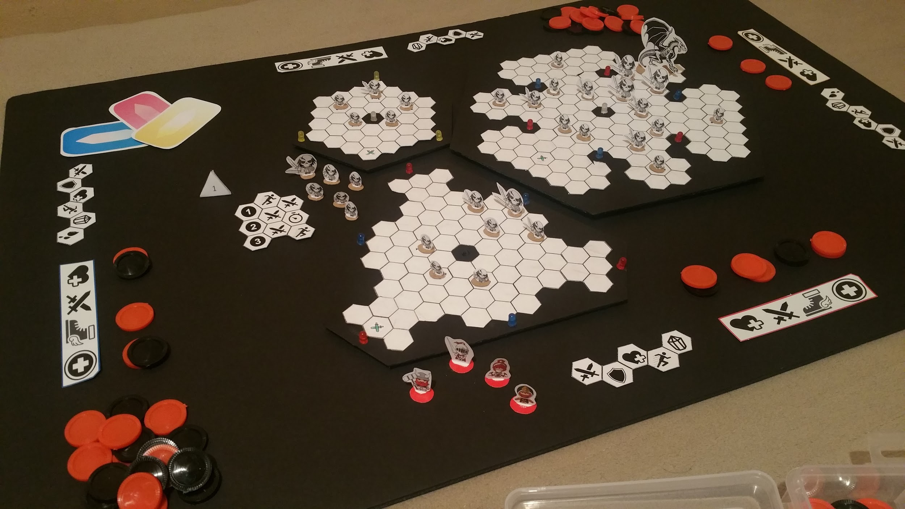
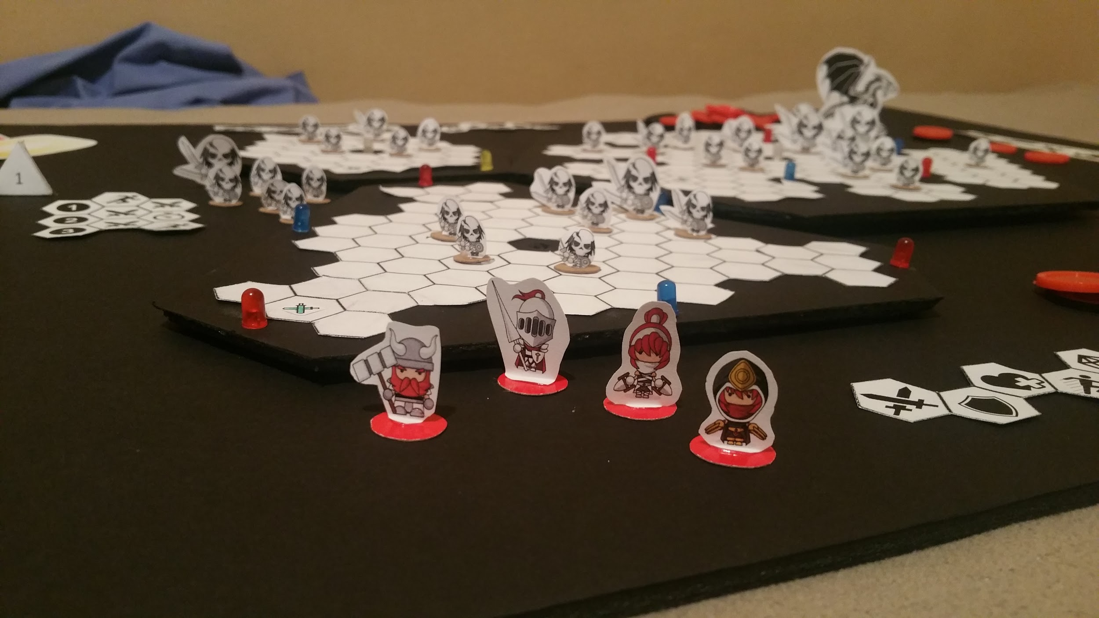
Prototype

Slide 12
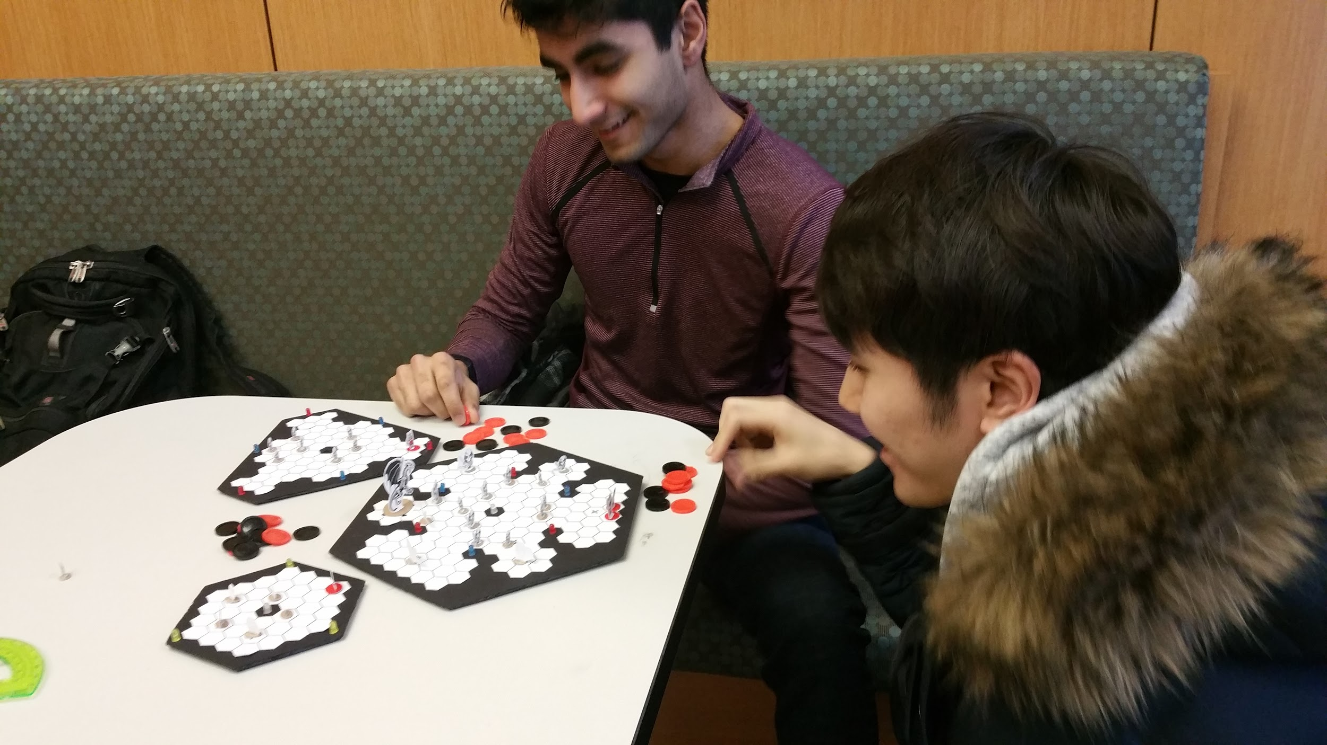
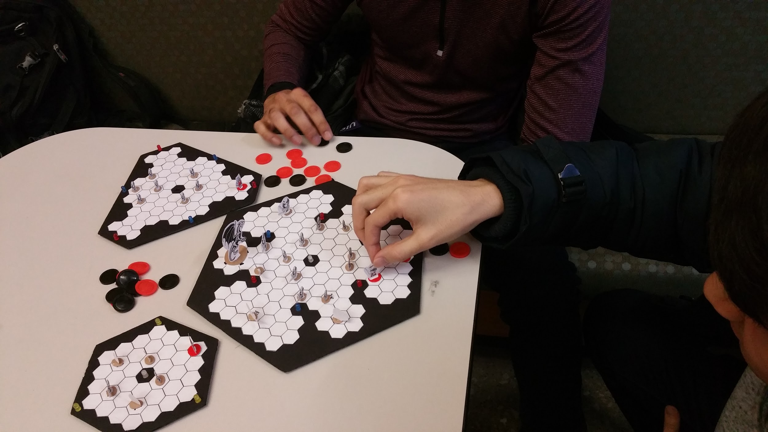
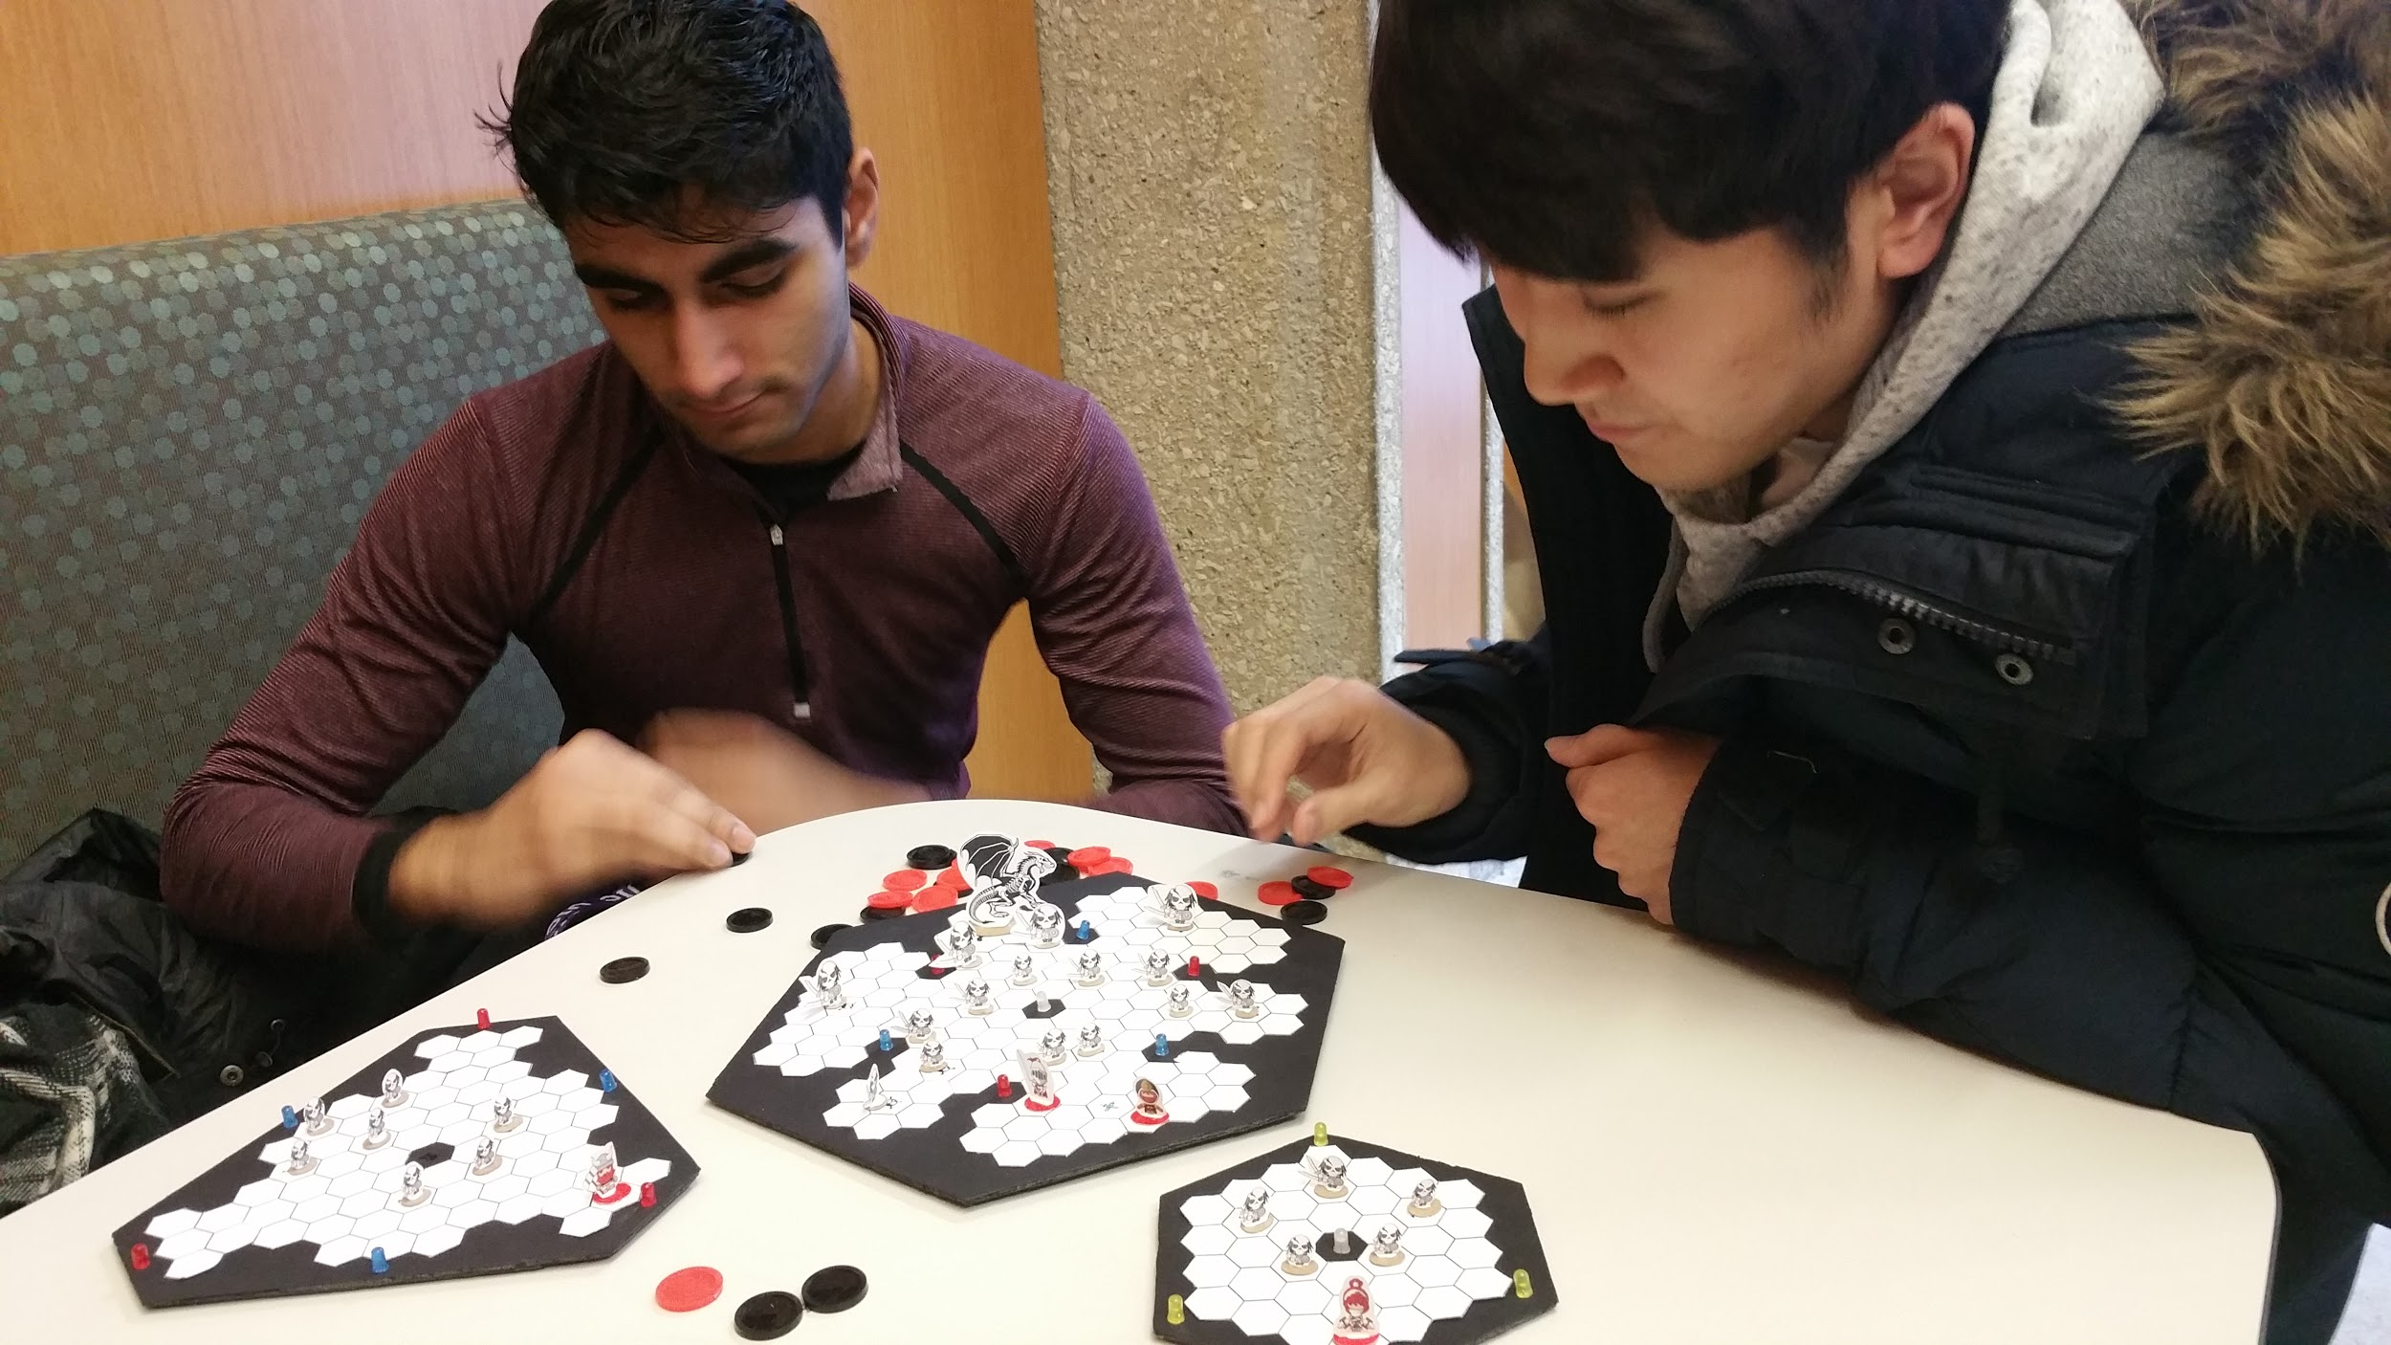
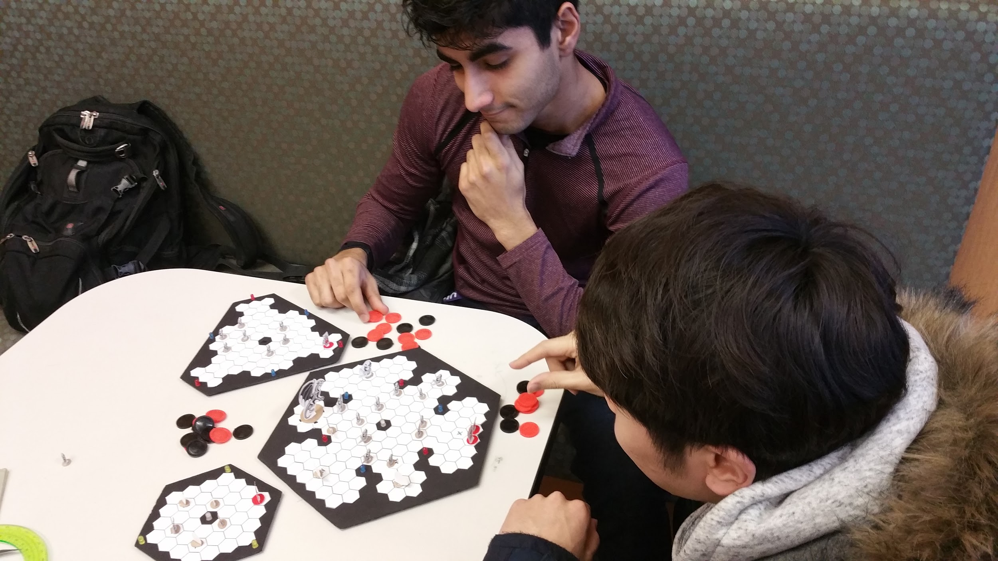
Images

Slide 13
Novelty
Why would this succeed?
Games that have multiplayer are more likely to make it into top 10 game list.
Games such as “HeartStone”, which is a turn based games that also made it into top 10 list proved that multiplayer games does not have to be “fast paced” games, but games that require playing with wit or simply a laid back games such as minecraft also are perfectly acceptable.

Slide 14
Images were provided by
https://cdn2.iconfinder.com/data/icons/fantasy-characters/512/assassin3-512.png
https://cdn2.iconfinder.com/data/icons/fantasy-characters/512/dwarf2-512.png
https://cdn2.iconfinder.com/data/icons/fantasy-characters/512/knight3-512.png
https://cdn2.iconfinder.com/data/icons/fantasy-characters/512/dwarf1-512.png
https://cdn2.iconfinder.com/data/icons/fantasy-characters/512/skeleton1-512.png
https://cdn2.iconfinder.com/data/icons/fantasy-characters/512/dwarf2-512.png
https://cdn2.iconfinder.com/data/icons/fantasy-characters/512/assassin2-512.png
http://www.endlessicons.com/wp-content/uploads/2013/02/skull-icon-614x460.png
https://imgs-tuts-dragoart-386112.c.cdn77.org/how-to-draw-a-dragon-skeleton-dragon-skeleton_1_000000010832_5.jpg
http://downloadicons.net/sites/default/files/sword-icon-78308.png
http://static1.squarespace.com/static/55eec0c3e4b077f580288013/t/55efecc4e4b08a4b89b9bda1/1475321892938/?format=1500w
https://freeiconshop.com/icon/heart-icon-compact-flat/
https://cdn1.iconfinder.com/data/icons/game-rpg/500/shoe-512.png
https://thenounproject.com/term/crossed-swords/152699/
https://cdn3.iconfinder.com/data/icons/glypho-science-and-medicine/64/heart-cross-medical-512.png
https://cdn3.iconfinder.com/data/icons/mobiset-2/512/medical_medicine_health_simple-512.png
http://downloadicons.net/sites/default/files/shield-icon-84266.png
https://cdn2.iconfinder.com/data/icons/sports-attitudes/1451/run-512.png
https://maxcdn.icons8.com/Share/icon/Gaming//crystal1600.png
http://www.free-icons-download.net/images/blood-drop-icon-71253.png
http://icons.iconarchive.com/icons/icons8/android/512/Measurement-Units-Time-icon.png
http://downloadicons.net/sites/default/files/number-1-icon-63209.png
http://www.unitelgroups.com/upl/product/2.png
http://downloadicons.net/sites/default/files/number-3-icon-63211.png
http://vignette3.wikia.nocookie.net/clubpenguin/images/2/2e/Epic_Knight_Helmet_Icon_1693.png/revision/latest?cb=20130919102232
https://cdn3.iconfinder.com/data/icons/diamonds-3/100/diamonds-47-512.png
http://flaticons.net/gd/makefg.php?i=icons/Sports/Victory-Stand.png&r=255&g=255&b=255
http://3.bp.blogspot.com/-0fe2MZJcxHI/UPs2aSonxEI/AAAAAAAAAZI/MOh18p80NuQ/s1600/wreath.png
https://asbestosawareness.training/wp-content/uploads/2015/07/award.png

