Slide 1

$ν$ @ MuC

Slide 2
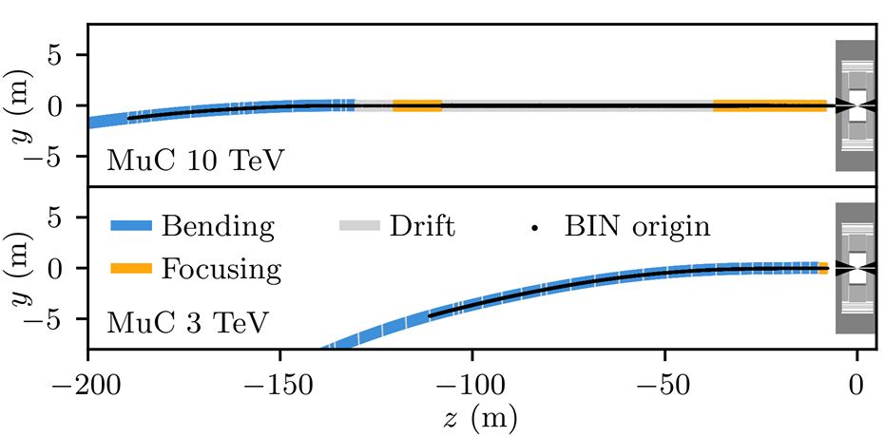



MuC 10 TeV configuration
$$z∈(−150m,150m)$$
$$ε Z^{μ} νγ_{μ}N+W^{μ}Nγ_{μ}ℓ$$
$$μ$$
N

Slide 3
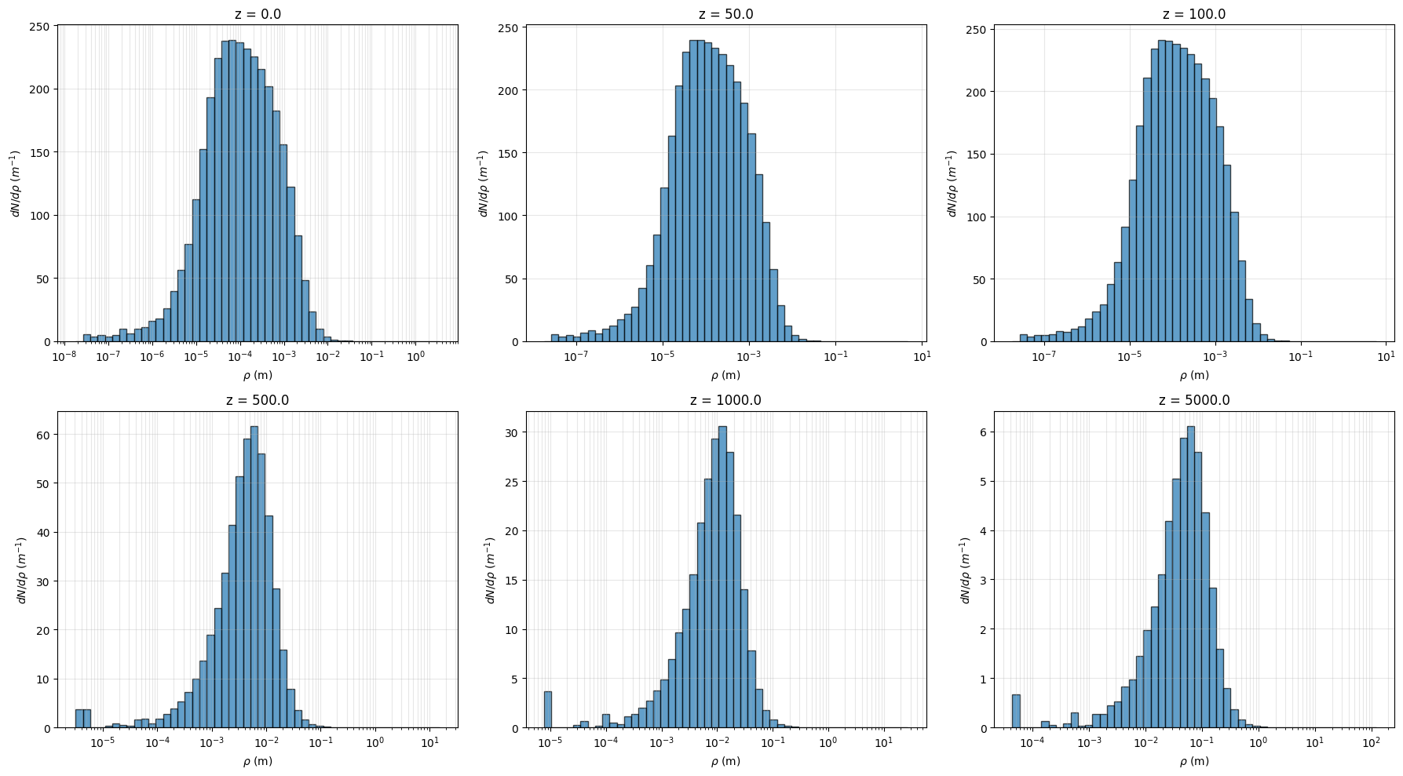

z: longitudinal distance from IP; assume muon decay at IP
$$ρ:\sqrt{x^{2}+y^{2}}$$
Numerical simulation

Slide 4
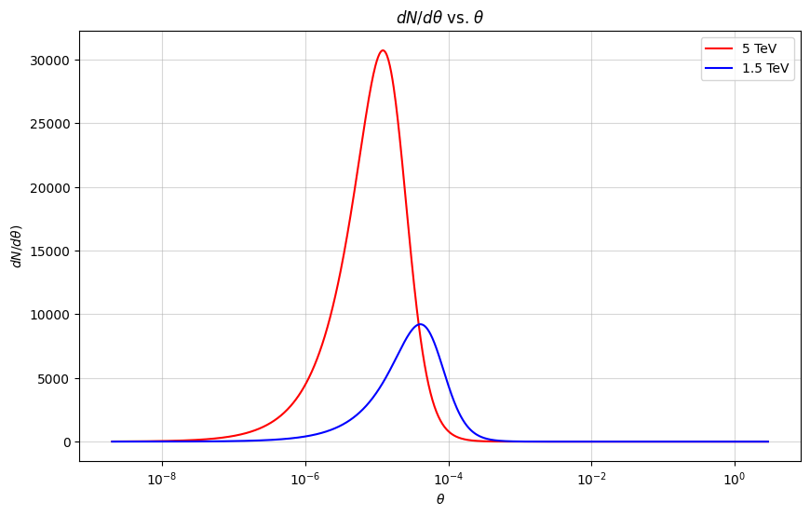
$\frac{dN_{ν}}{dθ}$: $ν$ angular distribution from a 5TeV $μ$ decay at center (z=0)

Slide 5
Comparing analytic and numerical result
Analytic:
Numerical simulation:

Slide 6
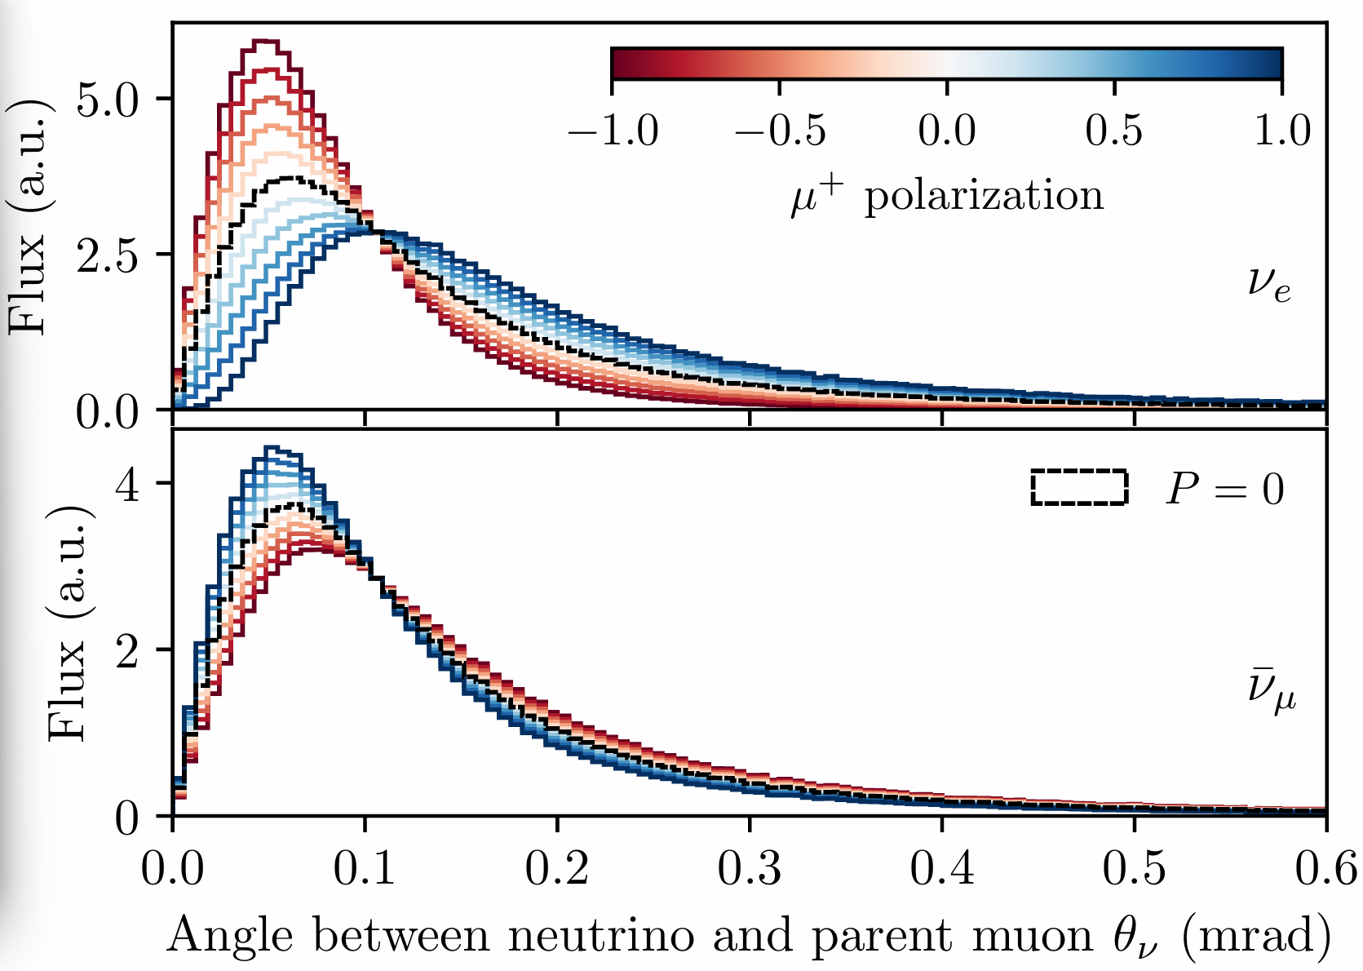
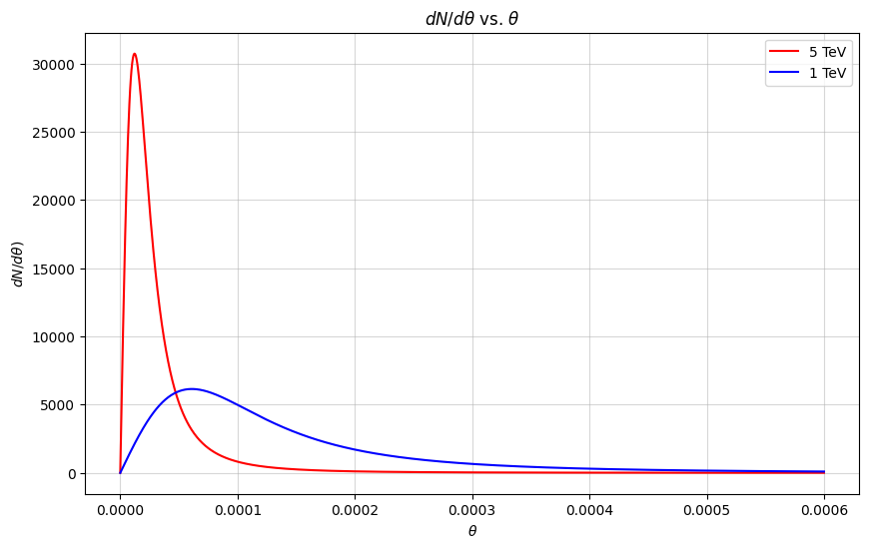

Compare with 2412.14115
$$P=0$$

Slide 7
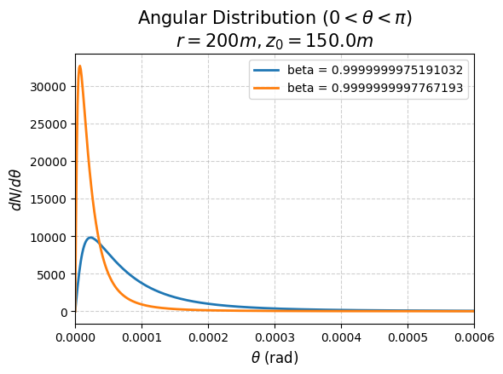
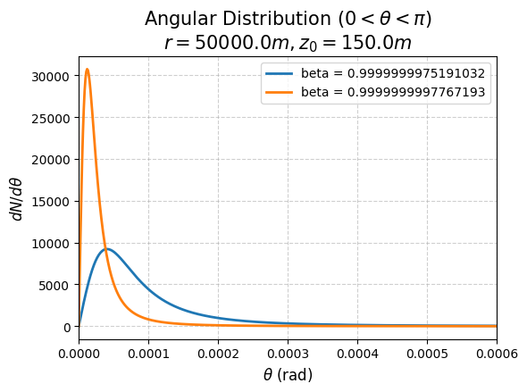
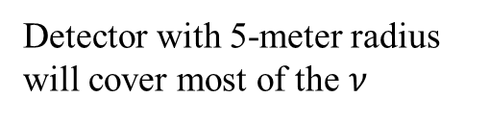
Angular distribution
Now I’m integrating z-axis from -150m to 150m
Detector with 5-meter radius will cover most of the $ν$

Slide 8

Total neutrino flux
After consider
$\frac{dN_{ν}}{dt}=1.8×{10}^{11}s^{−1}\sim 1×{10}^{18}year^{−1}$
3TeV MuC 10TeV MuC
50 km away from IP:
Detector with 5-meter radius will cover most of the $ν$

Slide 9
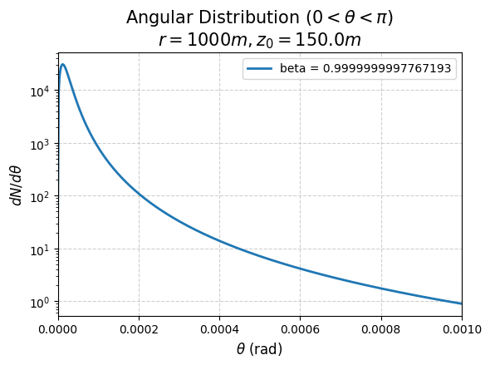
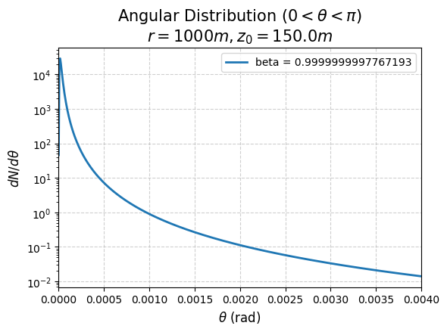

Angular distribution
Without consider beam divergence
$θ_{peak}=$2e-5

Slide 10
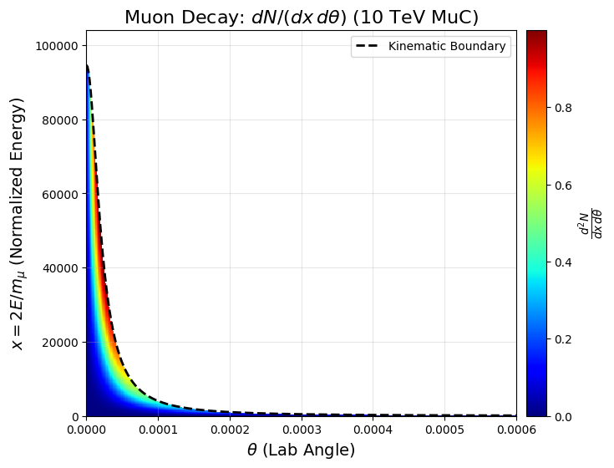
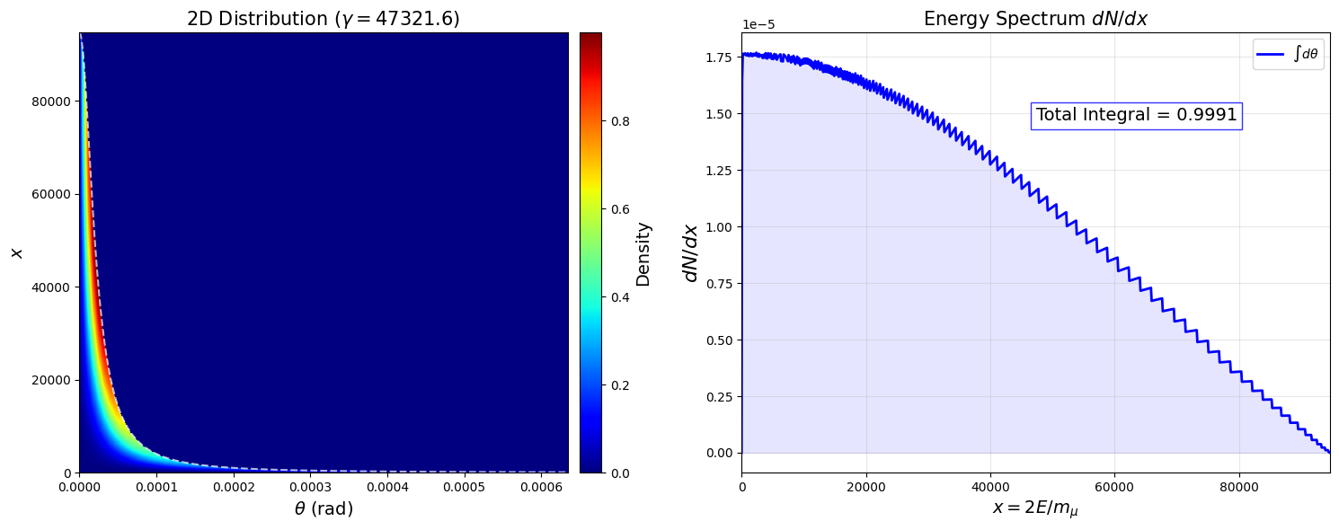
Spectrum
Without consider beam divergence

Slide 11
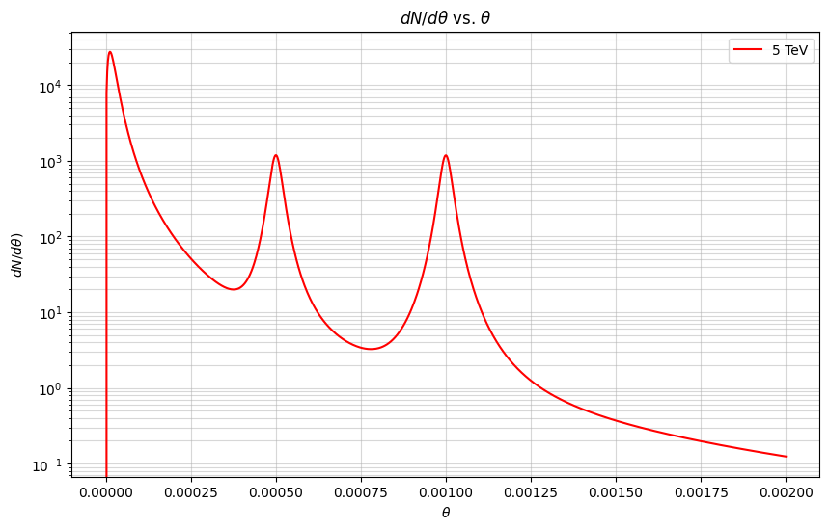
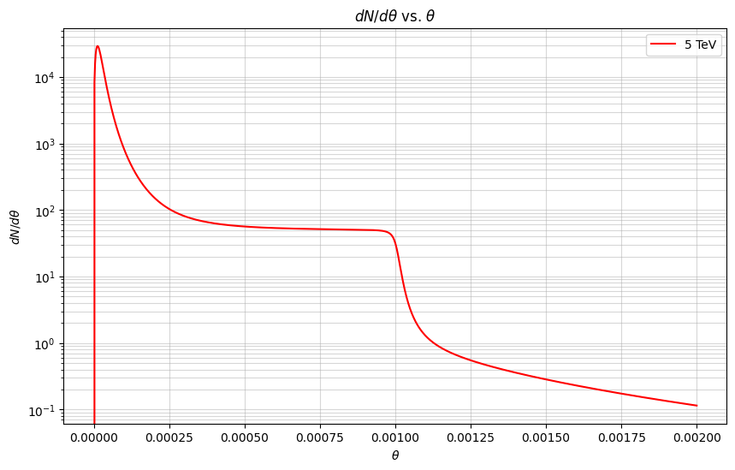
No beam divergence, but chicane
Chicane: 2.5% has 0.5mrad; 2.5% has 1mrad angle
Chicane: uniformly distribution of angle from 0~1mrad angle

Slide 12
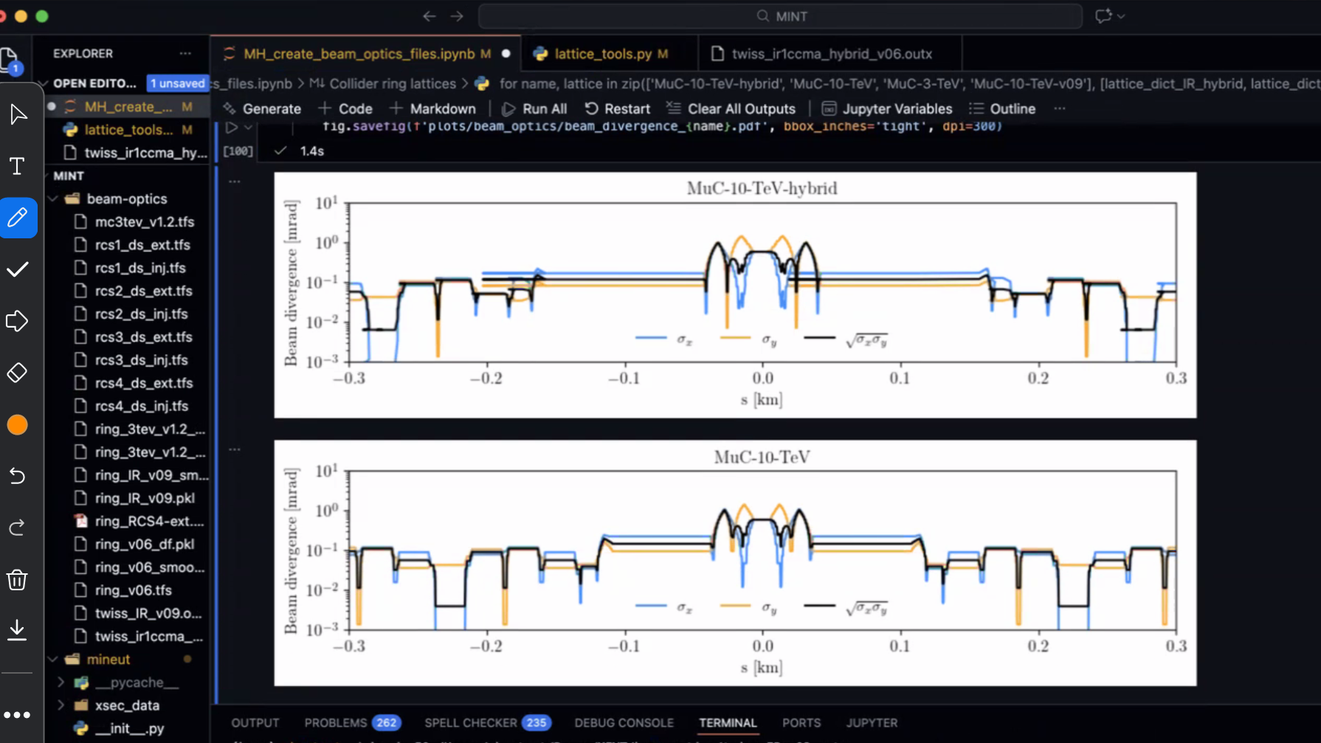
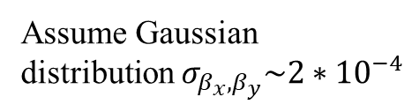
Assume Gaussian distribution $σ_{β_{x},β_{y}}\sim 2∗{10}^{−4}$

Slide 13
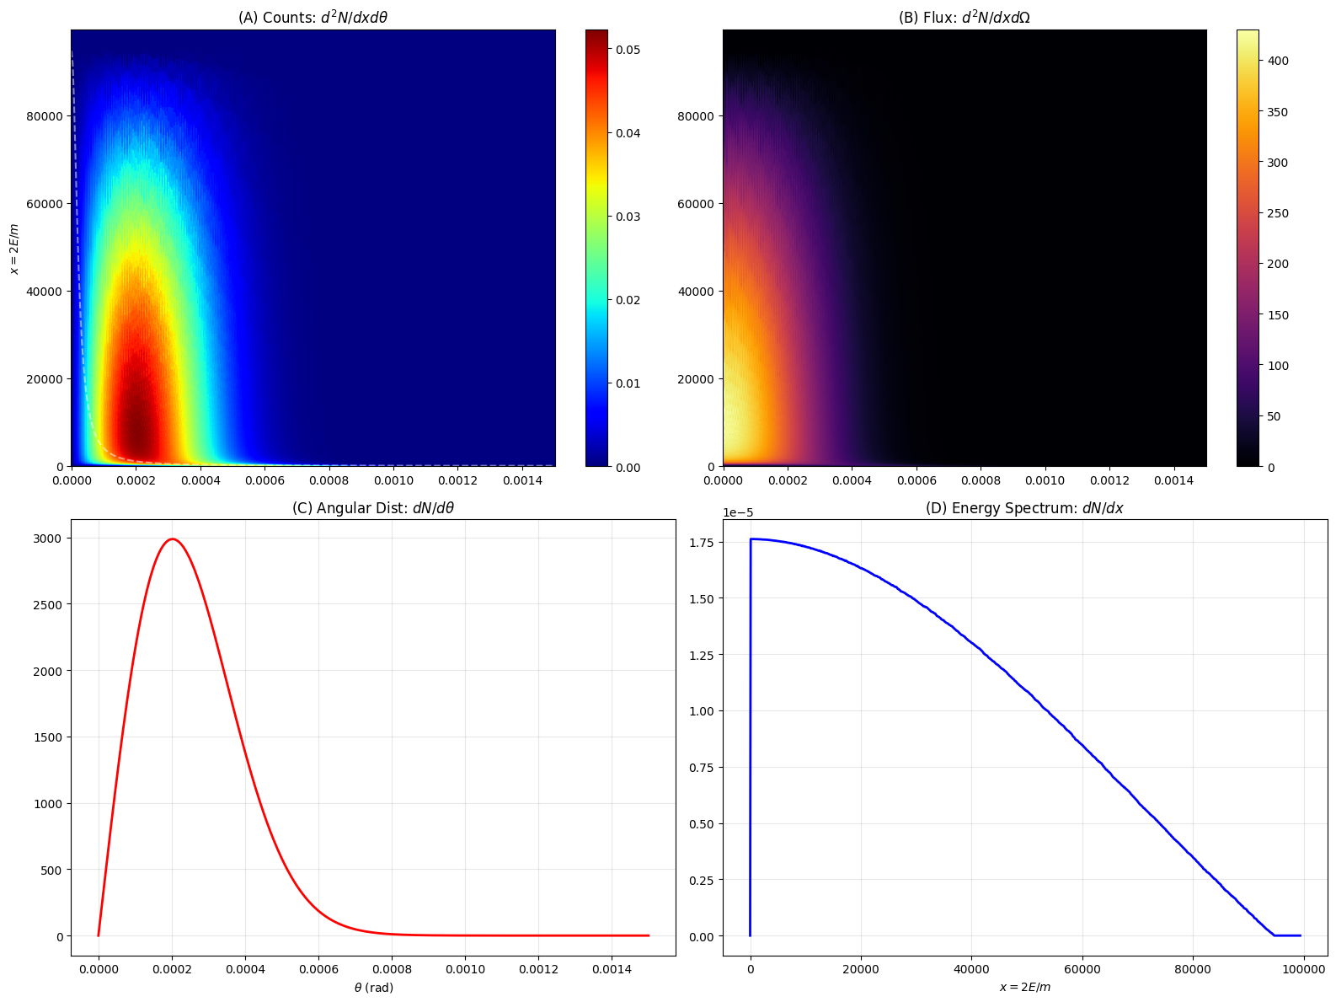
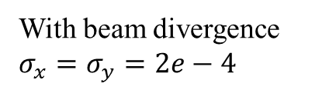
Spectrum
No beam divergence
10 TeV MuC
3 TeV MuC
With beam divergence $σ_{x}=σ_{y}=2e−4$
10 TeV MuC

Slide 14


Total number of $ν$
$\frac{dN_{ν}}{dt}=1.8×{10}^{11}s^{−1}$
$\frac{dN_{bunch}}{dt}=f_{inj}n_{turn}=5Hz∗3600=1.8×{10}^{4}s^{−1}$
$n_{turn}=\frac{γτ}{C}=\frac{5×{10}^{4}∗2.2×{10}^{−6}∗3×{10}^{5}km}{8.7km}=3600$

Slide 15
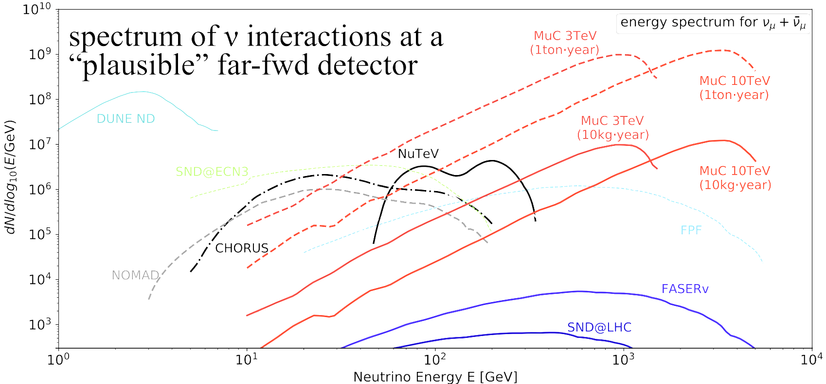
Note

Slide 16

Note
$p\left(\cos{θ}\right)=\frac{dN_{ν}}{d\cos{θ} }=\frac{1}{2γ^{2}{\left(1−β\cos{θ}\right)}^{2}}$ for $μ$ decay at z=0
$Φ(z=0)=\frac{dN}{dA}=\frac{dN}{2πr^{2}d\cos{θ}}=\frac{1}{4πγ^{2}{r^{2}\left(1−β\cos{θ}\right)}^{2}}$
$\overline{Φ}=∫Φ\left(z\right)p\left(z\right)dz$ where $p\left(z\right)=\frac{1}{2∗150m}$

Slide 17
Note

