Slide 1
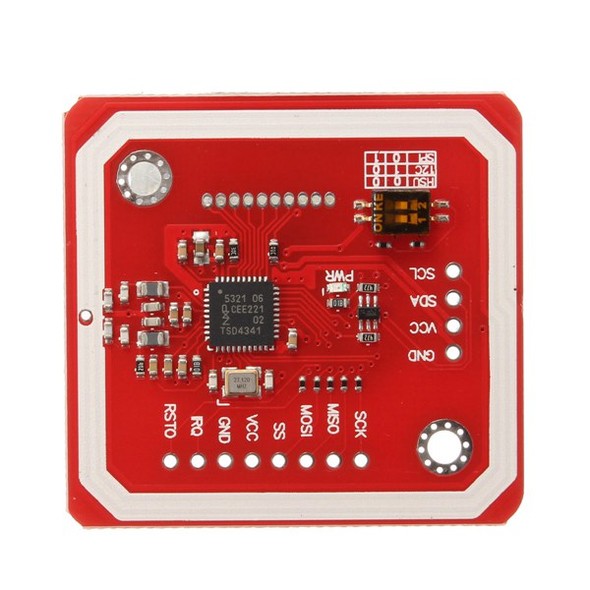
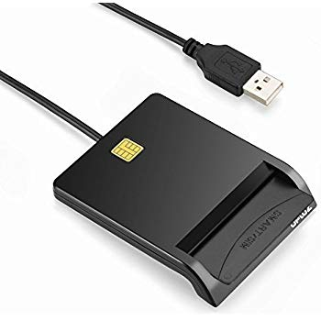
Deployment thru Azure IoT Edge on same device
Bankiosk-UI
(front end)
Contanier
Passing picture of customer
1
BankioskIoT
(local backend end)
Contanier
Customer id
4
NFC reader
6
Asking for Credit Card auth
5
Authentication confirmed or not
9
Smart Card reader
2
Telemetry
Passing picture
Then passing CC number
7
Azure Face API
3
BankioskAPI
(backend end)
Azure service or container
8
Azure Storage

Slide 2
