Slide 1

less3

Slide 2

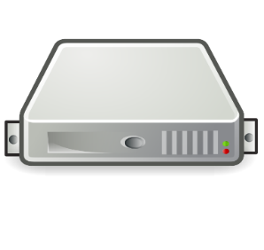
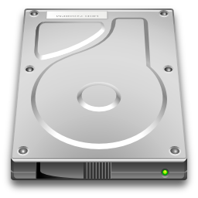

less3
<3
Less3 Server
Local Disk
Storage
AWS SDK

Slide 3

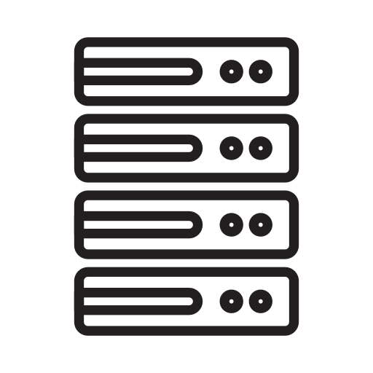
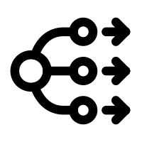


Clients, Servers, and Agents
Container Infrastructure
AWS SDK
Load
Balancer
Shared
Database
Local Disk
Storage
Less3 Servers

