Slide 1



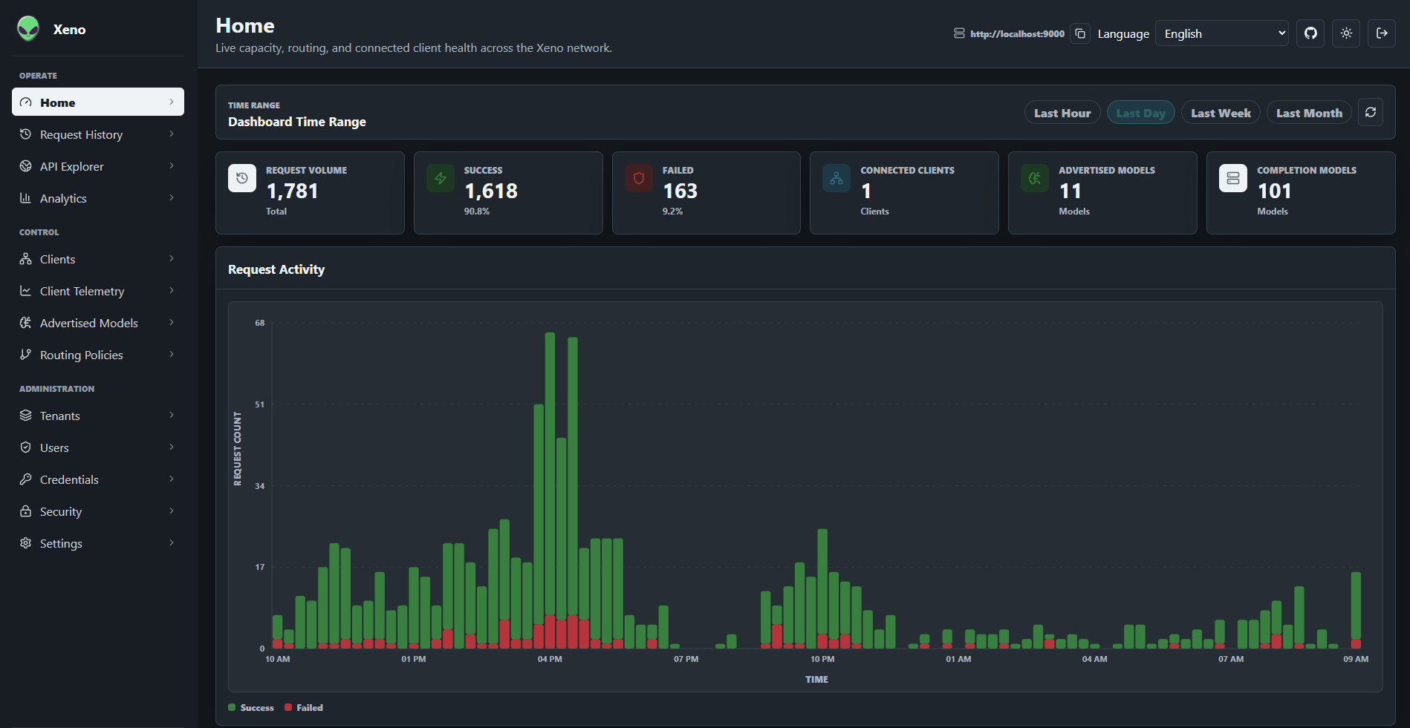
Clients OpenAI Compatible
Xeno Server Cloud or On-Premises Control Plane
Xeno Clients Workload Runners

