Slide 1
Quad-copter control center for iOS
By: Joe Ippolite

Slide 2
Outline
Background
Devices
Software
Demo
Code Review

Slide 3
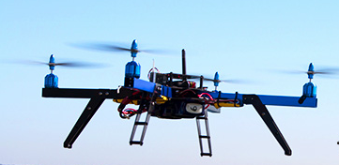
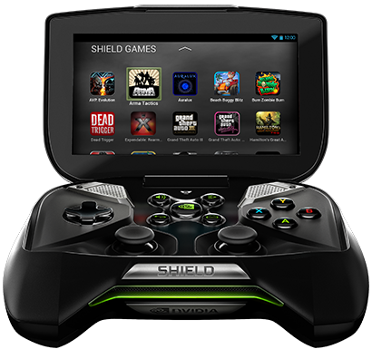
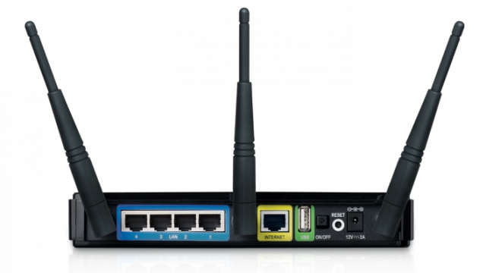
Background
Current Senior Design Project
Controls over same Wi-Fi network
Limited range
Need to know IP of quadcopter

Slide 4
Proposed Solution
Intermediate server
No need to know IP of quad
Access from everywhere
Nearly infinite range
Needs internet access

Slide 5
Devices Used
3D-Robotics Quad-Copter
APM(Ardu Pilot Manager)
Controls Rotors
Raspberry Pi (model B)
IOIO OTG microcontroller
Wifi Module
Replace with GSM module for portability*
iOS Device
Needs internet connection

Slide 6
Server Overview
Websocket integration
On connect unique “Key” given
On “Add” controllable device added to list of devices
On Message PWM duty cycles sent to appropriate device
I.E. “Key” ch1 ch2 ch3 ch4 ch5
On disconnect removes “Key” from list of devices

Slide 7
Raspberry Pi
Java program
Opens websocket connection to server
“Adds” itself to list of controllable devices
On message
Checks for all 5 channel inputs
Sends corresponding duty cycle to IOIO OTG
IOIO OTG
Sets PWM duty cycle of 5 GPIO pins
Pins are connected to APM
Acts as replacement RF receiver

Slide 8
Pitfalls
Possible delay
Server being overworked
Lack of video feed
GPS not being recorded
Currently based off of IP location

Slide 9
Demo

Slide 10
Code Review

