Slide 1
Clue: The Board Game on your console!
Presented by Julia Cicale, Kyle Erchinger, Kelsey Laurent, and Michelle Kinn
Notes:
My name is A and this is B, D, and C, and our project was to create a game of Clue for console in C++

Slide 2

Objectives – The Problem
Create a working game of Clue!
This will include one human player and up to five computer players
Game Setup
We need a board
Up to 6 players (1 human, remaining computer)
21 cards (18 dealt out to players)
A killer envelope including suspect, weapon, and location
Game Play
Players must be able to traverse the board
Players must be able to make suggestions and accusations
Players must be able to disprove other players’ suggestions
Notes:
Our game needs to work for one human player (the user) and up to five computer players.
The original game of Clue is a board game: it comes with a board, 6 player tokens, 6 murder weapons, and 21 cards (split into 6 suspects, 6 weapons, and 9 rooms). It also includes an envelope where the confidential killer cards are held after being randomly selected. The remaining 18 cards are dealt out to players.
During game play, players traverse the board, make suggestions in rooms, and disprove the suggestions of the other players using the cards they were dealt. Once a player has gathered enough information, she can make an accusation. If it is correct, she wins, but if it is wrong he/she loses.

Slide 3
Solution: Data Structures!
Kitchen
Ballroom
Conservatory
Billiard Room
Dining Room
Library
Lounge
Hall
Study
The board is a graph (the rooms are the nodes and their connected rooms are the edges)
The order of players is a circular like vector
Lots of vectors are used (cards, players, lists)
Notes:
To create our game of Clue, we used data structures and object-oriented programming. As illustrated here, our playing board is actually a graph. The rooms are nodes and the edges are what rooms are connected. Each room, as you can see, is connected to at least two other rooms, and the corners are connected to three. This is an undirected graph so that our players can move about the board.
The order that our players take their turns in works through a vector that behaves in a circular fashion. Once the last player is reached, we loop back to the first player in the vector to allow for turns to be taken. This logic is also enforced when disproving a suggestion – starting with the player to the left of the player who made the suggestion and continuing through until we reach the player to their right.
In fact, we actually ended up using a lot of vectors –in addition to the players, the decks of cards are vectors and the lists that are kept by computer players are vectors. Vectors are a very useful data structure for these types of constantly changing pieces of data.

Slide 4
Solution: Data Structures!
Additionally, we created many of our own data unique structures with properties and methods specific to Clue
Enumerations and structures were also helpful
Notes:
Outside of the data structures we learned about in class, we added several of our own data structures that were specific to Clue’s game play and rules. Notably, we created classes for the players (both human and computer) and those each had several methods that allowed the players to interact with each other, the board, and the cards.
Finally, we found both enumerations and structures to be very useful in building our program. The enumerations were used for the different types and subtypes of cards, which was a convenient method of storing them for easy access. We used a structure to store the confidential killer cards – this was very useful because it also corresponded to the data that would be used for an accusation or suggestion, and all would have to be compared. A structure makes this easy by storing the three pieces of data types all in one place.

Slide 5
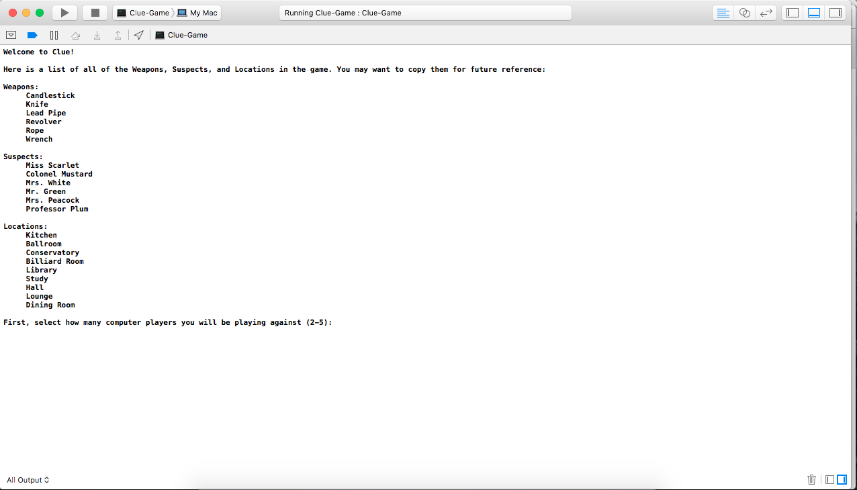
Demo
Notes:
This will be a very brief live demo of our program – probably just showing setup/character selection and maybe one round of turns, followed by making an accusation (that will most likely end up being false and losing the game)

Slide 6
Questions?
Notes:
Questions/comments

