Slide 1

Global DEMOGRAPHY

Slide 2

Definition of Terms: Demography-scientific study of the determinants and consequences of human population trends Demographic transition-refers to the transition from high birth and death rates to low birth and death rates as a country develops from pre-industrial to an industrialized economic system

Slide 3
INTRODUCTION: Demography: Demography is the scientific study of the determinants and consequences of human population trends. By the beginning of the 21st century, world population reached 6 billion. Most growth has occurred in the past 200 years As can be gleaned from Figure 1, a massive increase of billions of people occurred no less than 200 years ago. This is the global demographic transition, brought by momentous changes, reshaping the economic and demographic life cycles of individuals and restructuring populations. Clearly, before the transition, the growth of world population is close to stationary, depicting that life is short, births were many, growth is slow, and the population is young. Since 1800, global population size has already increased by a factor of six and by 2100 will have risen by a factor of 10. There will then be 50 times as many elderly but only five times as many children; thus, the ratio of elders to children will have risen by a factor of 10. The length of life, which has already more than doubled, will have tripled, while births per woman will have dropped from six to two (Lee, 2003).

Slide 4
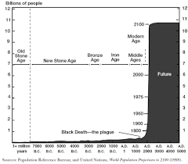

Slide 5
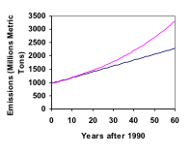
The Malthusian Theory: Thomas Malthus (1766-1834) was the first person to draw widespread ttention to the two components of natural increase-births and deaths fertility and mortality). Malthus formulated an essay titled "Essay on the Principle of Population," initially published in 1789, wherein he postulated that population tended to grow geometrically, while the means of subsistence grew only arithmetically (Figure 2) Thomas Malthus also argued that the difference between geometric and arithmetic growth created a tension between the team between the growth of population and that of means of subsistence-this gap could not persist indefinitely. Also, in the said essay, it was mentioned that population was held in equilibrium with the slowly growing economy. Faster population growth would depress wages, causing mortality

Slide 6
to rise due to famine, war or disease-in short, misery Depressed wages w also cause postponement of marriage, resulting in prostitution and other c including contraceptiore this he called the "preventive check. Since population could potentially grow more rapidly than the econo was always held in check by misery and vice, which were therefore the inev human lot. Economic progress could help only temporarily because population could soon grow to its new equilibrium level, where misery and vice would hold it in check. Only through moral restraint-that is, the chaste postponemen of marriage-did Malthus believe that humanity might avoid this fate, and he thought this an unlikely outcome (Lee, 2003)

Slide 7
Population Explosion: Contrary to what Malthus predicted, mortality has not risen to curb world population growth. As mentioned, the world population boomed up to near a billion in 1800 and reached 6 billion by the end of the 20th century. Apparently, Malthus did not recognize the force of the Industrial Revolution, which produces exponential growth in the means of subsistence.

Slide 8
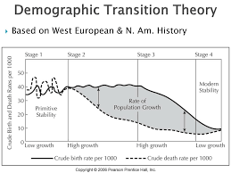
The Demographic Transition: During the first half of the 20th century, demograph notion of the demographic transition. The Demograph Tranton Framework conceived the illustrates population growth in terms of discrepances and changes in tw crude vital rates-mortality and fertility Stripped off the essentials, demographic transition refers to the transition from high birth and death rates to low birth and death rates as a country develops from a pre-industrial to an industrialized economic system

Slide 9
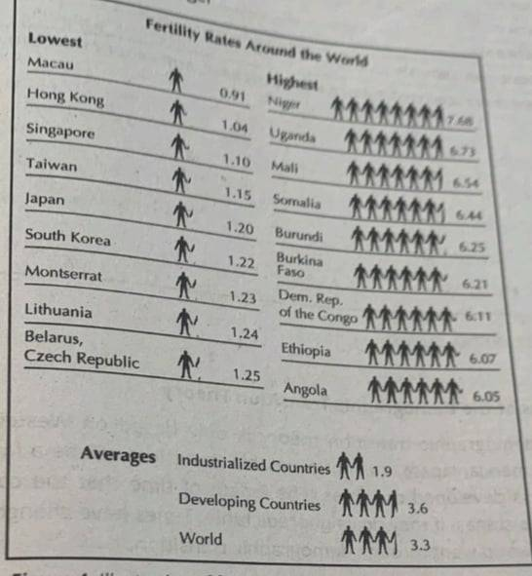
Stage 1: Preindustrial Society - high and unstable birth and death rates population growth rate slow, importance of children, low life expectancy Reasons for the changes in birth rate 1. Children are needed for farming. 2. They die at an early age due to illnesses, 3. No family planning and conception/giving birth is encouraged by religion and society. Reasons for the changes in death rate 1. Disease 2. Famine 3. Poor medical knowledge

Slide 10
Stage 2: Early Industrial Society high orth cases, falling death rate, hig population growth Reasons for the changes in birth rate 1. Children are needed for farming 2. They die at an early age due to inesses 3. No family planning and conception/giving birth is encouraged by religion and society. Reasons for the changes in death rate 1. Improvements in medical care 2. Water 3. Supply and sanitation 4. Fewer children die

Slide 11
Stage 3: Late Industrial Society low death rate, falling birth rate, high population growth Reasons for the changes in birth rate 1. Improved medical care and diet 2. Fewer children are needed for work Reasons for the changes in the death rate 1. Improvements in medical care 2. Water 3. Supply and sanitation 4. Fewer children die

Slide 12
Stage 4: Post Industrial Society - low birth and death rates, low population growth Reasons for the changes in birth rate 1. Family planning 2. Good health 3. Later marriages 4. Improving status of women reasons for the changes in death rate 1. Good health care 2. Reliable food supply 3. People are living much longer

Slide 13
In summary, based on the demographic transition model, it can be argued that because the industrialized countries underwent a dramatic change that resulted to lower rates of population growth, the developing countries can emulate these for their rates of population growth to become lower.

Slide 14
Criticisms of the Demographic Transition Theory The demographic transition theory is only based on Western societies (Europe, America, Japan). It is not inevitable that there will be a fall in fertility rates in less developed countries. The length of time that the countries will traverse the stages, if they do, is unpredictable. Times have changed since the developed world went through demographic transition

Slide 15
Criticisms of the Demographic Transition Theory The demographic transition theory is only based on Western societies (Europe, America, Japan). It is not inevitable that there will be a fall in fertility rates in less developed countries. The length of time that the countries will traverse the stages, if they do, is unpredictable. Times have changed since the developed world went through demographic transition

Slide 16
SUMMARY: Demography is a study of determinants and consequences of population trends. One important phase in world history is demographic transition where the Malthusian theory had been modified to cater several development stag of various countries. This demographic transition theory is not free from y criticisms at all as the same does not apply to all countries and due to other theories debunking it.

Slide 17
THANK YOU <3

