Slide 1
LazyBase: Trading freshness and performance in a scalable database
Jim Cipar, Greg Ganger,
*Kimberly Keeton, *Craig A. N. Soules,
*Brad Morrey, *Alistair Veitch
PARALLEL DATA LABORATORY
Carnegie Mellon University
* HP Labs

Slide 2
(very) High-level overview
LazyBase is…
Distributed data base
High-throughput, rapidly changing data sets
Efficient queries over consistent snapshots
Tradeoff between query latency and freshness
http://www.pdl.cmu.edu/

Slide 3


Example application
High bandwidth stream of Tweets
  Many thousands per second
  200 million per day
http://www.pdl.cmu.edu/

Slide 4
Example application
High bandwidth stream of Tweets
  Many thousands per second
  200 million per day
Queries accept different freshness levels
  Freshest: USGS Twitter Earthquake Detector
  Fresh: Hot news in last 10 minutes
  Stale: social network graph analysis
Consistency is important
  Tweets can refer to earlier tweets
  Some apps look for cause-effect relationships
http://www.pdl.cmu.edu/

Slide 5
Class of analytical applications
Performance
  Continuous high-throughput updates
  “Big” analytical queries
Freshness
  Varying freshness requirements for queries
  Freshness varies by query, not data set
Consistency
  There are many types, more on this later...
http://www.pdl.cmu.edu/

Slide 6
Applications and freshness
Freshness / Domain | Seconds | Minutes | Hours+
Retail | Real-time coupons, targeted ads | Just-in-time inventory | Product search, earnings reports
Enterprise information management | Infected machine identification | File-based policy validation | E-discovery requests, search
Transportation | Emergency response | Real-time traffic maps | Traffic engineering, route planning
http://www.pdl.cmu.edu/

Slide 7
Current Solutions
 | Performance | Freshness | Consistency
OLTP/ SQL DBs | ✗ | ✓ | ✓
Data warehouse | ✓ | ✗ | ✓
NoSQL | ✓ | ✓ | ✗
http://www.pdl.cmu.edu/

Slide 8
Current Solutions
 | Performance | Freshness | Consistency
OLTP |   |   |  
Data warehouse |   |   |  
NoSQL |   |   |  
LazyBase is designed to
support all three
http://www.pdl.cmu.edu/

Slide 9
Key ideas
Separate concepts of consistency and freshness
  Batching to improve throughput, provide consistency
Trade latency for freshness
  Can choose on a per-query basis
    Fast queries over stale data
    Slower queries over fresh data
http://www.pdl.cmu.edu/

Slide 10
Consistency ≠ freshness
Separate concepts of
consistency and freshness
Query results may be stale: missing recent writes
Query results must be consistent
http://www.pdl.cmu.edu/

Slide 11
Consistency in LazyBase
Similar to snapshot consistency
Atomic multi-row updates
Monotonicity:
  If a query sees update A, all subsequent queries will see update A
Consistent prefix:
  If a query sees update number X, it will also see updates 1…(X-1)
http://www.pdl.cmu.edu/

Slide 12
LazyBase limitations
Only supports observational data
  Transactions are read-only or write-only
  No read-modify-write
  Not online transaction processing
Not (currently) targeting really huge scale
  10s of servers, not 1000s
  Not everyone is a Google (or a Facebook…)
http://www.pdl.cmu.edu/

Slide 13
LazyBase design
LazyBase is a distributed database
  Commodity servers
  Can use direct attached storage
Each server runs:
  General purpose worker process
  Ingest server that accepts client requests
  Query agent that processes query requests
Logically LazyBase is a pipeline
  Each pipeline stage can be run on any worker
  Single stage may be parallelized on multiple workers
http://www.pdl.cmu.edu/

Slide 14
Pipelined data flow
Client
Ingest
http://www.pdl.cmu.edu/

Slide 15
Pipelined data flow
Old authority
Client
Ingest
Sort
Merge
Authority
table
http://www.pdl.cmu.edu/

Slide 16
Batching updates
Batching for performance and atomicity
Common technique for throughput
  E.g. bulk loading of data in data warehouse ETL
Also provides basis for atomic multi-row operations
  Batches are applied atomically and in-order
  Called SCU (self-consistent update)
  SCUs contain inserts, updates, deletes
http://www.pdl.cmu.edu/

Slide 17
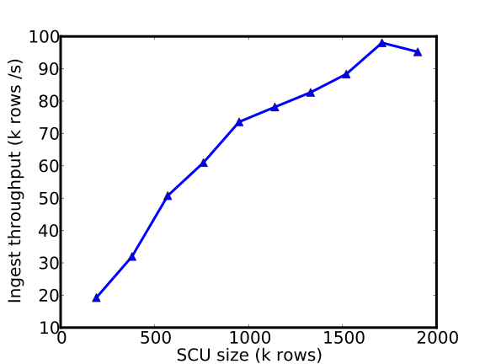
Batching for performance
Large batches of updates increase throughput
http://www.pdl.cmu.edu/

Slide 18
Problem with batching: latency
Batching trades update latency for throughput
  Large batches → database is very stale
  Very large batches/busy system → could be hours old
OK for some queries, bad for others
http://www.pdl.cmu.edu/

Slide 19
Put the “lazy” in LazyBase
As updates are processed through pipeline, they become progressively “easier” to query.
We can use this to trade query
latency for freshness.
http://www.pdl.cmu.edu/

Slide 20
Query freshness
Old authority
Client
Ingest
Sort
Merge
Authority
table
http://www.pdl.cmu.edu/

Slide 21
Query freshness
Old authority
Client
Ingest
Sort
Merge
Raw Input
Sorted
Authority
table
Slow, fresh Fast, stale
http://www.pdl.cmu.edu/

Slide 22
Query freshness
Quake!
Hot news!
Graph
analysis
Raw Input
Sorted
Authority
table
Slow, fresh Fast, stale
http://www.pdl.cmu.edu/

Slide 23
Query freshness
Quake!
Hot news!
Graph
analysis
Raw Input
Sorted
Authority
table
Slow, fresh Fast, stale
http://www.pdl.cmu.edu/

Slide 24
Query freshness
Quake!
Hot news!
Graph
analysis
Raw Input
Sorted
Authority
table
Slow, fresh Fast, stale
http://www.pdl.cmu.edu/

Slide 25
Query freshness
Quake!
Hot news!
Graph
analysis
Raw Input
Sorted
Authority
table
Slow, fresh Fast, stale
http://www.pdl.cmu.edu/

Slide 26
Query interface
User issues high-level queries
  Programatically or like a limited subset of SQL
  Specifies freshness
SELECT COUNT(*) FROM tweets
WHERE user = “jcipar”
FRESHNESS 30;
Client library handles all the “dirty work”
http://www.pdl.cmu.edu/

Slide 27
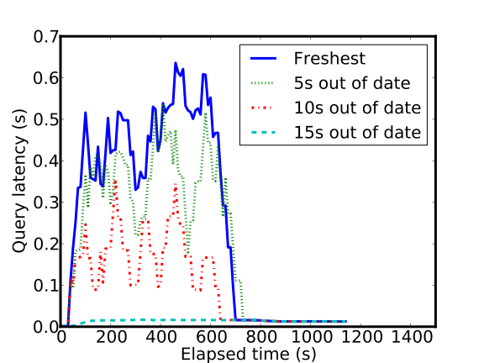
Query latency/freshness
Queries allowing staler results return faster
http://www.pdl.cmu.edu/

Slide 28
Experimental setup
Ran in virtual machines on OpenCirrus cluster
  6 dedicated cores, 12GB RAM, local storage
Data set was ~38 million tweets
  50 GB uncompressed
Compared to Cassandra
  Reputation as “write-optimized” NoSQL database
http://www.pdl.cmu.edu/

Slide 29
Performance & scalability
Large, rapidly changing data sets
  Update performance
Analytical queries
  Query performance, especially “big” queries
Must be fast and scalable
  Looking at clusters of 10s of servers
http://www.pdl.cmu.edu/

Slide 30
Ingest scalability experiment
Measured time to ingest entire data set
Uploaded in parallel from 20 servers
Varied number of worker processes
http://www.pdl.cmu.edu/

Slide 31
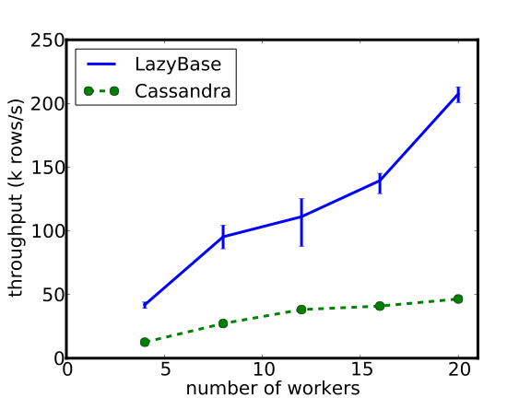
Ingest scalability results
LazyBase scales effectively up to 20 servers
Efficiency is ~4x better than Cassandra
http://www.pdl.cmu.edu/

Slide 32
Stale query experiments
Test performance of fastest queries
  Access only authority table
Two types of queries: point and range
  Point queries get single tweet by ID
  Range queries get list of valid tweet IDs in range
    Range size chosen to return ~0.1% of all IDs
Cassandra range queries used get_slice
  Actual range queries discouraged
http://www.pdl.cmu.edu/

Slide 33
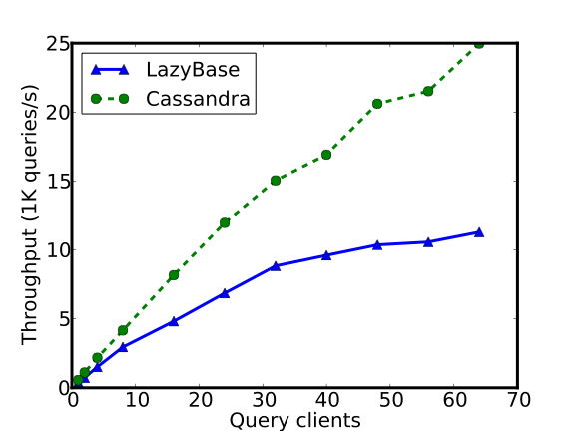
Point query throughput
Queries scale to multiple clients
Raw performance suffers due to on-disk format
http://www.pdl.cmu.edu/

Slide 34
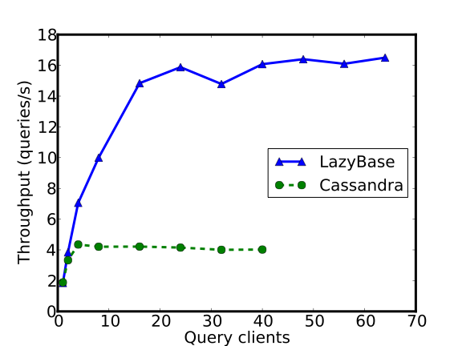
Range query throughput
Range query performance ~4x Cassandra
http://www.pdl.cmu.edu/

Slide 35
Consistency experiments
Workload
  Two rows, A and B.
  Each row has sequence number and timestamp
  Sequence of update pairs (increment A, dec. B)
  Goal: invariant of A+B = 0
  Background Twitter workload to keep servers busy
LazyBase
  Issue update pair, commit
Cassandra
  Use “batch update” call
  Quorum consistency model for reads and writes
http://www.pdl.cmu.edu/

Slide 36
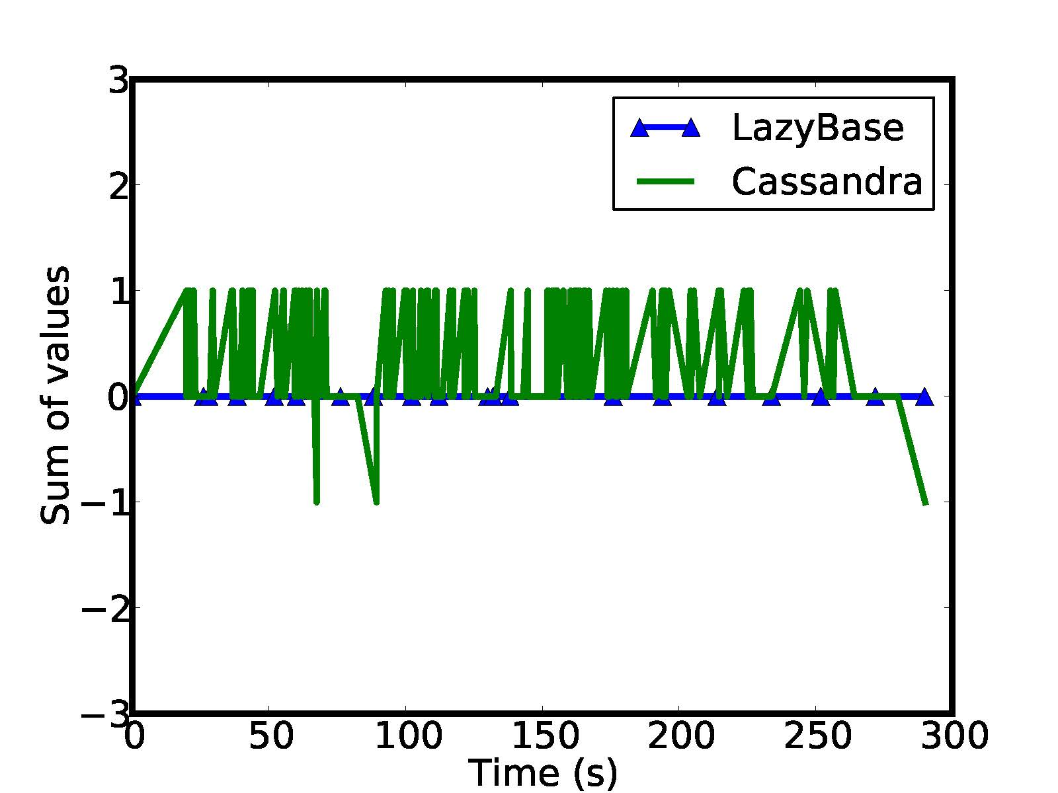
Sum = A+B
LazyBase maintains inter-row consistency
http://www.pdl.cmu.edu/

Slide 37
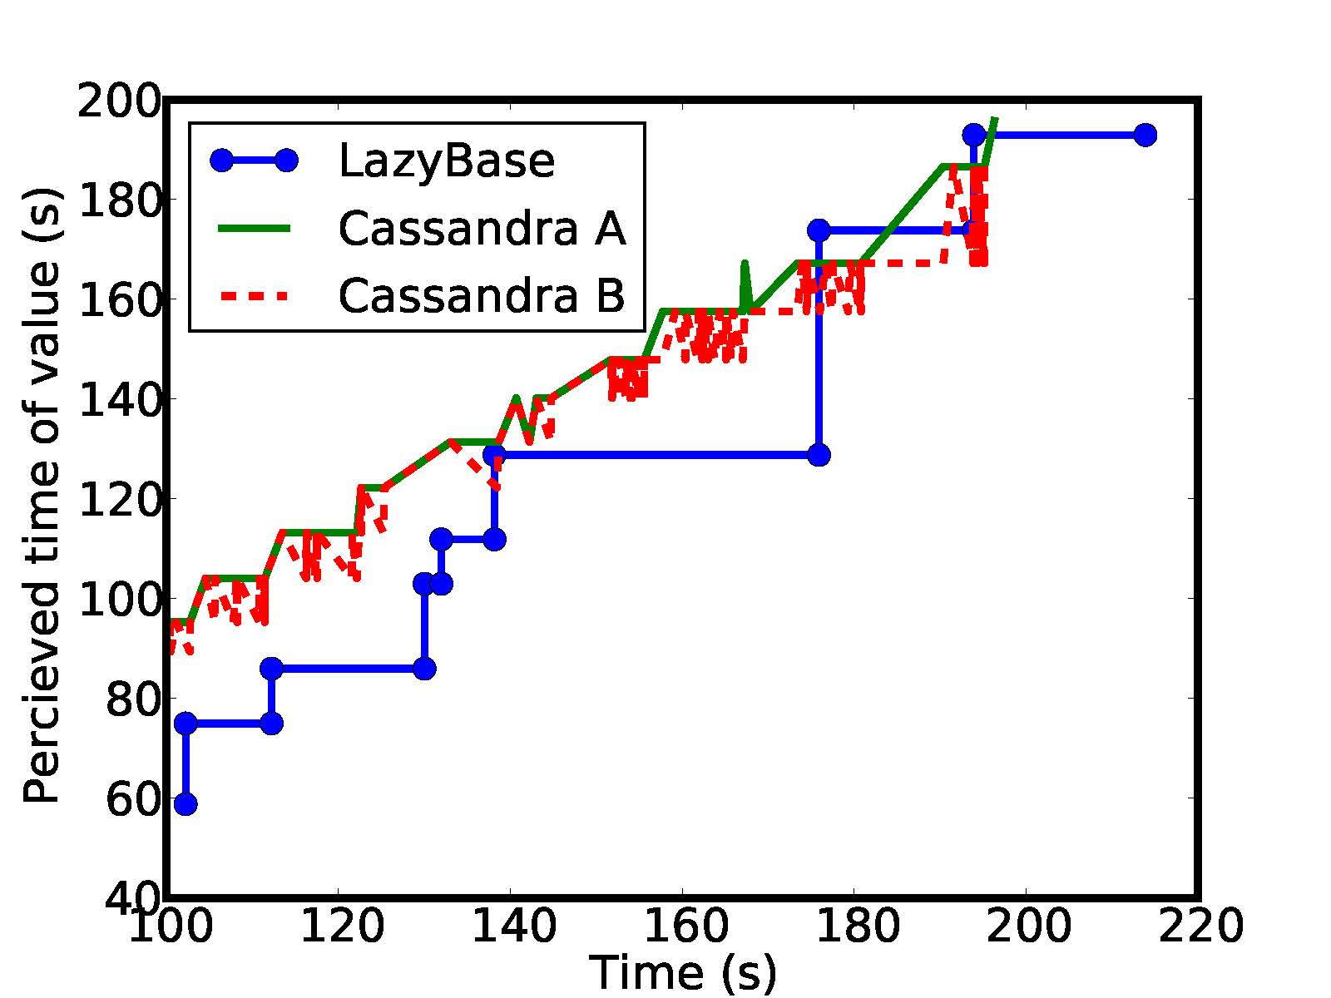
Freshness
LazyBase results may be stale,
timestamps are nondecreasing
http://www.pdl.cmu.edu/

Slide 38
Summary
Provide performance, consistency and freshness
  Batching improves update throughput, hurts latency
Separate ideas of consistency and freshness
  Tradeoff between freshness and latency
  Allow queries to access intermediate pipeline data
http://www.pdl.cmu.edu/

Slide 39
Future work
When freshness is a first-class consideration…
Consistency
  Something more specific than snapshot consistency?
  Eliminate the “aggregate everything first” bottleneck?
Ingest pipeline
  Can we prioritize stages to optimize for workload?
  Can we use temporary data for fault tolerance?
http://www.pdl.cmu.edu/

Slide 40
Parallel stages
Old Authority
Client
ID Remap
Ingest
Sort
Merge
Client
Merge
Ingest
ID Rewrite
Sort
Merge
Client
Merge
Ingest
ID Rewrite
Sort
Merge
Client
Merge
Merge
Raw Input
Sorted
Authority
http://www.pdl.cmu.edu/

Slide 41
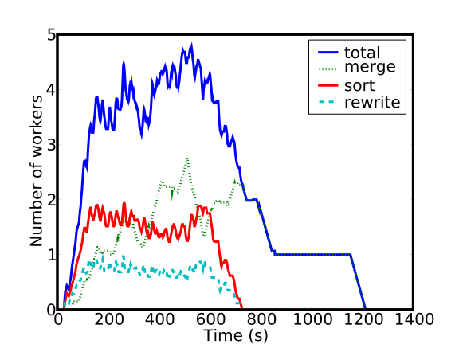
Dynamic pipeline allocation
Server’s roles reassigned as data moves through pipeline
http://www.pdl.cmu.edu/

Slide 42
Query library
Every query sees a consistent snapshot
  If SCU X is in results, so are SCUs 1…(X-1)
User specifies required freshness
  E.g. “All data from 15 seconds ago”
  LazyBase may provide fresher data if possible
May also specify “same freshness as other query”
  E.g. “All data up to SCU 500, and nothing newer”
  Allows multiple queries over same snapshot
http://www.pdl.cmu.edu/

Slide 43
Query overview
Find all SCUs that must be in query results
  Current time - freshness = time limit
  All SCUs uploaded before time limit are in results
  Newer SCUs may be in results
For relevant SCUs, find fastest file to query
  If merged, may include fresher SCUs than required
  Most SCUs can be read from authority file
  Some SCUs may have to be read from earlier stages
Query all relevant files, combine results
http://www.pdl.cmu.edu/

Slide 44
Query components
Client
  Gets plan from controller, sends request to agents
  Aggregates results
Controller
  Single controller for cluster
  Finds files relevant to query
Agents
  Run on all servers
  Read files, filter, send results to client
http://www.pdl.cmu.edu/

Slide 45
Query pictured
Client
Controller
Agents
Agents
Agents
Agents
http://www.pdl.cmu.edu/

Slide 46
Query pictured
1. Get query plan
Client
3. List of files to query
Controller
Agents
Agents
Agents
Agents
2. Find SCU files to match query
http://www.pdl.cmu.edu/

Slide 47
Query pictured
Client
4. Request data
6. Send results
Controller
Agents
Agents
Agents
Agents
5. Filter data
http://www.pdl.cmu.edu/

Slide 48
Query pictured
Client
7. Aggregate results
Controller
Agents
Agents
Agents
Agents
http://www.pdl.cmu.edu/

Slide 49
Query scalability
Query clients send parallel requests to agents
Agents perform filtering and projection locally
Query execution controlled by client
  Multiple processes can work on same query
http://www.pdl.cmu.edu/

