Slide 1
Solving the straggler problem with bounded staleness
Jim Cipar, Qirong Ho, Jin Kyu Kim, Seunghak Lee, Gregory R. Ganger, Garth Gibson,
Kimberly Keeton*, Eric Xing
PARALLEL DATA LABORATORY
Carnegie Mellon University
* HP Labs

Slide 2
Overview
It’s time for all applications (and systems) to worry about data freshness
Current focus: parallel machine learning
Often limited by synchronization overhead
What if we explicitly allow stale data?

Slide 3
A typical ML algorithm
Input data

Slide 4
A typical ML algorithm
(1) initialization
Input data
Intermediate
Program state

Slide 5
A typical ML algorithm
(1) initialization
Input data
Intermediate
Program state
(2) Iterate, many
small updates

Slide 6
A typical ML algorithm
(1) initialization
Input data
Intermediate
Program state
Output results
(3) Output results
after many iterations
(2) Iterate, many
small updates

Slide 7
A typical ML algorithm
(1) initialization
Input data
Intermediate
Program state
Output results
(3) Output results
after many iterations
(2) Iterate, many
small updates

Slide 8
Parallel ML
Generally follows bulk synchronous parallel model
Many iterations of
Computation: compute new values
Synchronization: wait for all other threads
Communication: send new values to other threads
Synchronization: wait for all other threads… again

Slide 9
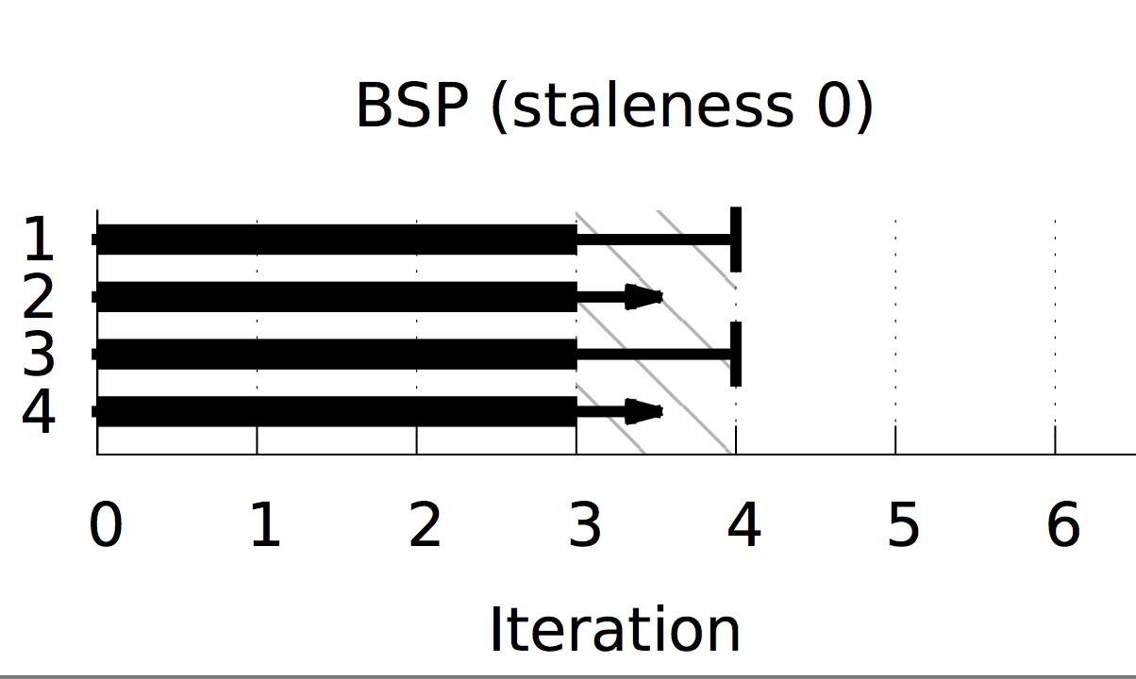
BSP Visualized
Thread
All threads must be on the same
iteration to continue

Slide 10
Stragglers in BSP
Slow thread(s) will hold up entire application
Predictable stragglers
Slow/old machine
Bad network card
More data assigned to some threds

Slide 11
Stragglers in BSP
Slow thread(s) will hold up entire application
Predictable stragglers➔ Easy case
Slow/old machine
Bad network card
More data assigned to some threads

Slide 12
Stragglers in BSP
Slow thread(s) will hold up entire application
Predictable stragglers➔ Easy case
Unpredictable stragglers ➔ ???

Slide 13
Stragglers in BSP
Slow thread(s) will hold up entire application
Predictable stragglers➔ Easy case
Unpredictable stragglers ➔ ???
Hardware: disk seeks, network, CPU interrupts
Software: garbage collection, virtualization
Algorithmic: Calculating objectives and stopping conditions

Slide 14
Stragglers in BSP
Slow thread(s) will hold up entire application
Predictable stragglers➔ Easy case
Unpredictable stragglers ➔ ???
Hardware: disk seeks, network latency, CPU interrupts
Software: garbage collection, virtualization
Algorithmic: Calculating objectives, stopping conditions
Don’t synchronize

Slide 15
Don’t synchronize?
Well, don’t synchronize much
Read old (stale) results from other threads
Application controls how stale the data can be
Machine learning can get away with that
Algorithms are convergent
Given (almost) any state, will find correct solution
Errors introduced by staleness are usually ok

Slide 16
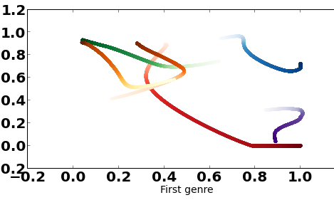
Trajectories of points in 2d
Points are initialized randomly,
Always settle to correct locations

Slide 17
Freshness and convergence: the sweet spot
Fresh
reads/writes
Stale
reads/writes

Slide 18
Freshness and convergence: the sweet spot
Iterations
per second
Fresh
reads/writes
Stale
reads/writes

Slide 19
Freshness and convergence: the sweet spot
Improvement
per iteration
Iterations
per second
Fresh
reads/writes
Stale
reads/writes

Slide 20
Freshness and convergence: the sweet spot
Improvement
per iteration
Iterations
per second
Improvement
per second
Fresh
reads/writes
Stale
reads/writes

Slide 21
Freshness and convergence: the sweet spot
The sweet spot
Iterations
per second
Improvement
per second
Fresh
reads/writes
Stale
reads/writes

Slide 22
Stale synchronous parallel
Allow threads to continue ahead of others
Avoids temporary straggler effects
Application can limit allowed staleness
Ensure convergence
E.g. “threads may not be more than 3 iters ahead”

Slide 23
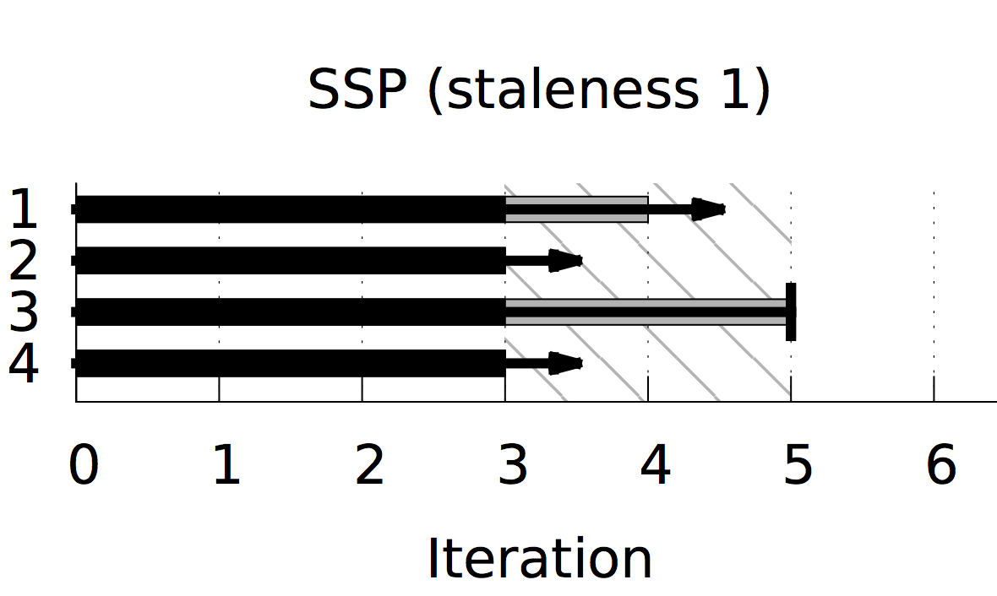
SSP Visualized
Thread
Threads proceed, possibly
using stale data

Slide 24
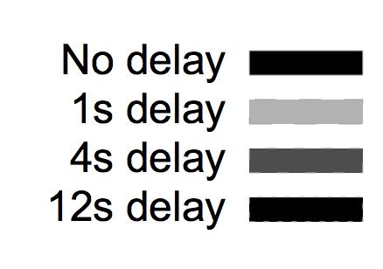
Total convergence time
I
Increased staleness can mask the effects of occasional delays

Slide 25
Ongoing work
Characterizing “staleness-tolerant” algorithms
Properties of algorithms, rules of thumb
Convergence proof
Automatically tune freshness requirement
Specify freshness by error bounds
“Read X with no more than 5% error”

Slide 26
Summary
Introducing staleness, but not too much staleness, can improve performance of machine learning algorithms.

