Slide 1
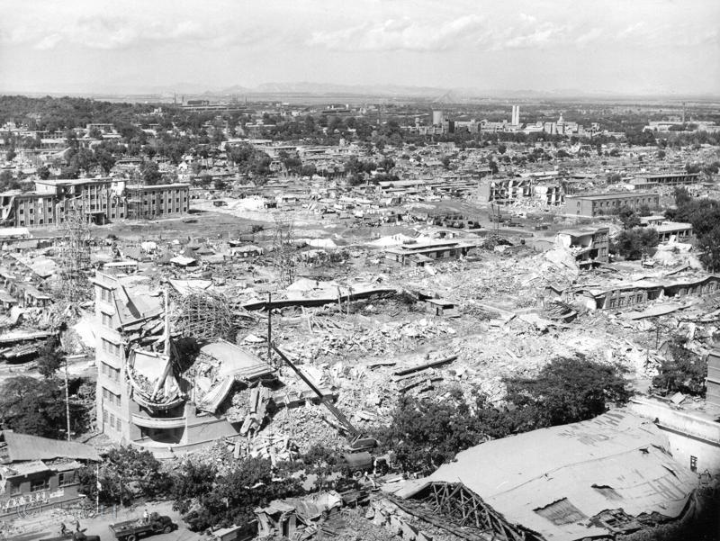
The 1976 Tangshan Earthquake
Samantha Day
Tania Menendez
Joshua Jolley
Kody Crocket
Adele Palmer
Jayton Palmer

Slide 2
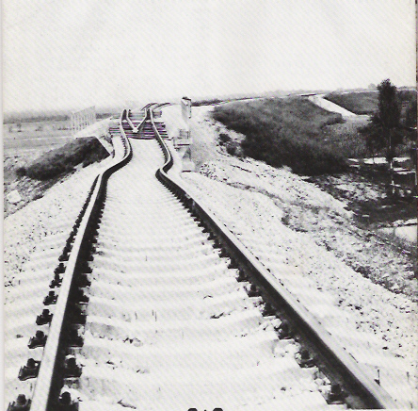
Background
China is native to earthquakes of variable magnitudes and sizes, however few come close to the tragedy that has since been known as the 1976 Tangshan Earthquake. On July 27, 1976 a devastating earthquake with a magnitude of 7.5 caused mass destruction in Tangshan, China. Not only was the actual first earthquake crippling to this area southeast of Beijing, but within a matter of hours the aftershock occurred, only to further the damage.
Though it seems obvious the two quakes reeked havoc on the landscape and city, flattening buildings, homes and liquefying railways to bend completely out of shape, the death toll alone reached far too great heights, not to mention just those were injured exceeding far beyond that.
SAMANTHA DAY

Slide 3
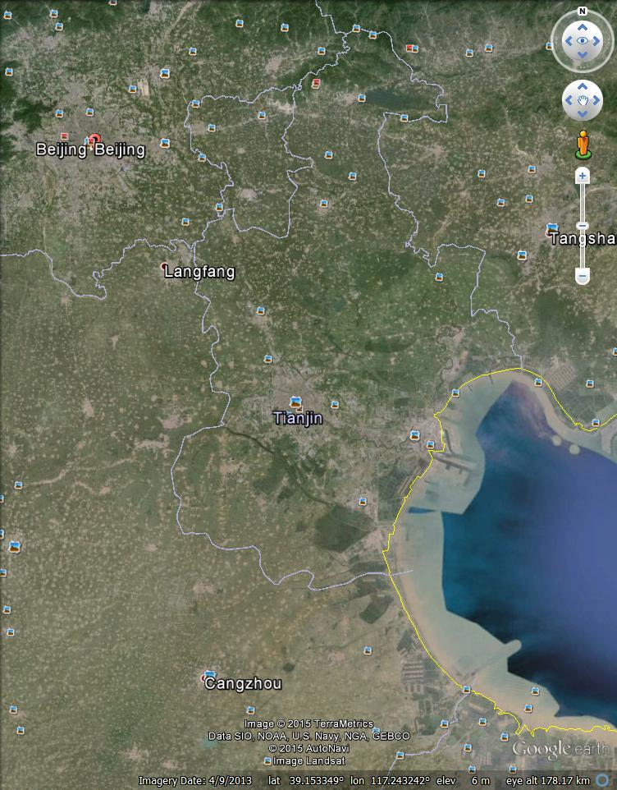
Intro/Background
Google Earth Map

Slide 4
Tangshan Earthquake Measurements
The Tangshan earthquake of 1976 was one of the largest earthquakes of that time. It measured at a magnitude of 7.8.
It had a focal depth of 15 kilometers, and an epicentral intensity of XI on the New Chinese Seismic Intensity Scale.
Tania Menendez

Slide 5
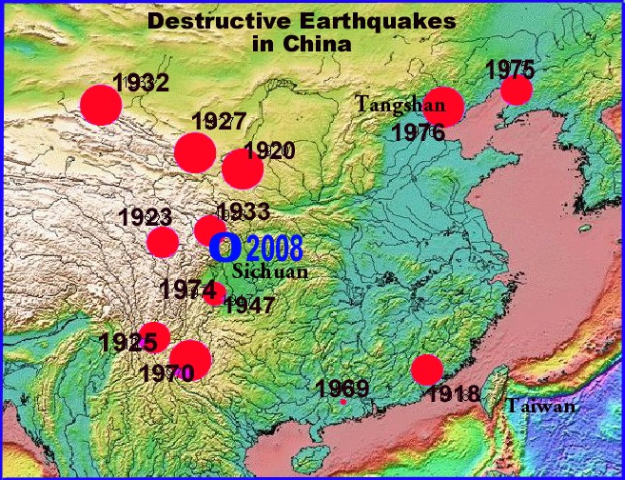
There were multiple warning signs, including fish jumping out of aquarium, earthquake predictions from the State Seismological Bureau, and water levels rising in wells.
It was only a matter of seconds after lightning flashed across the sky and the Earth rumbled that Tangshan was destroyed.
The earthquake was “intraplate” which means it was not located on a plate boundary.
It was located on the Tangshag-Lujiang fault. The Amurian Plate sliding along the Eurasian plate ruptured the fault and caused the earthquake.
Tania Menendez

Slide 6
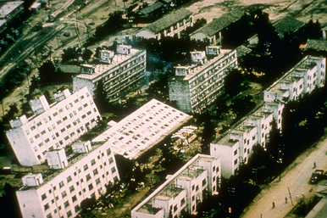
Processes that produced the Tangshan earthquake
High tectonic activity in northern China is very common. Northern China has experienced many powerful earthquakes over time. This high seismic activity began in 1815 and still continues today.
Maximum Intensity on Mercalli Scale: Surrouding region encountered VIII (severe). In the city of Tangshan they suffered X (extreme).
The Tangshan fault is a strike-slip fault.
A similar type of earthquake actually occurred about 800 miles away in Shaanxi, China. The structure of the buildings were also not able to withstand the high magnitude of 8.0.
The reason why both of these earthquakes were so deadly is because there was no warning, and the lack of structure strength.
Tania Menendez

Slide 7
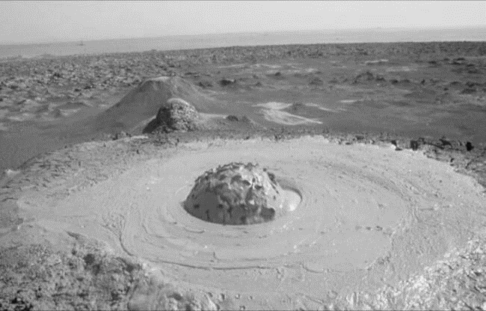
Effects of the Disaster - X Area
370-km^2 X Intensity – leveled 80% of all dwellings [1]
Half of the industrial buildings in this area were destroyed [1]
The earthquake created fountains and mud volcanoes [1]
Irrigation wells failed [1]
Figure 1
Joshua Jolly

Slide 8
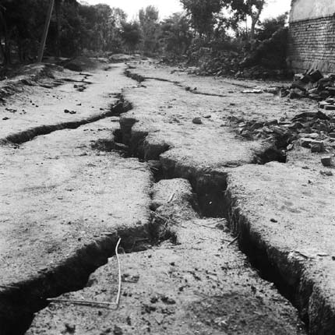
Effects of the Disaster - IX Area
1800-km^2 IX Intensity – destroyed 40% of all dwellings [1]
Half of the industrial buildings in this area were destroyed [1]
Up to 3 diameter mud volcanoes sprayed sand on farm land[1]
Sagging and fissuring of the ground surface [1]
Figure 2
Joshua Jolly

Slide 9
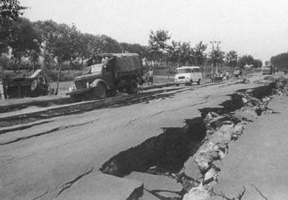
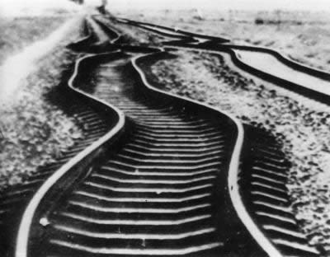
Effects of the Disaster
Transportation infrastructure destroyed [2]
Roads destroyed
Bridges collapsed
Railroad lines bent
Figure 3
Figure 4
Joshua Jolly

Slide 10
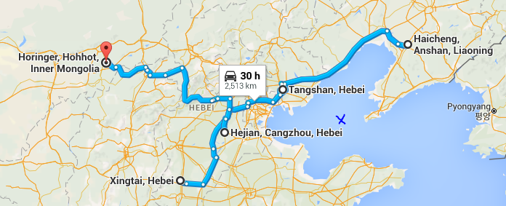
Previous Events in the Region
1966 Xingtai earthquake
1967 Hejian earthquake
1969 Bohai earthquake
1975 Haicheng earthquake
1976 Horinger earthquake
Bohai Sea
Figure 5
Joshua Jolly

Slide 11
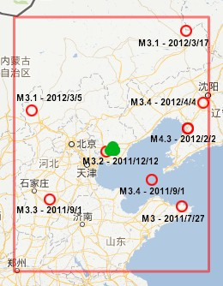
Outlook for Future Events
2012 Tangshan Earthquake 4.8 [3]
2015 Inner Mogila Earthquake – 5.8
Asia has one of the highest levels of seismicity on the planet [4]
As of 2009, China has 2574 earthquake monitoring stations to help measure and predict seismic activity [4]
Joshua Jolly
Figure 6

Slide 12
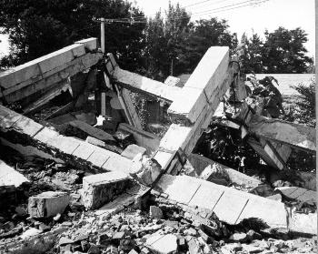
Significant Factors
Poor ground condition (sandy or puddly soil) contributed to the hardest hit regions [1]
In Tianjin, alluvial deposits and the high water table contributed to severity of the destruction. [1]
Poor construction quality [1]
Earlier earthquake threw off scientists predictions [1]
Joshua Jolly
Figure 7

Slide 13
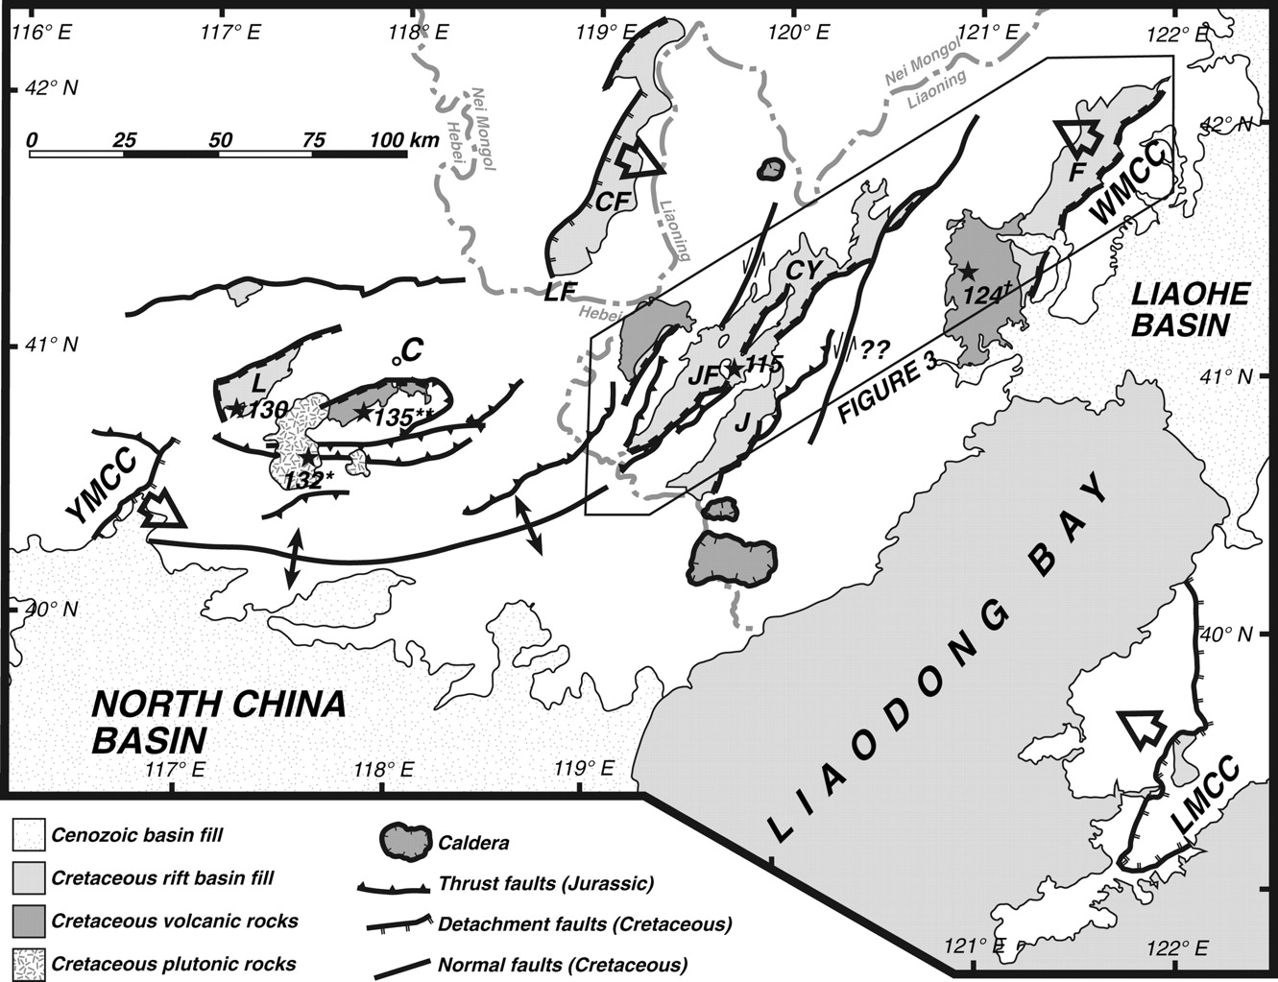
Interesting Details
Yan Shan belt anomalies
Less frequent small earthquakes [1]
Regular distribution of the first motion [1]
Formation of seismic gap [1]
P and S wave velocity ration getting closer to 1 [1]
Decrease in b-value [1]
Southern piedmont raised between 1970 – 1975
Figure 8
Joshua Jolly

Slide 14
Interesting Details
Odd things happened before the earthquake
Well water rose and fell 3 times the day before quake. [1]
Gas spouted out of a well weeks before the earthquake [1]
Animals acted strange before the strike [1]
Goldfish repeatedly jumped out of bowl
Chickens wouldn’t eat
Mice and weasels ran about looking for hiding places
Lights and Fireballs in the sky [1]
Roaring noises louder than an airplane [1]
Joshua Jolly

Slide 15
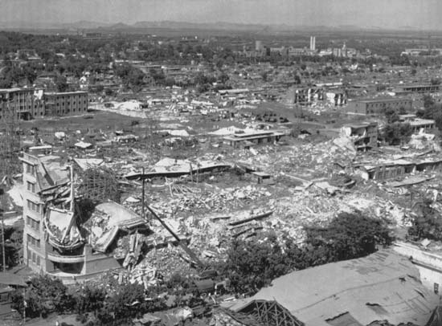
Economic Impacts
93% of residential buildings and 78% of residential buildings in Tangshan were destroyed. [2]
80% of water pumping stations were seriously damaged [2]
10 billion yuan in estimated damages. [3] That’s roughly $1.6 billion dollars
The earthquake leveled entire cities. [4]
Figure 10
Joshua Jolly

Slide 16
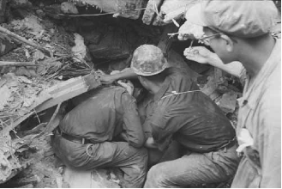
Casualty Statistics
Greatest death toll from an earthquake in the last 400 years. [1]
Second greatest death toll from an earthquake in recorded history. [1]
Official: 240,000 people killed. [1]
Unofficial estimates at 655,000 people killed. [1] Some estimates as high as one million. [4]
Over 799,000 injured [1]
In 7,218 households, all members of the family were killed [1]
Figure 11
Joshua Jolly

Slide 17
Historical Impacts–What was learned?
After the Tangshan Earthquake people from all over China were able to unite in an effort to rebuild creating unity in the community.
Building structures were the main things that people needed to change. Trying to make them more structurally sound and made of lighter material.
People were very apprehensive to rebuild and move into multiple story buildings.
“Most of the shelters have roofs consisting of nothing more than tar paper held down by bricks, because residents still don't dare to put anything heavier above their heads.”—The Earshawn Vault, Remembering the Tangshan earthquake of 1976 by Jeremy Goldkorn; May 13, 2008
Adele Palmer

Slide 18
Interesting Facts–Giving Warning
In the days and hours leading up to the Earthquake, many people made accounts of strange events involving animals and things occurring in the sky.
Animals
Over 1,000 chickens were reported to be seen refusing to eat and running around chirping– Out of character
Mice and weasels were seen running around looking for places to hide more than usual.
One gold fish owner witnessed their goldfish repeatedly jumping out of its bowl in the hours leading up to the earthquake.
Firballs
Multiple people saw flashes of light they descreibes as fireballs across the sky accompanied by loud noises.
Adele Palmer

Slide 19
Eyewitness
Journalists were not permitted to visit the site for 7 long years. When they were let in they saw the wreckage and the rest of the world was more fully aware of the extent of the damage.
Mr. Yao Guangqing was a city official that gave this account while he was heavily involved with reconstruction and recounted the following:
"That night, I couldn't sleep, and I lay in bed, just dozing. suddenly I was woken by a bright flash in the sky and the room was brilliantly lit as if by lightning. there was a roaring sound like a very big wind except that the air was still, and intermittent sounds of explosions. Then a great shaking motion began, up and down. I was shocked awake by the light, shook my wife awake and spent a long time looking for my slippers. it is my custom to put my slippers on when I get out of bed. By the time i reached the door, the up-and-down rolling motion had begun, and the building was rocking so much, i couldn't get the door open. I went back and clung to the bed. Outside the window, the trees were swinging back and forwards crazily. When the rolling motion finished less than a minute later, I opened the door and ran into the courtyard and found that all the buildings around had collapsed."
Jayton Birch

Slide 20
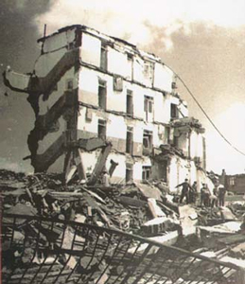
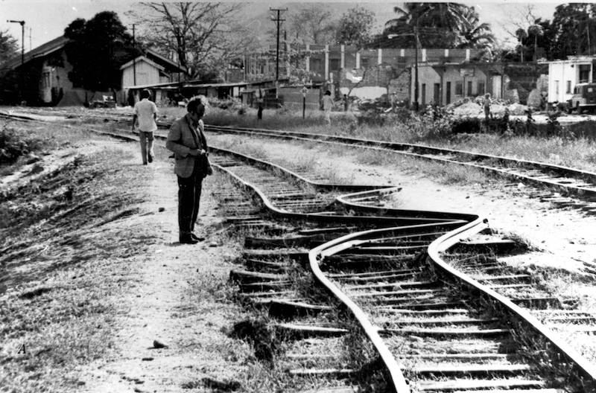
Conclusion
Magnitude 7.5
Devastating damage to buildings and infrastructure that required years of reconstruction
Death toll around 655,000
Jayton Birch

Slide 21
References
Fang, W. (1979). Historic Earthquakes: The 1976 Tangshan Earthquake. Retrieved October 5, 2015.
Fletcher, D. (2010, January 13). Top 10 Deadliest Earthquakes. Retrieved October 5, 2015.
The 1976 Tangshan Earthquake by Wang Fang; State Seismological Bureau of China
Tangshan: The Deadliest Earthquake by JenniferRosenburg
Tangshan earthquake survivors in terror or new quake
“Tangshan earthquake survivors in terror of new quake” November 2, 1983 By Graham Earnshaw in Tangshan http://www.danwei.org/the_earnshaw_vault/remembering_the_tangshan_earth.php
http://www.air-worldwide.com/_public/NewsData/000994/tangshan_hotel_eq.jpg
[1] Wang ,F., (unknown) . The 1976 Tangshan Earthquake. Retrieved from https://app.box.com/embed/preview/ryxink1a4rxj437pq0ngxefo4388bf82?theme=dark
[2] Rosenburg, J., (unkown) . Tangshan: The Deadliest Earthquake. Retrieved from https://app.box.com/embed/preview/ryxink1a4rxj437pq0ngxefo4388bf82?theme=dark
[3] Vervaeck, A. (May 31, 2012). Moderate earthquake near Tangshan, China reminds the 1976 disaster (also felt in Beijing today) Retrieved from http://earthquake-report.com/2012/05/28/moderate-earthquake-near-tangshan-china-reminds-the-1976-disaster-also-felt-in-beijing-today/
[4] International Workshop on Earthquake Risk Reduction in Northeast Asia Region, (April 2010) . REDUCTION OF EARTHQUAKE LOSSES IN THE NORTHEAST ASIA REGION – RELNAR - Retrieved from http://www.preventionweb.net/files/13898_187891e1.pdf
Figure 1 - http://en.citizendaily.net/wp-content/uploads/2015/07/mud-volcano-azerbaijan-4.jpg Figure 2 - http://www.chinadaily.com.cn/china/2006-07/26/xin_2707032610054542336414.jpg
Figure 3 - http://lishi.huisongshu.com/img/uploak/7/11937.jpg
Figure 4 -http://www.chinadaily.com.cn/china/images/attachement/jpg/site1/20080616/0013729e4abe09c04af203.jpg
Figure 5-https://www.google.com/maps/dir/Xingtai,+Hebei,+China/Tangshan,+Hebei,+China/Haicheng,+Anshan,+Liaoning,+China/Hejian,+Cangzhou,+Hebei,+China/Horinger,+Hohhot,+Inner+Mongolia,+China/
Figure 6 – http://earthquake-report.com/wp-content/uploads/2012/05/cn-28052012-2.jpg
Figure 7 - http://earthquake.usgs.gov/earthquakes/world/events/images/1976_07_27_545.jpg
Figure 8 - http://sp.lyellcollection.org/content/280/1/201/F2.large.jpg
Jayton Birch

Slide 22
References cont.
Figure 10 - http://media-1.web.britannica.com/eb-media/06/118106-004-E088594E.jpg
Figure 11- http://3.bp.blogspot.com/_fZjDYaU39Vs/R1K6MyLXgGI/AAAAAAAAAA0/UoDABqRcJNo/s1600-R/e6.png
[1] Unknown. (Unknown). Historic Earthquakes Tarshan,China. Retrieved from https://app.box.com/embed/preview/ryxink1a4rxj437pq0ngxefo4388bf82?theme=dark
[2] [1] Wang ,F., (unknown) . The 1976 Tangshan Earthquake. Retrieved from https://app.box.com/embed/preview/ryxink1a4rxj437pq0ngxefo4388bf82?theme=dark
[3] Stoltman, Joseph P. Lidstone, John. Dechano, M. Lisa. [2004] (2004). International Perspectives On Natural Disasters. Springer publishing. ISBN 1-4020-2850-4
[4] Ricks, R. (10/1/2015). Put into your own words and insert it in the. Retrieved from https://byui.brainhoney.com/Frame/Component/CoursePlayer?enrollmentid=34478216
Jayton Birch

