Slide 1

Emacs got you
feeling down?
Notes:
R:Computer science classes are difficult as they are. Why add the learning curve of an non intuitive editor?
J: Would you like to use a more traditional GUI editor? How about never having to log in to the Linux lab to edit a file again?
R: We’re going to go over setting up SFTP in Sublime Text to make this easier.

Slide 2
SFTP in Sublime Text 3
Justin Ricks, Joshua Jolley
Notes:
Introduce ourselves

Slide 3



1.
Forecast
What to expect
Install Packages
Configure
Verify Results
Notes:
J: There are a number of things we won’t cover, including:
Installing Sublime
Setting up RSA keys for SSH
R: There are things you’re expected to know already
Copy and pasting
Logging in to the Linux Lab
Creating directories on your computer or the linux lab

Slide 4
Map
Install Packages
Get package control
Paste into console
Restart Sublime
Get SFTP package
Configure
Create necessary directories
Edit the configuration file
Save a file
Verify Results
Log on to a Linux Lab computer
Compare files
Notes:
Talk about scope: What we will include
Installing the packages you need for SFTP
Configuring those packages so that you can save locally and it will automagically save remotely
How to verify that you’ve correctly configured everything

Slide 5
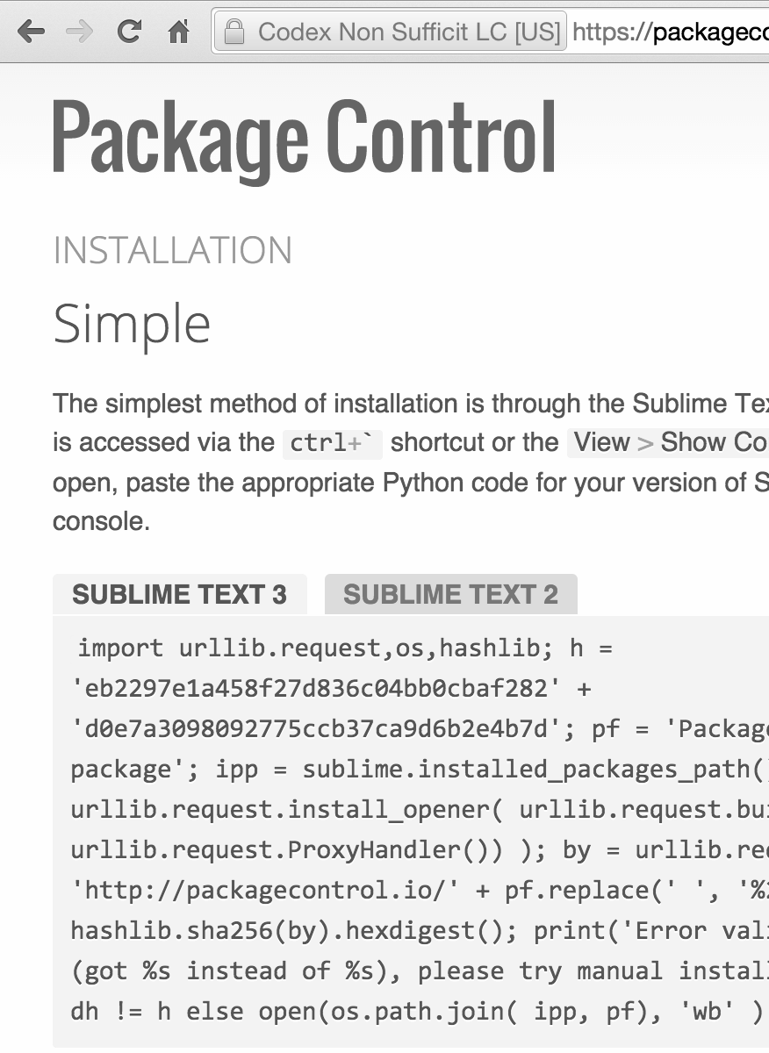
Copy this Python script
Visit https://packagecontrol.io/installation
Be sure to select Sublime Text 3!
Install Packages | Configure | Verify Results
Get package control | Paste into console | Get SFTP package
Notes:
J: Go to this website and copy the script
R: Make sure you select Sublime Text 3

Slide 6
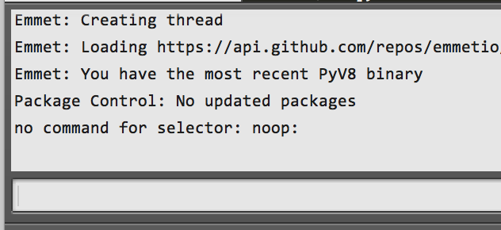
Paste into Sublime console
Open Console
Paste
Return
Restart Sublime
Install Packages | Configure | Verify Results
Get package control | Paste into console | Get SFTP package
Notes:
View > Show Console to open the console
Paste into the bottom bar and hit enter

Slide 7
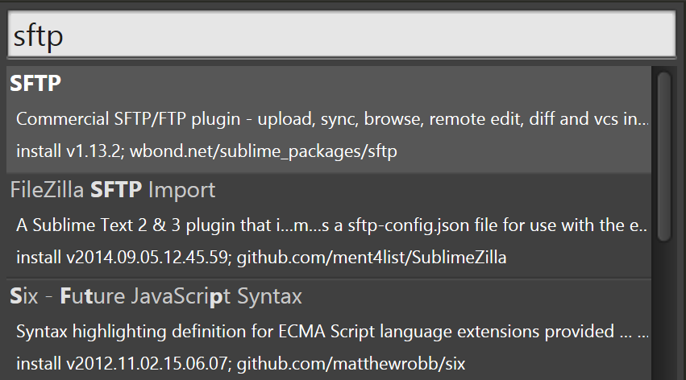
Install SFTP Package
Type “Install Package” in the Command Pallette
Type “sftp” in the dialog that opens
Install Packages | Configure | Verify Results
Get package control | Paste into console | Get SFTP package
Notes:
Open the Command Pallette
Tools > Command Pallette to open the Command Pallette
Type “Install Package”
Type “SFTP”

Slide 8

Create Directories
Install Packages | Configure | Verify Results
Create directories | Edit configuration file | Save a file
Notes:
J: Create a directory on your local machine. After everything is configured, when you save a file in this directory it will automagically be put on the linux lab.
Log into the linux lab
R: Create a directory on the linux lab. After everything is configured, this is where the files will be stored when you save them locally.
J: Make a note with the absolute paths of these directories, you’ll use them later.

Slide 9
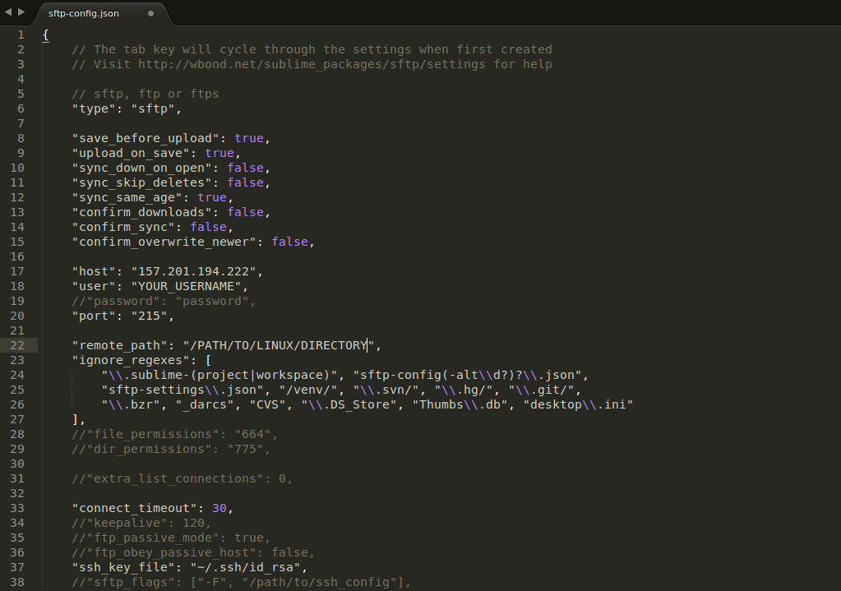
Your config file
Should look like this
Notes:
Get this file later if you’d like. You must replace some things from this file

Slide 10

Create a File
Install Packages | Configure | Verify Results
Create directories | Edit configuration file | Save a file
Notes:
Go to file > new file to create a new file
CTRL + s to save (or command + s on a Mac)

Slide 11


Log on to a Linux lab Computer
Install Packages | Configure | Verify Results
Login to the Linux Lab | Compare Files
Notes:
Log on to the linux lab.

Slide 12
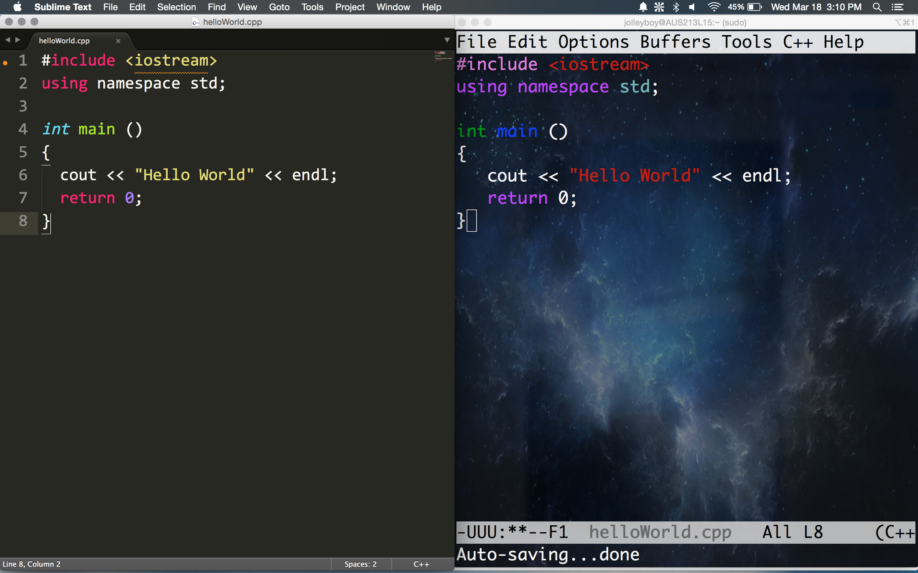
Compare files
Install Packages | Configure | Verify Results
Login to the Linux Lab | Compare Files
Notes:
They’re the same!
If not, you have a(nother) problem.

Slide 13

Notes:
Recap:
Installed package control and SFTP
Configured Sublime Text
Verified results

Slide 14
Credits
Special thanks to all the people who made and released these awesome resources for free:
Minicons by Webalys
Presentation template by SlidesCarnival
Photographs by Unsplash
http://www.chimpytech.com/wp-content/uploads/2014/03/computer-frustration.jpg
http://www.graphicsfuel.com/wp-content/uploads/2012/03/folder-icon-512x512.png
https://cdn2.iconfinder.com/data/icons/windows-8-metro-style/512/wifi.png
http://www.unclaimedmoney.com/news/wp-content/uploads/2012/07/find-unclaimed-property-and-money-with-the-Pensylvania-treasury.jpg

