Slide 1
What happens when you fail to meet audience expectations?
Perceived as
Arrogant
Self-centered
Uncaring
Poorly prepared
You fail
Notes:
Audience includes readers and listeners

Slide 2
Audience Analysis
taken from
Zwickel, S.B. and Pfeiffer, W.S.
Pocket Guide to Technical Presentations & Professional Speaking
Pearson Prentice Hall, Upper Saddle River, NJ, 2006
Notes:
Note what I have done: the title slide is not the first slide

Slide 3
Readers
Technical documents are not read
For pleasure
From cover to cover
Notes:
This is review

Slide 4
Readers and Listeners
Readers and listeners
Will interpret your communication based on their background
Want “need to know” information
Are impatient
Less is more
Notes:
Less is more: four 5-minute speakers or one 20-minute speaker in Sacrament Meeting

Slide 5
Readers and Listeners
May not share your
Knowledge
Concerns
Values
Fascination with the topic
Communicate with their needs in mind
Notes:
Communicate with their needs in mind: priesthood blessing analogy

Slide 6
Interests
Organization
Help the work organization do better
Personal
Performance appraisal
Promotion
Increased income
Relate to an interest to gain interest

Slide 7
Values and Attitudes
Don’t invite the audience to fight you
Biases and prejudices
Controversies (religious wars)
Superlatives

Slide 8
Values and Attitudes
Audience will filter your material
Hear what they want to hear
See what they want to see

Slide 9
Limitations
What are you asking the audience to do?
Something easy?
Change in behavior?

Slide 10
Limitations in Presentations
BABE
Brain can Absorb only what the Backside can Endure
Timing
First thing in the morning
Just before lunch
After lunch
Last item of the day

Slide 11
Things to Consider
Technical level
Background material
Vocabulary
Educational background
Advanced degree != advanced understanding of topic

Slide 12
Things to Consider
Cultural background
Use of jargon, slang
Presentations: your accent
Notes:
All of us have an accent

Slide 13
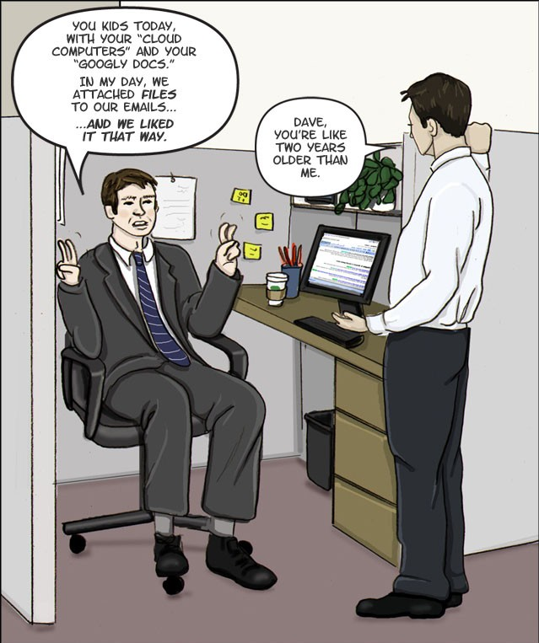
Things to Consider
Generational differences

Slide 14
Regardless
Keep it simple!
But not too simple
Keep it short!
But not too short
Presentations
Finish on time or a little early
But not too early
Notes:
Length of articles in the Ensign
In this class, if given 5 minutes
No less than 4 minutes
No more than 5 minutes

Slide 15
Regardless
Do not exceed the maximum
Length
Time
Overtime is the unforgivable sin
“There is no forgiveness in this world nor in the world to come”
Notes:
I’ve stopped listening. Why haven’t you stopped talking?
D&C 76:34

Slide 16
Types in the Audience
Decision makers
Managers
Experts
Advisors
Influence decisions
Implementers
Ones who will do it
Notes:
Need to modify approach depending on which type you are appealing to

Slide 17
Audience
Lacks your technical knowledge
Vulnerable to distractions
External
Internal

Slide 18
Audience
Impatient with material that is
Hard to follow
Monotonous (dull)
Too long

Slide 19
A Cautionary Tale
Poor audience analysis
or
an “unnatural” presentation?
Presenters trying to be something they weren’t

Slide 20
A few years ago two engineering students asked one of the authors for help in presenting a design project to the judges in a national competition. We worked over their material so that they had a dynamic, interactive, exciting presentation that we were sure would persuade the judges to them a high score. When they returned from the competition, they were crestfallen. They had come in twelfth out of fourteen entries. We sat down and did a post-mortem, discovering that the audience analysis was faulty. They had described the judges as being middle-aged men who are interested in science and technology, which we had interpreted to mean that they were "guys like us." When the students described the winning presentation, we realized that this analysis was all wrong. The judges were accustomed to having presenters stand behind a lectern, reading their papers aloud, word for word, without visual aids and without any kind of interactivity. The winning team gave them what they expected, while the enthusiastic, energetic team came in far behind.

Slide 21
A few years ago two engineering students asked one of the authors for help in presenting a design project to the judges in a national competition. We worked over their material so that they had a dynamic, interactive, exciting presentation that we were sure would persuade the judges to them a high score. When they returned from the competition, they were crestfallen. They had come in twelfth out of fourteen entries. We sat down and did a post-mortem, discovering that the audience analysis was faulty. They had described the judges as being middle-aged men who are interested in science and technology, which we had interpreted to mean that they were "guys like us." When the students described the winning presentation, we realized that this analysis was all wrong. The judges were accustomed to having presenters stand behind a lectern, reading their papers aloud, word for word, without visual aids and without any kind of interactivity. The winning team gave them what they expected, while the enthusiastic, energetic team came in far behind.

Slide 22
Enthusiasm and energy
Trivialize the
Topic?
Presenters?
Make the presenters appear less knowledgeable?

Slide 23
Credibility
First impression is critical
Language
Avoid distractions
Age bias
Establish credentials without establishing arrogance

Slide 24
Credibility
Presentation appearance
Dress and grooming
Ethics
Don’t mislead

