Slide 1
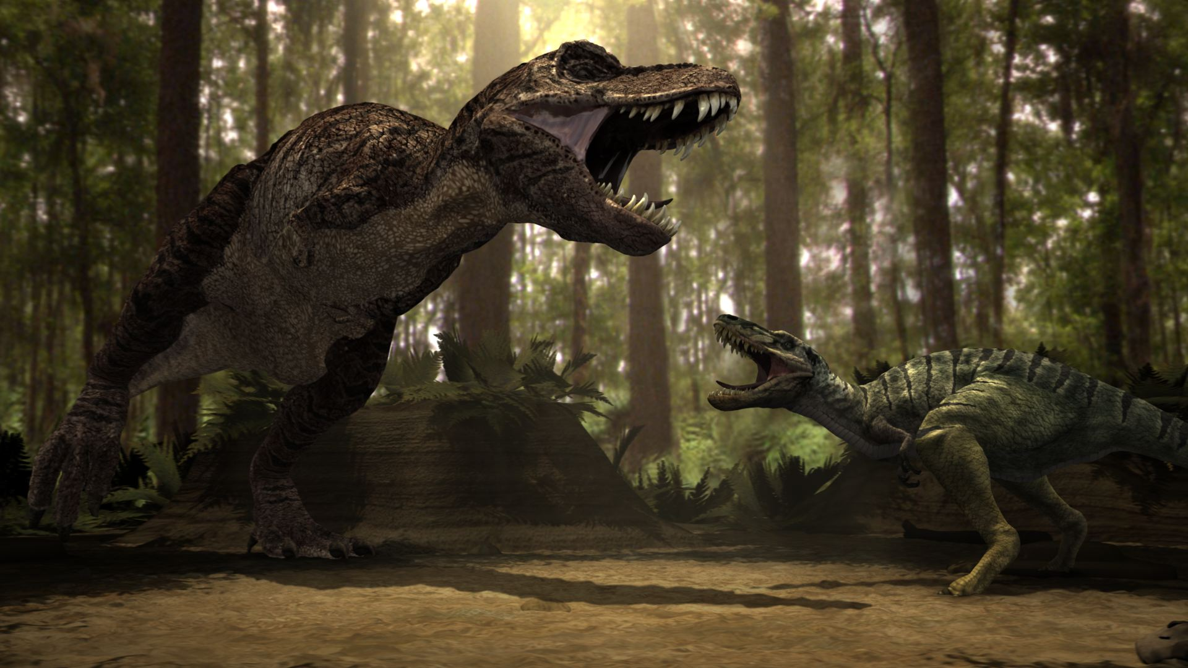
Notes:
http://www.popstarsplus.com/images/dinosaursfightingpicture.jpg

Slide 2
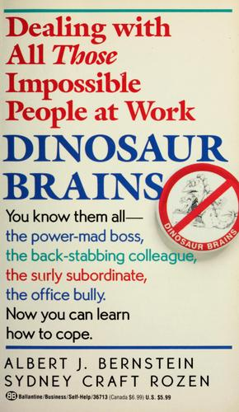
Dinosaur Brains
Albert J. Bernstein and Sydney Craft Rozen
Dinosaur Brains: Dealing with All Those Impossible People at Work
1989

Slide 3
Purpose
Recognize your situation
Recognize the situation of others
Take the appropriate action
Notes:
In all of this
You cannot control others
You can only control your response to others
There are difficult people in the work place

Slide 4
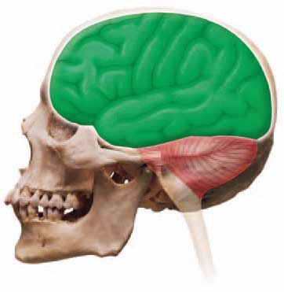
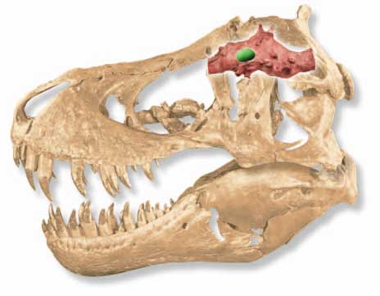
Two Parts
Cortex
Logical
Rational
Dinosaur Brain
Unconscious decisions
Instinctive reactions
Highly emotional
Sometimes defies logic
Notes:
Unconscious decisions are the Reptile Response based on Lizard Logic
Sometimes defies logic (seems logical at the time)
http://www.clipart.dk.co.uk/DKImages/exp_dinosaur/image_exp_dino086.jpg
http://www.clipart.dk.co.uk/DKImages/exp_dinosaur/image_exp_dino085.jpg

Slide 5
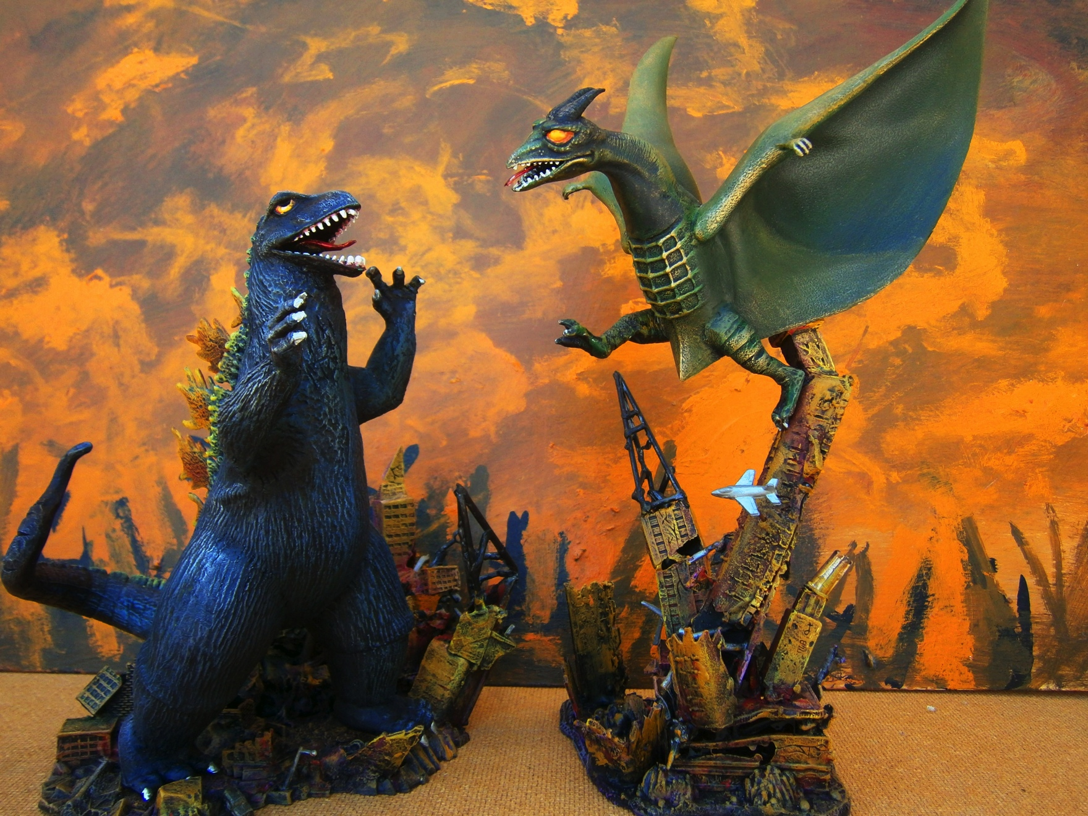
Godzilla meets Rodan
Notes:
Two people in Dinosaur Brain mode: Godzilla meets Rodan
Great deal of sound and fury, buildings shake
But very little gets accomplished

Slide 6
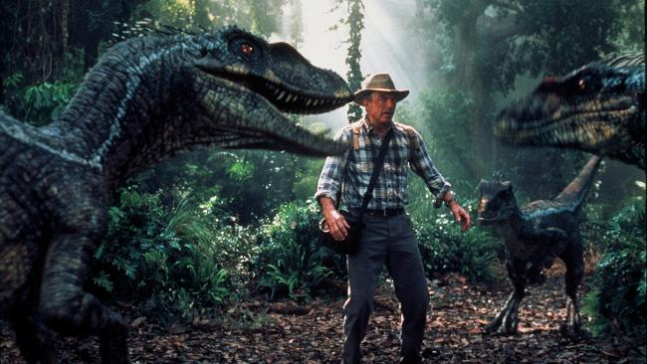
Goal
Keep the cortex in charge over the Dinosaur Brain
Notes:
Learn to recognize when you are in Dinosaur Brain mode
http://resources1.news.com.au/images/2010/07/31/1225899/500653-jurassic-park.jpg

Slide 7
Lizard Logic
Get it now!
Fight, flight, or fright
Be dominant!
Defend the territory!
Get the mate!
If it hurts, hiss!
Like me, good. Not like me, bad.

Slide 8
Lizard Logic
Get it now!
Fight, flight, or fright
Be dominant!
Defend the territory!
Get the mate!
If it hurts, hiss!
Like me, good. Not like me, bad.

Slide 9
Get It Now!
Instant gratification isn’t fast enough
Can’t wait – must be immediate
Short-term with high emotional involvement
Put out brushfires over long-term planning
Impulsive
Notes:
Push through a crowd – what you are doing is more important
Sounds like an expressive

Slide 10
Lizard Logic
Get it now!
Fight, flight, or fright
Be dominant!
Defend the territory!
Get the mate!
If it hurts, hiss!
Like me, good. Not like me, bad.

Slide 11
Fight, Flight, or Fright
Response to a threat
Fight
Flight – run
Fright – freeze

Slide 12
Fight
Competitive
Better right than happy
No tolerance for impediments
Overly sensitive to perceived threats
Everything is personal
There is always a winner and a loser
Notes:
Drivers ???

Slide 13
Flight
Avoidance
Procrastination
Forgetting
Running away
Being sick
Indecisiveness
Notes:
Analytical ???

Slide 14
Flight – Avoidance Techniques
Everything else takes priority over the difficult and challenging [whatever]
Impossible to act because everything is under somebody else’s control

Slide 15
Fright
Send your mind out of the room while you remain, trembling
Results in immobilization and overload

Slide 16
Lizard Logic
Get it now!
Fight, flight, or fright
Be dominant!
Defend the territory!
Get the mate!
If it hurts, hiss!
Like me, good. Not like me, bad.

Slide 17
Be Dominant!
Only one pecking order
Only one rule: “the strong survive”
Every conflict is a struggle for power
Not only run the show, but own the show
If you act dominant, you will be seen as dominant
Notes:
Only one pecking order: be tough, competitive, and aggressive to move up
Every conflict is a struggle for power – no area is too small
If you act dominant . . .
Power walk
Power talk
Power lunches (next slide)

Slide 18
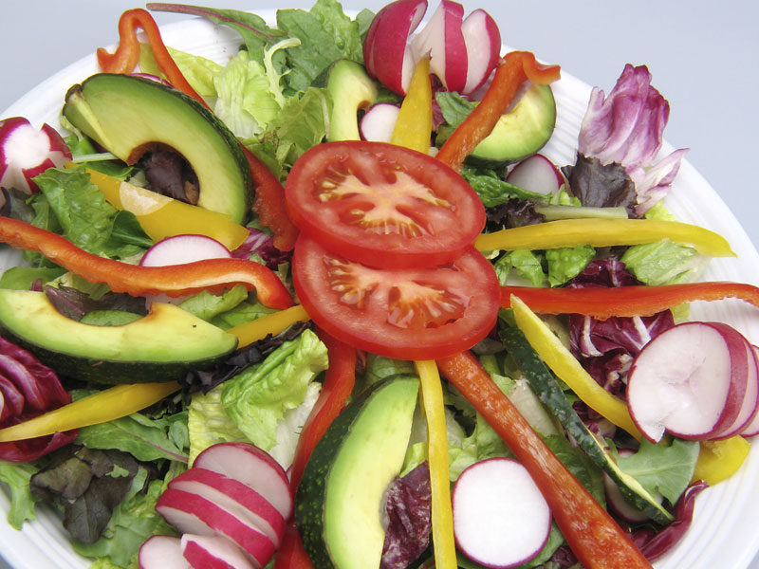
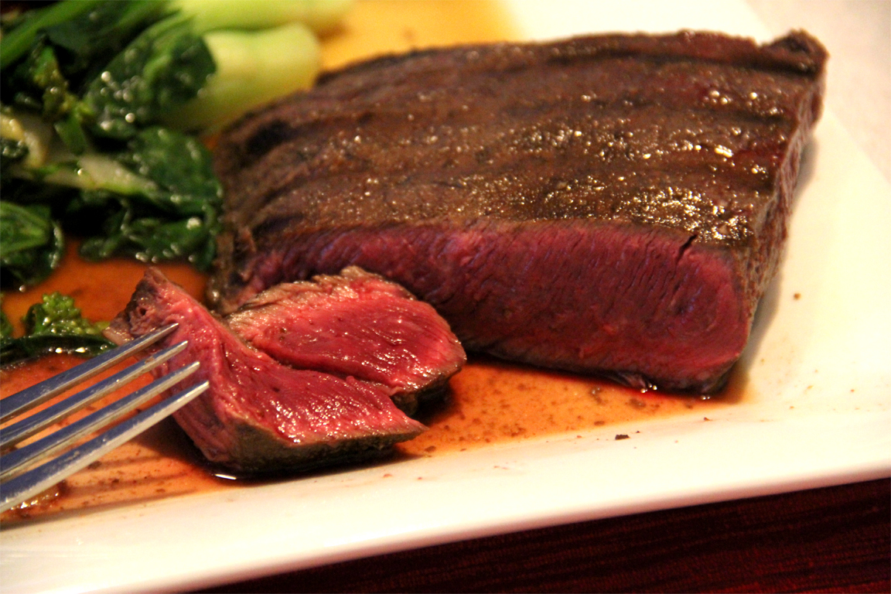
Act Dominant!
Notes:
Power lunch
Power stance / position (take as much space as possible)
Power ties (next slide)
http://pujawellness.com/wp-content/uploads/2013/07/salad3.jpg
http://3.bp.blogspot.com/-WEvPlc_PAGc/Tc21coCrvVI/AAAAAAAAA68/tFo4mOYr2Tg/s1600/051011FlatIronSteakRareBokChoy1.jpg

Slide 19

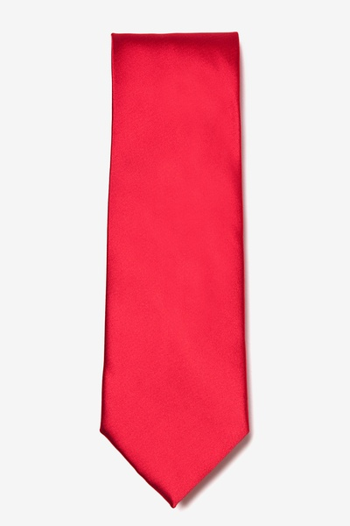
Act Dominant
Notes:
Power tie
McKinney example –
Some function above the rules
http://p.cdn.ties.com/black-microfiber-power-on-button-tie-229727-505-600-0.jpg
http://p.cdn.ties.com/tomato-polyester-tomato-tie-233618-505-600-0.jpg

Slide 20
Lizard Logic
Get it now!
Fight, flight, or fright
Be dominant!
Defend the territory!
Get the mate!
If it hurts, hiss!
Like me, good. Not like me, bad.

Slide 21
Defend the Territory!
Agitation
Names and titles
Intrusion on your territory
Invasion of personal space
Size matters
More powerful in own territory
Notes:
Agitation –
Someone sits in your seat in class
“That’s my chair! He has no right to do that.”
“Don’t be silly. It’s just a chair.”
Names and titles –
Consider how you feel when someone gets it wrong
SENATOR Barbara Boxer and the general
Compare with how President Monson introduces himself as “Brother Monson”
Intrusion on your territory feels like an attack
Invasion of personal space is a problem
Stand too close
Touch (too much)
Means of control by keeping you off balance
Size – office, desk, chair, etc. establishes territory
More powerful in own territory than the person who has to come to your

Slide 22
Defend the Territory!
Looks silly (from outside)
Delegation becomes difficult
Empire building
Notes:
From the outside, it looks silly
When it is really anything but silly (to the participants)
Delegation becomes difficult – giving up territory

Slide 23
Dealing with Territoriality
Stop, back up, and leave the territory
Communicate from the border
Validate the lizard’s position as owner of the territory
Don’t laugh
Notes:
Don’t lose track of your goal
Do what you need to do to get the job done (while maintaining integrity)

Slide 24
Lizard Logic
Get it now!
Fight, flight, or fright
Be dominant!
Defend the territory!
Get the mate!
If it hurts, hiss!
Like me, good. Not like me, bad.

Slide 25
Get the Mate!
Office romances
Lovesick lizards
Can be either gender approaching either gender
Are blind
Think they are outside the rules of professional behavior
Notes:
Sexual harassment

Slide 26
Reasons for Discussing This
You may do it
Recognize the situation
If not married, think carefully
If married, repent!
You may be subjected to it
Recognize the situation
Quickly quash it

Slide 27
Stages
I see
I want
I get
I got
I go / I stay
Notes:
Stage one: I see
Observation
Banter
Display
Stage two: I want
Separating from the herd
Fantasy (fantasizing)
Arranging meetings at work
Confiding
Calling the person at home (“business” reasons)
Giving gifts
Touching
Stage three: I get
Becoming overtly sexual
Overt possessiveness
The emotional issue
Stage four: I got
The relationship has become sexual
Territory (the other person is located closer)
On and off
Stage five: I go / I stay
Reality intrudes
Married lovers

Slide 28
Termination
Image assessment
Straight arrow
Don’t do it again!
Notes:
Straight arrow & don’t do it again – repent!!!

Slide 29
Lizard Logic
Get it now!
Fight, flight, or fright
Be dominant!
Defend the territory!
Get the mate!
If it hurts, hiss!
Like me, good. Not like me, bad.

Slide 30
If It Hurts, Hiss!
No virtue in suffering in silence
Blaming
Telling about it

Slide 31
Blaming
Not trial and error
Trial and success
Trial and punishment
When decision goes awry, focus on people rather than on decision itself
Notes:
He failed – he ought to be fired!

Slide 32
Blaming
Goal shifts from succeeding to figuring out who to blame upon failure
Blame protects the ego – you become the victim
Notes:
EG&G – determine who to blame before project starts

Slide 33
Telling About It
Tell everyone you can
Including yourself
Over and over again
Gossip in “support” groups
Complain but don’t do anything
Notes:
Tell yourself over and over again – can become an obsession
Gossip in “support” groups – distorted view of reality

Slide 34
Lizard Logic
Get it now!
Fight, flight, or fright
Be dominant!
Defend the territory!
Get the mate!
If it hurts, hiss!
Like me, good. Not like me, bad.

Slide 35
Like Me, Good. Not Like Me, Bad.
Two groups of people
Good (like me)
Evil (not like me)
Basis for
Discrimination
Prejudice
Racism
Example: other majors
Example: “stupid users”
Notes:
Two groups of people – read first two paragraphs from page 79
How many of you belong to the first group? the second group?
Distortion of reality
No facts
Vague adjectives
Strong moral connotations

Slide 36
Like Me, Good. Not Like Me, Bad.
Two ways to do things
My way
Wrong way
Tendency to ignore facts

Slide 37
May Show Up As
Personality clash
Workaholic ethic
Notes:
Personality clash (don’t take sides)
Workaholic ethic (and perfectionism, too)

Slide 38
Lizard Logic
Get it now!
Fight, flight, or fright
Be dominant!
Defend the territory!
Get the mate!
If it hurts, hiss!
Like me, good. Not like me, bad.
Notes:
The end of this section

Slide 39
Avoiding the Reptile Response
The victor is
not the person who yells the loudest
but the one who stays the coolest.
The way to win an argument at work is to avoid the Reptile Response pattern.

Slide 40
Avoiding the Reptile Response
Ask for time to stop and think.
Listen to your heart, literally.
Hold your immediate response.
Ask yourself, “What do I want to happen?”

Slide 41
Avoiding the Reptile Response
If the other person is yelling, don't do anything until you get him or her to stop.
Speak softly
Slow down
Remember that explaining your point of view will not help.
Let the other person know you hear.
Ask, “What would you like me to do?”

Slide 42
Avoiding the Reptile Response
State what you want.
Negotiate.
Get verbal acknowledgement of what you both have agreed to do.
Let the other person have the last word, if at all possible.

