Slide 1

Good, Better, Best
Notes:
Discuss this visual – does the graphic help?
Slides to follow are good, better, and best

Slide 2
iOS vs. Android
App launch crashes are annoying
Crittercism: more crashes with Apple iOS
Notes:
Good – lacks anything to grab audience attention

Slide 3

iOS vs. Android
App launch crashes are annoying
Crittercism: more crashes with Apple iOS
Notes:
Better – audience attention, but graphic doesn’t help explain

Slide 4
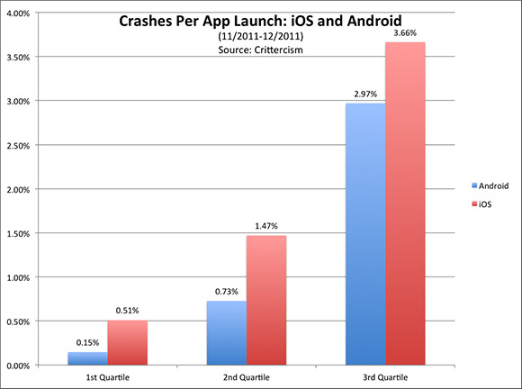
iOS vs. Android
Notes:
best

Slide 5
Graphics Guidelines
taken from
Technical Communication Today
by Richard Johnson-Sheehan

Slide 6
What is a Graphic?
Notes:
Image, figure, table, chart, etc.

Slide 7
A Graphic Should …
Tell a simple story
High cohesion
Less is generally more
Reinforce the written text, not replace it
Be ethical
Be labeled and placed properly

Slide 8
Graphics Guidelines
taken from
Technical Communication: A Practical Approach
by Pfeiffer and Adkins

Slide 9
Font Guidelines
Consider the reader’s or company’s preferences
Consider the need for clarity
Consider the space available
Consider the purpose of the document
Consider the tone you want to convey
Notes:
Goudy Old Style

Slide 10
Century Gothic
Consider the reader’s or company’s preferences
Consider the need for clarity
Consider the space available
Consider the purpose of the document
Consider the tone you want to convey

Slide 11
Handwriting – Dakota
Consider the reader’s or company’s preferences
Consider the need for clarity
Consider the space available
Consider the purpose of the document
Consider the tone you want to convey

Slide 12
Copperplate Gothic Light
Consider the reader’s or company’s preferences
Consider the need for clarity
Consider the space available
Consider the purpose of the document
Consider the tone you want to convey

Slide 13
Braggadocio
Consider the reader’s or company’s preferences
Consider the need for clarity
Consider the space available
Consider the purpose of the document
Consider the tone you want to convey

Slide 14
Graphics Guidelines
Determine the need for a graphic
Evaluate the accuracy and validity of the data
Refer to all graphics in the text
Think about where to put graphics
Position graphics vertically when possible
Avoid clutter
Provide titles, notes, keys, and source data

Slide 15
Graphics Guidelines
taken from
Pocket Guide to Technical Presentations and Professional Speaking
by Zwickel and Pfeiffer

Slide 16
Guidelines for Numbers
Clearly identify quantities, percentages, percentiles, and averages (mean and median)
Don’t write dates with slashes
Is 4/6/1830 April 6 or June 4?
April 6, 1830 or 6 April 1830
Define symbols, terms and variables
Limit repeating elements (e.g., MB)

Slide 17
Tables, Graphs, and Charts
Label with a unique identifier (e.g., Figure 2)
Provide a legend
Use plenty of white space
Use high contrast

Slide 18
Tables, Graphs, and Charts
Color issues
Print without color
10% of men are color blind
Use distinguishable patterns
Notes:
Note: I don’t use color!

Slide 19
Tables, Graphs, and Charts
Avoid deception
Be clear on scale
Don’t misrepresent trends
Compare kumquats to kumquats
Don’t mix scales
Notes:
Scale: log scales, “all values in thousands of pennies”

Slide 20
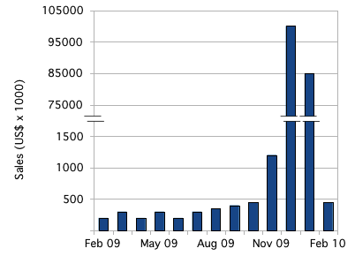
Deception: Break in Scale
http://tomhopper.files.wordpress.com/2010/08/bar-chart-natural-axis-split1.png

Slide 21
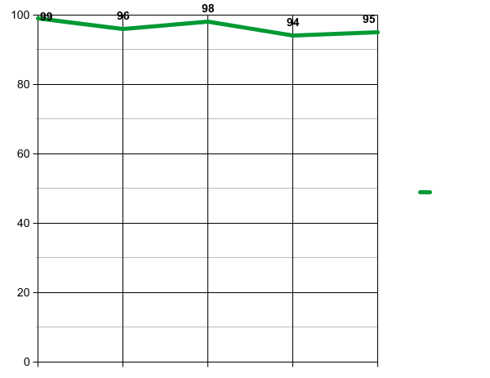
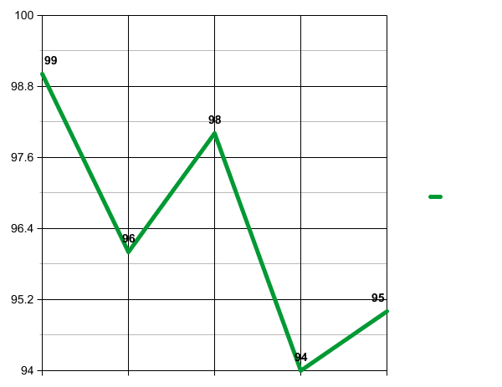
Deception: Graph Range

Slide 22
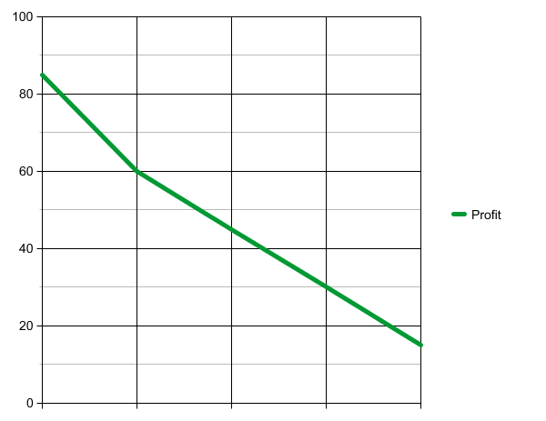
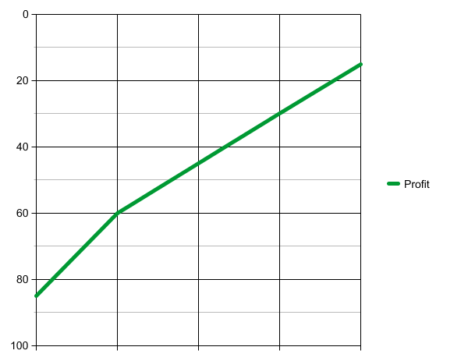
Deception: Misleading Trend

Slide 23
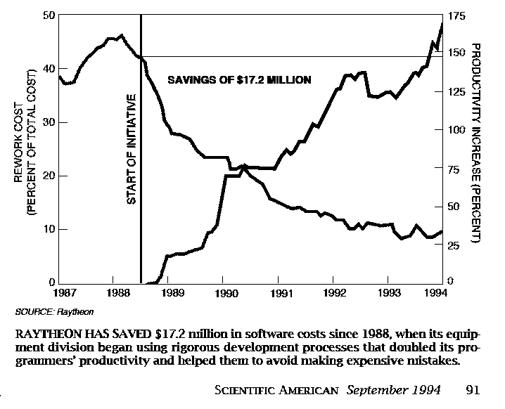
Black and White

Slide 24
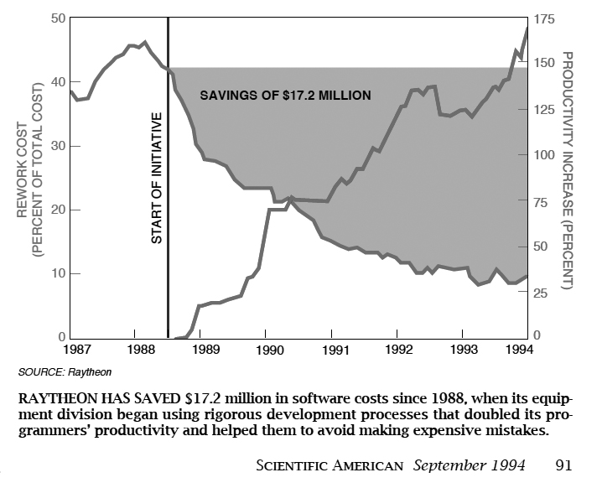
Gray

Slide 25
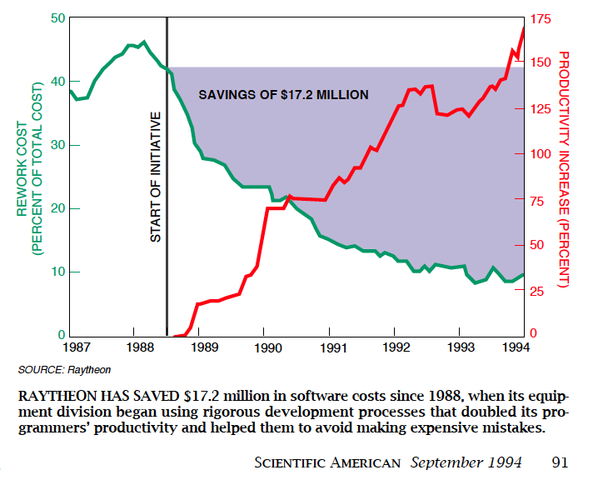
Original Color

Slide 26
Tables, Graphs, and Charts
Keep it simple
Avoid 3D
Avoid clutter
Eliminate unnecessary detail
Cite the source

Slide 27
Line Charts
Time: x-axis, left to right
Generally, start at zero (both axes)
Vertical-to-horizontal ratio: 3 to 4 is common
Grid lines: less “ink” is better
Avoid too many lines
Beware of color

Slide 28
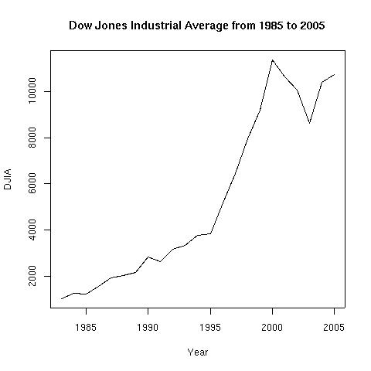
Which Type of Graphic is Appropriate?
I want to show a trend.

Slide 29
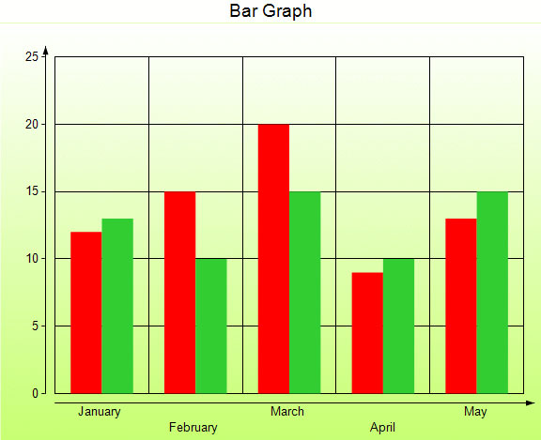
Which Type of Graphic is Appropriate?
I want to compare two or more quantities.

Slide 30
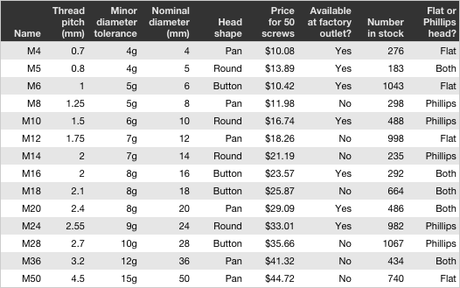
Which Type of Graphic is Appropriate?
I need to present data or facts for analysis and comparison.

Slide 31
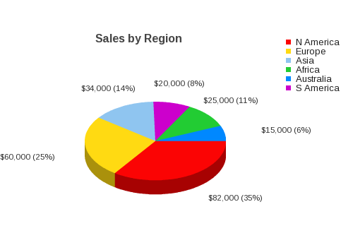
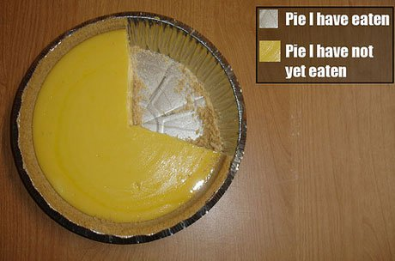
Which Type of Graphic is Appropriate?
I need to show how a whole is divided into parts.
Notes:
Pie pie chart
http://losthunderlads.files.wordpress.com/2008/10/pie-chart.jpg

Slide 32
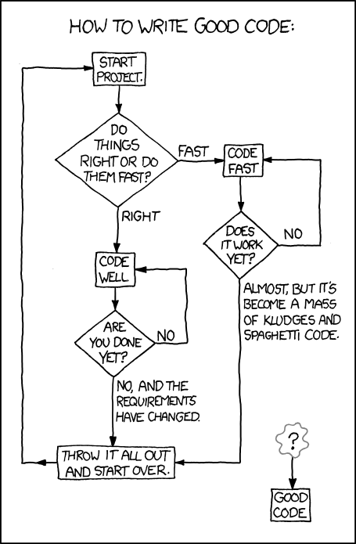
Which Type of Graphic is Appropriate?
I need to show how things, people, or steps are linked together.

