Slide 1

“… the kind of answers you get to your technical questions depends as much on the way you ask the questions as on the difficulty of developing the answer.”
– Eric Steven Raymond
Notes:
Eric Steven Raymond – author of The Cathedral & the Bazaar and The Art of UNIX Programming
Also co-author of Learning GNU Emacs

Slide 2
Internet Forums
Including Etiquette
Notes:
Main source: cplusplus.com forum
Abridged version of the work of Eric Steven Raymond by “Grey Wolf”
Original at http://www.catb.org/esr/faqs/smart-questions.html

Slide 3

How do I find a forum?
Notes:
Demonstrate: Google search on ________ forums

Slide 4
How do I know which one to interact with?
Read posts
Read responses
Do I want to be part of this?
Notes:
Usually need to register as a user

Slide 5
Before You Ask
Try to find an answer by
Searching the forum archives
Searching the Web
Reading the manual
Reading a FAQ
Inspection or experimentation
Asking a skilled friend
Notes:
http://www.cplusplus.com/forum/articles/1295/

Slide 6
Before You Ask
Read the rules of the forum
Abide by them
Notes:
http://www.n-etiquette.com/forum.htm
http://forum-services-review.toptenreviews.com/25-forum-posting-etiquette-tips.html

Slide 7
Before You Ask
Prepare your question
Notes:
Think it through
Hasty questions get hasty answers (or none at all)
http://www.cplusplus.com/forum/articles/1295/

Slide 8
Before You Ask
Remember privacy
Protect intellectual property
Notes:
Privacy: your privacy, your company’s privacy, privacy of other contributors
Don’t post content that violates copyright
http://forum-services-review.toptenreviews.com/25-forum-posting-etiquette-tips.html

Slide 9
When You Ask
Choose forum carefully
On topic
Appropriate level
Do not post the same question on several forums
Notes:
On topic – if not, probably ignored (or worse)
Appropriate level – elementary question where advanced questions are expected
http://www.cplusplus.com/forum/articles/1295/

Slide 10
When You Ask
Use meaningful, specific subject headers
Notes:
http://www.cplusplus.com/forum/articles/1295/

Slide 11
When You Ask
Be patient
Avoid “urgent” in subject line
Notes:
Patient – it’s a free service!
http://forum-services-review.toptenreviews.com/25-forum-posting-etiquette-tips.html

Slide 12
When You Ask
Presentation matters
Clear language
Correct grammar
Correct spelling
NOT ALL CAPS
Notes:
Must be precise
This isn’t a text message or IM
http://www.cplusplus.com/forum/articles/1295/

Slide 13
When You Ask
Precise and informative
Describe
Problem symptoms carefully, clearly
Environment (machine, OS, application)
Your research
Your diagnostic steps
Notes:
http://www.cplusplus.com/forum/articles/1295/

Slide 14
When You Ask
Anticipate questions
Answer them in advance
Notes:
http://www.cplusplus.com/forum/articles/1295/

Slide 15
When You Ask
Volume is not precision
Simplified question more likely to be answered
Simplified question more likely to get a useful answer
While simplifying, you may solve the problem
Notes:
Volume: data (or code) dump does not help
http://www.cplusplus.com/forum/articles/1295/

Slide 16
When You Ask
Describe symptoms
Not guesses
If state guess
Clearly label it as such
Describe why it isn’t working
Notes:
Raw symptoms of what goes wrong, rather than your interpretations and theories
http://www.cplusplus.com/forum/articles/1295/

Slide 17
When You Ask
Describe the goal
Not the intermediate step
Maybe wrong approach
Solving step doesn’t solve problem
Notes:
http://www.cplusplus.com/forum/articles/1295/

Slide 18
When You Ask
Explicit about question
Open-ended questions
Open-ended time sinks
More useful response
If explicit about what you want
Notes:
Explicit: what are you looking for?
No time for
http://www.cplusplus.com/forum/articles/1295/

Slide 19
When You Ask
If you don’t understand an answer
Search the forum archives
Search the Web
Read the manual
Read a FAQ
Inspect or experiment
Ask a skilled friend
If all else fails, seek clarification
Notes:
http://www.cplusplus.com/forum/articles/1295/

Slide 20
When Asking About Code
State problem that respondents should look for
Compiler error
Run time error
Notes:
Compiler error: include message from compiler
http://www.cplusplus.com/forum/articles/1295/

Slide 21
When You Respond
Clearly indicate the post to which you are responding
@author
You are responding to a real person
Be civil
Do so as you would in person
Notes:
http://www.n-etiquette.com/forum.htm
http://forum-services-review.toptenreviews.com/25-forum-posting-etiquette-tips.html

Slide 22
When You Respond
Stay on topic
Ignore spammers
Quote no more than necessary
Write concisely
Notes:
Quote from post to which you are responding
Concisely: no not ramble
http://forum-services-review.toptenreviews.com/25-forum-posting-etiquette-tips.html

Slide 23
When You Respond
Avoid useless responses
Cool
lol
Be patient with newbies
Notes:
Quote from post to which you are responding
http://forum-services-review.toptenreviews.com/25-forum-posting-etiquette-tips.html

Slide 24
Follow Up
Brief note as conclusion
To all who helped
Express gratitude
Sense of closure
Post the final solution
Helps future searchers
Notes:
Keep it brief
Provide the solution, but not the whole troubleshooting sequence
http://www.cplusplus.com/forum/articles/1295/

Slide 25
No Answer
Don’t repost
Respondent
Different time zone
Hasn’t seen question
No one knows
Question poorly formed
Being ignored
Notes:
No one knows: after all, neither do you
http://www.cplusplus.com/forum/articles/1295/

Slide 26
How to Answer Questions
Be gentle
Reply to a first offender off-line
Clearly state any uncertainties
If can’t help, don’t hinder
Probing questions to elicit detail
Give good value
Notes:
Hinder: don’t “humorously” suggest things that clearly won’t work
Good value: suggest good approaches, good tools
http://www.cplusplus.com/forum/articles/1295/

Slide 27
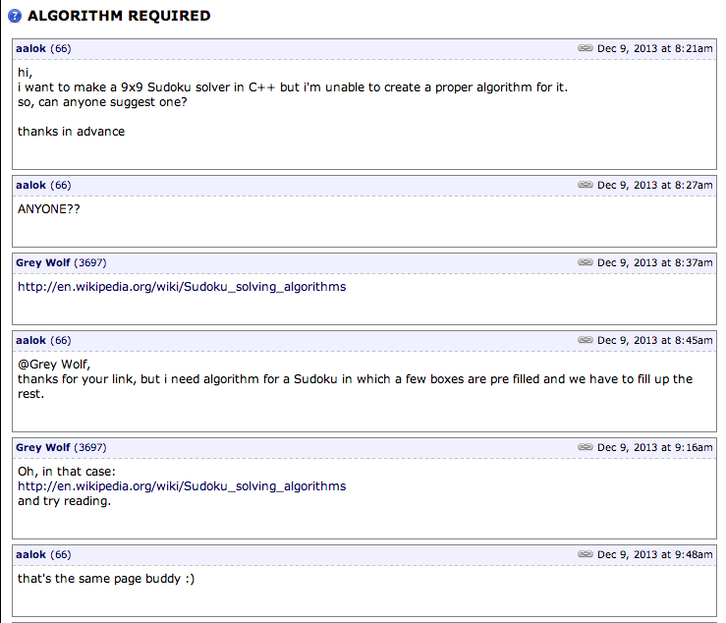
Notes:
Later comment omitted because of language
What was done correctly?
What sins have been committed?
http://www.cplusplus.com/forum/general/119422/

