Slide 1
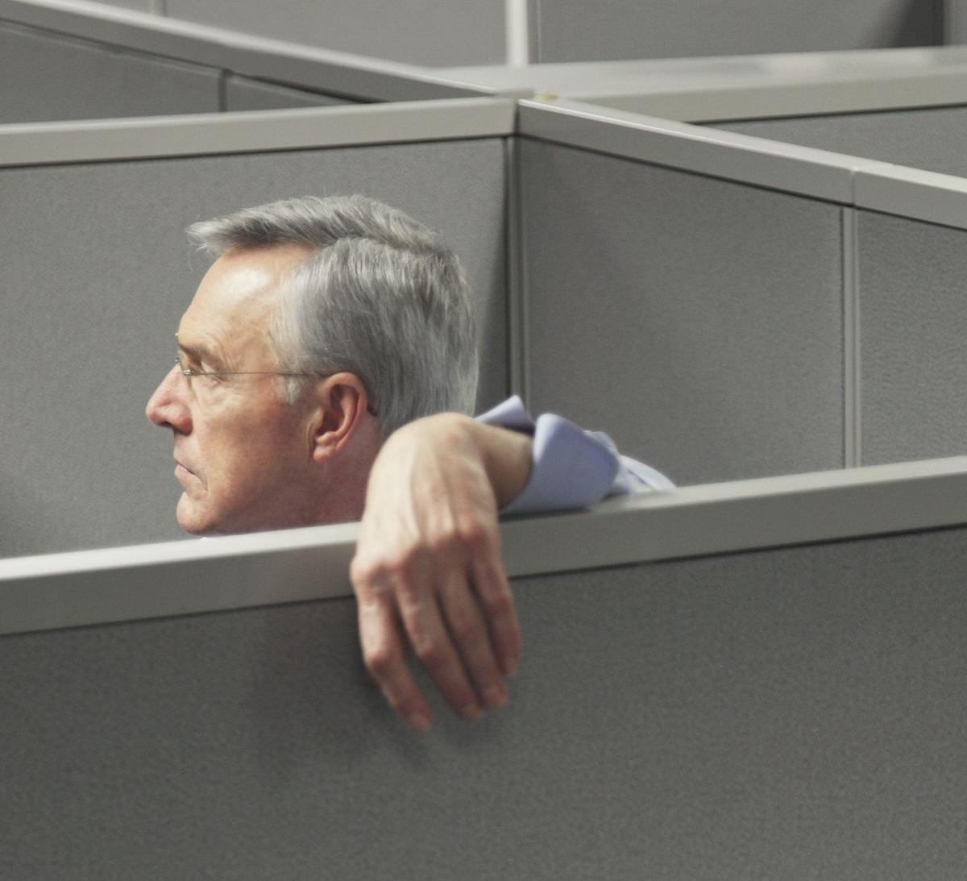
Are you lonely?
Notes:
http://media.nbcmiami.com/images/1200*1093/cubicle+thumb.jpg

Slide 2
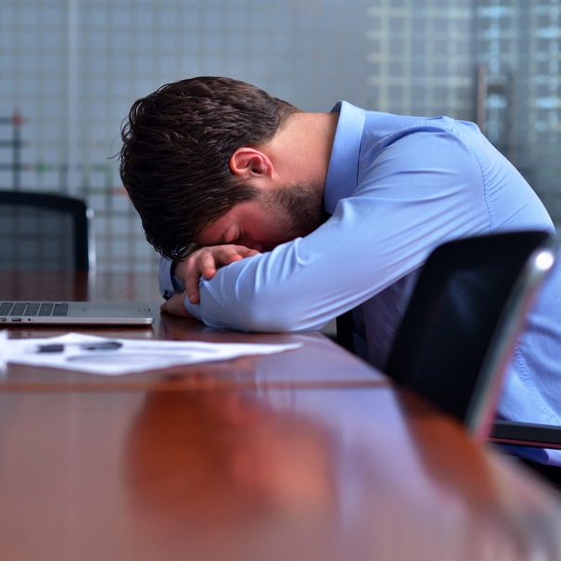
Are you tired of working on your own?
Notes:
http://www.careeradvisordaily.com/wp-content/uploads/2013/07/130730-Alone-at-Work.jpg

Slide 3
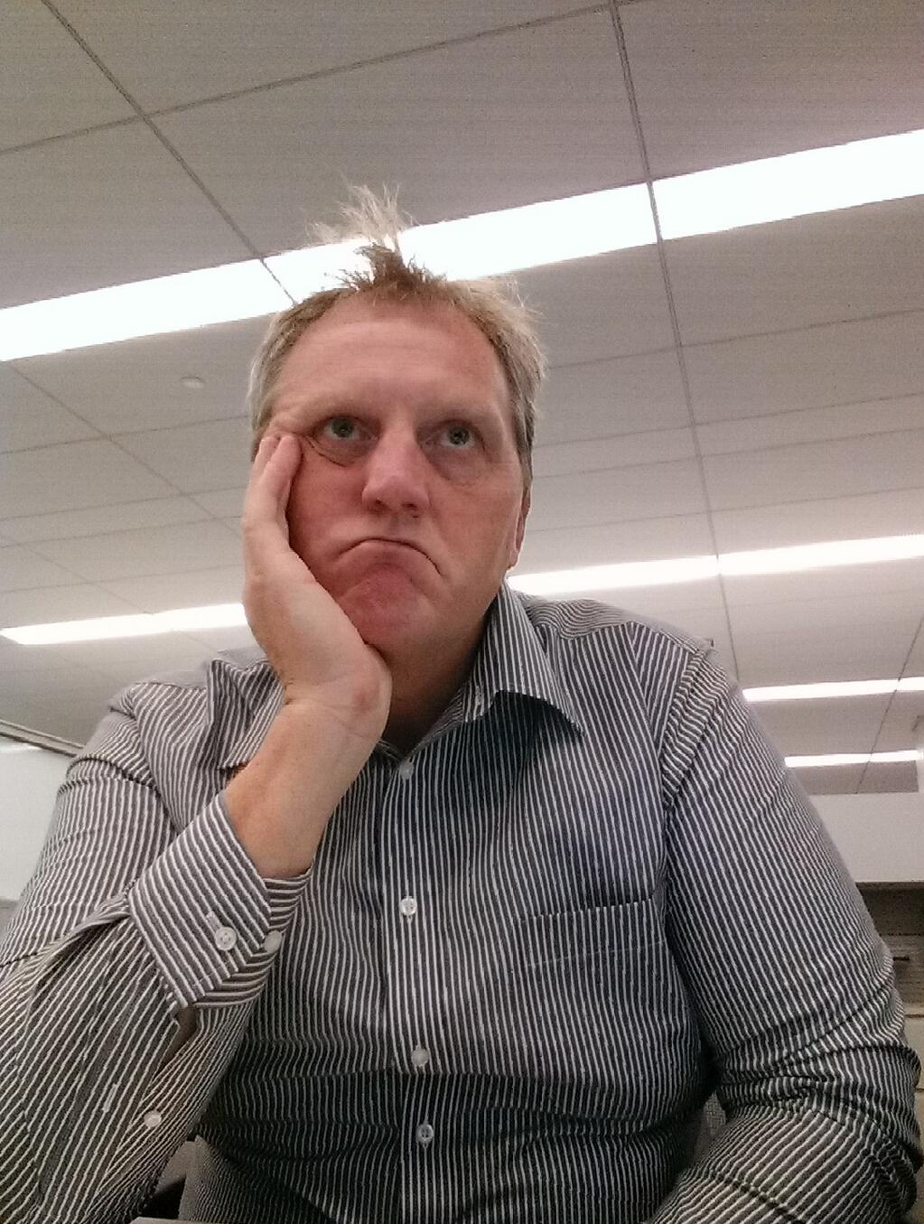
Do you hate making decisions?
Notes:
https://pbs.twimg.com/media/BX7ITGoIYAA2aui.jpg:large

Slide 4
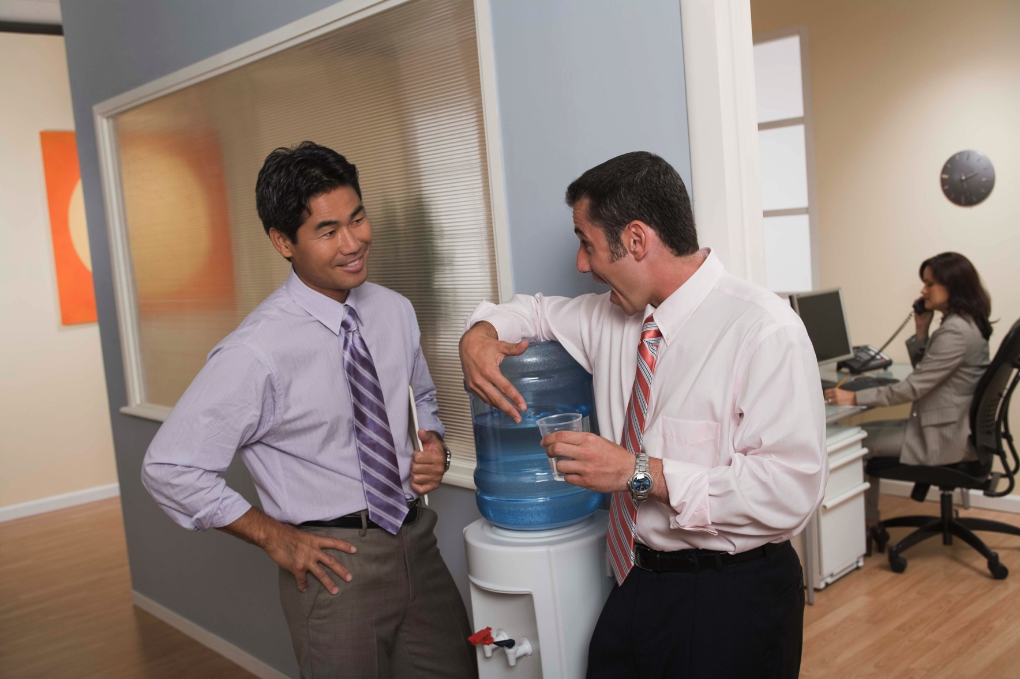
Would you rather talk about something than do it?
Notes:
http://thetrainingfactor.com/blog/wp-content/uploads/2012/08/86519105.jpg

Slide 5

Then hold a meeting!
See people
Show charts
Impress your colleagues
Feel important
Offload decisions
Eat free donuts
Sleep in peace
Notes:
http://blog.officezilla.com/wp-content/uploads/2013/06/Any-More-People-and-Chaos-Reigns.jpg

Slide 6
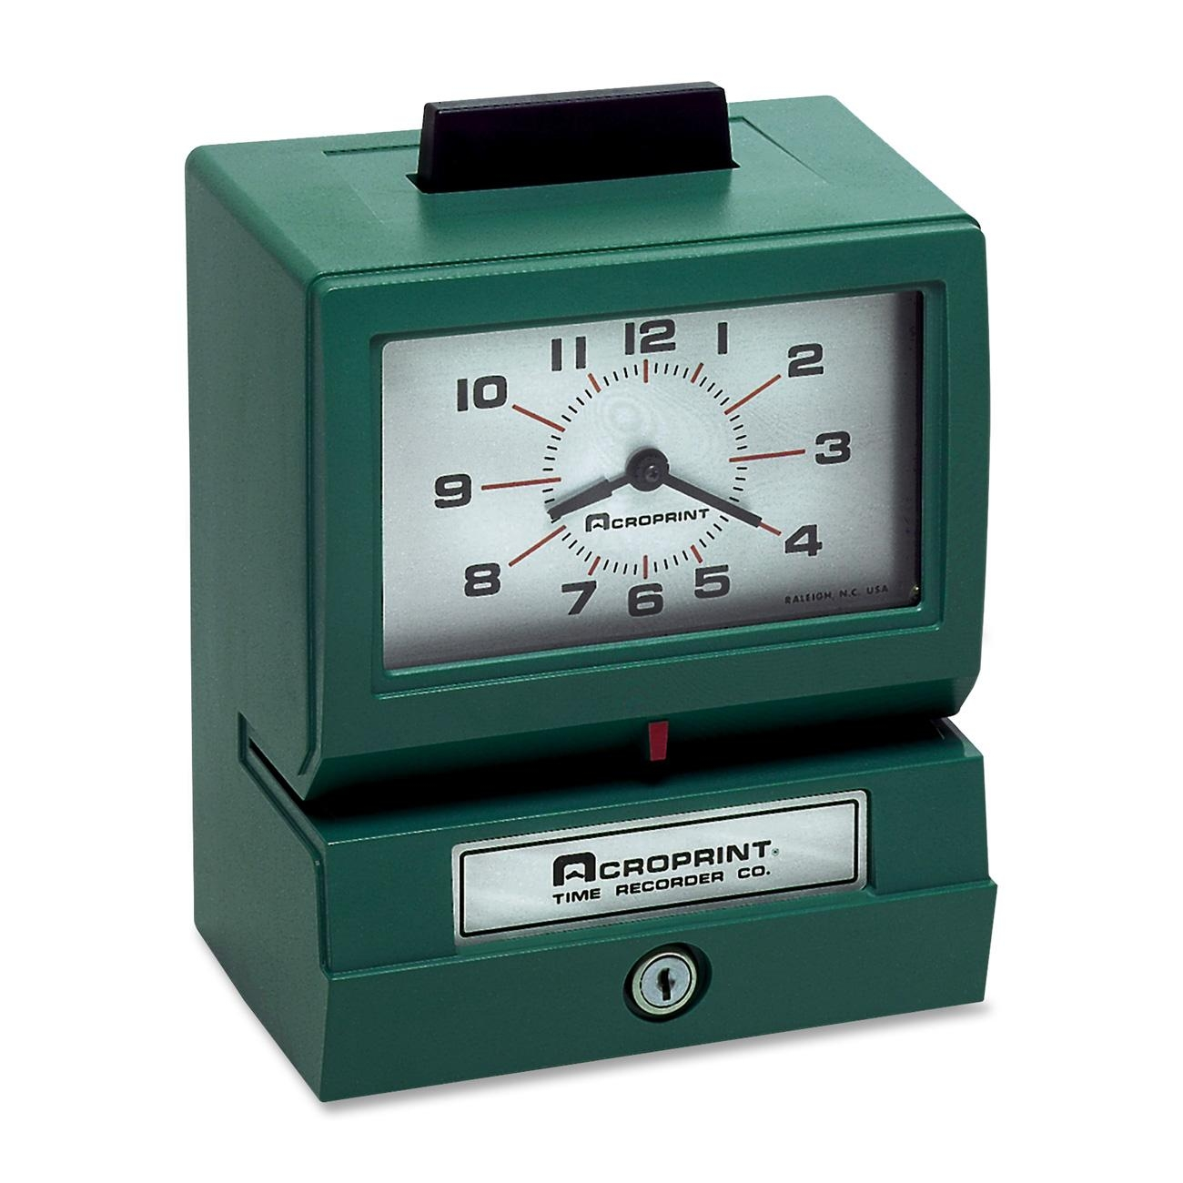
All on company time!
Notes:
http://www.theofficedealer.com/mm5/graphics/product_images/1300/seo/1372706246/Acroprint-011070411-Manual-Time-Clock--Recorder.jpg

Slide 7
Meetings
The Practical Alternative to Work

Slide 8
From a Wise Bishop
In meetings, you
Report work that has been done
Review work that is being done
Plan work to be done
But you don’t do any work
Notes:
Not totally true in the workplace, but the basic idea is valid
All this has been negative – justifiably so

Slide 9
Why have meetings?
Training
Coordinate
Collaborate
Communicate

Slide 10
Goal
Achieve positive results
Quickly
Notes:
Discussion will center on you as a meeting participant
However, you can extrapolate to you as a leader
Thanks to Fall 2013 CS 364 class for input

Slide 11
Prepare
If no advance agenda
Request one
Once you have the agenda
Review the agenda
Gather relevant material
Plan to contribute

Slide 12
Prepare
Check out the location
Table with power outlets
Wi-Fi
That works
Whiteboard
With markers that work
And erasers
Large display
Compatible with your laptop
Notes:
Large display: projector, monitor

Slide 13
If You Can’t Attend
Let someone know
Contribute via proxy
Notes:
Meeting should not be delayed because of uncertainty (do we start or wait?)

Slide 14
Arrive Early
If presenting
Early enough to set up
If participating
Early enough to settle in
If amiable, expressive, or extrovert
Early enough to get people stuff over with
Notes:
Arrive early – how early?
Set up could include distributing handouts

Slide 15
Don’t be Late
Force meeting to start late
Rude
Expensive
Disruptive
Grand entrance
Force a rerun to bring you up to date
“We’ve already discussed that”
Notes:
Story of worker who chided people for being late and then was late the next meeting
Grand entrance: focus shifts from meeting to you; might as well pause

Slide 16
Contribute to the Meeting
Don’t work during the meeting
Don’t bring mobile devices
Unless absolutely necessary
They are distractions
At least mute them
Notes:
Working: why are you there?
Mobile: laptops, tablets, cell phones
Don’t bring: particularly if you are addicted
student with laptop, tablet, and smartphone
Distractions: it’s not hidden; it’s just not mentioned
Mute: no vibrate
http://timemanagementninja.com/2012/01/10-bad-meeting-behaviors-to-avoid/
http://www.pmhut.com/meeting-behaviors-the-good-the-bad-and-the-ugly

Slide 17
Contribute Meaningfully
Pay attention
Respect time
Be succinct – avoid rambling
Total time of meeting

Slide 18
Contribute Meaningfully
Humor
Can help diffuse tension
Not to excess

Slide 19
Contribute Meaningfully
Ask questions
Be respectful
Don’t dominate
Don’t interrupt
Keep Pandora’s Box closed
Notes:
Pandora’s box: math department meeting – use a calculator? Maple or MatLab?
http://timemanagementninja.com/2012/01/10-bad-meeting-behaviors-to-avoid/
http://michaelhyatt.com/ten-annoying-meeting-behaviors.html
http://www.pmhut.com/meeting-behaviors-the-good-the-bad-and-the-ugly
http://humanresources.about.com/od/meetingmanagement/a/meeting_people.htm

Slide 20
Contribute Meaningfully
Avoid contention
Don’t attack
Devil’s advocate ???
Positive is better than negative
Avoid sarcasm
Snide comments never helpful
If negative, suggest an improvement
Notes:
http://timemanagementninja.com/2012/01/10-bad-meeting-behaviors-to-avoid/
http://michaelhyatt.com/ten-annoying-meeting-behaviors.html
http://www.pmhut.com/meeting-behaviors-the-good-the-bad-and-the-ugly
http://humanresources.about.com/od/meetingmanagement/a/meeting_people.htm

Slide 21
Contribute Meaningfully
Be organized
Be clear
Stay on topic
The agenda has a purpose
Notes:
http://timemanagementninja.com/2012/01/10-bad-meeting-behaviors-to-avoid/
http://michaelhyatt.com/ten-annoying-meeting-behaviors.html
http://www.pmhut.com/meeting-behaviors-the-good-the-bad-and-the-ugly

Slide 22
Contribute Meaningfully
Proper level of abstraction
Details when appropriate
Keep it relevant
Avoid tangents
Help return to topic

Slide 23
Contribute Meaningfully
“Large group decision” is an oxymoron
Suggest committees to expedite decision making

Slide 24
Avoid Side Conversations
Appoint among yourselves a teacher, and let not all be spokesmen at once; but let one speak at a time and let all listen unto his sayings, that when all have spoken that all may be edified of all, and that every man may have an equal privilege.
Doctrine and Covenants 88:122
Notes:
http://michaelhyatt.com/ten-annoying-meeting-behaviors.html
http://www.pmhut.com/meeting-behaviors-the-good-the-bad-and-the-ugly

Slide 25
Contribute Meaningfully
KYMS
Notes:
Last idea regarding meaningful contributions
Note passed to me at one meeting

Slide 26
Take Notes
Stay engaged
Capture ideas and questions
Later in the meeting
After the meeting
Record commitments
Notes:
Taking notes will help you stay engaged
Later in the meeting: for ideas that are not appropriate at the time
After the meeting: ideas require incubation; questions require research
Commitments: may be meeting minutes distributed; may be not
http://michaelhyatt.com/ten-annoying-meeting-behaviors.html
http://michaelhyatt.com/recovering-the-lost-art-of-note-taking.html

Slide 27
Symbology
Important
Needs research
Needs resolution
Requires follow-up
Notes:
Check ❑ when follow-up is complete
http://michaelhyatt.com/recovering-the-lost-art-of-note-taking.html

Slide 28
After the Meeting
Complete your commitments

Slide 29
Virtual Meetings
Teleconference
Video conference
What’s different?

Slide 30
Virtual Meetings
Visual
Limited body language
Audio
Limited voice quality
Nuances absent
Notes:
http://blogs.hbr.org/2011/03/how-to-conduct-a-virtual-meeti/

Slide 31
Virtual Meetings
Good for routine information exchange
Not good for emotional stuff
Resolve disagreements
Motivate coworkers
Notes:
http://blogs.hbr.org/2011/03/how-to-conduct-a-virtual-meeti/

Slide 32
Virtual Meetings
Temptation to mute
And work on something else
Notes:
http://blogs.hbr.org/2011/03/how-to-conduct-a-virtual-meeti/

Slide 33
Virtual Meetings
Label your emotions
Suggest others do the same
Notes:
Label emotions: “I am excited about”, “I surprised to learn”
http://blogs.hbr.org/2011/03/how-to-conduct-a-virtual-meeti/

