Slide 1
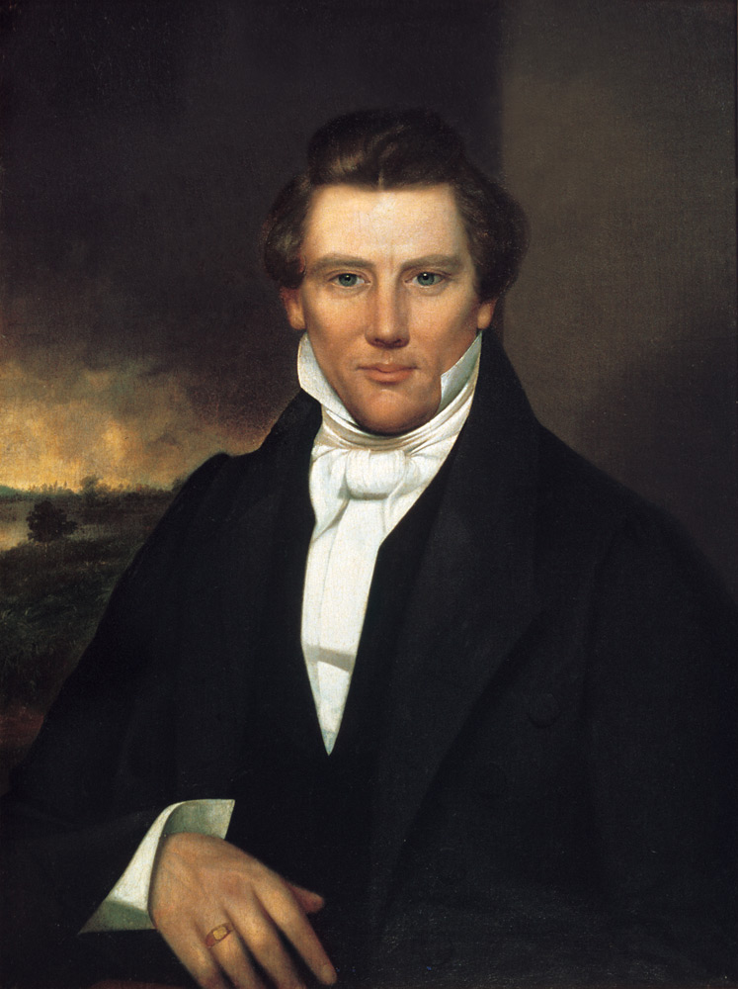
If we start right, it is easy to go right all the time;
but if we start wrong we may go wrong,
and it will be a hard matter to get right.
– Joseph Smith

Slide 2
Organizing
portions taken from
Zwickel, S.B. and Pfeiffer, W.S.
Pocket Guide to Technical Presentations & Professional Speaking
Pearson Prentice Hall, Upper Saddle River, NJ, 2006
Notes:
Review homework assignment

Slide 3
Requirements and Design
Audience analysis is part of the requirements process
Organization is part of design

Slide 4
Purpose Statement
State the purpose in a single sentence
Conjunctions indicate low cohesion
Good example
Explain the process of eliciting requirements
Bad example
Explain the process of eliciting requirements, specifying requirements, and converting the requirements into design

Slide 5
Outline
A weak outline will result in a weak paper or presentation
Don’t procrastinate outlining
Need time to research
Need time to revise
Need time to start over
Notes:
Group work can take longer

Slide 6
Outline Methodology
Typically hierarchical
Two approaches
Bottom up
Top down
Notes:
Top down and bottom up – next two slides

Slide 7
Bottom Up
Start with the purpose statement
Formulate ideas from research
Sort ideas
Identify main points (two or three)
Discard non-essential
Organize into an outline
Notes:
Sticky notes work well

Slide 8
Top Down
Start with the purpose statement
Conclusion first
Introduction next
Body last
Iterate for each section (introduction, body, and conclusion)
Iterate for each subsection (introduction, body, and conclusion)

Slide 9
Introduction - Body - Conclusion
“First you tell ‘em what you’re gonna tell ‘em, then you tell ‘em, and then you tell ‘em what you told ‘em.” – an apocryphal preacher
Particularly important for presentations
Listeners only hear it once
Readers can go back and review
Audience prefers a clear, linear, mental outline
More often encountered – more likely remembered

Slide 10
Conclusion
Should be created first
Why?
Last thing encountered is most remembered
Everything in paper leads to conclusion
Purpose statement provides focus
Restate main points (summary)
Tie it together
Indicate what happens next (if appropriate)
Notes:
Twitchell thinks summary information is very important, as is tying it together

Slide 11
Introduction
Establishes
Tone
Credibility
Worthiness of audience’s attention (relevance)
Created after conclusion
Purpose statement provides focus
Forecast main points
Can be used to aid transitions
Provide “mental glue”
Notes:
Forecast – use same terms, not synonyms
Twitchell thinks forecast is very important

Slide 12
Introduction
Rhetorical question
Relevant anecdote (but not a joke)
Startling statement or prediction
Presentations
Screening question, worksheet, or pre-test
Game, puzzle, activity
Notes:
Audience interaction is a wonderful thing – but it takes more time (make provisions for it)

Slide 13
Body
Focus from the
Purpose statement
Conclusion
Introduction
Limit the number of main points
Show relationships
Support generalizations with specific examples
Notes:
Generalization: use the language best suited for the application
Examples: Java for concurrent, Perl for text processing, C for real time

Slide 14
Body – Organizational Patterns
Question / answer
Cause / effect
Problem / solution
Comparison of options
Chronological sequence of events
Process description
Classifying and describing parts of objects

Slide 15
Plan for …
Transitions
Pauses (in presentations)
Graphics
Quantity of material for each section
Time milestones for presentations
Iterative development
Notes:
Pauses: Sunday school example, ask question but no time to ponder
Graphics are required
Do not organize around graphics

Slide 16
Outline Uses
Full text or script
Handout
Presenter’s notes
Memory will fail!
Have notes no matter what
Notes:
Presenter’s notes are required

Slide 17
Creating an Outline
Handwritten notes
Word processor
Presentation software

Slide 18
Handwritten Notes
Pencil and paper
Advantages
Done anywhere
Eraser works wonders, as does the garbage can
Inexpensive
Disadvantages
Transfer to electronic media
Readability
Reordering
Use note cards, one per “function”

Slide 19
Word Processor
Outline function
Advantages
Electronic
Easy to revise
Disadvantages
Transfer to presentation software
Hardware required

Slide 20
Presentation Software
Outline function
Advantages
Electronic
Easy to revise
Immediate visuals
Disadvantages
Hardware required
Temptation to work on visuals rather than outline logic and flow

