Slide 1
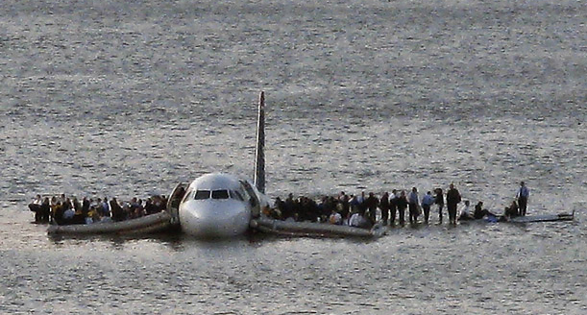
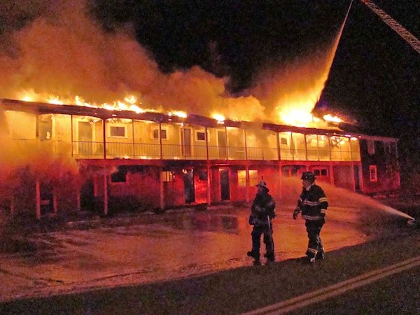
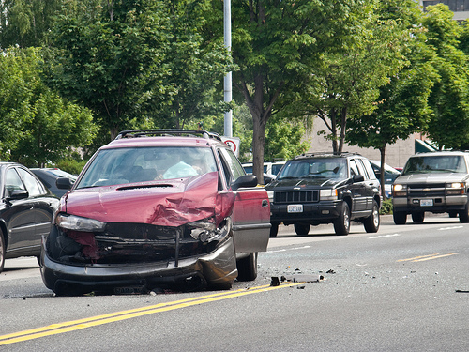

Job Interview Expenses
Notes:
Consider expenses for a job interview – air fare, lodging, ground transportation, meals
What’s a company to do?
http://img.timeinc.net/time/photoessays/2009/plane_crash_redux/plane_crash_redux_01.jpg
http://brewsterfire.com/wp-content/uploads/2012/11/11-25-12-Stone-Horse-Motel-fire-Harwich-038.jpg
http://www.bayareainjurycenters.com/wp-content/uploads/2011/03/Car-accident.png
http://i-cdn.apartmenttherapy.com/uimages/kitchen/2011_08_12-FoodPoisoning.jpg

Slide 2
Phone Interviews

Slide 3
Purpose
Reduce the number of face-to-face interviews
Preliminary screening
Validate the résumé
First (or second) round of interviews
The goal is to weed
Notes:
Regardless, the goal is to weed

Slide 4
Overview
Your advantages
Be aware of
Preparation
Things to do

Slide 5

Your Advantages
Dress and grooming not an issue
Notes:
Dress and grooming: dress professional to sound professional
http://i91.photobucket.com/albums/k301/temporalparadox/SDC10309.jpg

Slide 6
Your Advantages
Ready access to reference information
Résumé
Specifics regarding résumé items
“Tell me about a time”
Definitions
Scannable bulleted lists
Notes:
Résumé – also cover letter, emails from interviewer
Specifics – projects, work assignments, course content, accomplishments
Don’t rely too heavily on printed support material – it will show

Slide 7
Beware of
Noisy
Paper
Computer
Sounding like you are reading a script

Slide 8
Take It Seriously!
Purpose: avoid a face-to-face interview
Treat it exactly the same as a face-to-face interview
Preparation
Rules
Notes:
Treat it – same preparation (research the company, review technical information)

Slide 9
Rules
Same rules as face-to-face interviews
Goldilocks answers
Observe etiquette
Use interviewer’s title and surname, not given name
Don’t chew
Don’t interrupt
Notes:
Goldilocks – not too short, not too long

Slide 10
Prepare
Practice
Avoid filler words
Avoid talking too fast

Slide 11
Prepare
Find a quiet place
With a door
With a land line
Verify speaker phone
With desk space
Lay out papers
Take notes
Notes:
If no land line – be in a place with superior service
Speaker phone – works for interviewer (clear, no background noise)
No food or gum

Slide 12
Prepare
Warn others
Avoid interruptions
Avoid distractions

Slide 13
Prepare
Mute everything
Not the phone
Electronic devices including computer
Disable call waiting
Turn off TV and stereo
Family and friends
Pets
Notes:
If using land line, mute your cell phone

Slide 14
Prepare
Container of water
Reserve sufficient time
Notes:
Water container needs to be quiet
Sufficient time – usually 15-20 minutes, but could be longer

Slide 15
Why Prepare?
“… but if ye are prepared ye shall not fear.”
Doctrine and Covenants 38:30

Slide 16
Things to Do
Remember no visible body language
Voice must compensate
Verbally indicate you are thinking
Notes:
No body language from interviewer, to interviewer
Voice compensate – excitement
Brief pauses (few seconds) may be OK, but sustained pauses are a problem (are you there?)

Slide 17

Things to Do
Smile
Notes:
Theory – if you are actually smiling, that will reflect in your voice
http://www.compeap.com/wordpress/wp-content/uploads/fake-smile.jpg

Slide 18
Things to Do
Speak
Moderate speed
Clearly
Notes:
Don’t slow down too much or over-enunciate

Slide 19
Things to Do
Focus on the interview
Don’t multitask
Take notes
Allow interviewer time to take notes
Notes:
Multitask – text, surf, homework

Slide 20
Things to Do
Confess if problem
Interruption
Notes:
Confess to the interviewer what the problem is and beg for indulgence

Slide 21
Things to Do
Obtain interviewer’s
Name
Contact information
“Thank you” as part of conclusion
Follow up with thank-you note
Notes:
Write down name
Thank-you note as discussed elsewhere

Slide 22
Help is Available
Request help from the Academic Discovery Center
Notes:
“We do offer phone interviewing skills and etiquette training during the scheduled phone and Skype appointments. This material can also be taught during face-to-face appointments if the students requests or asks for the information.” – Justin Hodges, 8/22/2013

