Slide 1
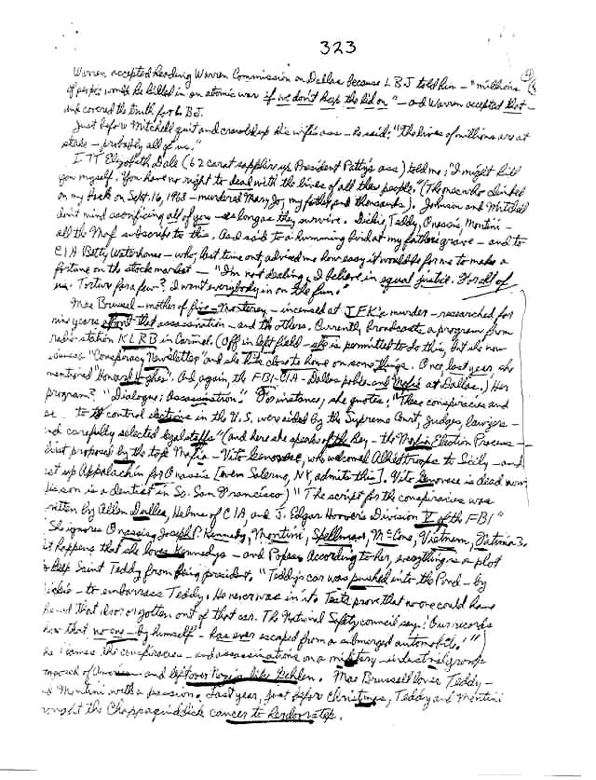
Research in Ancient Times
Notes:
Handwritten notes

Slide 2

Research in Olden Times
Notes:
copier

Slide 3

Research Today
Notes:
Save full text
Disk (hard drive)
cloud

Slide 4
Keep track where …
You put the information
The information came from
Notes:
Second bullet: so you can avoid the problem of …

Slide 5
Plagiarism
If you steal from one author, it's plagiarism;
if you steal from many, it's research.
Wilson Mizner

Slide 6
Plagiarism
What plagiarism is
Common knowledge
Citations
Verbatim quotations

Slide 7
Plagiarism
What plagiarism is
Common knowledge
Citations
Verbatim quotations

Slide 8
Plagiarism is …
Use of another’s intellectual property without citation
Implies that the material is the plagiarist’s work
Intent is not an issue
Unintentional is just as bad as intentional
A significant sin
In the real world
In this class

Slide 9
To Avoid Plagiarism
Cite!
Obtain permission
Include page numbers
Notes
Citations – early drafts

Slide 10
Plagiarism
What plagiarism is
Common knowledge
Citations
Verbatim quotations

Slide 11
Common Knowledge
If several reputable sources state the same thing without citation, it probably is common knowledge
Doesn’t need to be cited
Otherwise, cite!

Slide 12
Plagiarism
What plagiarism is
Common knowledge
Citations
Verbatim quotations

Slide 13
Citations are Required
Text
Verbatim quotations
Paraphrase
Not limited to verbatim quotations

Slide 14
Citations are Required
Graphics
Figures
Tables
Images
Ideas

Slide 15
Style
Numbers in square brackets
[2]
[4,8]
Alphabetical works cited
By author’s surname
Even distribution

Slide 16
Plagiarism
What plagiarism is
Common knowledge
Citations
Verbatim quotations

Slide 17
Verbatim Quotations
Clearly label verbatim quotations
Consider quotation marks
Use of verbatim quotations is rare in technical writing
You may not include any verbatim quotations

Slide 18
Paraphrase / Summarize
Accurate
Capture the “essence”

Slide 19
Paraphrase This
Computer Science and Engineering is a field that attracts a different kind of thinker. I believe that one who is a natural computer scientist thinks algorithmically. Such people are especially good at dealing with situations where different rules apply in different cases; they are individuals who can rapidly change levels of abstraction, simultaneously seeing things “in the large” and “in the small.”
- Donald Knuth
Notes:
Should attempt to capture the “essence” in a paraphrase
62 words in the quotation

Slide 20
Plagiarism
What plagiarism is
Common knowledge
Citations
Verbatim quotations

