Slide 1
Notes:
Show PowerPoint Proposal video
Call attention to necktie (not that it is necessary)

Slide 2

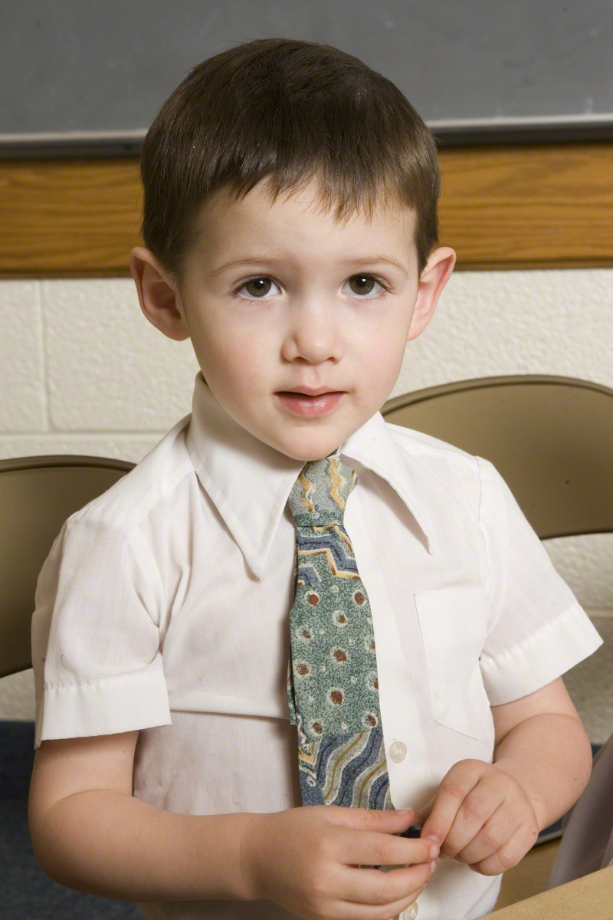
Notes:
Presenting since a child

Slide 3
Presentations
parts taken from
Technical Communication: A Practical Approach
by W S Pfeiffer and K E Adkins
from
Technical Communication Today
by R Johnson-Sheehan
and from
Pocket Guide to Technical Presentations & Professional Speaking
by S B Zwickel and W S Pfeiffer

Slide 4
Presentations
Formal
Time to prepare
Informal
Extemporaneous in nature
Notes:
Give examples of each
Majority of presentations are informal

Slide 5
Physical Situation
Visit the room prior to the presentation

Slide 6
Physical Situation
Location
Lectern?
Behind a table?
Standing out in the open?
Microphone?
Needed?

Slide 7
Physical Situation
Projector available?
Compatible with your laptop?
Other visual aids available?
Whiteboards
Flip charts
Large notepads

Slide 8
Physical Situation
Will handouts be effective?

Slide 9
If things go wrong …
It may be someone else’s fault
But you will be the one who looks unprepared

Slide 10
Allocation of Time
Use the time given
Maybe a little less
But certainly not a lot less
Fill the time with something worthwhile
Overtime is the unpardonable sin
I’ve stopped listening – why haven’t you stopped talking?

Slide 11
Humor
Appropriate
Help make a point
Make a point relevant, memorable
Inappropriate
Serious topic
Ineffective
Notes:
Ineffective – next slide

Slide 12
Ineffective Humor
Sarcasm
Obscure allusions
Puns
Jokes
Especially sexual and discriminatory

Slide 13
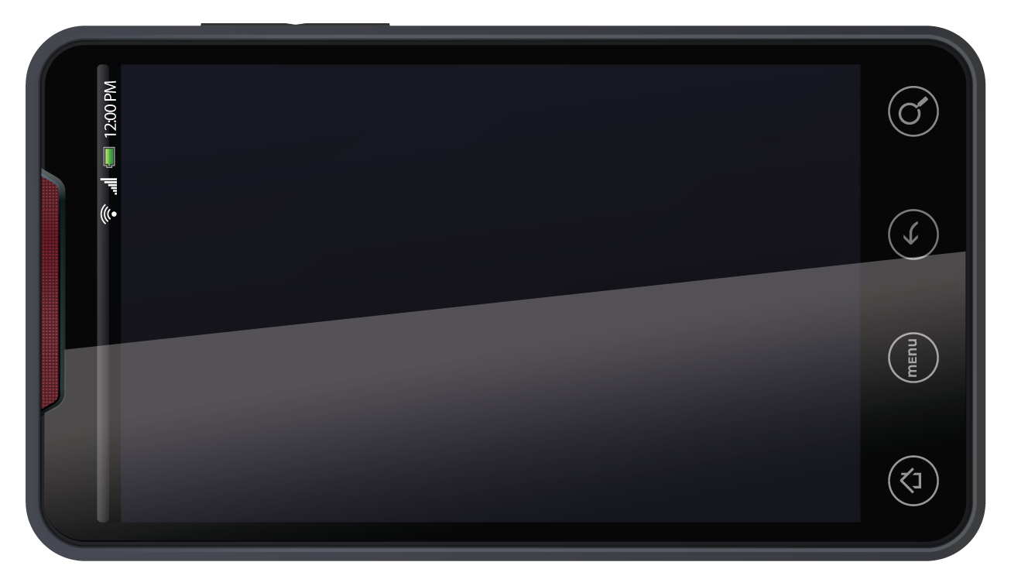
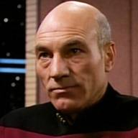

Conclusion
Apps
GPS
Widgets
Sync
What Would Jean-Luc Picard Do?
Conclusion
Overview
Notes:
Hyrum Denney ???
Android vs iOS vs Windows

Slide 14
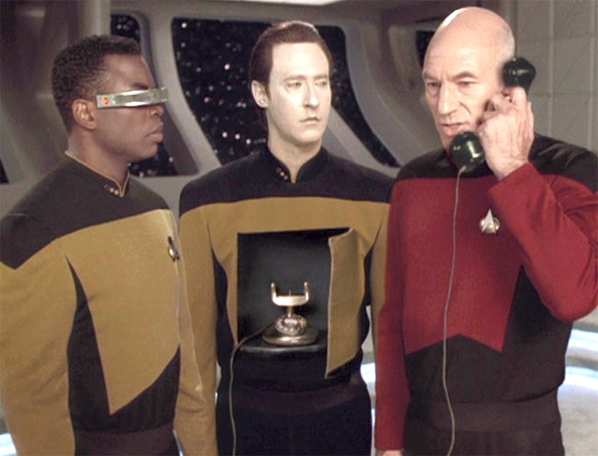
Smartphones
Picard uses Android with unlimited Data
Notes:
Adapted from http://weblog.sinteur.com/index.php/2011/02/24/captain-picard-uses-android-smartphones-with-an-unlimited-data-plan/

Slide 15
Effective Humor
Anecdotes
Personal
Used as a theme
Self-deprecation

Slide 16
Ronald Reagan Humor
“It's true hard work never killed anybody, but I figure, why take the chance?”
Asleep while meeting with the Pope
“I have left orders to be awakened at any time in case of national emergency -- even if I'm in a Cabinet meeting.”

Slide 17
Ronald Reagan Humor
“How could an actor become president?”
“How can a president not be an actor?”
“I've noticed that everyone who is for abortion has already been born.”

Slide 18
Reagan – Mondale Debate
Notes:
Background: Reagan didn’t perform well in previous debate; age was an issue
Reagan – Mondale debate: YouTube video at http://www.youtube.com/watch?v=LoPu1UIBkBc

Slide 19
Credibility
Why should the audience believe you?

Slide 20
What makes a person credible?
Don’t let anything get between your message and your audience
Profanity or offensive terminology
Make audience angry or upset

Slide 21
What makes a person credible?
Work to overcome age bias
Keep things fairly formal

Slide 22
What makes a person credible?
Nonverbal communication
Eye contact
Facial expressions
Body language
Notes:
Act out: not looking at audience

Slide 23
What makes a person credible?
Personal appearance
Face
Hair
Appropriate attire

Slide 24
What makes a person credible?
Be prepared!
If all else fails, appear to be prepared
Notes:
Boise and no overhead display panel

Slide 25
Notes:
Start here!

Slide 26
Ethics
Do not mislead
Your qualifications, experience, or credentials
Your topic
Your purpose

Slide 27
Ethics
Give credit where credit is due
Don’t reveal confidential information
Respect other presenters

Slide 28
Questions and Answers
A Sport Fan’s Lament – interview by NPR’s Scott Simon, 26 January 2008
How well is the first question answered?
What is the content of the answer to the first question?
How does the answer to the first question compare with the answer to the second question?
Notes:
A sport fan’s lament – start at 2:32, stop at 4:48

Slide 29
Questions and Answers
Let the person complete the question
What if the question is a ramble?
Notes:
Ramble: “I’m not sure I understand where you are going with that question …”
You rephrase: “If I understand you correctly, …. Is that correct?”

Slide 30
Questions and Answers
Be sure you understand the question
Ask the questioner to rephrase
You rephrase
Time to develop an answer
Notes:
Ramble: “I’m not sure I understand where you are going with that question …”
You rephrase: “If I understand you correctly, …. Is that correct?”

Slide 31
Questions and Answers
Repeat the question
In case someone didn’t hear the question
Time to develop an answer

Slide 32
Questions and Answers
Pause for a moment before answering
Gather your thoughts
Emphasizes the importance of the question

Slide 33
Questions and Answers
Admit it when you don’t know
Don’t bluff
Options:
Explain why you don’t have an answer
Offer to research and answer later

Slide 34
Questions and Answers
What if the question was asked and answered previously?

Slide 35
Answer – Bad Example
“I am not familiar precisely with exactly what I said. But I stand by what I said, whatever it was.”
- Presidential Candidate, 2012
Notes:
Mitt Romney

Slide 36
Questions and Answers
Avoid contention
Acknowledge the difference of opinion
Agree to disagree
Offer to discuss later (in person)
Notes:
Contention: do not argue, quarrel, or debate

Slide 37
Questions and Answers
Always end on time
Additional questions can be handled later
After the meeting
By e-mail or telephone

Slide 38
Presentation Guidelines
Also important for written technical communication
Examples
Purpose statement
Cohesion

Slide 39
1 – Know Your Listeners
Interaction is important
Read body language
Timing of questions and answers
During the presentation
At the end of the presentation
Attention span
Notes:
Let your audience know what you expect regarding questions

Slide 40
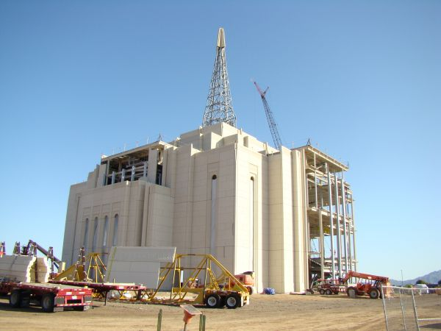
Listeners
Need a structural framework
Navigation aids are important
Notes:
Gilbert AZ temple
Photograph taken February 18, 2012, courtesy of Hank Eyring
ldschurchtemples.com
Examples of navigation aids follow

Slide 41
Overview
Background (what is NLP?)
What is NLP?
Databanks
Understanding Humans
Computer Understanding Today
How It Works
Question Answering
Challenges
Future Applications of NLP
Emotional Analysis
All-Purpose Command Interpretation
Universal Translation
Notes:
Jeremy

Slide 42
What is NLP?
NLP - the means by which computers understand Language
Subfield of Artificial Intelligence
Background Today’s Understanding Future Application
What is NLP? Databanks Understanding humans
Notes:
Me: David Ferrucci (a PHD at IBM research facility), “Computer systems that can directly and accurately answer peoples’ questions over abroad domain of human knowledge have been envisioned by scientists and writers since the advent of computers themselves.”

Slide 43
Databanks
Word definitions
Sentence structure
Data comparison
Future
Facial features
Tone of voice
Background Today’s Understanding Future Application
What is NLP? Databanks Understanding humans
Notes:
Jeremy: Computers always will need to have an understanding stored somewhere that they can compare their input to.
Data banks started out simple with word recognition and have slowly advanced to understanding sentences. This happens because of data comparison and how a computer can compare what is being read in and what our response would be. In order to incorporate all of the Natural language we will need to have a way to store facial features and tone of voice and some forms of body language. This is where the industry is struggling with how to compare this in such a way that a computer can understand.

Slide 44
Understanding Humans
More than just words
Complexities of language
Connotations
Body language
Nonverbal cues
Background Today’s Understanding Future Application
What is NLP? Databanks Understanding Humans
Notes:
Me
The point is getting computers to understand all that too

Slide 45
Computer Understanding Today
How It Works
Question Answering
Challenges
Background Today’s Understanding Future Application
How It Works Question Answering Challenges
Notes:
Jeremy

Slide 46
How It Works
Semantic Module
Pragmatic Module
Multimodal Dialogue Module
Background Today’s Understanding Future Application
How It Works Question Answering Challenges
Notes:
Me: Introduce 3 parts

Slide 47
How It Works
Semantic Module
Pragmatic Module
Parser
User Action Interp.
Context Tracking
Pragmatic Scoring
& Analysis
DOM. KNOW.
&
Inference
User Input
Interp.
Multimodal Dialogue Module
Multimodal Interface
Task Manager
Program Output
http://ieeexplore.ieee.org/stamp/stamp.jsp?
Background Today’s Understanding Future Application
How It Works Question Answering Challenges
Notes:
Jeremy: The semantic module receives the input signal and decides what to do with it. Some parsing and comparing happen in this module, but for the most part, it takes the input and formulates it together in an understandable way.
Me:
The pragmatic module is the brain of the operation. It uses a combined understanding of the language’s words and sentence structure and in the future would include a tone/volume analyzer as well to formulate and understanding of what has been recorded.
Jeremy: The understanding is then sent to the MDM, where it is formulated into a response and then sent to the interface that responds

Slide 48
Question Answering
Interpret, retrieve, rephrase
Examples
Siri, Iris
Watson
Background Today’s Understanding Future Application
How It Works Question Answering Challenges
Notes:
Me: David Ferrucci says that deep language processing would benefit a wide variety of areas, including healthcare and social computing. He shows how NLP is connected with other domains such as information retrieval and machine learning to accomplish QA.
Jeremy: Examples

Slide 49
Challenges
Understanding as a human does
Drawing implications
Machine learning
Emotional analysis
Background Today’s Understanding Future Application
How It Works Question Answering Challenges
Notes:
Me: AI-complete
Me: Drawing implications
Jeremy: other stuff

Slide 50
Future Applications
Emotional Analysis
All-Purpose Command Interpretation
Universal Translation
Background Today’s Understanding Future Application
Emotional Analysis All-Purpose Command Interp. Universal Translation
Notes:
Intro: me

Slide 51
Emotional Analysis
Interpret and imitate emotions
Scanning online texts
Respond to user emotions
Background Today’s Understanding Future Application
Emotional Analysis All-Purpose Command Interp. Universal Translation
Notes:
Jeremy

Slide 52
All-Purpose Command Interp.
Discern true meaning of requests
Adapt to user needs
Avoid handholding
Involves other areas of AI
Background Today’s Understanding Future Application
Emotional Analysis All-Purpose Command Interp. Universal Translation
Notes:
Me
Need to record conversations

Slide 53
Universal Translation
No longer far-fetched
Currently imperfect
Google Translate Example
Improve and refine
Background Today’s Understanding Future Application
Emotional Analysis All-Purpose Command Interp. Universal Translation
Notes:
Jeremy introduces
My example: So etwas hast du sicher nicht gesagt.
Something like you said not sure.

Slide 54
Conclusion
Summary
Natural language processing
Using data
Relevance to today
Popular technology
Continuing to advance
Notes:
Jeremy summary
Me: Relevance
More useful in future

Slide 55
Overview
Types of learning
Rote Learning
Analog Learning
Decision Tree Learning
Genetic Learning
Real World Applications
Patient Diagnosis in Hospitals
Video Games
World Wide Web
Future Discoveries
Rote Learning
Analog Learning
Decision Tree
Genetic Learning
Hospitals
Video Games
Internet
The Future
Notes:
First we’ll go over four approaches to machine learning.
We’ll then overview a few of the applications that we can use them for.

Slide 56
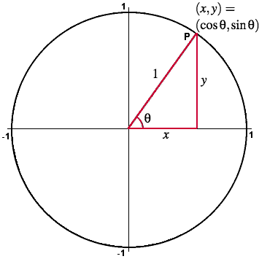
Rote Learning
One of the simplest methods known.
Calculations are done before storing data.
Data is retrieved with very little processing
Rote Learning
Analog Learning
Decision Tree
Genetic Learning
Hospitals
Video Games
Internet
The Future
Notes:
The first method is Rote Learning and it is one of the simplest methods of Machine Learning.
The main component involved is memory.
If calculations are needed, they are done before storing the data in the computer.
This way the data can be retrieved with a minimal amount of processing.
An example of this is when a computer might need to calculate the values of a
trigonometric functions many times throughout a program. Values can be calculated once
And then stored for future reference.

Slide 57
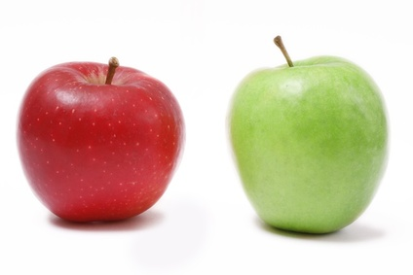
Analog Learning
Relate new knowledge to something familiar.
Build off of what is already known.
Machine searches data bank for similarities.
Rote Learning
Analog Learning
Decision Tree
Genetic Learning
Hospitals
Video Games
Internet
The Future
Notes:
2nd type of learning is analog learning.
This is very similar to how a human being learns.
We relate new knowledge to something familiar that we already know.
This works by comparison.
When a condition is inserted into the system, it will search its databank for anything that presents similarities.
This of the last hard math class you had, the only way to learn was to build off of previous math skills you learned.

Slide 58
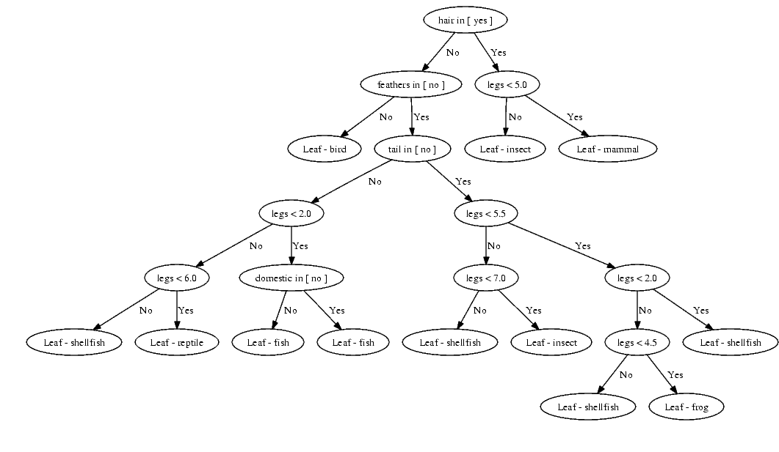
Decision Tree Learning
Similar to the game “Twenty Questions.”
Each question eliminates ½ the possibilities.
2^20 possibilities (more than 1 million)
Uses tree structure built from top down.
Rote Learning
Analog Learning
Decision Tree
Genetic Learning
Hospitals
Video Games
Internet
The Future
Notes:
The third type of learning is Decision Tree Learning.
Lets relate this to the game of Twenty Questions.
With each question that is asked it eliminates ½ the possibilities.
If all the 20 questions are asked, the databank can hold a total of 2^20 possibilities which is more than 1 million.
These tree structures are built from the top down.

Slide 59
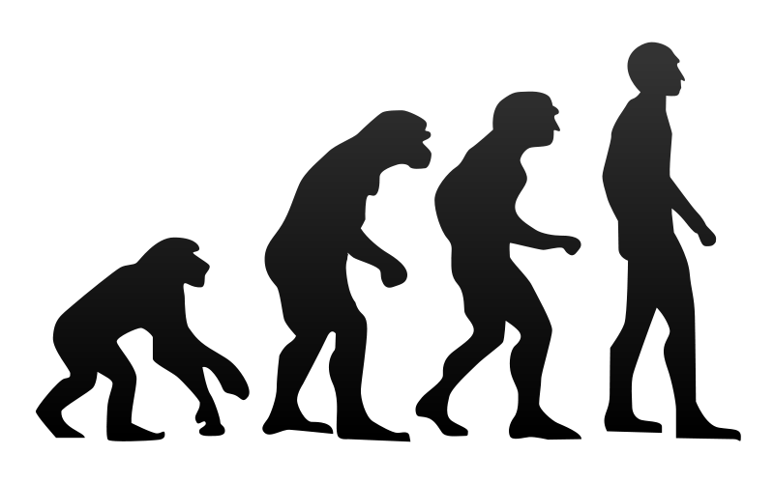
Genetic Learning
Inspired by Darwin’s Evolution.
Uses Evolutionary Algorithms (EA)
Population of Programs
Fitness ratings are given
Each generation produces
a better population.
Rote Learning
Analog Learning
Decision Tree
Genetic Learning
Hospitals
Video Games
Internet
The Future
Notes:
The fourth approach to machine learning is Genetic Learning.
This is technique is inspired by Darwin’s Theory of Evolution.
If it exists naturally out in nature why can’t that be recreated in a computer.
It makes use of what is known as Evolutionary Algorithms (EA).
We create a population of programs to complete a certain task.
Each program is given a fitness rating depending on how well it completes the task.
The fittest programs are then combined and sometimes randomly mutated to create another generation of programs.
This process continues until the desired fitness level is reached.

Slide 60
Overview
Types of learning
Rote Learning
Analog Learning
Decision Tree Learning
Genetic Learning
Real World Applications
Patient Diagnosis in Hospitals
Video Games
World Wide Web
Future Discoveries
Rote Learning
Analog Learning
Decision Tree
Genetic Learning
Hospitals
Video Games
Internet
The Future

Slide 61

Patient Diagnosis in Hospitals
Doctors can’t always make accurate decision
Decision Trees are used to make diagnosis
Computers use vast knowledge database
Data is added after patients are treated.
Rote Learning
Analog Learning
Decision Tree
Genetic Learning
Hospitals
Video Games
Internet
The Future
Notes:
In hospitals doctors want to make the correct decision when diagnosing a patient with a disease.
Doctors can’t always make the most accurate decisions.
Decision trees can be used to make the decision just the game of twenty questions can do.
It uses the vast knowledge from the database composed from previous patients.
Obviously you don’t want to leave it completely up to the computer, the doctor must also give his recommendation.
Once current patients are treated, their records are also added to the database to improve it.

Slide 62


Video Games
Game programmers struggle to ensure challenging difficulty level.
Computer tends to out shoot the player rather than out think them.
Learn by “observing” human players
Genetic Algorithms used
to improve strategies
Rote Learning
Analog Learning
Decision Tree
Genetic Learning
Hospitals
Video Games
Internet
The Future
Notes:
Video Games are one of the most popular forms of entertainment today.
If the game is too easy the player become board very quickly, the game difficulty is increased.
The problem is that the computer tends to out shoot the player rather than out think them.
The computer uses a brute force strategy rather then actually applying strategy.
The computer can learn by observing the human player and what he does during different situations.
It will then apply it to how it plays.
Genetic Algorithms are also used to complete this task.
Game programmers are still far away from creating human like behaviors.

Slide 63
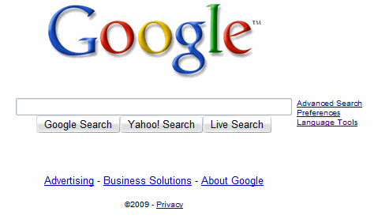
World Wide Web
Information constantly added.
Index information for easy access.
Web Crawlers browse from site to site.
Uses the process of Rote Learning.
Rote Learning
Analog Learning
Decision Tree
Genetic Learning
Hospitals
Video Games
Internet
The Future
Notes:
The World Wide Web is constant in use and information is added by the second.
From one moment to the next it will never be the same.
Search engines such as Google.com must have a way to index the information.
Programs known as Web Crawlers browse from site to site and get an accurate picture of the current state of the web.
The can be done without any human intervention.
This method used here is Rote Learning.

Slide 64
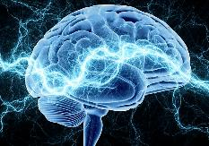
Future Discoveries
Enthusiasm needed for machine learning.
Significant amount of research to complete.
Include non-technological fields of study.
Rote Learning
Analog Learning
Decision Tree
Genetic Learning
Hospitals
Video Games
Internet
The Future
Notes:
For machine learning to progress and advance, we must generate enthusiasm for the subject.
There is still a significant amount of research to be completed.
This research may include those from a non-technological field of study.
Perhaps other techniques will be developed by those engineers who are here today.
By doing this we can improve our society, our standard of living, and our way of life.
Thank you for your time.

Slide 65
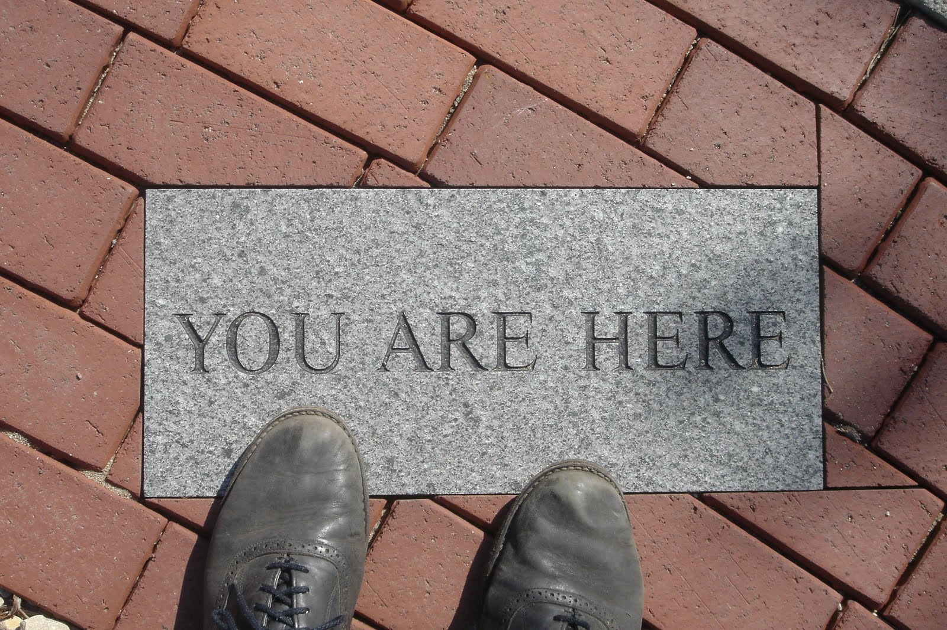
Notes:
Questions on navigation aids?
Overview required
Navigation aids required
Navigation aid on every slide

Slide 66
Notes:
Start here!

Slide 67
2 – Use the Preacher’s Maxim
“First you tell ‘em what you’re going to tell ‘em, then you tell ‘em, and then you tell ‘em what you told ‘em.”
Introduction – Body – Conclusion
Critical for presentations

Slide 68
3 – Stick to a Few Main Points
Miller’s Rule of 7 ± 2
My brain is full – can we stop now?
Triads
President Monson
Notes:
Consider President Monson’s use of triads

Slide 69
4 – Put Your Outline on Cards or Paper
Best if you don’t need notes
Be prepared, just in case
Presenter’s notes
Required for this class
Large font
Cards versus paper versus presentation software
Notes:
Presenter’s notes: Jan Brewer, Rick Perry

Slide 70
5 – Practice, Practice, Practice
Corrections as you go
Dress rehearsal

Slide 71
6 – Speak Vigorously and Deliberately
Speak appropriately
For the audience
Speak naturally
Notes:
If “naturally” is dull & boring – repent!

Slide 72
7 – Avoid Filler Words
Count!
Use pauses
To eliminate filler words
Following an important point
Practice helps
Notes:
Count – “You know you know” by Caroline Kennedy (six in 13 seconds, also an um)

Slide 73
8 – Use Rhetorical Questions
Judicious use

Slide 74
Review
Know your listeners
Use the preacher’s maxim
Stick to a few main points
Put your outline on cards or paper
Practice, practice, practice
Speak appropriately
Avoid filler words
Use rhetorical questions

Slide 75
9 – Maintain Eye Contact
Audience size
Small
Large
Don’t stare at the audience
Look away from time to time

Slide 76
10 – Use Appropriate Gestures and Posture
Open hand and arm gestures
Don’t fidget
Or fiddle
Laser pointer

Slide 77

Notes:
Demonstrate laser pointer

Slide 78
10 – Use Appropriate Gestures and Posture
Open hand and arm gestures
Don’t fidget
Or fiddle
Laser pointer
Notes:
Demonstrate laser pointer
Alternative to laser pointer?

Slide 79
Other Considerations
Over prepare
Have quick, simple definitions
Be ready for anything

Slide 80
Other Considerations
Include your name on the title slide
Title slide shall not be the first slide

Slide 82
Other Considerations
Keep slides simple
Rule of 6-6
Avoid bells and whistles
One idea per visual

Slide 83
Other Considerations
Visuals should add to
Not detract from
Graphics if
Enhance understanding
Don’t detract from presentation
Notes:
Something breaks: Obama and Presidential Seal

Slide 84
Other Considerations
If something breaks, press on
Notes:
Something breaks: Obama and Presidential Seal

