Slide 1

Proposals
Notes:
Will discuss proposals – homework assignments
Not this kind – although some of you may want to work on this one

Slide 2
Persuasive Communication: Proposals
taken from
Technical Communication
2nd Edition, 2000
by Lay, Wahlstrom, Selfe, Selzer, and Rude

Slide 3
General Principles
Persuade!
Anticipate and answer questions
Always competitive
To do the same work
To obtain the same resources
Funding
Facilities
Personnel
Notes:
Goal is persuasion
Facilities: time on a supercomputer
547

Slide 4
Other Uses
Planning and management
Scope
Functionality
Quality
Cost
Schedule
Commitment
Notes:
Plan details: dates, tasks, specific outcomes, objectives
Proposal is a commitment to execute tasks within budget & schedule
547

Slide 5
Types
Solicited
Unsolicited
Notes:
Solicited – RFP (Request for Proposals)

Slide 6
Before
Determine expectations
Proposal guidelines, RFP
Do not deviate
Organization
Wording
Notes:
May have guidelines for unsolicited proposals
Deviate: discuss bureaucrat and stack of proposals
Must be fair in evaluation (hence, reject late)
547

Slide 7
Proposal Sections
Executive Summary
Introduction
Problem Statement
Objectives
Plan
Budget
Personnel and Qualifications
Facilities and Equipment
Notes:
These are required for homework assignment
548

Slide 8
1. Executive Summary
Summary of entire proposal
All sections
Only thing managers may read
Highlight special strengths
First impression
Not the introduction
Notes:
Essentially an abstract
All sections: high level overview (e.g., take 6 months and cost $10,000)
Special strengths: staff, efficient methodology, exceed minimum requirements
Gives reviewers first impression
549

Slide 9
2. Introduction
Purpose of proposal
Problem statement
Objectives
Relevance to audience
Credibility of performing organization
Proposal organization
Sections and their contents
Notes:
549

Slide 10
3. Problem Statement
Reason for the proposed project
Explain the problem
What it is
When
Where
Why
Impact
Significance
Demonstrate understanding
Notes:
What it is: may be absence of benefits
Impact: to whom and to what
Significance: provide short-term and long-term costs (financial and otherwise)
Demonstrate understanding: RFP may already state the problem
549-550

Slide 11
Needs Assessment
Alternative to Problem Statement
Explain the needs
What
Who
When
Where
Why
Notes:
Problem Statement is required; do not include a Needs Assessment
550

Slide 12
4. Objectives
Project outcomes
What you will achieve
Not how
Specific
Verifiable
Notes:
Outcomes: intended results
How: next section
Verifiable: often means measurable
550-551

Slide 13
Sample Objectives
Students will have a registration system that actually works.
The reliability of the registration system will be improved such that it will be available 24/7.
Notes:
invite class to create a good objective

Slide 14
5. Plan
How you will achieve objectives
What (tasks)
When (schedule)
Where
By whom
Build confidence
Feasible
Demonstrate ability
Notes:
By whom: personnel & qualifications in later section
Build confidence: persuade!
Feasible: select proposal with best plan (tasks and schedule)
Demonstrate ability: don’t leave any doubts – getting started and completing task
551-552

Slide 15
5. Plan (continued)
Specific
Prepare for budget
Progress reports
Relative time periods
Gantt chart
Notes:
Budget: next section
Relative time periods: first week, second week, etc.
Gantt chart: example next page
551-552

Slide 16
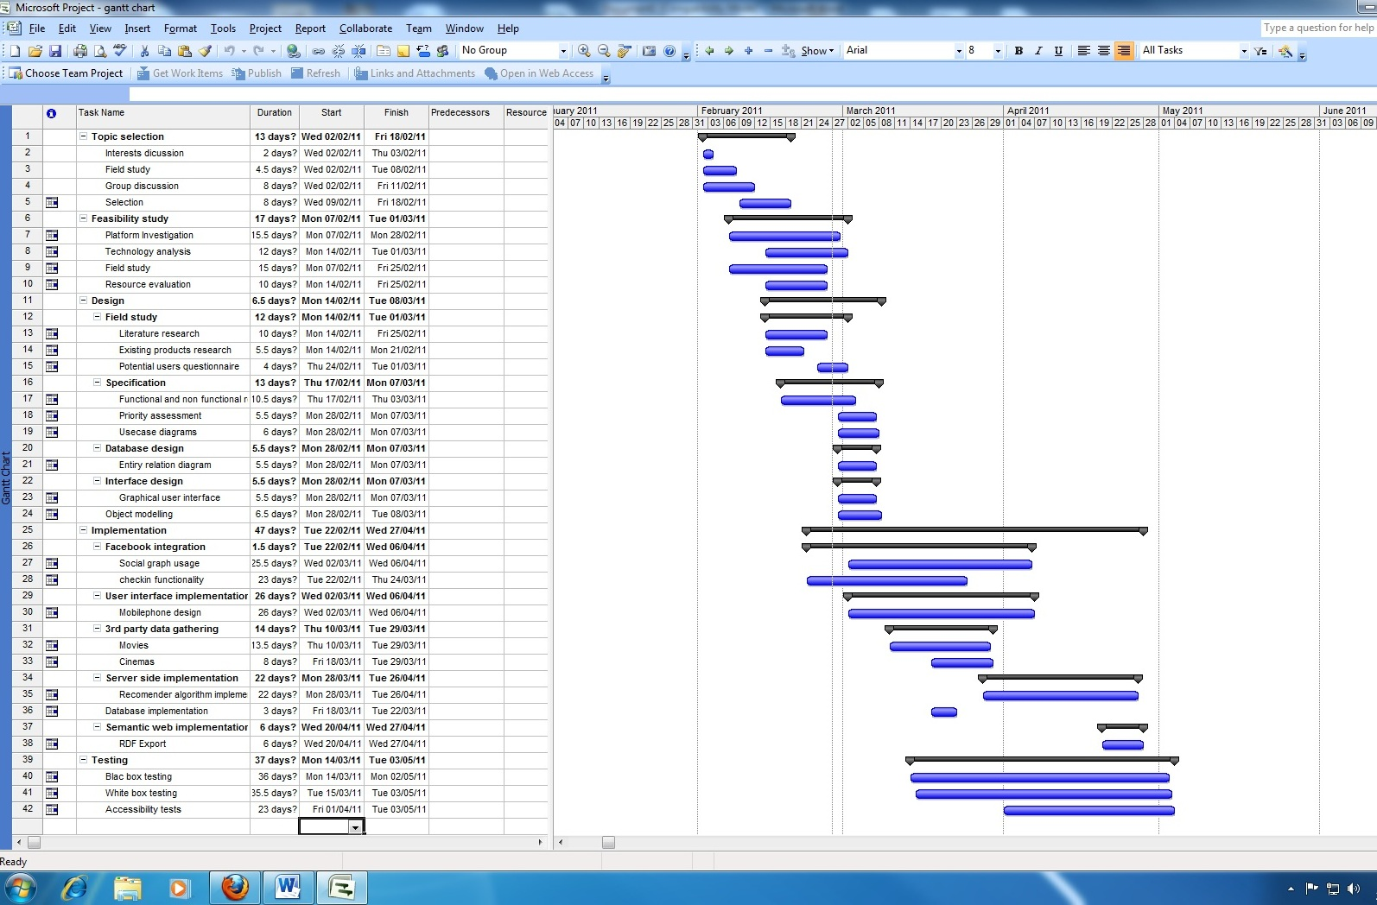
Sample Gantt Chart
Notes:
Tasks in relation to other tasks: start, finish, sequential and parallel
Where project should be at a given point in time
http://blog.soton.ac.uk/cybertube/files/2011/05/ganttchart-version1-image.jpg

Slide 17
6. Budget
Reviewers concerned with
Individual items
Bottom line
Return on investment (ROI)
Notes:
Individual items: some may not qualify for funding
Demonstrate ROI
552-553

Slide 18
6. Budget
Specific
Complete
Correct
Reasonable
Notes:
Complete: if postage, then plan should state what is mailed
Correct: no arithmetic errors
Reasonable: not inflated, only things actually needed
Formatting: consider a table
552-553

Slide 19
Who wins?
Not always the lowest bid
Also important
Quality
Safety
Security
Timeliness
Attention to detail
Sound arguments
Low cost
Notes:
Who wins the competition?
552

Slide 20
7. Personnel and Qualifications
Internal audience
Staff needs: names / positions and timeframe
External audience
Résumés
Qualifications
Specific
Relevant
Previous related experience
Notes:
Names / positions and timeframe: DBA for weeks 3-6, Mary for weeks 2-8
Use external for homework assignment
Résumés of key project staff
No résumés for homework assignment
Regardless, previous related experience
553

Slide 21
8. Facilities and Equipment
Specialized facilities / environment
Specialized equipment
Needed
Include why
Available
Include where
Notes:
Specialized facilities: cleanroom
Specialized environment: Unix computers
Specialized equipment: fabrication
553

Slide 22
Supplements
Keep proposal readable!
“Excess” material
Résumés
Detailed budget
Letters of endorsement
Spec sheets
Cohesion
Separate appendix for each item
Notes:
554

Slide 23
Graphics
Improve understandability
Increase impact
Examples
Notes:
Graphics are required
Examples: illustration of final product (screen shot)
554

