Slide 1
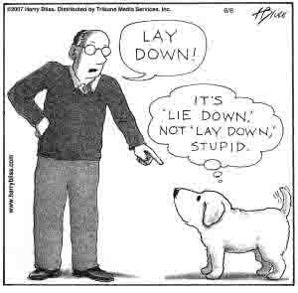

Slide 2
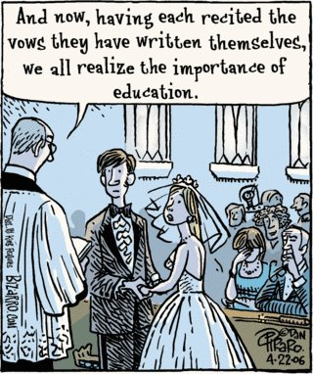

Slide 3
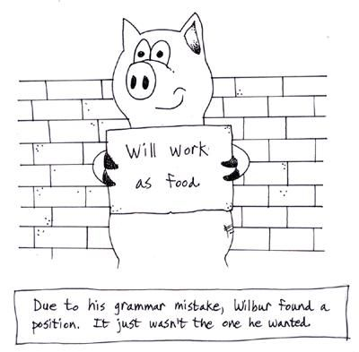

Slide 4

Notes:
Reviewing is more than just checking spelling, grammar, and punctuation

Slide 5
Reviewing
taken from
Technical Communication Today, Second Edition
by Richard Johnson-Sheehan
Notes:
Where did I learn to drench your papers in red ink?
At work.

Slide 6
Four Levels
Revising
Substantive editing
Copyediting
Proofreading

Slide 7
Four Levels
Revising
Substantive editing
Copyediting
Proofreading

Slide 8
Revising Overview
“Global editing”
Requires courage
Communication’s
Subject
Purpose
Readers
Notes:
Global editing – look at the document as a whole
Courage
– the entire document may need to be tossed
– major parts may need to be refactored

Slide 9
Subject
Does the subject need to be narrowed or broadened?
Has the communication strayed from the subject?

Slide 10
Purpose
Is the communication achieving its purpose?
Is the purpose clearly stated in the introduction?

Slide 11
Readers
Does the communication …
meet the needs of the primary readers?
anticipate the values and attitudes of the primary audience?
sufficiently address the needs of non-primary audience?
Notes:
Consider the characteristics of the primary readers and other possible readers

Slide 12
Four Levels
Revising
Substantive editing
Copyediting
Proofreading

Slide 13
Substantive Editing Overview
Content
Organization
Design

Slide 14
Content
Look for any gaps or digressions in the content
Are there any places where the communication lacks proof or support for claims?
Is the communication limited to “need to know” information or does it include “want to tell” information?

Slide 15
Organization
Does the introduction clearly identify the subject, while stating the purpose and the main point?
Should the introduction include more background information or stress the importance of the subject?
Does the conclusion tie summary information together, restate the main point, and restress the importance of the subject?
Should the conclusion look to the future?
Notes:
Conclusion should also provide summary material

Slide 16
Design
Is the text scannable?
Does the design clarify the structure of the text with titles and subheadings?
Do the graphics support the text, and do they clarify difficult points?

Slide 17
Computer Science Linux Computer Lab Help
Revising
Subject
Purpose
Readers
Substantive Editing
Content
Organization
Design

Slide 18
Four Levels
Revising
Substantive editing
Copyediting
Proofreading

Slide 19
Copyediting Overview
Improve style
Clarity
Consistency
Informative or persuasive
Sentence and paragraph levels
Notes:
Sentence and paragraph material to follow

Slide 20
Sentences
Make sure sentences are clear and concise
Are there unnecessary prepositional phrases?
Are the sentences breathing length?

Slide 21
Paragraphs
Make sure paragraphs support specific claims
Does each paragraph have a clear topic sentence and enough support to back it up?
Is the topic sentence the first sentence?
Does the text flow smoothly?

Slide 22
Headings
Easy to understand
Consistently used
Do the headings properly reflect the information that follows them?
Notes:
Headings are required

Slide 23
Headings
Do the headings make the communication scannable, highlighting places where important information can be found?
Are there clear levels of headings that help readers identify
The structure of the communication and
The importance of each part of the communication?
Notes:
Numbered headings are required

Slide 24
Graphics
Support the text
Accurate
Does each graphic tell a simple story?

Slide 25
Graphics
Does each graphic support the text without replacing it?
Are the graphics clearly titled and referred to by number in the written text?
Notes:
Requirement: identifier, title, source

Slide 26
Four Levels
Revising
Substantive editing
Copyediting
Proofreading

Slide 27
Proofreading Overview
Grammar
Punctuation
Spelling
Typos
Word usage
Notes:
“Punctuation is designed to mirror the way we speak.”
Do not rely to heavily on computer grammar and spell checkers
Spelling: use a dictionary

Slide 28
Dangers from Failure
Communication looks
Sloppy
Unintelligent

Slide 29
Dangers from Failure
Readers doubt
Communication quality
Information quality
Your abilities
Your commitment to quality

Slide 30
The Mythical Man-Month
Copyediting
Proofreading

Slide 31
Verification and Validation
Read and locate tests
Can they find it?
Understandability tests
Can they understand it?
Performance tests
Can they do it?

Slide 32
Revising
Which comments do you
Incorporate?
Ignore?
Specific comments are easy to incorporate
Notes:
Non-specific comments: this doesn’t make sense, I’m confused, lacks clarity, this paragraph doesn’t belong here
What about: need a specific example

