Slide 1
Social Style
“Social style does NOT focus on the innermost workings of one’s personality, nor focus on one’s values or beliefs.
A social style is a pervasive and enduring set of interpersonal behaviors.
It is quite simply how one acts – and what one says.”
David W. Merrill and Roger H. Reid

Slide 2
Goals
There isn’t a “best” social style
“It is perfectly normal – and okay – to be as you are”
You may not have a single social style
Different social styles for different situations
Notes:
Different situations: work, home, church

Slide 3
Goals
Purpose
Recognize yours
Recognize other person’s
Make appropriate adjustments
A trait can be both beneficial and problematic
Notes:
Story time: performance appraisal and Rau
Next slide: I responded

Slide 4
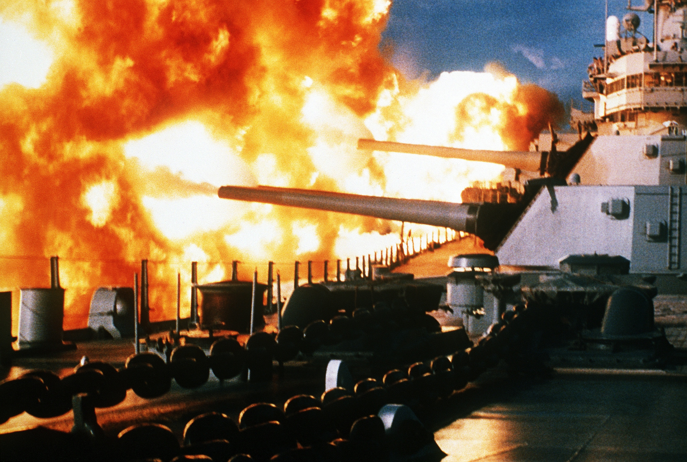
Notes:
http://upload.wikimedia.org/wikipedia/commons/3/3f/USS_New_Jersey_firing_in_Beirut,_1984.jpg

Slide 5
X Axis
Dominance – the amount of control and forcefulness you attempt to exert over people and situations
Assertiveness – the degree to which a person’s behaviors are seen by others as forceful and directive
ask
tell
Notes:
Draw graph
Tell assertive: when I want your opinion, I’ll give it to you
Ask assertive: prefer to be told what to do

Slide 6
Y Axis
Sociability – your willingness to express emotions and focus on either people or tasks
Responsiveness – the degree to which a person’s behaviors are seen by others as emotionally controlled
control
task
emote
people
Notes:
More responsive people react noticeably to their own emotions or to the emotions of others.
Less responsive people are more guarded in their emotional expression.
Control: controls emotions
Emote: display emotions

Slide 7
Quadrants
Analytical | Driver
Amiable | Expressive

Slide 8
Putting it Together
Analytical Control Ask | Task Driver Tell
Amiable Emote | People Expressive

Slide 9
Graph
Quadrants tend to describe extremes
Each quadrant has four sub-quadrants

Slide 10
Sub-quadrants
Analytical Analytical | Driver Analytical | Analytical Driver | Driver Driver
Amiable Analytical | Expressive Analytical | Amiable Driver | Expressive Driver
Analytical Amiable | Driver Amiable | Analytical Expressive | Driver Expressive
Amiable Amiable | Expressive Amiable | Amiable Expressive | Expressive Expressive

Slide 11
Analytical
Task focus and ask assertive
Orientation: think things through and be right
Focus on facts more than feelings
Evaluate situations objectively
Prefer organized work environments
Notes:
Not assertive
Not emotionally expressive
Total perfectionist
Good planner
Someone who likes to rely on proven ways of doing things
Very hesitant to make decisions (never enough data)
Analyze things to death – but decisions are usually sound – if you can get one
Give him a plan and he provides ten reasons why it won’t work
Prefers working independently
Usually not good in team environments
Dependable (unless you need a decision, then predictable)

Slide 12
Analytical Traits
Positive: precise, methodical, organized, rational, detail oriented
Negative: critical, formal, uncertain (never enough data to make a decision), judgmental, picky
Notes:
Why do you want this person on your team?

Slide 13
Analyticals with Others
Decide!
Speak and smile more
Show appreciation and personal interest
Relax
Share information and be more open
Remember, enthusiasm won’t kill you

Slide 14
Amiable
People focus and ask assertive
Orientation: have relationships, please others, and have security
Responsive and friendly
Want you to respect them and value them
Prefer organized work environments
Notes:
A people person – very people focused – likes to be with people
Somewhat emotionally expressive
Unassertive, does not push his way
Enjoys spending a lot of time helping people
Likes talking and fellowshipping with people
Mr. Nice Guy
Mr. “I’ll give you the shirt off my back”
Mr. “I’ll give you my last nickel”
Loyal
Easygoing
Good listener
Values team players who don’t “rock the boat”
Conformist and follower – rarely leader
Avoids conflict
Not a good decision maker – happier if others make the decisions

Slide 15
Amiable Traits
Positive: cooperative, dependable, warm, listener, negotiator
Negative: undisciplined, dependent, submissive, overly cautious, conforming
Notes:
Why do you want this person on your team?

Slide 16
Amiables with Others
Speed up when communicating with “fast” people
Talk more, listen less
Take control occasionally
Be assertive
Take some risks
Notes:
Fast people: drivers and expressives

Slide 17
Expressive
People focus and tell assertive
Orientation: intuitive, creative, and humorous
Outgoing, enthusiastic, and friendly
Prefer to work with other people
Want to be acknowledged, not ignored
Notes:
Excitable
Highly assertive
Always striving after goals
Relies totally on having a new, exciting goal to go for
If no new goal, gets discouraged and depressed
When gets a goal, becomes so excited that doesn’t have time to sit down and think about everything that could go wrong – not patient
Just goes off like the proverbial “bull in a China shop” impulsively off in his direction and doing his thing
High energy level
Great idea generators, but usually do not have ability to see the idea through to completion
Very opinionated and egotistical
Money motivated
Can be a good communicator
Prefer to direct and control rather than ask and listen

Slide 18
Expressive Traits
Positive: enthusiastic, persuasive, outgoing, positive, communicator
Negative: ego centered, emotional, exploitive, opinionated, reacting, impatient
Notes:
Why do you want this person on your team?

Slide 19
Expressives with Others
Slow down, listen more
Write things down
Set specific goals
Check details
Remember to stay calm
Learn to focus

Slide 20
Driver
Task focus and tell assertive
Orientation: win! and act decisively and in control
Know where they want to go and how they are going to get there
Good at managing tasks; results oriented
Like competitions and want to win
Notes:
Typical manager, boss type
Very assertive
Not emotionally expressive
Very work oriented
Does not care about people (“I Hate People” is his song)
Will trample all over people; doesn’t care about their feelings
Just want to get the job done
Takes charge, dictates, commands – the boss!
Intense, focused, relentless
Thrives on the thrill of the challenge
Has the internal motivation to succeed
Money is only a measure of success; it is not a driving factor
Results and performance oriented
Has compassion for the truly disadvantaged
No patience or tolerance for the lazy or whiners

Slide 21
Driver Traits
Positive: persistent, independent, decision maker, effective, strong willed
Negative: aggressive, strict, intense, relentless, rigid
Notes:
Why do you want this person on your team?

Slide 22
Drivers with Others
Listen!
Slow down with “slow” people
Hold back from dominating
Learn when to relinquish some control
Show more patience
Act more relaxed

Slide 23
Cars
Analytical
Good resale value and great gas mileage
Amiable
Four-door sedan or mini-van to take the kids (and everyone else) to sporting events
Expressive
Red convertible with great stereo; gas mileage not an issue
Driver
Prestige car (not for attention but because a wise investment)

Slide 24
Party
Analytical
Wants to know why so much money was spent on A&W when Western Family could have been purchased; comes with a laptop
Amiable
Cleans up after party is over
Expressive
Originated idea for party, but never helps clean up – on the way to another party
Driver
Wants to know why there is a party, what the benefits are, and if the right people were invited

Slide 25
Avoid Judgment
No right or wrong social style
People from all four styles can be successful
Focusing on tasks does not mean lack of concern for people
Focusing on relationships does not mean lack of concern for completing the job

Slide 26
Potential Problem – Extremes
Analytical Analytical |  |  | Driver Driver
Amiable Amiable |  |  | Expressive Expressive

Slide 27
Potential Problem – Opposites
Analytical | Driver
Amiable | Expressive

Slide 28
Potential Problem – Opposites
Analytical | Driver
Amiable | Expressive

Slide 29
Review from Previous Class
No best social style
Purpose
Recognize yours
Recognize other person’s
Make appropriate adjustments

Slide 30
Review from Previous Class
Analytical Control Ask | Task Driver Tell
Amiable Emote | People Expressive

Slide 31
Team Composition
What social styles should be represented on a team?
In what roles?
Leader
Interface with customer
Interface with other teams
Worker

Slide 32
Determining Social Style
Task oriented or people oriented?
Control or emote?
Tell assertive or ask assertive?

Slide 33
Which Social Style?
Darth Vader
Luke Skywalker
Princess Leia Organa
Yoda
R2-D2
C-3PO
Notes:
Anakin Skywalker

Slide 34
Which Social Style?
Frodo Baggins
Gollum
Gandalf
Legolas
Gimli
Aragorn
Notes:
Smeagol

Slide 35
Brother Twitchell
 |  |  | Expressive Driver
Notes:
I am expressive driver
Read description

Slide 36
The characteristics your references attribute to you as a driver are: assertive, sure of your opinions, and results-oriented. You are usually perceived as a person who likes to challenge new ideas, responds quickly, and does not hesitate to correct, amend, modify, or confront others. People see you as straightforward, quick to act, opportunistic, and forceful.
As a driver, your goals are best achieved when in charge and taking the initiative. You prefer situations which allow you to formulate plans, then have others carry them out. As a driver, you are seen as liking to make things happen, taking risks, and enjoying the challenge involved in taking on new problems and tasks.
You are perceived as working best when the climate is not constrained. Independence to do your own thing is important and you usually proceed in an organized, goal-oriented manner. Time is important and you like people to respect your schedules. A climate that allows you to initiate action, monitor the activities of others, and provide direct feedback is comfortable for you.

Slide 37
Although your driving characteristics are perceived as dominant, you are perceived as having expressive characteristics also. The expressive characteristics your references use to describe you include:
Showing enthusiasm when excited about something.
Showing concern for people; giving people strokes and making them feel good about themselves and your relationship.
Somewhat open and willing to share personal feelings and ideas.
As a driver, you are perceived as having the following strengths:
Taking charge, command, or control.
Being quick to act.
Liking challenges; preferring to deal with things that are difficult to master.
Focusing on producing results and getting things done.

Slide 38
In addition to the perceived strengths, there are some driving characteristics that certain people may sometimes find disturbing. Examples are:
Because drivers are work-oriented and proceed in a forceful manner, some people believe that drivers don’t take the time to build relationships or to listen to and understand the positions of others.
Competitiveness is seen by some as “stepping on others to reach a goal,” trying to match wits with adversaries, and getting into win-lose battles.
A driver’s independence, desire to control, and aggressiveness can create relationship tension, compliance in some, and even fear in others.

Slide 39
Brother Twitchell
What should I do to better interact with you?
What should you do to better interact with me?
Notes:
Be specific, clear, and brief
Do not over-explain, ramble, or be disorganized
From beginning to end, focus on results
Select the key facts and use them when making your case
Present them logically and quickly
Stay on topic
Keep the pace up
Honor time limits
Depart quickly but graciously

