Slide 1

How many like to write documentation?
How many like it when no documentation is available?
Notes:
By the show of hands …
http://thevirtualpresenter.com/wp-content/uploads/2012/02/hands_showof_handup_handsup_iStock_000009311779Large_TheVirtualPresenter.com_.jpg

Slide 2
Technical Documentation
Notes:
Requests to discuss this – added to schedule
We already have
Some review, some new material
Most of class will center on source code comments

Slide 3
Examples
Spec / data sheet
Patent
User guide
Help
Requirements specification
Architecture description
Design description
Notes:
All informative documents – we have already discussed informative technical communication
Purpose is to explain

Slide 4
Assumption
Someone will read the documentation
“Now faith is the substance of things hoped for, the evidence of things not seen.” – Hebrews 11:1
Notes:
Huge assumption
As such, a matter of faith

Slide 5
Benefits
Reduce help desk calls
Perceived to be a better product
Users
Developers
Maintenance

Slide 6
Audience
End user
Novice
Veteran
Maintenance
Novice
Veteran
Notes:
Who is the audience?

Slide 7
Do
Consider your audience
Technical or non-technical
Proper level of detail
Remember
Detail obscures truth for non-technical
Detail reveals truth for technical

Slide 8
Do
Be consistent
Notes:
Consistent: avoid synomyms

Slide 9
Do
Practice over theory
Notes:
Remember instructions – background helps, but need the actual nuts and bolts

Slide 10
Do
Emphasize clarity
Include examples
Include graphics

Slide 11
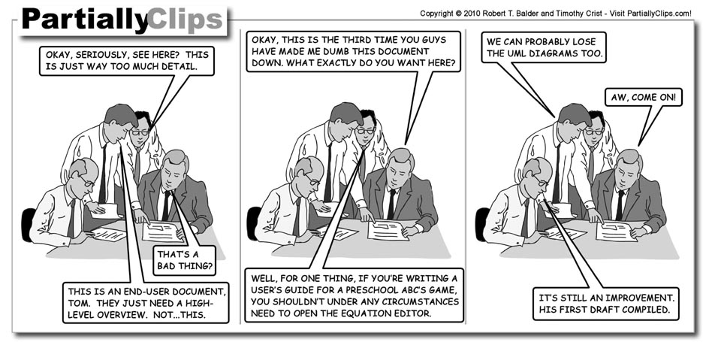
Keep it Simple
Notes:
Finally …
http://partiallyclips.com/comics/2010-08-24_document_review.jpg

