Slide 1
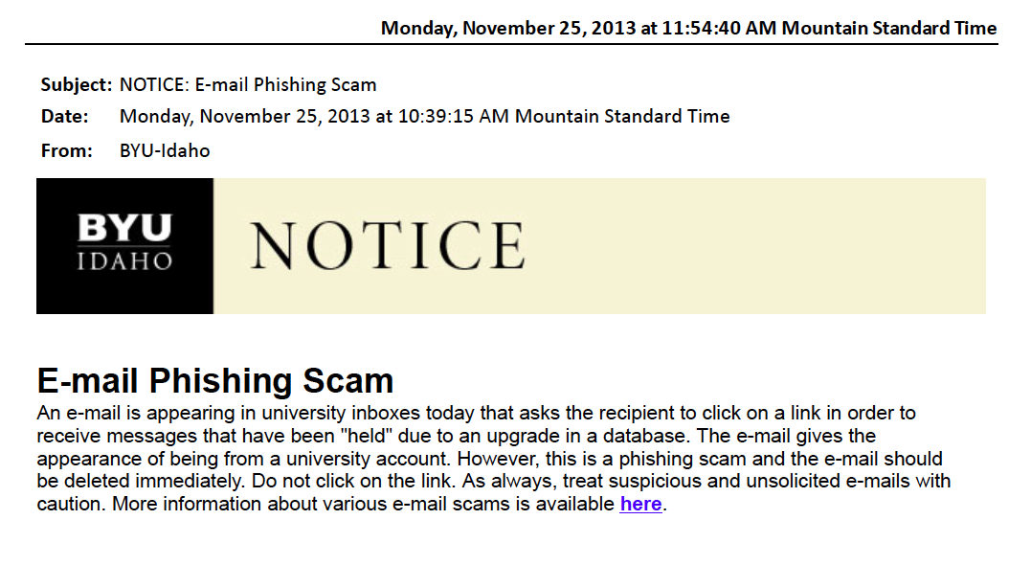
Notes:
Real example of workplace communication

Slide 2
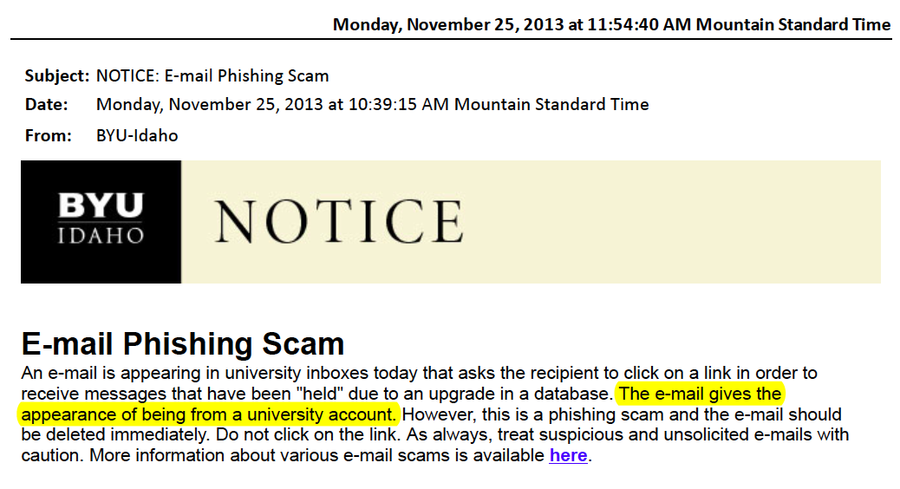

Slide 3
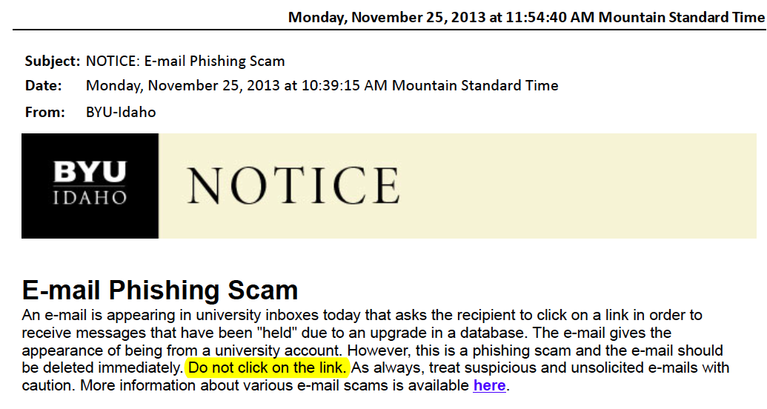

Slide 4
Workplace Communication
Email
Letters
Memos
Telephone

Slide 5
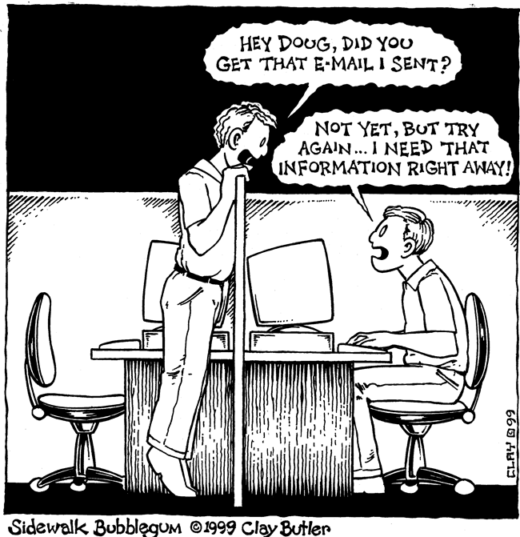
Notes:
Email
http://sidewalkbubblegum.com/wp-content/uploads/2010/03/sidewalk_bubblegum_199.gif

Slide 6
General
Provide a meaningful subject
Address intended receiver if cc or bcc
If necessary, introduce yourself
Notes:
Address intended received: Dear Frank or Frank –

Slide 7
Formality
Less formal than letters and memos
Less formal != casual
Maintain business formality

Slide 8
Formality
Business formal language
Avoid slang
Minimize abbreviations
“r u there?”
Spelling, grammar, punctuation
Proofread before sending

Slide 9
Attachments
Attach first
Rational names for attachments
Notes:
Habit of both curly braces / parentheses / square brackets
Attach first: don’t forget promised attachment

Slide 10
Less is More
Keep it short
No fancy formatting
Appropriate font size
Notes:
Fancy formatting: fonts, backgrounds, emoticons, etc.
Font size to enhance readability

Slide 11
Tone
No body language
No verbal cues, either
Maintain professional tone
No need for emoticons
Notes:
Verbal cues: pitch, tone, inflection, etc.
Professional tone: no sarcasm

Slide 12
Emphasis
Discrete use of bold and italics
DO NOT SHOUT
Calm down!!!!!!!!
Notes:
Bold & italics: formatting may not be received (text vs html)
Calm down: avoid excessive use of exclamation marks

Slide 13
Reply
Timely
Within 24 hours

Slide 14
Stop and Think
Remember the Reptile Response
Don’t overreact
Think first
If angry, wait 24 hours
Notes:
When replying, stop and think
Keep the cortex in charge

Slide 15
Privacy
You have none
Keep it professional
Nothing confidential
Notes:
You have none: company email is company property

Slide 16
Privacy
Use bcc when sending to a group

Slide 17
Privacy
When forwarding
Delete personal material
Delete identifying information
Notes:
Delete identifying information: if appropriate

Slide 18
Forever
Archived
Replied to and forwarded
Replied to and forwarded
Replied to and forwarded
Replied to and forwarded
Replied to and forwarded
Replied to and forwarded
Replied to and forwarded
Replied to and forwarded
Replied to and forwarded
Notes:
Email is forever in two ways

Slide 19
Oops!
Avoid reply to all
Recall probably too late
Confess instead

Slide 20
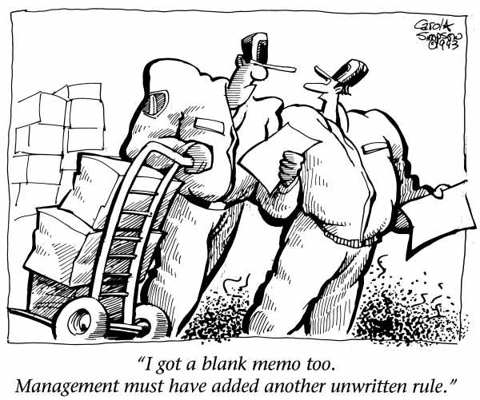
Notes:
Letters and memos
http://www.cartoonwork.com/the_company_memo_sjpg517.jpg
Cartoon from Kevin Astle

Slide 21
Memorandum
Latin – memorandus
To be remembered
Formal means of documenting
Notes:
Shared purpose of letters and memos: to be remembered

Slide 22
Similar
Formal language
Official record

Slide 23
Difference
Letter – external
Memo – internal

Slide 24
Format
Usually hardcopy
Company specific
Office staff will help

Slide 25
Endorsement
Sign letter
Initial memo

Slide 26
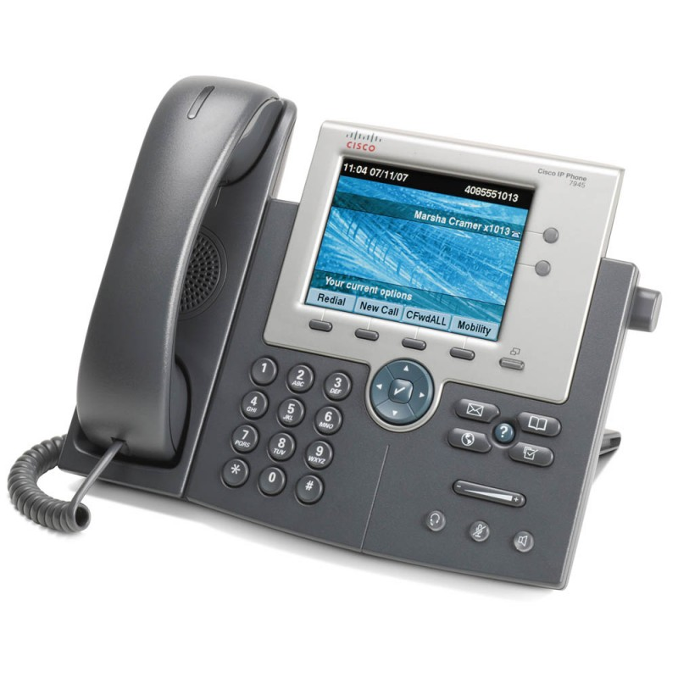
Notes:
Much of this discussed when subject was telephone interviews
http://www.ipendpoints.co.uk/image/cache/data/phones/cisco/7945-right-800x800.jpg

Slide 27


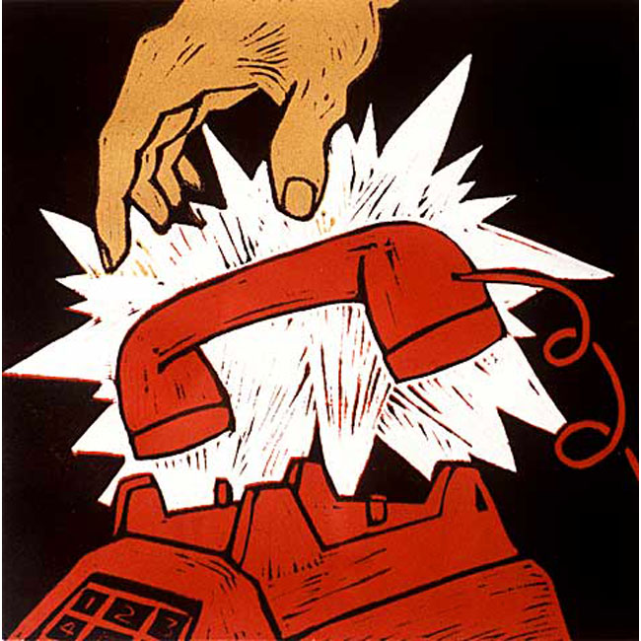
Notes:
Story of when I hung up on EPA person
Used speakerphone
Will be trained to hang up professionally
http://elletbranch.akronlibrary.org/files/2012/10/Storytime_logo3.jpg
http://college.lattc.edu/rrptraining/files/2012/09/epa_logo.jpg
http://www.alanlamont-art.com/images/Hangup.jpg

Slide 28
Benefits
Synchronous interaction can be faster
Voice
Pitch, tone, inflection
No body language
No written record
Notes:
No written record: Foundations Capstone prerequisites story

Slide 29
Speakerphone
Warn other person
Identify who else is present
Volume
Respect others in vicinity

Slide 30
Voice Mail
Asynchronous
But benefits of verbal
Identify self
Don’t ramble

Slide 31
Caution!
Beware mute
No written record
Notes:
Mute: may not be on when you think it is on

