Slide 1
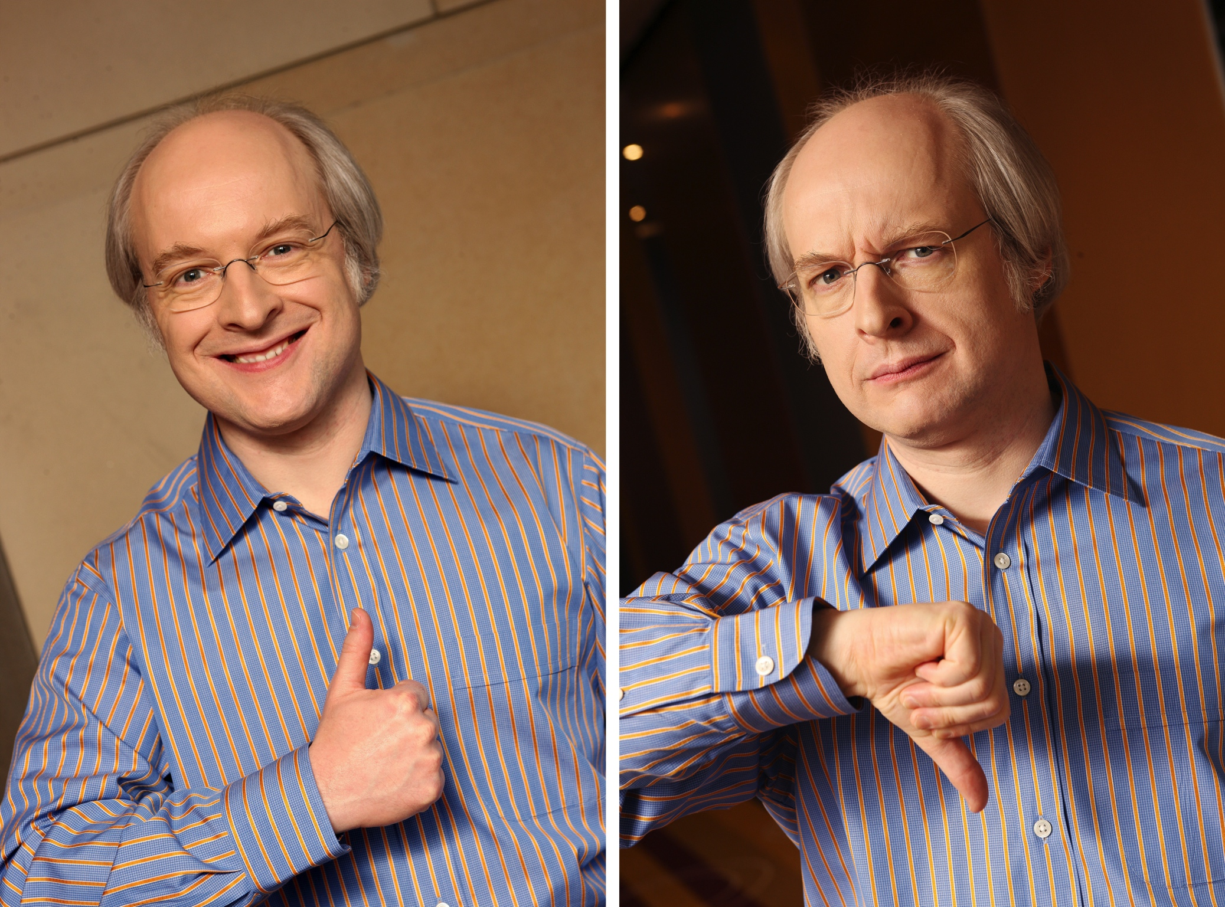
Notes:
Jakob Nielsen (born 1957 in Copenhagen, Denmark) is a web usability consultant. He holds a Ph.D. in human–computer interaction from the Technical University of Denmark in Copenhagen.
http://www.nngroup.com/

Slide 2
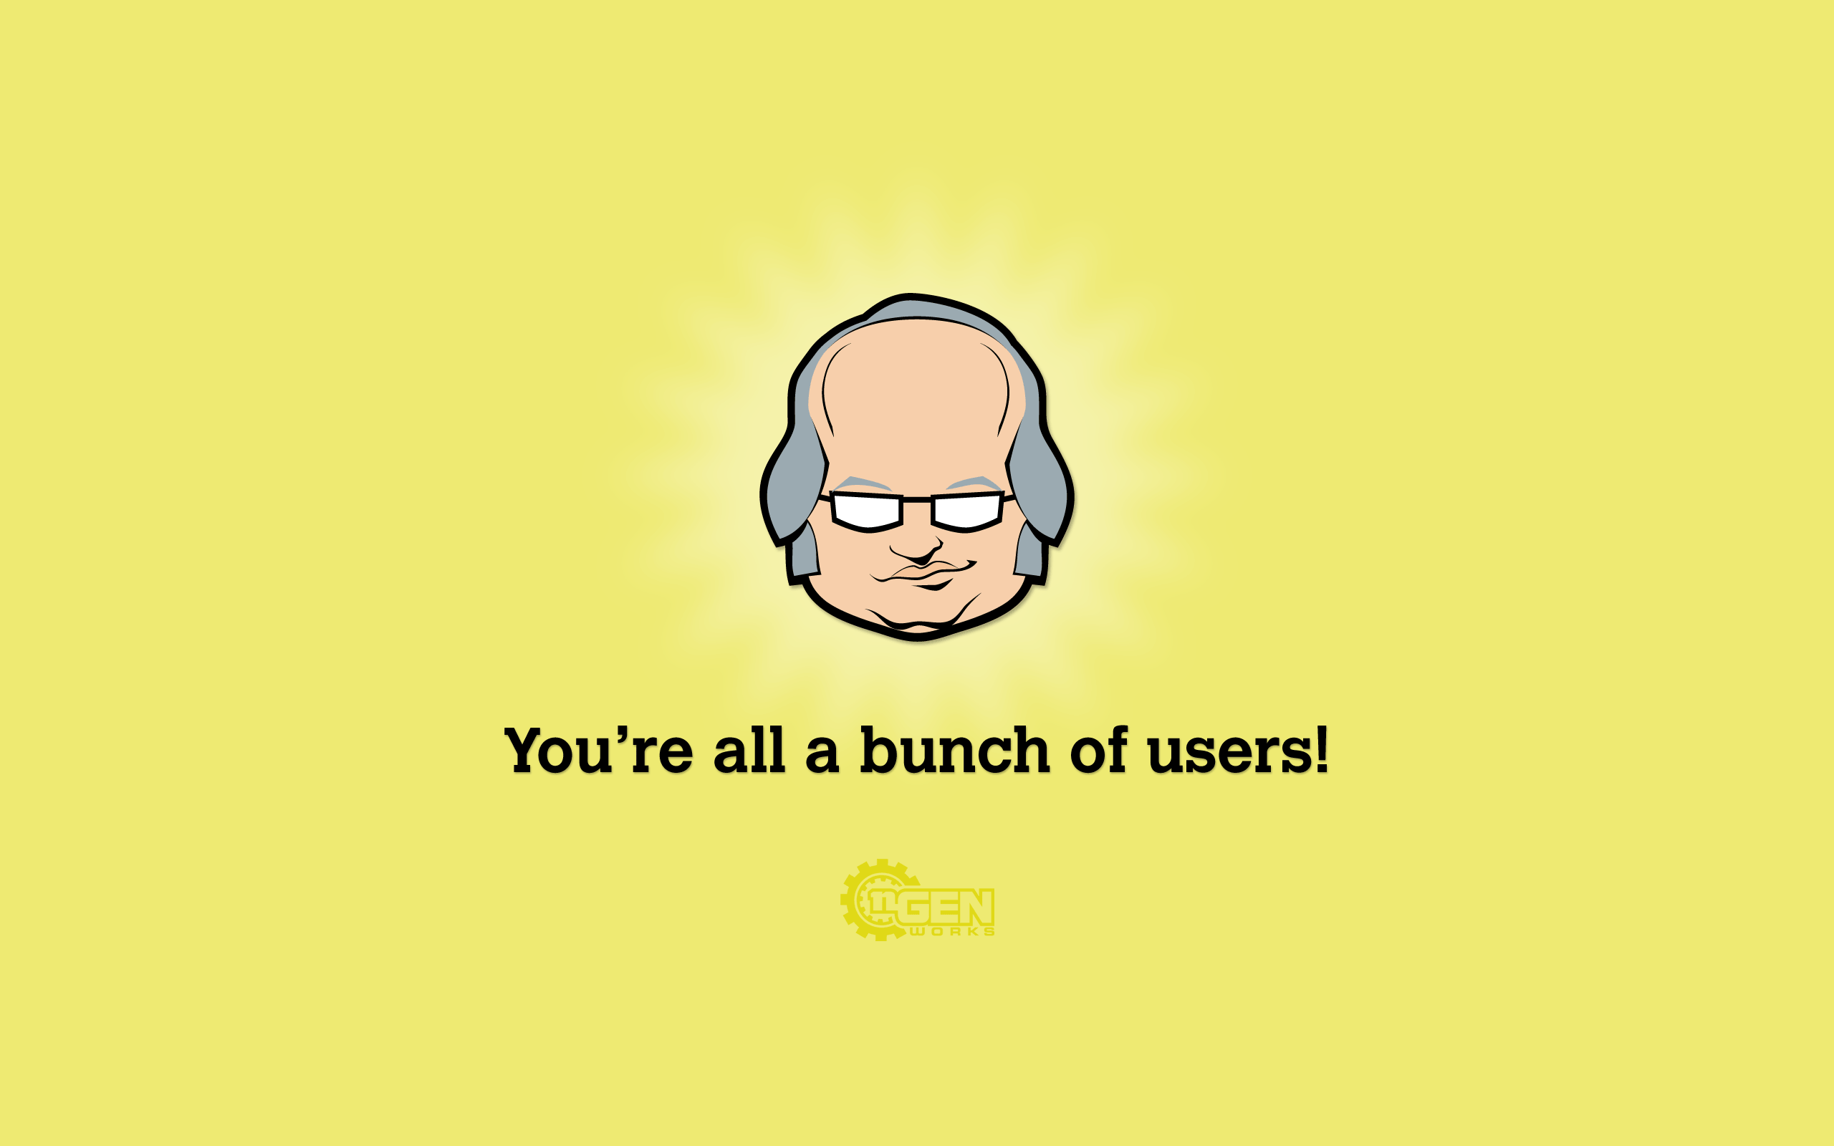
Notes:
Started Web usability studies in the nineties.
Evaluated how users actually used the web and viewed web pages.

Slide 3
Writing for the Web
Also Applies to Mobile
Notes:
Generally true for most technical communication

Slide 4
How Users Read
They don’t
They scan

Slide 5
User Behavior
Forage
Scannable text
Consume
Relevant text
Notes:
To satisfy behavior, provide ____ text
Relevant text – provide sought-after answers
http://www.nngroup.com/articles/eyetracking-study-of-web-readers/

Slide 6
First Two
Most important information
First two paragraphs
First two words
Notes:
First two words [of whatever] – next slide
http://www.nngroup.com/articles/f-shaped-pattern-reading-web-content/

Slide 7
First Two Words
Start with information-carrying words
Headings
Sub-headings
Summaries
Paragraphs
Bullet points
Captions
Links
Notes:
First two words are critical
Which of these facilitate foraging? Consuming?
Links – next slide
http://www.nngroup.com/articles/f-shaped-pattern-reading-web-content/

Slide 8
Headline / Link
Users scan down the left part of a list
Specific terms
Not a clever phrase
“Out of this world”
“Settling Mars”
Notes:
First 2 or 3 words are critical for scanning
“User’s don’t read – they scan” vs “Users scan”
http://www.nngroup.com/articles/writing-style-for-print-vs-web/

Slide 9
Headline / Link
Passive voice better
“Students propose adding scheduling the bishop from LDS Tools”
“Bishop scheduled using LDS Tools”
Notes:
Passive voice: emphasis on what was done rather than on who did it
http://www.nngroup.com/articles/writing-style-for-print-vs-web/

Slide 10
Headline / Link
Keywords
For searchability
Search engines
Search the page
Notes:
http://www.nngroup.com/articles/writing-style-for-print-vs-web/

Slide 11
Applying This
Headline, then summary
Four words for user
Reduce duplication of salient keywords
Four different words
Notes:
Look at first two words of headline, then first two words of summary == total of four words
http://www.nngroup.com/articles/passive-voice-is-redeemed-for-web/

Slide 12
How Users Read
F-shaped pattern
Two horizontal stripes
Followed by a vertical stripe
Notes:
F-shaped pattern – next slide
http://www.nngroup.com/articles/passive-voice-is-redeemed-for-web/

Slide 13
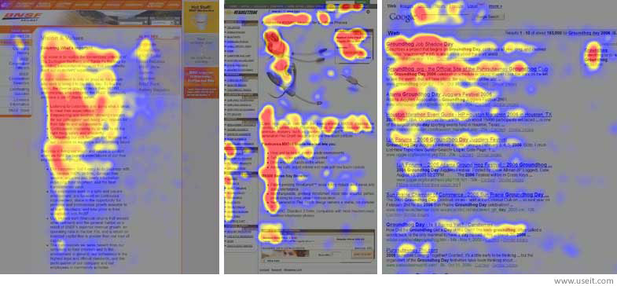
How Users Read
Notes:
Heatmaps from user eyetracking studies of three websites. The areas where users looked the most are colored red; the yellow areas indicate fewer views, followed by the least-viewed blue areas. Gray areas didn't attract any fixations.
F-viewing pattern is a rough, general shape
http://www.nngroup.com/articles/f-shaped-pattern-reading-web-content/
http://media.nngroup.com/media/editor/alertbox/f_reading_pattern_eyetracking.jpg

Slide 14
Content
50% of hardcopy text
Read 25% slower
Read 20% of text
Scanning is the norm
Headings and sub-headings
Quickly to the point
Notes:
Web gets 50% of hardcopy text because
Read 25% slower from screen than from hardcopy
http://www.nngroup.com/articles/be-succinct-writing-for-the-web/
http://www.nngroup.com/articles/writing-style-for-print-vs-web/
http://www.nngroup.com/articles/how-little-do-users-read/

Slide 15
Content
Cohesion: one idea per paragraph
Notes:
Why? Based on the first two words, I may or may not read the rest of the paragraph
http://www.nngroup.com/articles/how-users-read-on-the-web/

Slide 16
Traditional Writing
Start with background
Most important supporting information
Conclusion

Slide 17
Inverted Pyramid
Reverse of traditional writing
Conclusion
Most important supporting information
End with background

Slide 18
Numbers
Digits, not words
23, not twenty-three
Digits even when first word
Sentence
Bullet point
Notes:
Billion – can figure out all those zeroes
http://www.nngroup.com/articles/web-writing-show-numbers-as-numerals/

Slide 19
Numbers
Numbers up to one billion
2,000,000 rather than two million
2 billion rather than 2,000,000,000
24 billion
Notes:
http://www.nngroup.com/articles/web-writing-show-numbers-as-numerals/

Slide 20
Numbers
Spell out if no specific fact
Thousands of users
4,096 users
Notes:
http://www.nngroup.com/articles/web-writing-show-numbers-as-numerals/

Slide 21
Writing for Mobile Devices
Also Applies to Web
Notes:
Generally, separate page for mobile and for desktop

Slide 22
Mobile vs Desktop
Small screen
Tiny Text
Slower downloads
No mouse hover
Notes:
http://www.nngroup.com/articles/mobile-content-is-twice-as-difficult/

Slide 23
Mobile vs Desktop
“It’s much harder to understand complicated information when you’re reading through a peephole.”
Comprehension
Desktop: 39%
Mobile: 19%
Notes:
Quotation: R. I. Singh, et al; University of Alberta
Comprehension: of privacy policies
http://www.nngroup.com/articles/mobile-content-is-twice-as-difficult/

Slide 24
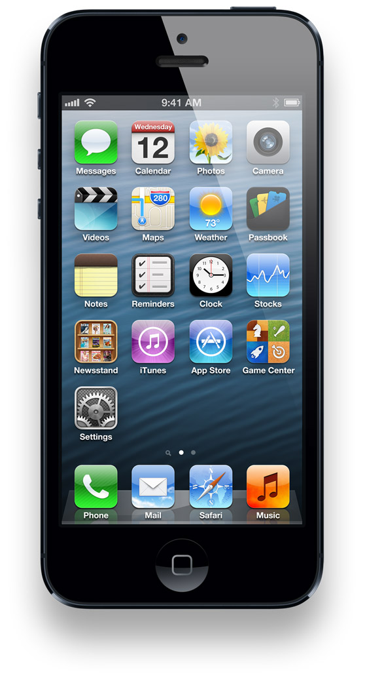
User Comprehension
48% of desktop
108% harder to understand using mobile
Notes:
Another study
Mobile comprehension is 48% of desktop comprehension
108% harder to understand mobile
Due to small screen size – next slide
http://www.nngroup.com/articles/mobile-content-is-twice-as-difficult/
http://www.nngroup.com/articles/defer-secondary-content-for-mobile/
http://s3.amazonaws.com/crunchbase_prod_assets/assets/images/original/0021/2054/212054v1.jpg

Slide 25
Small Screen Size
See less
Less context == less understanding
Rely on fallible memory
More scrolling
More time – degrading memory
Diverts attention
Reacquire previous location
Notes:
Fallible, degrading memory – human memory
Diverts attention from problem at hand to locating required part of page
http://www.nngroup.com/articles/mobile-content-is-twice-as-difficult/

Slide 26
Mobile Content
If in doubt
Leave it out
Extra, secondary stuff undesirable
Main points desirable
Short is too long
Ultra-short is better
Notes:
http://www.nngroup.com/articles/condense-mobile-content/
http://www.nngroup.com/articles/defer-secondary-content-for-mobile/

Slide 27
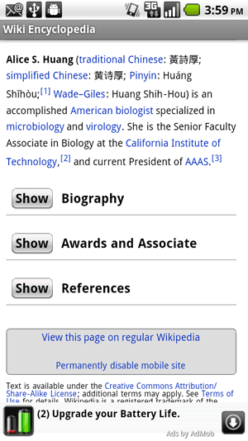
Example
Notes:
http://media.nngroup.com/media/editor/alertbox/wikipedia-mobile-initial.png

Slide 28
Now You Do It
Proposal Executive Summary
Notes:
For the web and, if time, for mobile
First – what do you need to do?

