Slide 1
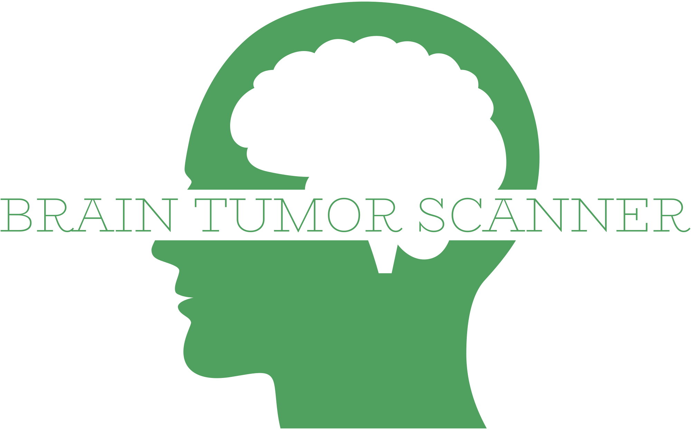
A deep learning application
By Juan Jimenez
Data source: https://www.kaggle.com/datasets/masoudnickparvar/brain-tumor-mri-dataset

Slide 2
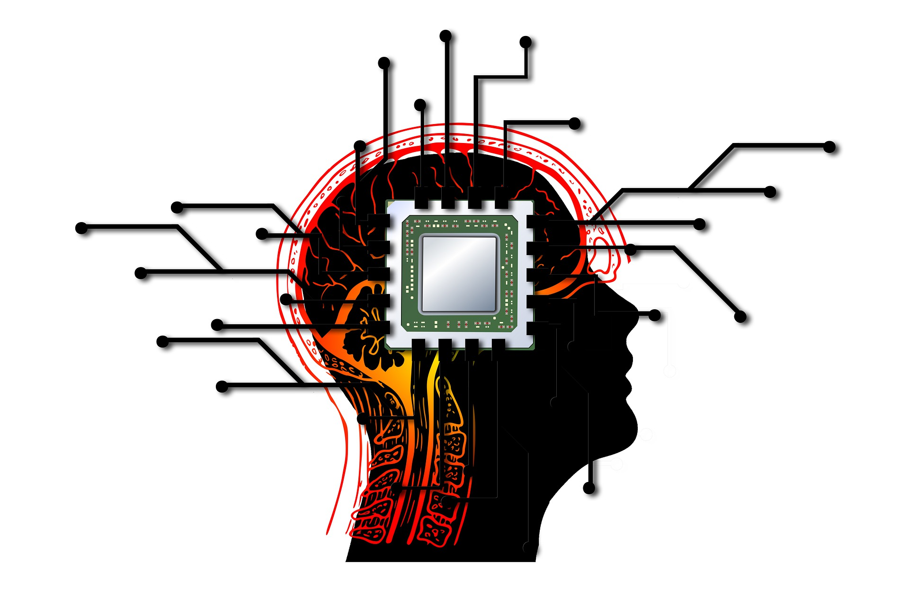
The human brain
Irreplaceable.
Essence of being human.
Runs automated body processes.
Extremely delicate.
Own environment.

Slide 3
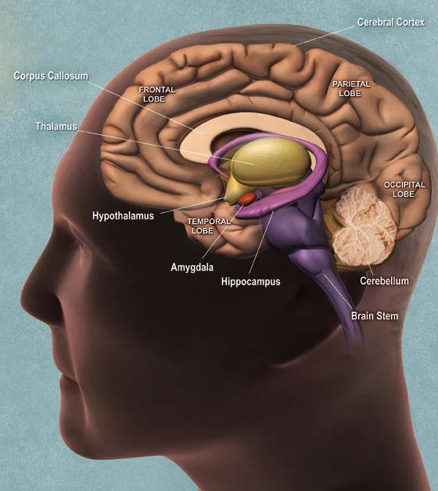
Brain anatomy
The brain is comprised of many parts, but the most relevant ones would be the following:
Cerebrum (divided in hemispheres and lobes)
Cerebellum
Medulla oblongata
Glands (pineal, pituitary, hypofisis)
This whole structure is covered by four membranes: the meninges.

Slide 4
3 types of tumors
We have trained our machine learning model with 3 different types of tumors:
Glioma
Meningioma
Pituitary

Slide 5
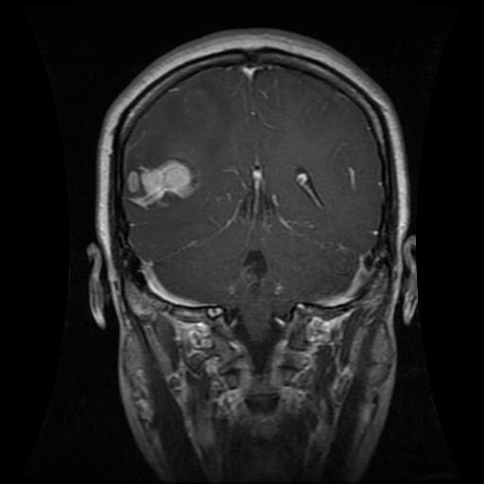
3 types of tumors: Glioma
Common type of tumor originating in the brain.
About 30 percent of all brain tumors (and 80% of all malignant ones). They originate in the glial cells that surround and support neurons in the brain.
Called intra-axial brain tumors as they grow within the substance of the brain and often mix with normal brain tissue.
Due to the location of these tumors (and since different cells and tissue can be involved), the treatment is complicated and the prognosis is not usually favorable, even for the Grade I and Grade II tumors.

Slide 6
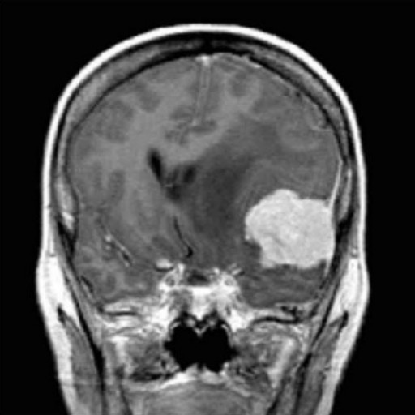
3 types of tumors: Meningioma
The most common type of primary brain tumor, approximately 30 percent of all brain tumors.
Overall, meningiomas have the best prognosis, since they originate in the meninges, which are close to the cranium, so surgery is less risky
The relative 5-year survival rate for atypical and anaplastic meningioma is 63.8%

Slide 7
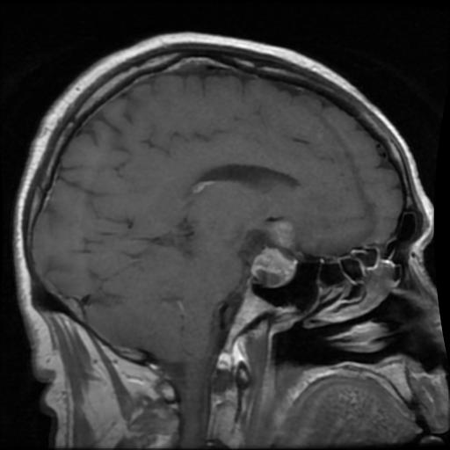
3 types of tumors: Pituitary
The pituitary is a small gland at the base of the skull, just below the brain and above the nasal cavities. The optic nerves pass just above it.
Considered the “master control gland” - it generates the hormones that control other endocrine glands in the body.
Very limited space, so any abnormal growth can press on the optic nerves – causing blindness.
Also, can affect the normal release of hormones, increasing or decreasing it. Some examples:
  Growth hormone
  Thyroid-stimulating hormone
  Luteinizing hormone (LH) and follicle-stimulating hormone (FSH)

Slide 8
Benign or malign tumors?
Whether the tumors are malign or benign, they pose serious health risks.
The brain is a pressurized environment with very little space, so any abnormal growth can cause increased pressure and issues like headaches, seizures, progressive weakness or paralysis on one side of the body, vision or speech problems.
Any major body function is subject to serious problems, apart from the the complications derived from a malign tumor growth.

Slide 9
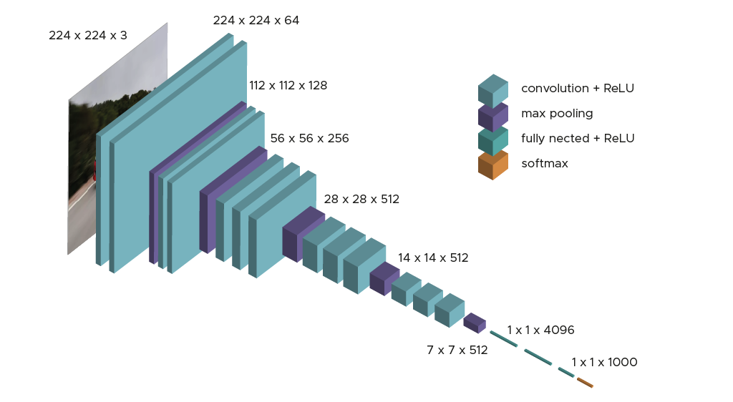
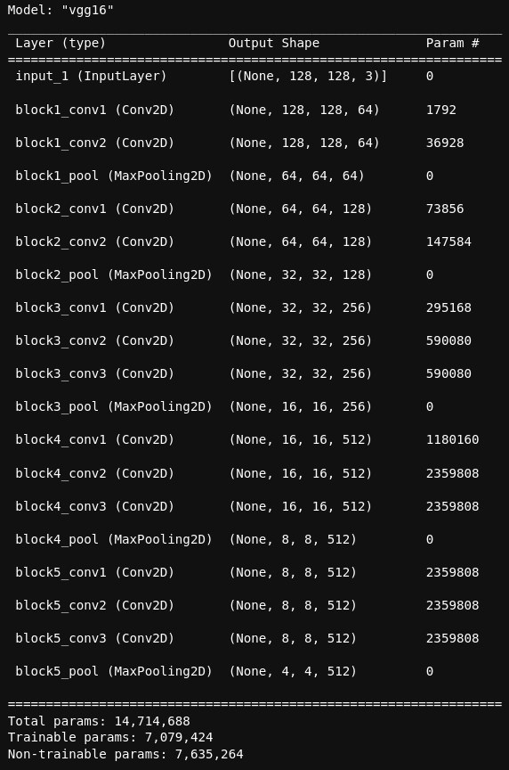
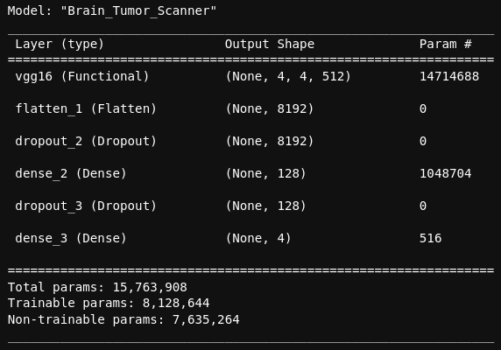
Brain scanner model
Our model takes a database with 5712 images belonging to 4 classes on the train set, and 1311 pictures on the test set.
After trying many different models and even switching to a binary model (transforming the original dataset), we have used a pre-trained model and retrained it with our dataset: VGG16.

Slide 10
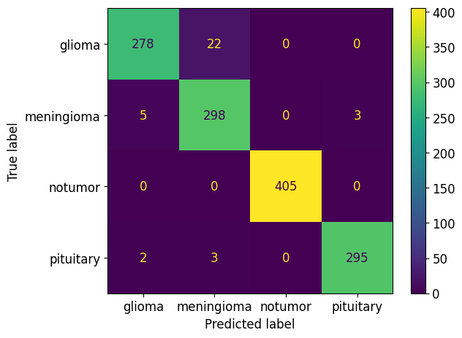
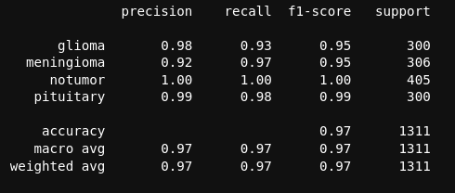
Model performance

Slide 11
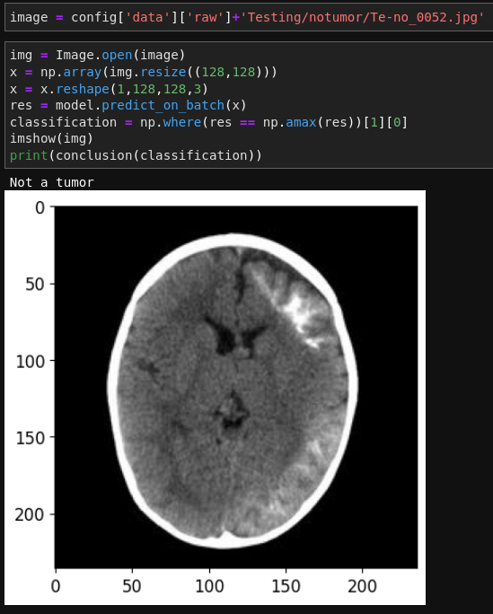
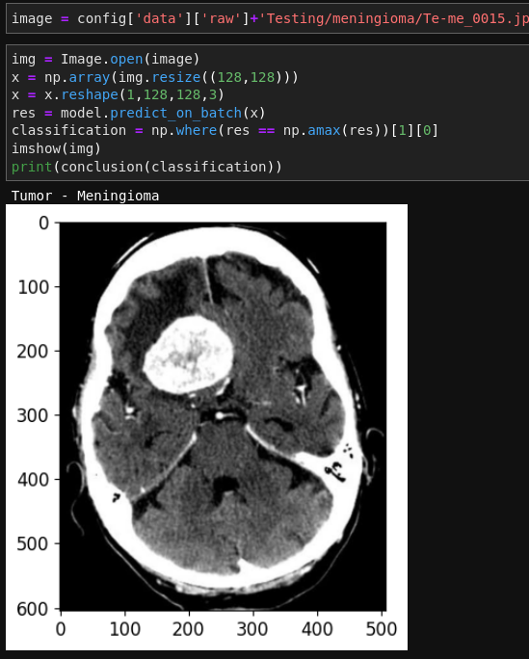
Some examples

Slide 12
Thanks for your time!
Now it’s time to check the app.

