Slide 1
STARS AIR ABMUBLANCE MISSION DATA ANALYSIS
07. 14. 2023
Jesse Keith
jkeith37@gatech.edu

Slide 2
Project

Slide 3

The Organization
STARS (Shock Trauma Air Rescue Service) is a helicopter air rescue and ambulance service that operates across the western Canadian provinces of British Columbia, Alberta, Saskatchewan and Manitoba.
STARS provides critical care, anywhere. Providing rapid critical care to a dispersed population across a large geographic area
STARS is one of the most recognizable and well-known not-for-profit organizations in Western Canada.
STARS Website

Slide 4
Project Overview
The opportunity:
Throughout the year, STARS must decline some mission calls for safety or technical reasons, such as weather that is not suitable for helicopter flight, or inadequate fuel availability along the route. However, in recent years, STARS has seen an increase in the number of mission declines because the helicopter covering the call area is already busy on another mission. This shows that at certain times STARS’ existing infrastructure (helicopters, crews, etc.) is over-capacity and that investing in additional infrastructure would lead to higher mission acceptance rates and to increased lives saved. However, investing in backup infrastructure is costly, and will likely be utilized only a portion of the time. Prior to making this investment, STARS requires a thorough quantitative evaluation of these resource allocation challenges. The goal of this project will be to use the STARS mission call database to arrive at a data-driven understanding of the need and timing for additional infrastructure.

Slide 5
Methodology

Slide 6
Methodology
The following high-level methodology has been outlined for this project but may be modified as the project progresses. Each stage is elaborated in more detail in the following slides.
Data
Goal: Build a dataset for modeling this problem
Acquiring the data
Understanding the data
Exploring the dataset
Modifying/Cleaning the data for analysis
Modeling
Goal: Create a model that matches the STARS mission/request data and is predictive of future time periods. The follow approaches are being considered (ranked based applicability to the problem):
Time-series approaches
Machine Learning approaches
Analysis
Goal: Use the fitted model and work with STARS strategy & planning staff to perform threshold analysis to quantify the cost and impact trade-offs of investing in additional resource.
Times of maximum impact
Cost/Benefit (Cost vs Missions Fulfilled)

Slide 7
Data

Slide 8
Data Warehouse
STARS’ mission and call center data from 2010 onwards is stored in a data warehouse (DW)
The first step in this process was to explore and understand the DW so that a dataset suitable for modeling the problem could be developed
SQL queries were made to the DW using Python and SQLAlchemy
Research, and collaboration with STARS’ Database Administrator was required to understand the DW and build the queries required to get a dataset for modeling

Slide 9
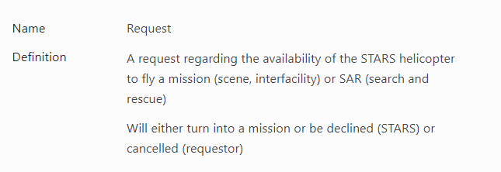
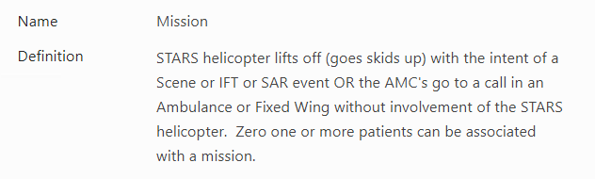
Data Terminology
A key step in the exploring the data warehouse was learning about STARS’ operations and terminology
The dataset applicable to this problem is built around the entities of Requests and Missions for the helicopter ambulances. Some of these terms are outlines below for illustration:
The goal of this project is to determine the likelihood that STARS will have to decline a Request due to already being on an “Other Mission”

Slide 10
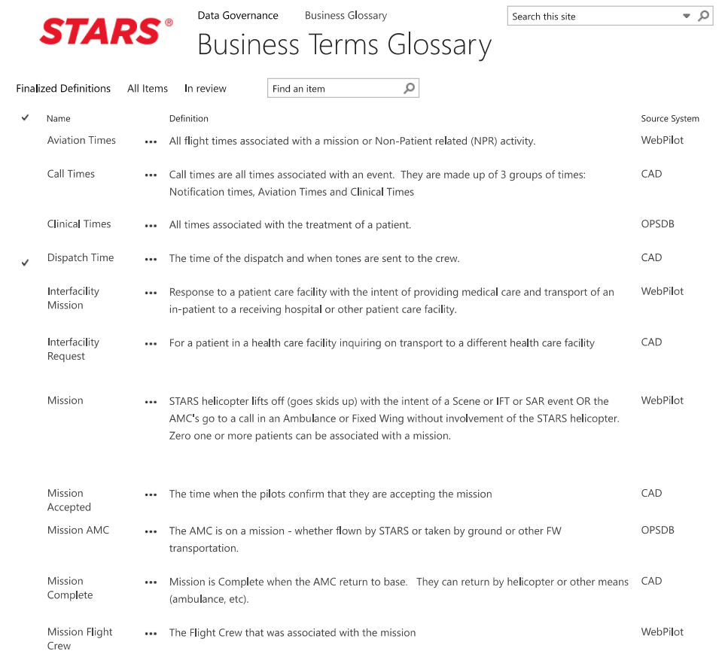
Data Definitions
Mission and Requests in the DW are associated via numerous databases and tables and contain many data fields.
Understanding which fields were required to build a dataset of “other mission” declines required learning about the DW and was a time-consuming process.

Slide 11
Data Preparation
Data is warehoused according to each individual Mission or Request
This data needed to aggregated into a dataset that was applicable for modeling
The selected approach has been to aggregate the data as a time-series, as the data shows significant seasonality components, as well there is time link between missions flown and requests declined
A weekly and daily aggregation have been selected as the time scale for modeling
However, monthly approaches were also considered however this timescale is not granular enough for decision making as per STARS SMEs
Daily predictions can be aggregated to weekly or monthly, but it is difficult to move the other way.
Queries were written to pull data for all missions that were declined due to “Other Mission”. These events do not happen every day. Therefore, empty days in the dataset needed to be populated with 0s.
Other mission is a compound metric between Requests and Missions. Another way to approach this problem would be to model Requests and Missions separately. Or to model Requests and assume a threshold capacity.

Slide 12
Dataset/Data-Views
There has been some disagreement between subject-matter-experts at STARS on the correct “Other Mission” count and dataset that should be used for this project
The primary focus of this project has been to look at bulk (all) OM coded request declines
Another view represents a more conservative count for “Other Mission” based on direct association with an executed mission in the DW
Collaboration was required to gain agreement on the correct data to use for modeling, and modeling was conducted on both subsets/views of the data
In general, these data subsets show the same trend and seasonality effects, although the total/magnitude of the “Other Mission” numbers are different
The “conservative” dataset is very sparse (contains a lot of zeros) which is a challenge for modeling
STARs SMEs have confirmed a change in data coding in 2018, which drives a noticeable change in the trend in the dataset. For this reason, analysis was focused on datapoint >01.01.2018

Slide 13
Data Exploration

Slide 14
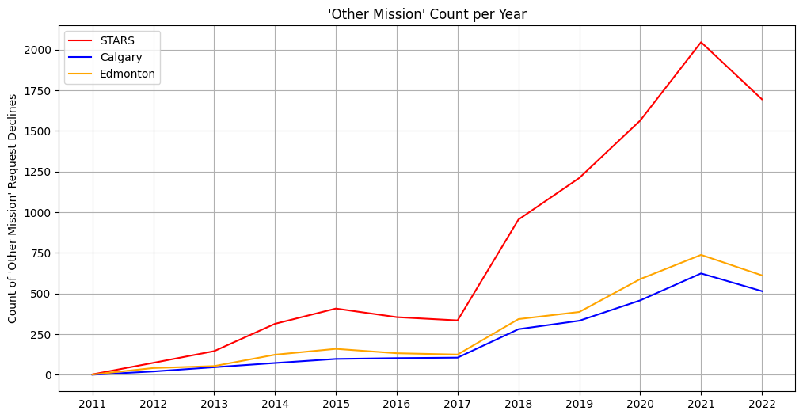
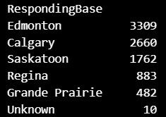
Mission Declines due to ‘Other Mission’
‘Other Mission’ declines 2011 - 2022
This plot shows the main problem/opportunity of this project. The number of missions being declined due to “Other Mission” are increasing.
The focus of the modeling stage will be on the Calgary and Edmonton bases, as these are the largest and busiest centres, leading to majority of the ‘OM’ declines.

Slide 15
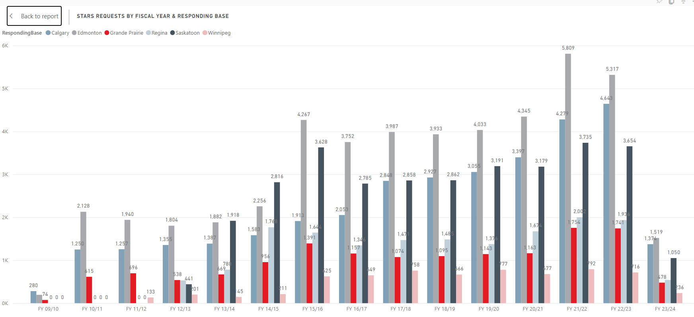
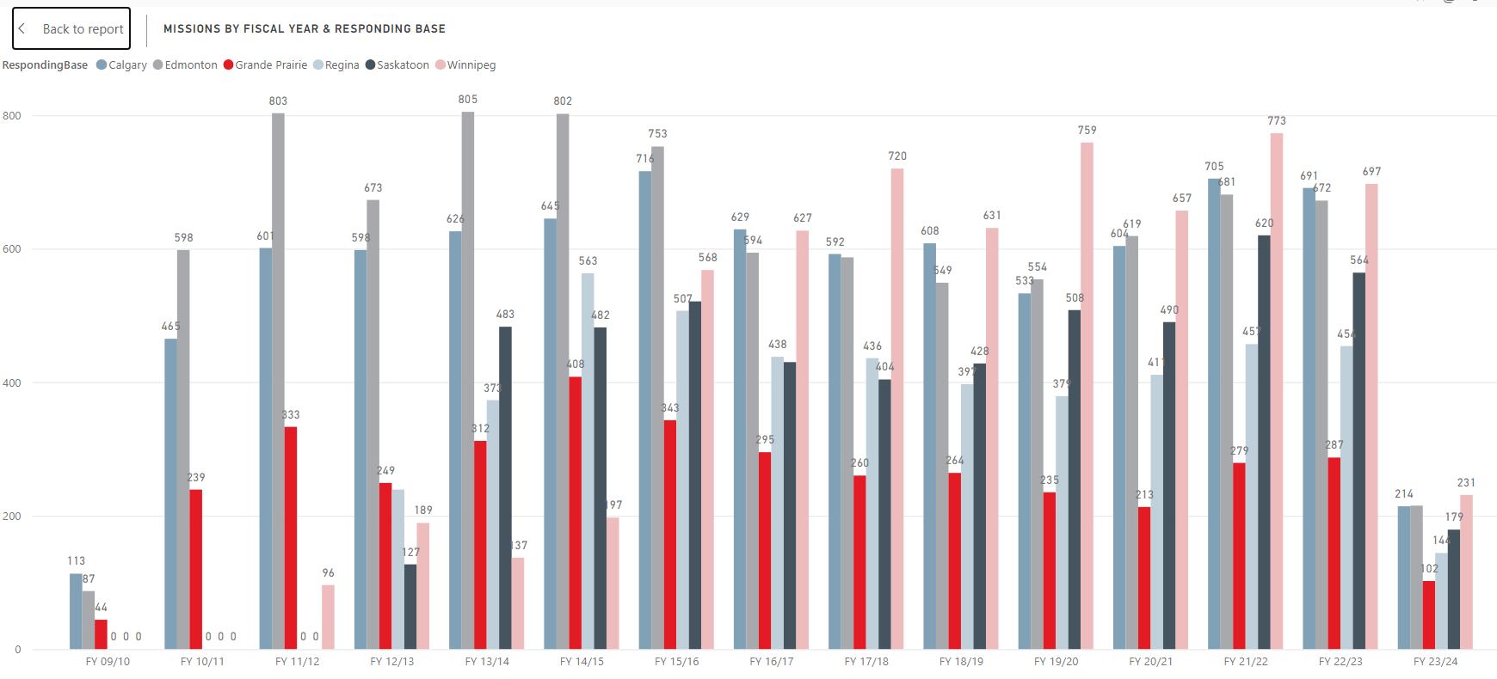
Requests vs Missions
Requests are increasing but missions are not increasing at the same rate

Slide 16
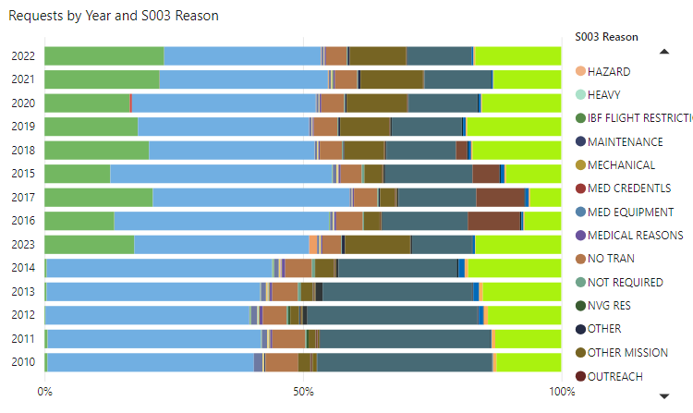
OM Decline Ratio

Slide 17
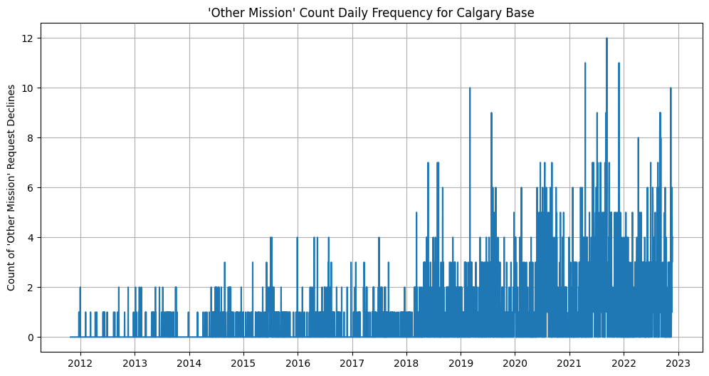
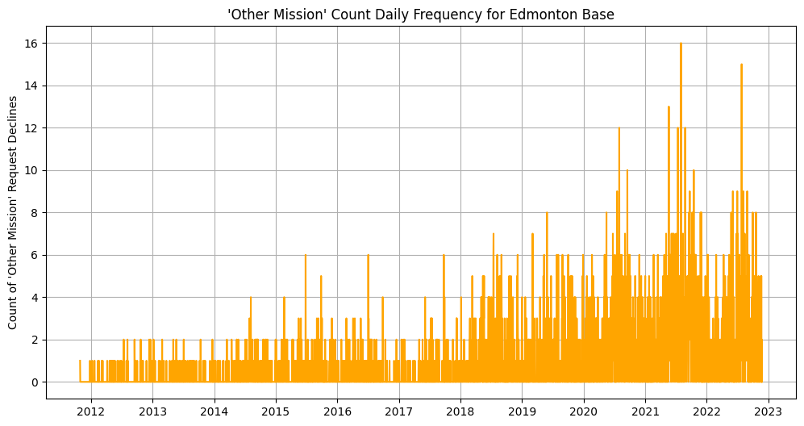
Mission Declines due to ‘Other Mission’ - Frequency
The data shows an increase in magnitude of the daily ‘OM’ declines.
We can see a clear seasonality component to the data

Slide 18
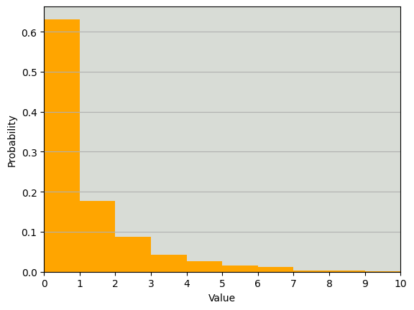
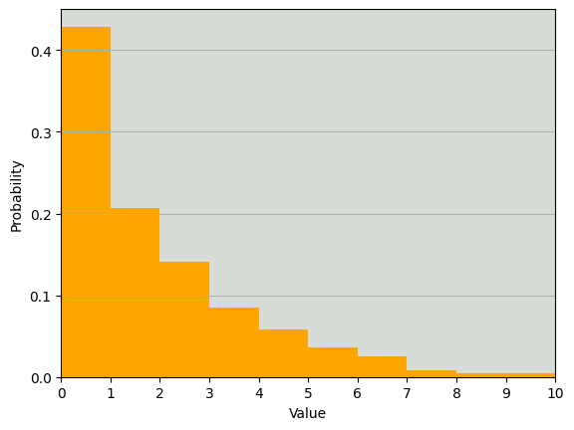
Histogram of Daily ‘OM’ Declines for Edmonton
2011 - 2022
2018 - 2022
On most days there are no missions declined due to ‘other mission’. However, the probability/percentage of these days has been decreasing in recent years.
From 2018 – 2022 there are more days with >1 OM decline than without

Slide 19
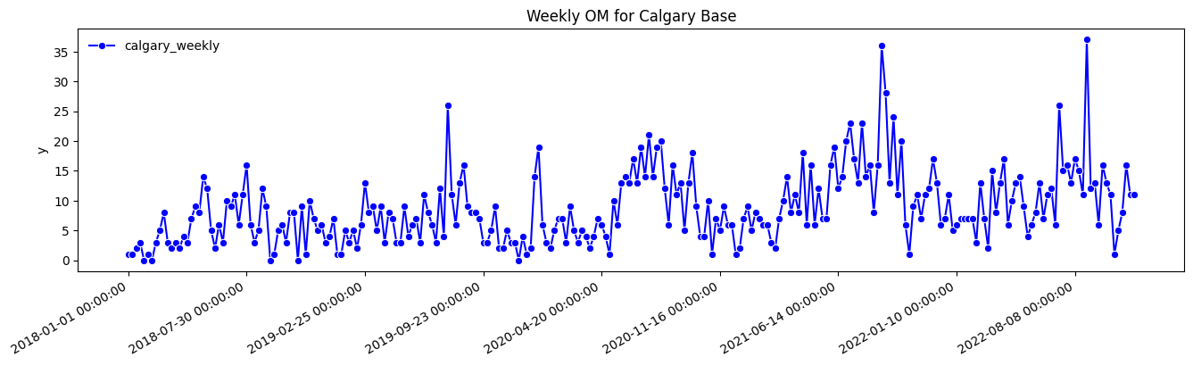
Focus on >2018

Slide 20
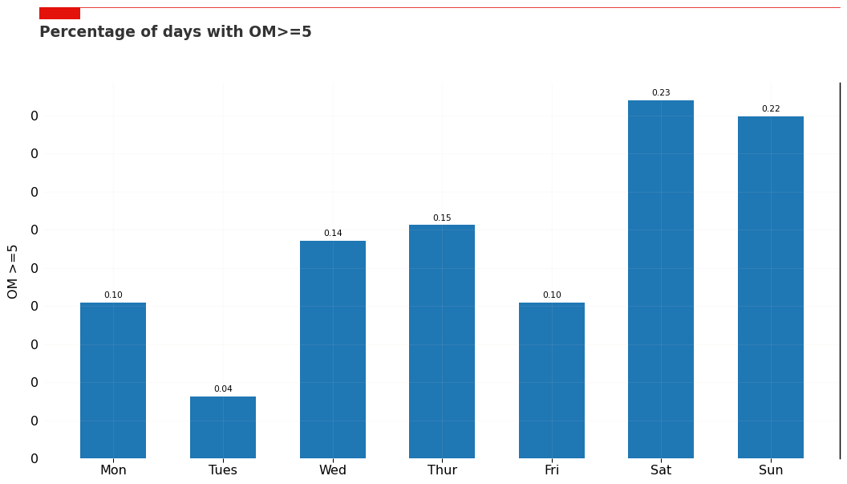
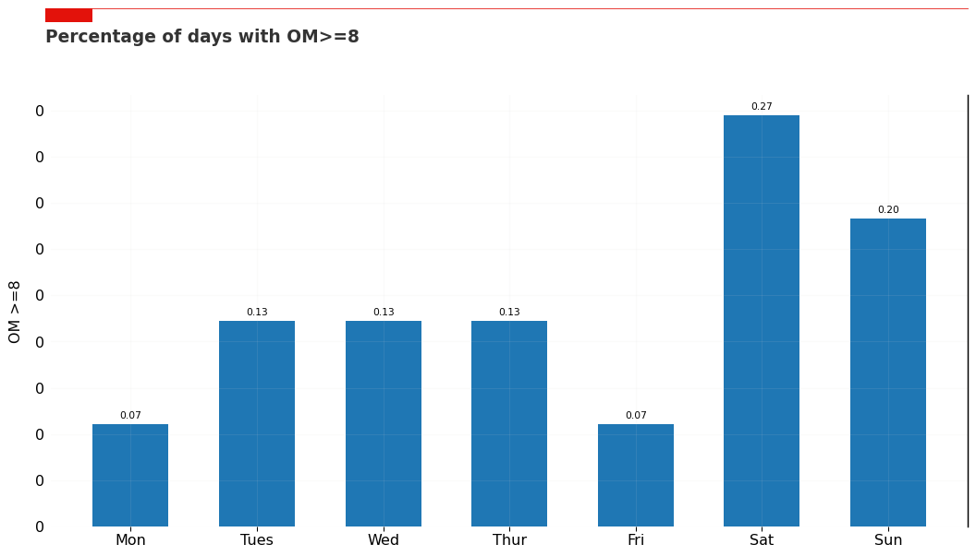
Daily Breakdown
Percentage of OM Declines by Day-of-Week (Calgary Base)
Data shows that weekends are busy times with a higher-than-expected ratio of OM declines
Even daily split would be ~14.3%

Slide 21
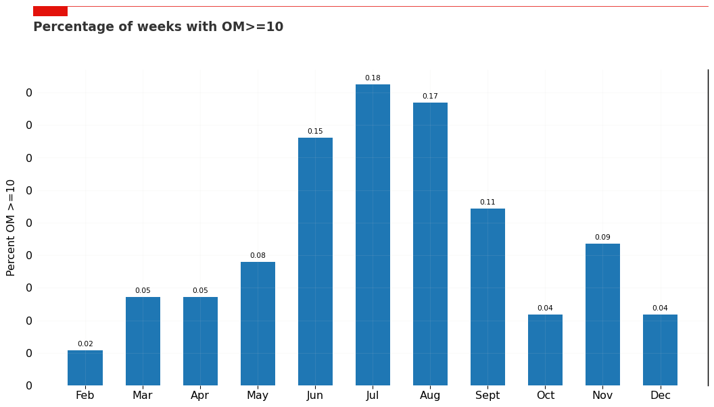
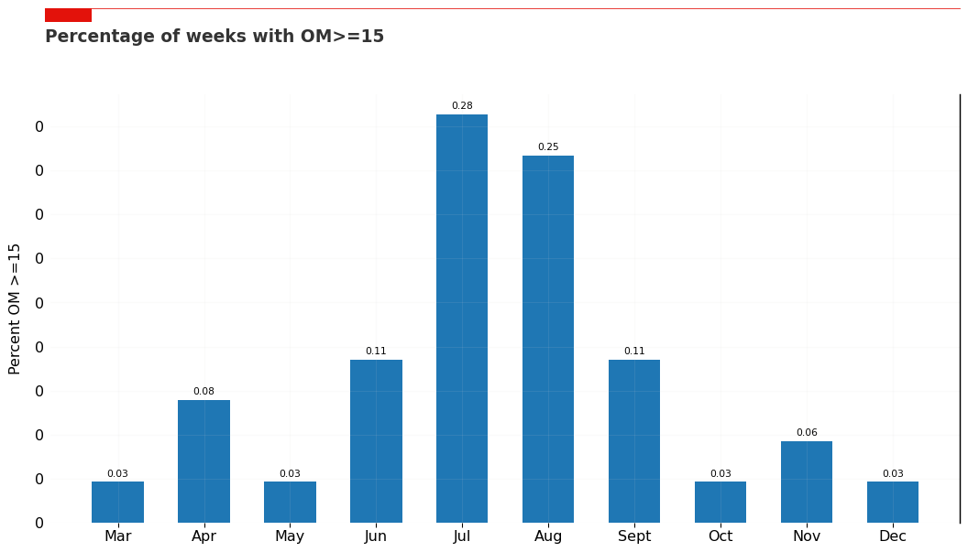
Monthly Breakdown
Percentage of OM Declines Month (Calgary Base)
Clear seasonal trend with the majority happening between June - Sept

Slide 22
Modeling

Slide 23
Time-Series
The initial modeling approach for this dataset was to approach it as a time-series
It has clear seasonal effects. This is corroborated by STARS subject-matter-experts.
It was clear weekly effects.
The OM declines shows a clear increasing trend with time.
Time-series Algorithms can:
Incorporate seasonality and holiday effects
Incorporate trend
Potential to incorporate exogenous features to account changes in trend (example: population increases)

Slide 24
Time-series models
The time-series Algorithms tested were:
Holt-Winters Exponential Smoothing
Meta Prophet
Excellent ability to deal with holiday effects
ARIMA(X)
Does not deal well with short-term data that has longer seasonal effects (ex: daily data with annual seasonality), so this was dropped quickly
Has the capability to incorporate exogenous variables such as population growth or COVID effects
Model were cross-validated and evaluated using Mean Absolute Error (MAE) as the evaluation metric.
Model validation was done using “walk-forward” temporal 5-fold cross-validation
Periodized train/test split
Walk-forward validation to test hyper-parameters over 5-folds

Slide 25
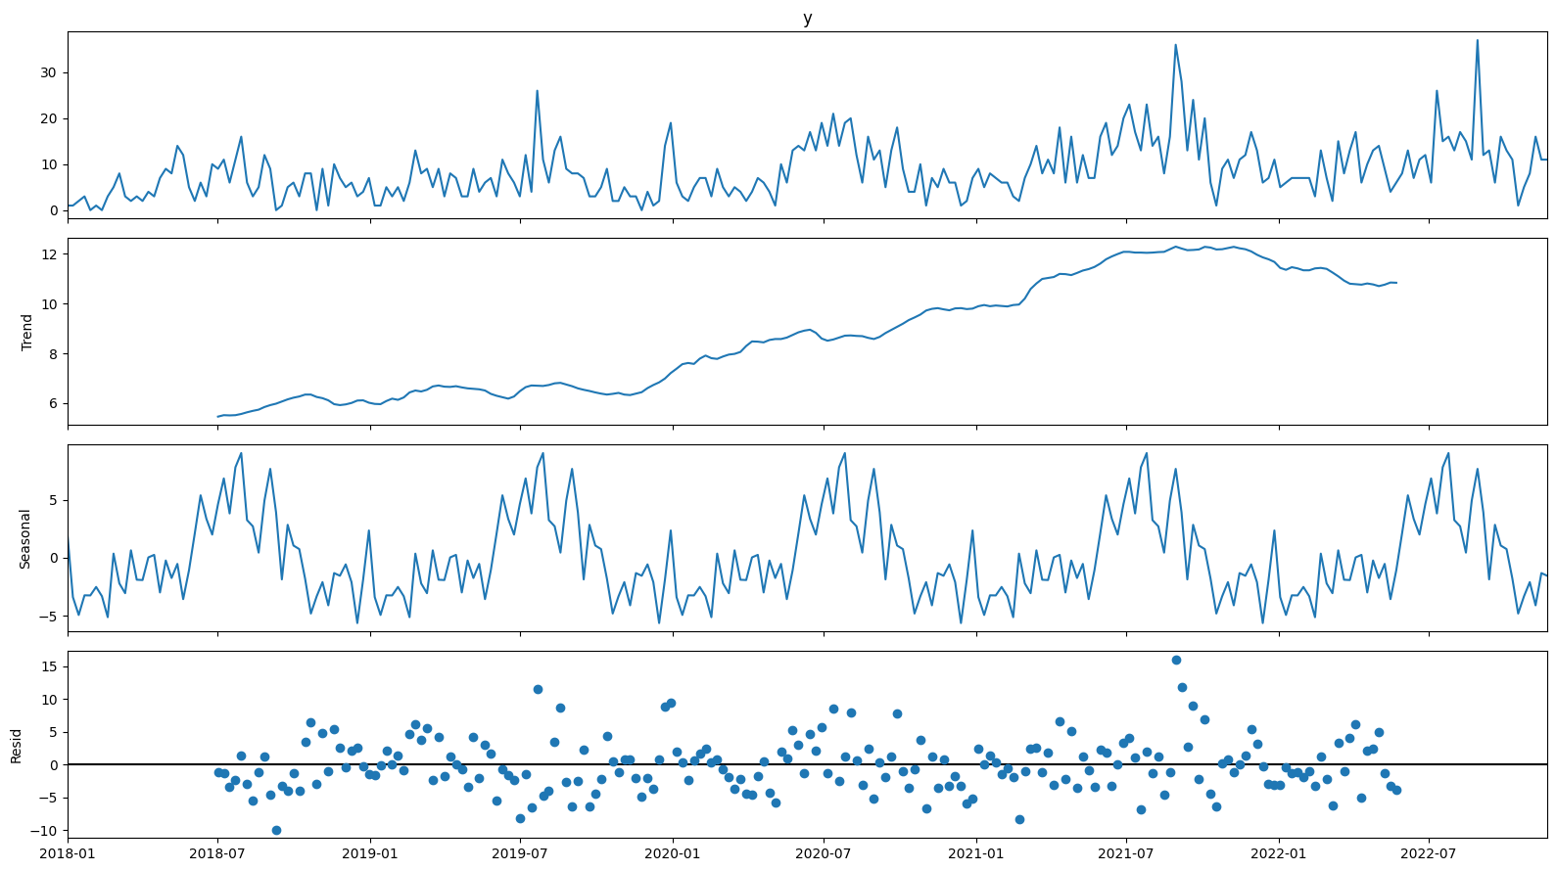
Time-Series Decomposition
Increasing trend
Summer and Labour day Seasonality

Slide 26
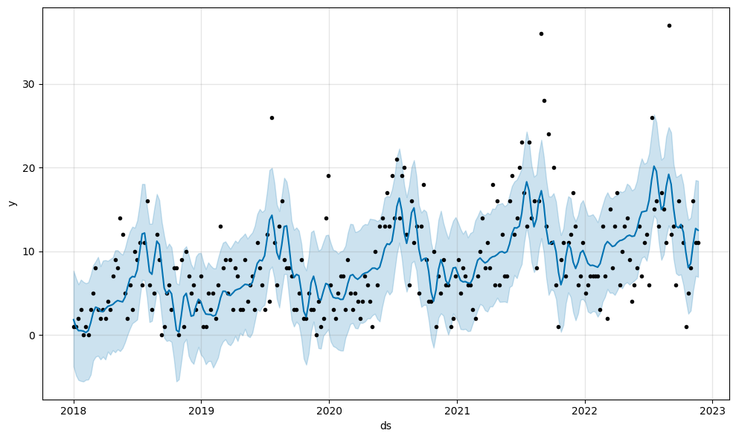
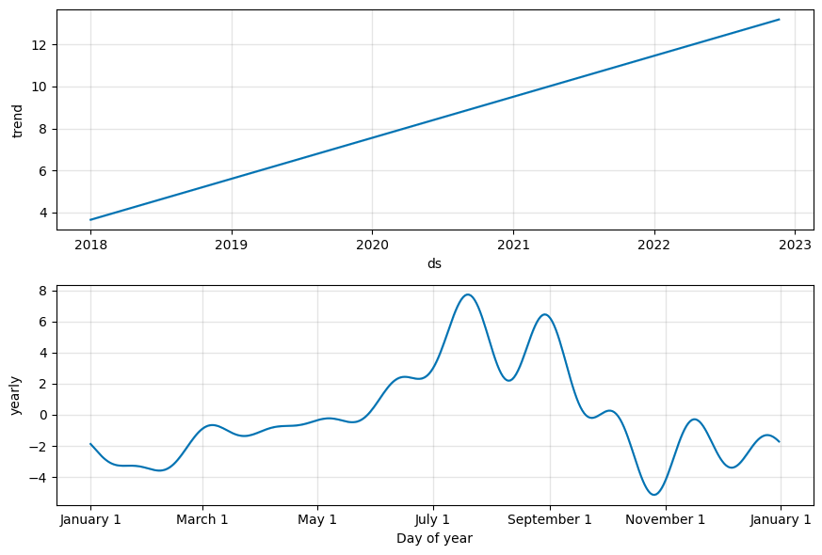
Prophet Time Series Model
Weekly Meta-Prophet Model for Calgary
OM Count
Best-fit model was able to capture the annual seasonality and a capture the bulk of the data
However, there is some high variability and potential outlier points that can be approximated but are difficult to fully capture
High days will be high days, but high peaks are far from the body of the data
There are possible “COVID” effects in 2020 and 2021, which impacted behaviour patterns. This may be challenging because there is minimal post-COVID data.

Slide 27
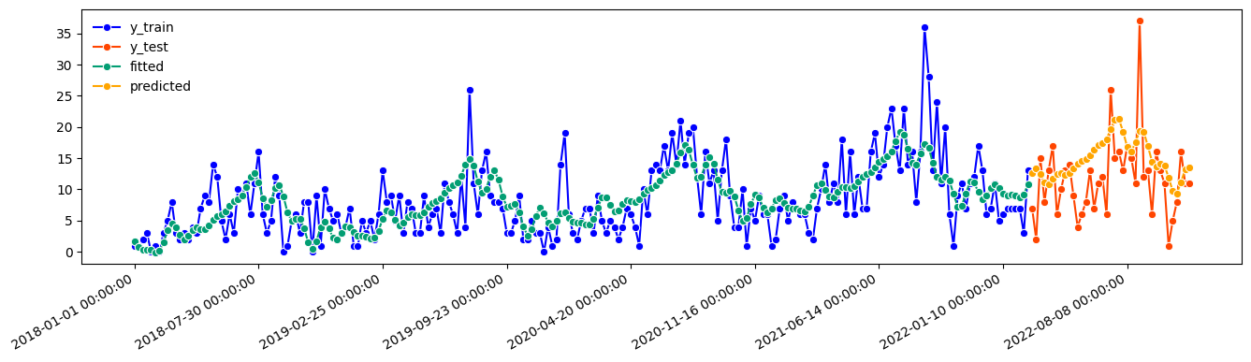
Prophet Time Series Model
Weekly Meta-Prophet Model for Calgary
Model with additive seasonality
Note: Multiplicative seasonality isn’t a fit for this dataset due to the number of 0s

Slide 28
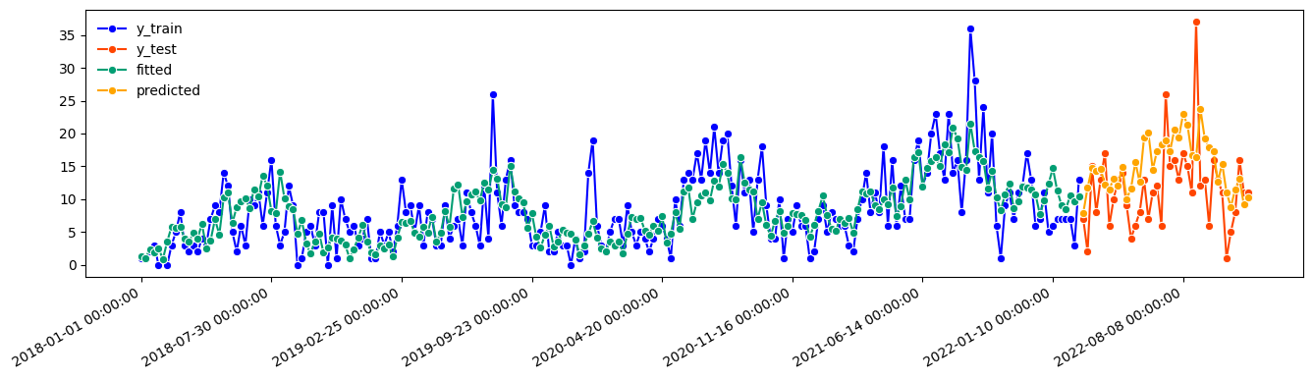
Holt-Winters Exponential Smoothing
Weekly HW Exponential Smoothing Model for Calgary
Model with additive seasonality
Box-Cox used to account for outliers

Slide 29
Analysis

Slide 30
Insights from Weekly Models
There are important period components in the data focused on:
Summer (June – Sept)
Weekend
This provides focus points
Simply covering weekends between Canada Day and Labour Day would cover a large percentage
Time-series models could be implemented for medium (annual) and short-term (coming months, weeks) planning.
Data is highly variable, but models catch the highs, which is sufficient for threshold analysis

Slide 31
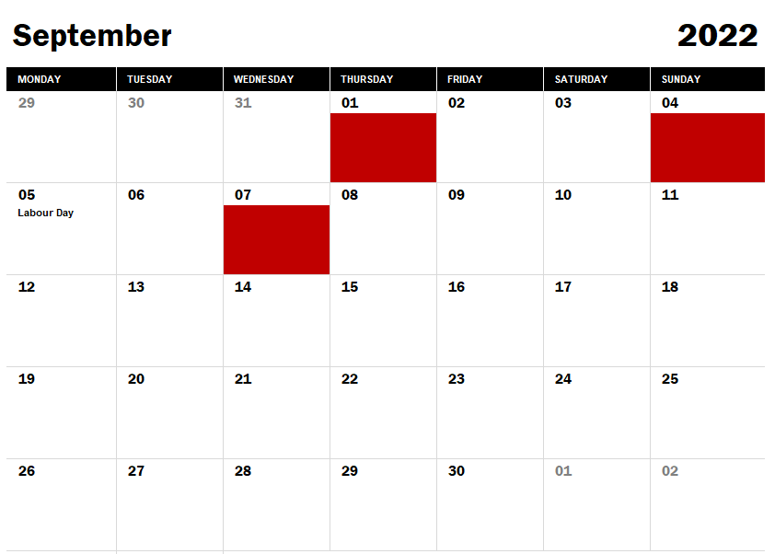
High-Point Analysis
Date | OM Count | holidays | weekday | month
2021-09-03 | 9 | 0 | 4 | 9
2021-09-04 | 9 | 0 | 5 | 9
2021-09-05 | 9 | 0 | 6 | 9
2021-09-08 | 6 | 0 | 2 | 9
2021-09-09 | 12 | 0 | 3 | 9
Date | OM Count | holidays | weekday | month
2022-09-01 | 9 | 0 | 3 | 9
2022-09-04 | 9 | 0 | 6 | 9
2022-09-07 | 8 | 0 | 2 | 9
Potential hypothesis testing point – Labour day week – Sunday before Labour Day

Slide 32
Next Steps

Slide 33
Next Steps
Implementation
Time-series models could be implemented for medium (annual) and short-term (coming months, weeks) planning.
Data is highly variable, but models catch the highs, which is sufficient for threshold analysis
Focus on key high-periods for prediction testing
Covering summer weekends is likely enough to cover the majority of OM declines
Shift splits
Current frequency analysis is down to the daily level. Frequency data could also be split to the shift-level
Collaborate with STARS SMEs and operations staff to ensure that solutions are fit-for-purpose
This may be as simple as key focus-weeks where there is high certainty of need
Hypothesis testing
Avenues for Further Investigation
Use models to perform threshold/trade-off analysis
Periods of additional resource vs utilization
OM Declines is a compound metric could consider analysis specifically on requests & missions

Slide 34
THANK YOU
People that have helped move this project forward:
Kenny Doleac – Chief Strategy & Development Officer – Project Sponsor
Vaish Machiraju – Database Administrator
Michael Parker – Desktop Support Analyst
Andrea Callaghan – Critical Patient Services Manager
John Griffiths – Director Emergency Link Center
Kevin Hatch – ELC Technology and Systems

Slide 35
Alternative Dataset

Slide 36
Alternative dataset
This view represents a more conservative count for “Other Mission” based on direct association with an executed mission in the DW
In general, these data subsets show the same trend and seasonality effects, although the total/magnitude of the “Other Mission” numbers are different
The “conservative” dataset is very sparse (contains a lot of zeros) which is a challenge for modeling

Slide 37
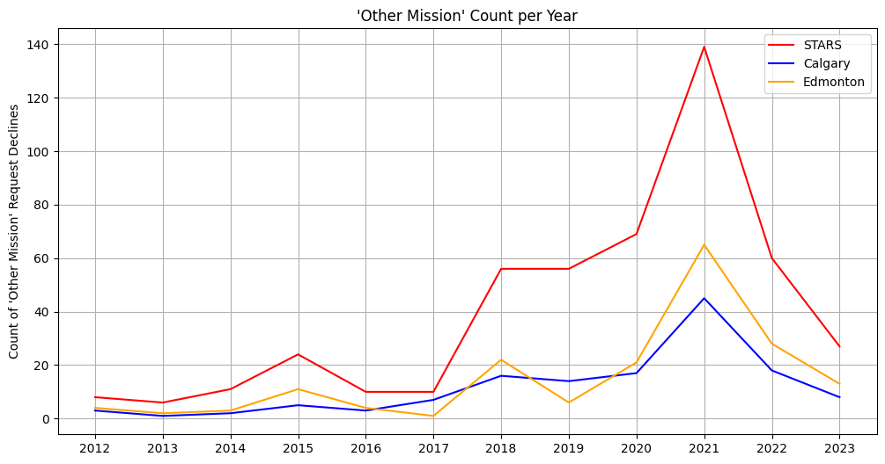
Trend Comparison

Slide 38
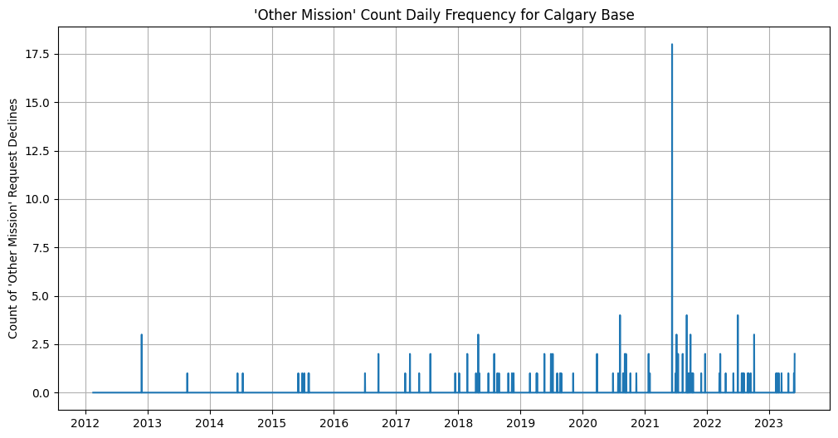
Daily Comparison
Mission-linked dataset is very spares (mostly 0s)
Can see a comparable seasonality trend although the magnitudes are different

Slide 39
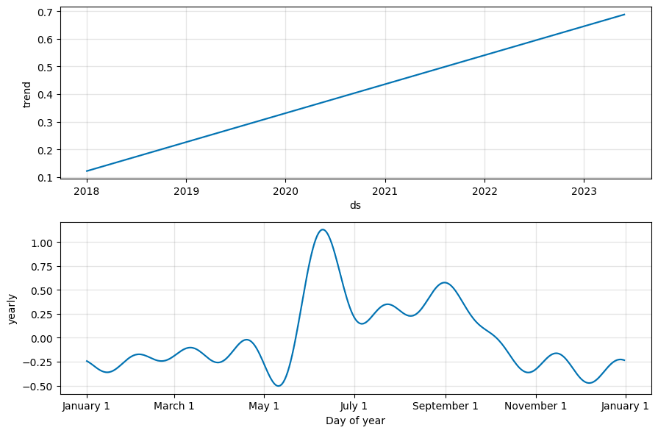
Seasonality Comparison
Comparable seasonality trend
Summer months are the focus in both sets

Slide 40
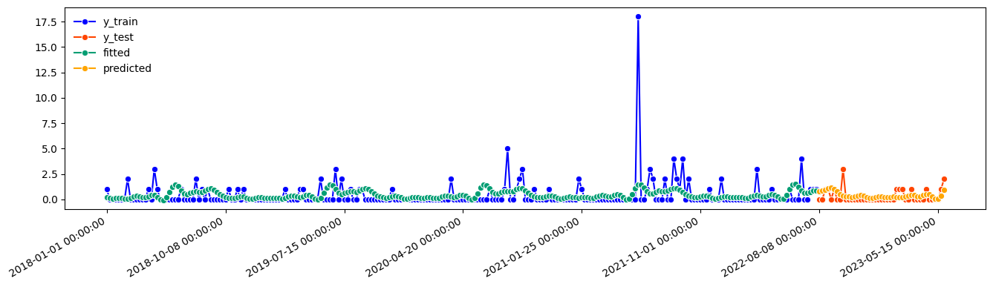
Modeling
Modeling is challenging when most datapoints are 0
Another approach would be required for this dataset -> potentially logistic (1/0) (yes/no)

