Slide 1
Hacking a career in Offensive Security
- Spoiler alert: there are no ‘experts’ ☺ -
Leo McCavana, 11th March 2020

Slide 2

> whois Leo (@jckhmr_t)
Red Team Operator for Allstate
Been in Information Security for 15+ years
Unusual path into infosec (is there a ‘normal’ one?)
Interested in: automation, breaking stuff
Occasional t-shirt winner (‘being a force for good’)
Long distance cyclist (n+1 bikes)

Slide 3

On the agenda
What do I do?
How did I get into this game?
What sort of cool stuff do I do?
What tips can I offer on how to get a start
Notes:
Why haven’t we automated you yet? Mistaken believe that all aspects of appsec pen testing could always be automated

Slide 4

What do I do?
Red Team Operator
Adversary simulation activities
Using the same tactics, techniques and procedures as external attackers to find gaps in the defensive posture of an organization.
Red teams essentially exist to test and help improve defensive capabilities.
We don’t purely exist to break things.
Notes:
Why haven’t we automated you yet? Mistaken believe that all aspects of appsec pen testing could always be automated

Slide 5
So how did I get into this game?
Notes:
Why haven’t we automated you yet? Mistaken believe that all aspects of appsec pen testing could always be automated

Slide 6
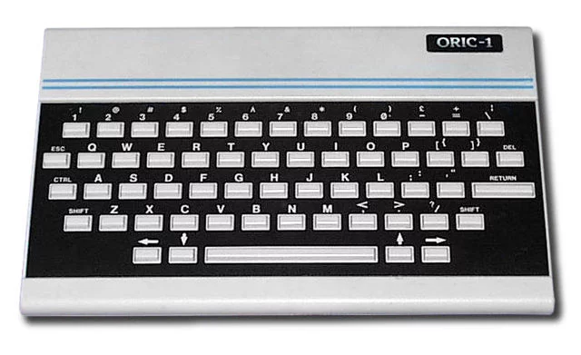
So how did I get into this game?
It started with this in 1984: ORIC-1
Typing, typing, typing
Playing the games …. m’eh!
More interested in modding/creating/cheating/bypassing copy protection*.
* Purely to feed my own curiosity! ☺

Slide 7

So how did I get into this game?
And this …
I learned to strip cars* and worked on a engine conversion at 15 years old.
Why? Because I was curious and wanted to prove that something could be done better.
Not the ACTUAL car ! ☺
* For clarity: all legally obtained! ☺

Slide 8
Then in 1994 I did a degree in Media Studies …

Slide 9
Then in 1994 I did a degree in Media Studies …
Followed by a MSc. In Computing &
Information Systems. (1994-1995)

Slide 10
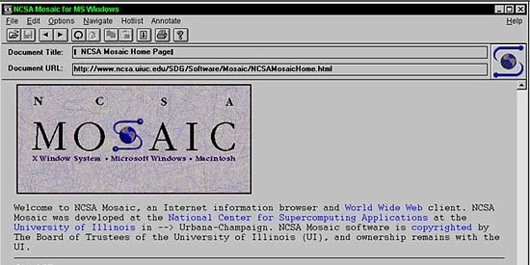
“Leo …. You should consider this great
new thing called the WWW …. It is going
to take over the world.”
MSc Studies advisor, 1995

Slide 11
Fast forward … after 7 years in web and ‘new media’.
I joined a Fortune 500 company and discovered ‘Information Security’ …

Slide 12
Technical (‘Tech’) Writer – 2004 thru 2010
Training developers (because in my previous life I made EVERY mistake in the book)
Discovered OWASP (www.owasp.org)
The ‘top 10’ became my entrance to hacking
Saw a ‘hacking demo’ from a pen tester (now my boss) and thought ‘this is me’.
Started attending conferences, learning, reading

Slide 13
Security Architect – 2010 thru 2013
Process track lead to embed security into every stage of Software Development
Back then Waterfall was the ONLY show in town …
… then I remembered I missed being hands-on technical

Slide 14
Appsec Pen Tester – 2013 - 2016
I had ‘arrived’ – I now got to ‘break’ things!
Aggressive but fun learning experience
Operational in 3 months (was supposed to be 6)
Focus: learning the ropes from others
Expertise: Mobile App Security … it was a new thing
Constant learning
Then Agile and Agile XP became the new dev methodologies

Slide 15
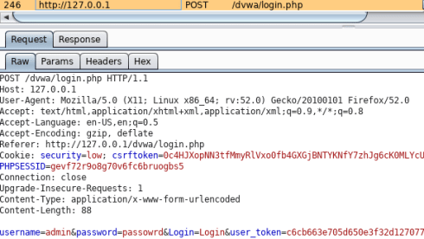
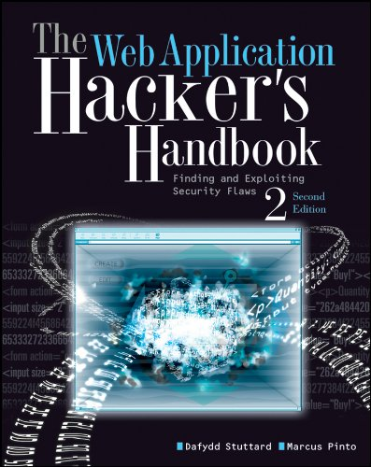
The two most important resources
Burpsuite (portswigger.net)
The Web Application Hacker’s Handbook

Slide 16
Red Team Operator 2017 - present
Transition period in first year
2018: Learning the ropes
2019: Hit the gas – probably the best year of my career yet!

Slide 17
So what do I do?
Goal led operations: focused on data, not necessarily root
Targets: electronic, physical and human
Tool and infrastructure dev: Did I say I love automation? ☺
I’m the word-smith on my team. Find your niche.
Known for my –vvv focus on detail (which works MOST of the time) ….
Report writing and communication
Purple team activities
Legal liaison

Slide 18
All very well, but what sort of cool stuff do I experience on a day to day basis?
Notes:
Why haven’t we automated you yet? Mistaken believe that all aspects of appsec pen testing could always be automated

Slide 19

All very well, but what sort of cool stuff do I experience on a day to day basis?

Slide 20
Some practical tips ….
Develop your ‘hacker mindset’
Be curious to know how something can be made to operate in a manner that it is not to supposed to
Try harder
Be on the look out for opportunities
Read and learning from many different sources
Experiment, make mistakes, gain experience, have fun
Stay out of jail
Develop your communication skills: especially report writing!
Notes:
Why haven’t we automated you yet? Mistaken believe that all aspects of appsec pen testing could always be automated

Slide 21
Some practical tips ….
Get comfortable with Linux
Build a home lab (which can be in the cloud)
Keep an eye on the hot areas - you can’t be ‘expert’ in everything though, but develop your own niche skillset. This will be part of your personal brand to market yourself
Get a mentor (not necessarily a techie)
Be active in the community: learn and ‘give back’
Online learning (vulnhub,Hackthebox, root-me.org, Udemy, Pluralsight, CTFs, etc, etc, etc)
Have a realistic plan for your career
Keep learning: everyday is a school day.

Slide 22
Thank you.
Questions?
jckhmr.net @jckhmr_t
github.com/jckhmr
jckhmr@posteo.net

