Slide 1

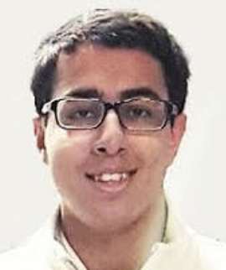
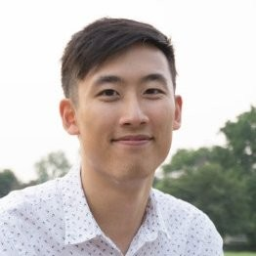
CCPs 706 FINAL Project
Arsalan Khuwaja
Jacob LAM

Slide 2

Contents
Project Overview
Examples
www.google.com
www.walmart.ca
Images
www.401games.ca
www.tamarackvalley.ca
Conclusion

Slide 3
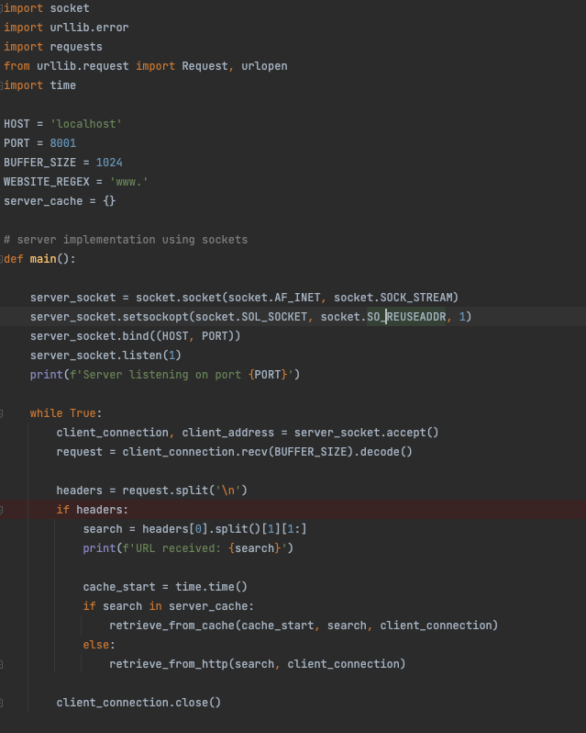
Project Overview: Proxy server
Serves static files from sites
Example used to show necessary considerations for connections to actual servers
Cache as a file vs. cache as Python dictionary

Slide 4
Conclusion
Cache orders of magnitude (~10,000x) faster than http request. This is clearly advantageous when many requests are made.
Connecting to real servers involves many considerations:
SSL cipher suite negotiation (401games)
Non-HTTP errors such as net::ERR_CONNECTION_RESET 200 (OK) (Tamarack Valley)
Improvements:
Consider using caching in files if the retrieved resource needs to be persistent
Only hold records for a specific amount of time
Bypassing bot detection

