Slide 1

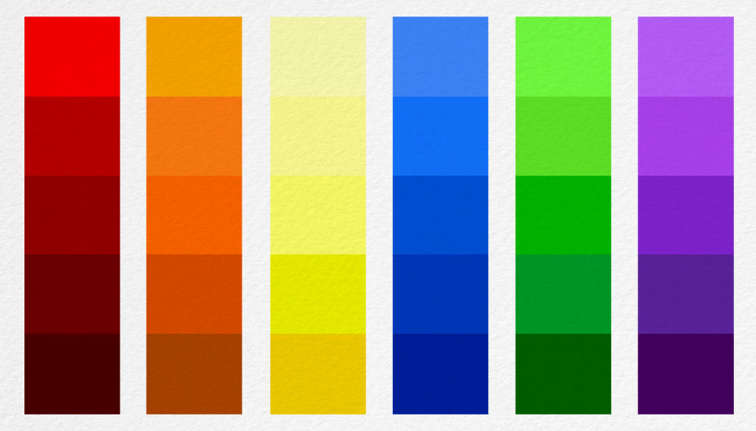
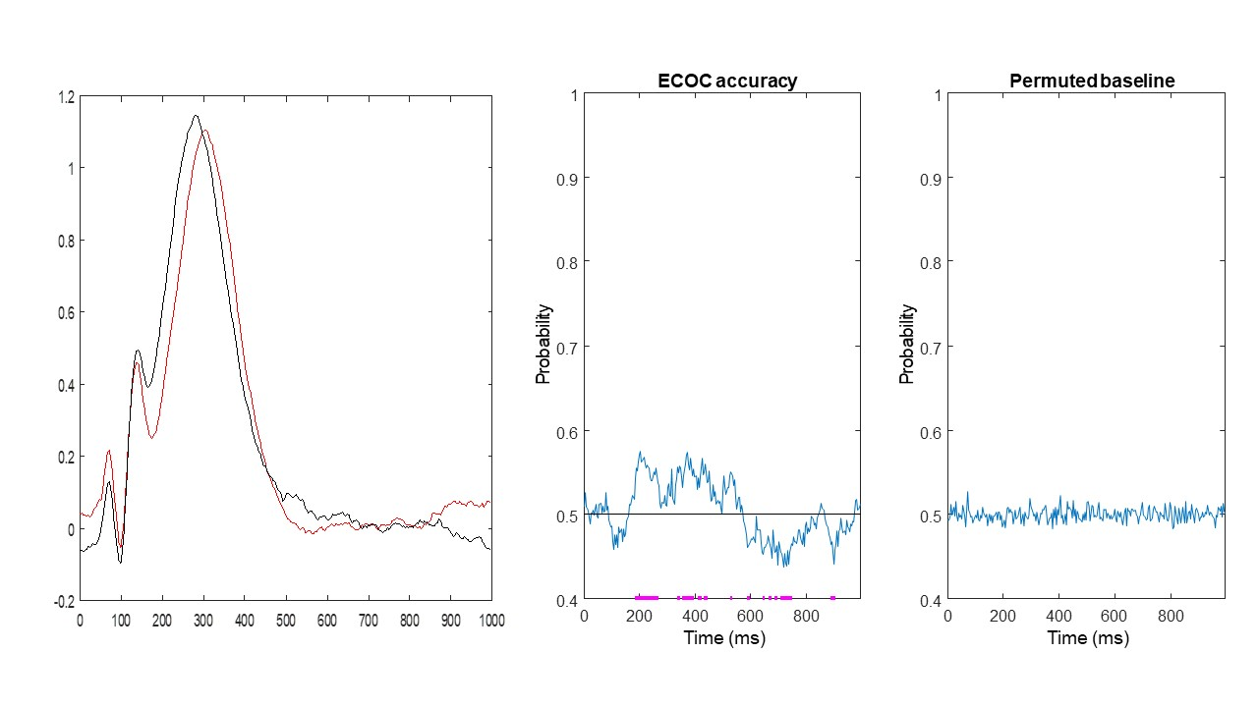

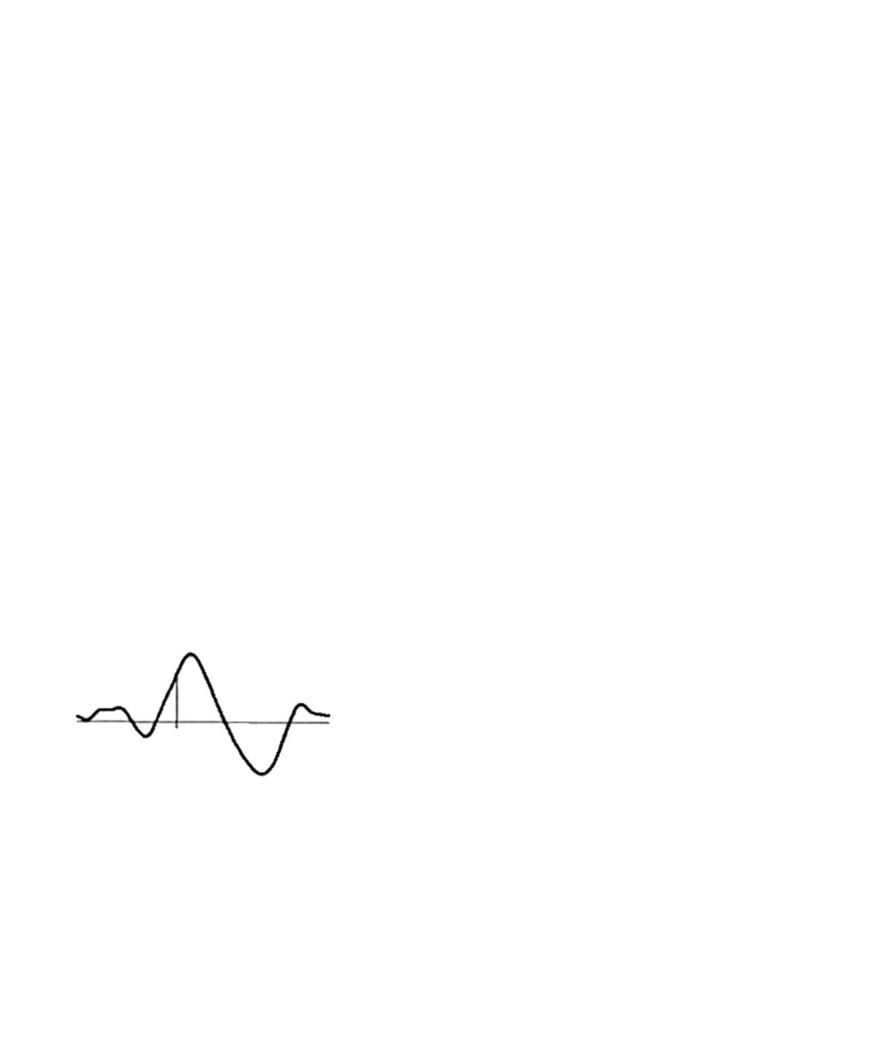
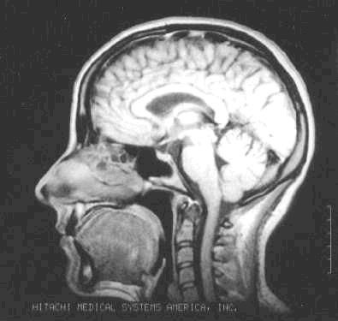
Effects of Temporal and Spatial Signal Shifts on Decoding Accuracy
Jakub Kowalczyk - Supervised by Dr Jasna Martinovic
Rationale:
In EEG data, electrical impulses at the scalp do not reflect underlying brain activity. This is called the problem of “ground truth”.
Potential solution? Simulate data.
This allows to establish ground truth!
Able to manipulate EEG data parameters
Design:
Simulate data using SEREEGA (Krol et al., 2018) toolbox for a single p300b component and introduce physiologically plausible variance for latency (+/- 40ms) & source (+/- 2,6,4 for x,y,z respectively) parameters.
Examine study questions through decoding analysis conducted using Linear Discriminant Analysis algorithm
Background
Hue and luminance contrasts are basic visual features.
Hermann., et al. (2022) decoded colour from M/EEG data.
Decoding is a multivariate technique that uses pattern information from multiple recording sites in order to predict whether information contained in signal can be used to differentiate between conditions.
This suggests that the electrical signals generated by the brain may somehow represent information about how colour/luminance is stored and represented in the brain.
Authors suggest that information discerning colour is contained spatially. M/EEG in general have worse spatial resolution than fMRI, which makes it surprising to reliably find information spatially encoded.
Is colour spatial represented in the brain? Or could this be a temporal distinction shifted in time?
Example Product of Research
P300b
Potential (µV)
Time (ms)
Figure 1: Left - ERP at Fz showing a shift in latency by 20ms (black line, 280 ms peak)
causes a perturbation of amplitudes over the entire P300b window, resulting in a higher amplitudes at the beginning, and lower at the end). Right - This shift in amplitude is decodable (decoding from 64 channels). With decoding probability > .5 indicating greater than chance performance. Magenta dots on the bottom reflect significant differences (fdr-corrected).
Predictions:
Spatial and temporal shifts will increase decoding accuracy
We predict that, due to a higher temporal resolution of EEG, decoding accuracy will be greater for temporal shifts compared to spatial shifts.
Study Questions
How do spatial/temporal shifts affect decoding?
Specifically, if there is an effect of the two, is it additive or multiplicative?
References:
Krol, L. R., Pawlitzki, J., Lotte, F., Gramann, K., & Zander, T. O. (2018). SEREEGA: Simulating event-related EEG activity. Journal of Neuroscience Methods, 309, 13-24.
Hermann, K. L., Singh, S. R., Rosenthal, I. A., Pantazis, D., & Conway, B. R. (2022). Temporal dynamics of the neural representation of hue and luminance polarity. Nature Communications, 13(1), 1-19.

