Slide 1
RewardReady
Anurag Saroha, Ayush Sahay, Diego Espinoza, Jackson Prillaman, Jacob Kubik, Rohit Rane

Slide 2
Rough Slide (To Ref Submission Criteria)
Description of the project
Background
Goals
Possible users
Main functions/features

Slide 3
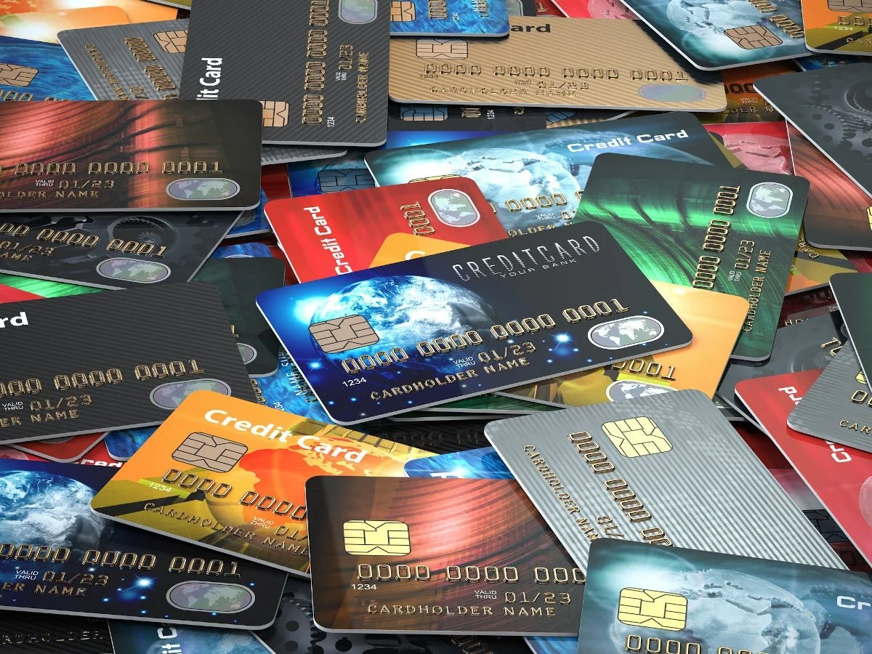
Your Rewards, Ready - From Anywhere
Maximize additional savings
Credit and loyalty card rewards
Deals optimized by merchant/location
Register to save details for quick access
Detect user information
Provide the best card for the given purchase

Slide 4

Multiple Reward Types Combined
Combine all your cards and potential rewards
Centralize your rewards tracking
Optimize your rewards
Get customized recommendations

Slide 5

You - The User
Ownership of multiple cards
Looking to maximize rewards
Has credit and loyalty cards
Searching for
Coupons
Relevant deals
Open to new ways to save quickly

Slide 6
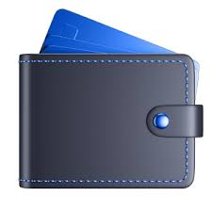
What’s the best card to use for this?
Create your wallet with loyalty and credit cards you own
Share your location to automatically optimize for merchants
Get the recommended card per purchase
Maximize your rewards

Slide 7

Do you think this store has coupons?
Based on your known data
Your current loyalty cards
User preferred item types
Locations logged
Finds coupons for the current purchase
Saves the user money

