Slide 1
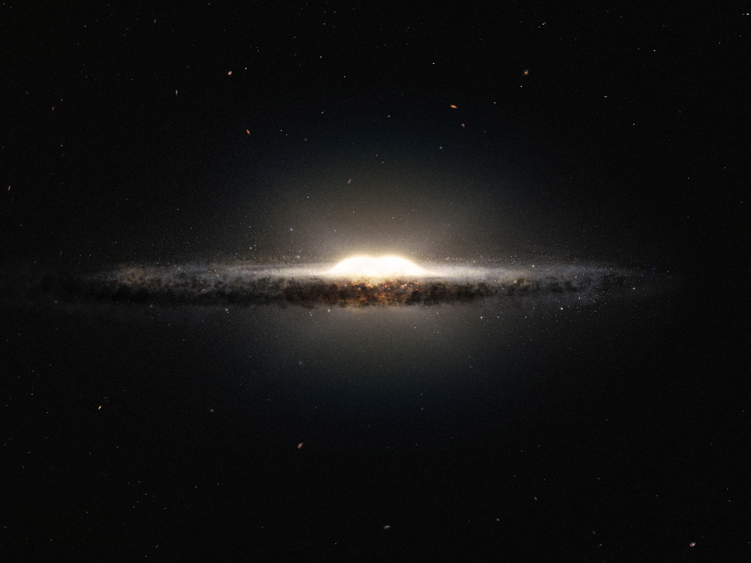
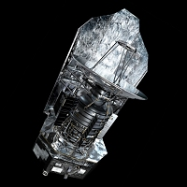
Mining Herschel Space Telescope data
Team Members:
Jon Allured (4502)
Jacob C. Levine (4502)

Slide 2
Mining Herschel Space Telescope data
The Problem
To create a temperature map of the galactic plane based on variance between long-wave infrared wavelength intensities using data from the Herschel Hi-GAL dataset.
The different wavelengths are 70, 160, 250, 350, and 500 microns.

Slide 3
Mining Herschel Space Telescope data
Why is this interesting?
Extra-solar temperature maps are useful when studying:
HII regions (regions of ionized hydrogen)
Molecular clouds
Stellar nurseries
… and many more!

Slide 4
Mining Herschel Space Telescope data
Prior Work
This is an area of active study in the scientific community
Several similar (but more in-depth) papers have been published
These studies often incorporate dust cloud density data as well as temperature

Slide 5
Mining Herschel Space Telescope data
Getting to Know the Data, part 1
Hi-GAL dataset from the Herschel Space Telescope
Flexible Image Transport System (FITS) file format, 13 GB of data, approx. one billion data points
Main Attributes: galactic latitude, galactic longitude, intensity, wavelength, angular size
All attributes are numeric and discrete
Data quality: missing some data for some wavelengths in some areas

Slide 6
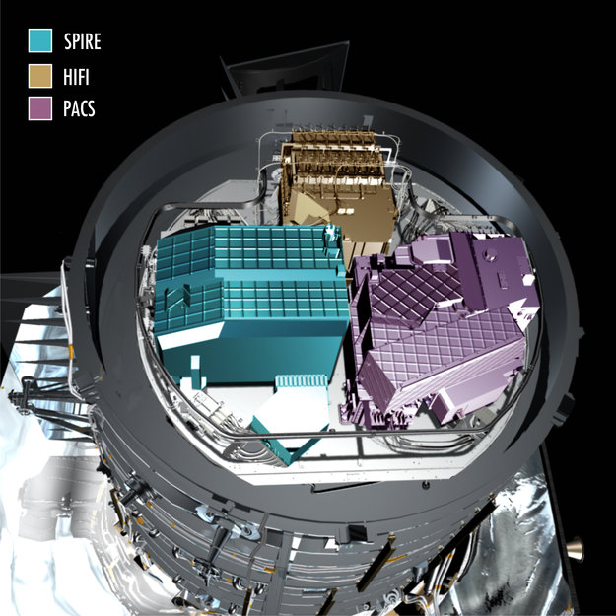
Mining Herschel Space Telescope data
Getting to Know the Data, part 2
Three different instruments collected the data, generating different resolutions
Galactic latitude and longitudes did not line up perfectly across the different wavelengths
This is a private dataset. Thanks to Professor John Bally (Department of Astrophysical and Planetary Sciences, CU Boulder) for giving us access to the data.

Slide 7
Mining Herschel Space Telescope data
Tools Used
Montage: a tool kit developed at IPAC (Infrared Processing and Analysis Center, at Caltech). Used for preprocessing and producing images from FITS files.
AstroPy: contains a library for working with FITS headers and FITS data arrays within Python
SciPy: for data analysis (curve_fit function)

Slide 8
Mining Herschel Space Telescope data
Data Preprocessing, part 1
Using Montage, we processed the data to:
align each wavelength’s dataset with the galactic coordinate system
achieve consistent resolutions across all 5 wavelengths

Slide 9
Mining Herschel Space Telescope data
Data Preprocessing, part 2
One small subsection of the data turned out to be anomalous to the extent that it was unusable.
We used backup data that contained zero values instead of NaNs, which caused issues during reprojection
Montage package includes a module that should have been able fix the data, however at the time of discovery the module was not working properly. Got in touch with Montage’s senior software engineer who then made changes to the module.

Slide 10

Mining Herschel Space Telescope data
Data Analysis, part 1
Originally wanted to use SciPy’s curve_fit function to match our data points to the blackbody radiation cure defined by the equation:
We were unable to generate usable data with the curve_fit function, requiring us to use a back-up plan to mine the dataset

Slide 11
Mining Herschel Space Telescope data
Data Analysis, part 2
Instead of using curve_fit, we wrote code to mine the data for the max intensity wavelengths and generate new FITS files for each wavelength
The new files contain data for only those galactic coordinates that correspond to max intensity values
We then correlated the max intensity values to approximate temperatures

Slide 12
Mining Herschel Space Telescope data
Results, part 1
Our results were surprising. We expected a lot more variation in the approximate temperatures generated by our data.
However, the overwhelming majority of the galactic plane represented by our data is radiating predominantly at a wavelength of about 160 μm
This wavelength corresponds to an approximate temperature of 18.1⁰ Kelvin (-427.09⁰ Fahrenheit).

Slide 13
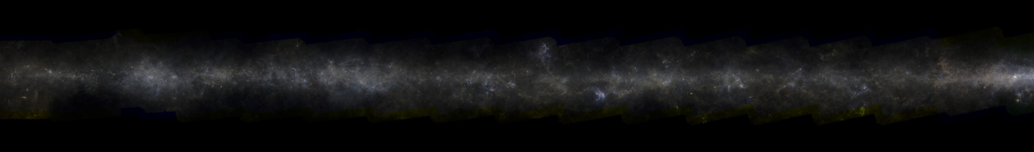
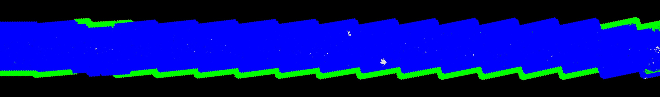
Mining Herschel Space Telescope data
Results, part 2
Mosaic generated with Montage
Our resulting temperature map

Slide 14
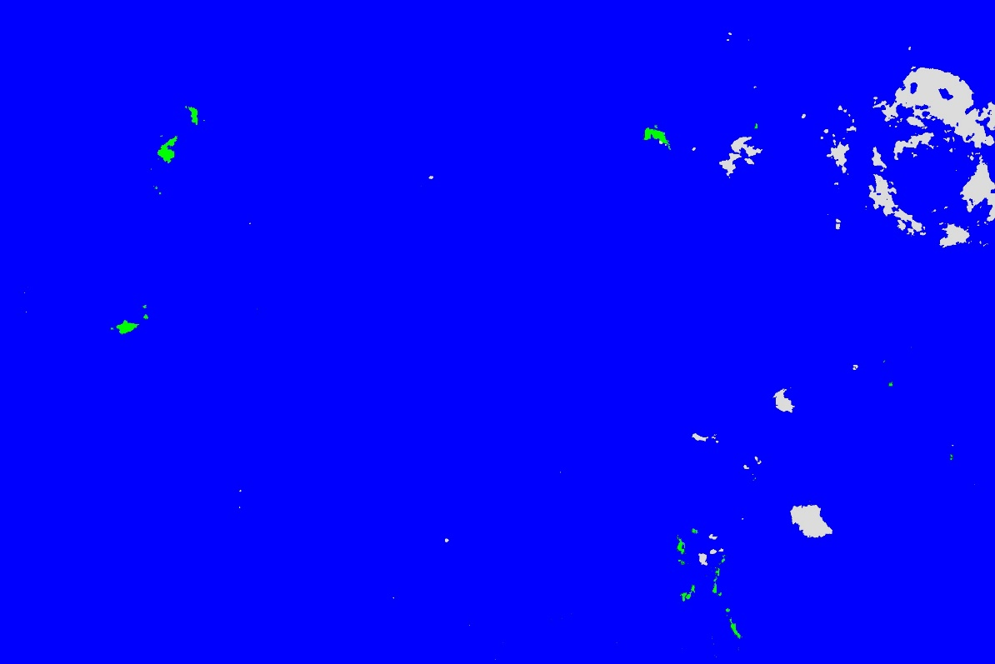
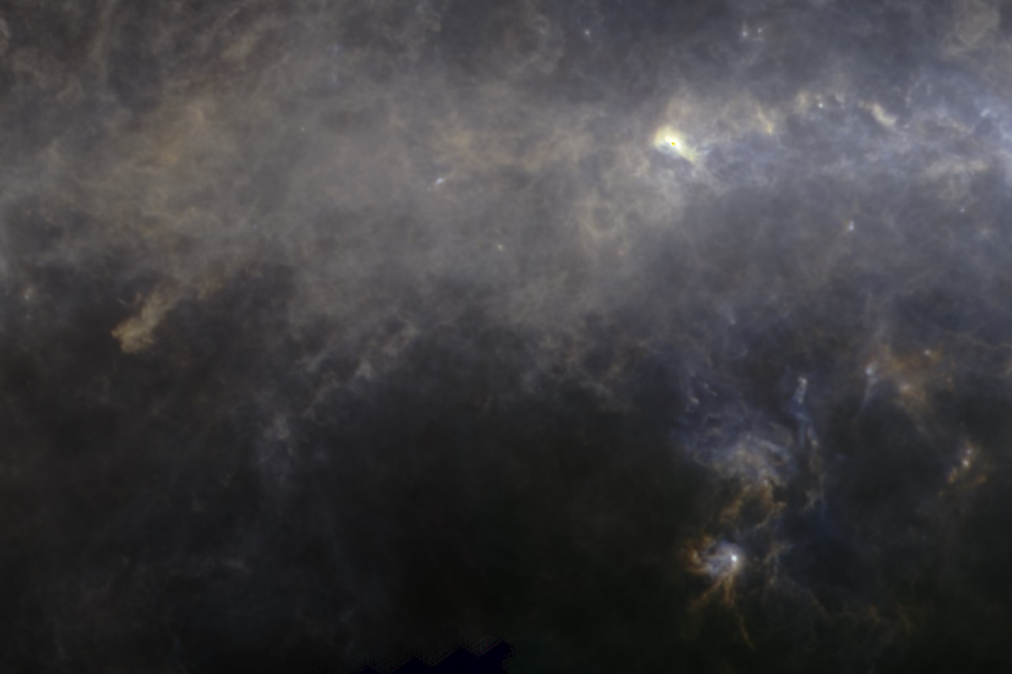
Mining Herschel Space Telescope data
Results, Part 3
Close-up of an interesting region

Slide 15
Mining Herschel Space Telescope data
Conclusions, Lessons Learned
Due to long processing times, we ended up working with one quarter of our complete dataset.
The domination of the 160 μm wavelength was unexpected and surprising.
Would be interesting to analyze the rest of the data to see if the 160 μm wavelength is as prominent across all the data.
It’s good to have a back-up plan! We needed our back-up plan when our original plan of using the curve-fit function didn’t work.

