Slide 1
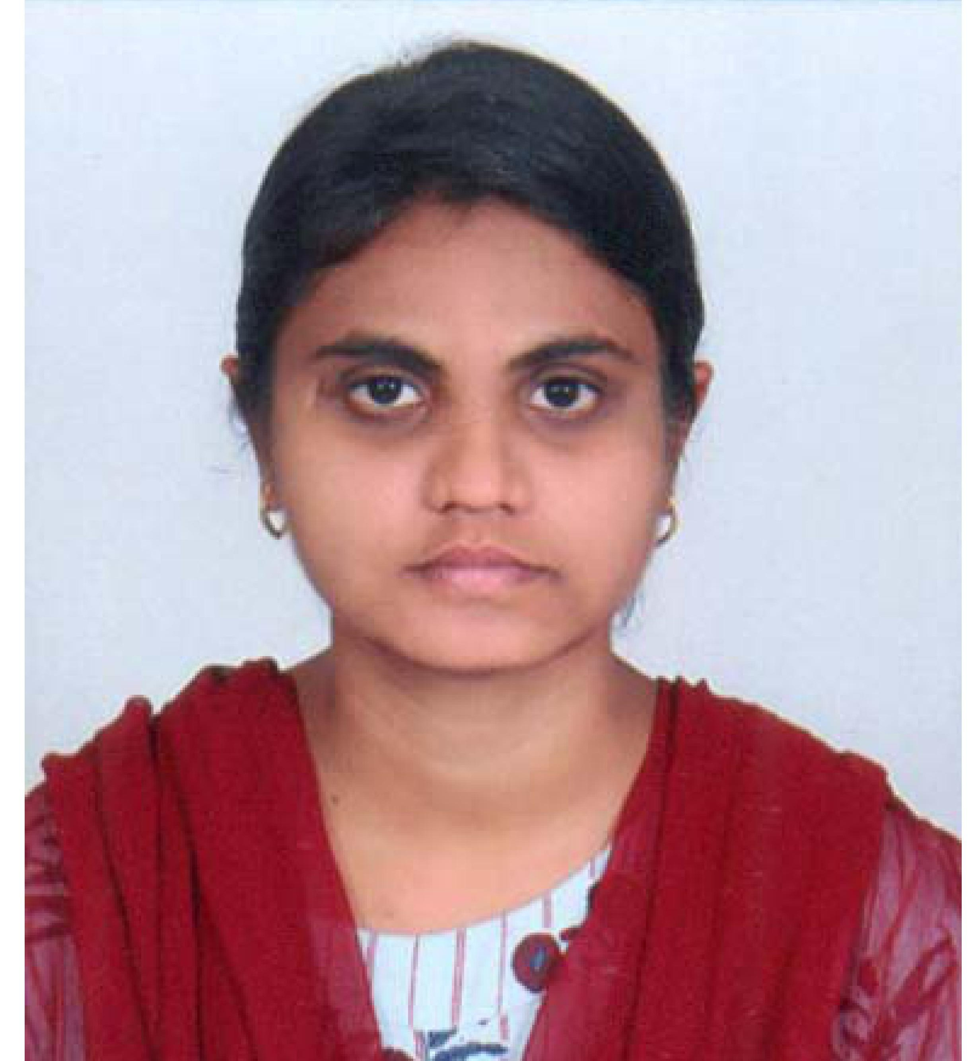



Lavanya Chinthakunta
Analyst/Software Engineer
Bachelor of Technology
Computer Science : 2016 - 2020
Skills Java 8 /J2EE
Spring Boot
Spring MVC
MERN Stack
NodeJS
MongoDB
Database
SQL database – MySQL
No SQL database – MongoDB
Web Technologies
HTML5
CSS3
Javascript
AddOns
Github
Maven
Postman
Additional Details
Leadership
Quick Learner
Team management
Bangalore
Chinthakunta.lavanya@capgemini.com
9392236477
A4
Software Engineer who is Strong in design and integration with intuitive problem-solving skills. Passionate about implementing and launching new projects.
Ready to learn new technologies and implement them to further improve my knowledge.
Eager to work in a team of dedicated people and serve a key role in the enhancement and development of the project.
Has working knowledge on Angular and Java Microservice Development using Spring framework on an intermediate level.
Hotel Management System
Completed end to end case study of Hotel Management System along with JWT authentication, Swagger and payment testing using Braintree in MERN Stack. Material-UI and React Bootstrap used for user interface.
HTML CSS JAVASCRIPT for web developers at Coursera
Completed this course with 98.6% and Designed responsive Restaurant website using HTML5 CSS3 Bootstrap and Javascript
Check out my work on GitHub: https://github.com/jclavanya/aaa-final & Video: https://github.com/jclavanya/HMS-videorecording.git

