Slide 1
Box Platform Developer Workshop Cummins
Jonathan LeBlanc
Director of Developer Advocacy, Box
Twitter: @jcleblanc
Github: https://github.com/jcleblanc

Slide 2
Webhooks

Slide 3
Webhooks V1

Slide 4
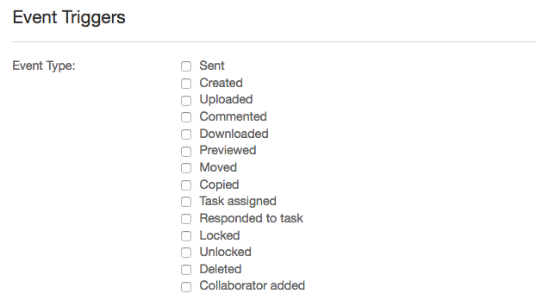
Webhooks V1 Details
Manually created through the app dashboard: https://app.box.com/developers/console
Cannot be adjusted programmatically
Produces webhook events for all actions in an app and cannot be bound to a file / folder.
Notes:
Review webhooks V1 by clicking on your app at https://app.box.com/developers/console then select “Webhooks” from the left menu.

Slide 5
Webhooks V2

Slide 6
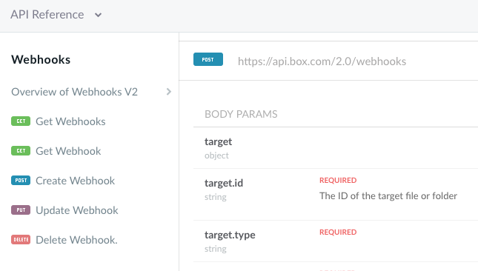
Webhooks V2 Details
Programmatically created and maintained through the Webhooks APIs.
Create, Read, Update, and Delete endpoints.
Can be bound to a single file or folder

Slide 7
User Events
ACCESS_GRANTED
ACCESS_REVOKED
COLLAB_ADD_COLLABORATOR
COLLAB_INVITE_COLLABORATOR
COLLAB_REMOVE_COLLABORATOR
COLLAB_ROLE_CHANGE
COMMENT_CREATE
COMMENT DELETE
ENABLE_TWO_FACTOR_AUTH
GROUP_ADD_USER
GROUP_REMOVE_USER
ITEM_COPY
ITEM_CREATE
ITEM_DOWNLOAD
ITEM_MAKE_CURRENT_VERSION
ITEM_MOVE
ITEM_PREVIEW
ITEM_RENAME
ITEM_SHARED
ITEM_SHARED_CREATE
ITEM_SHARED_UNSHARE
ITEM_SYNC
ITEM_TRASH
ITEM_UNDELETE_VIA_TRASH
ITEM_UNSYNC
ITEM_UPLOAD
LOCK_CREATE
LOCK_DESTROY
MASTER_INVITE_ACCEPT
MASTER_INVITE_REJECT
TAG_ITEM_CREATE
TASK_ASSIGNMENT_CREATE
TASK_CREATE
Notes:
https://developer.box.com/reference#standard-user-events
https://developer.box.com/reference#section-enterprise-events

Slide 8
Links and Code Samples

Slide 9
Code Samples
Webhooks
Create Webhook: https://github.com/jcleblanc/box-workshops/blob/master/webhooks/webhooks-create.js
Update Webhook: https://github.com/jcleblanc/box-workshops/blob/master/webhooks/webhooks-update.js
Delete Webhook: https://github.com/jcleblanc/box-workshops/blob/master/webhooks/webhooks-delete.js

