Slide 1
An Introduction to Stan and RStan
Houston R Users Group
Michael Weylandt 2016-12-06
Rice University

Slide 2
Introduction

Slide 3
Credits
I (MW) am not a developer of Stan, only a very happy user.
Credit for Stan goes to the Stan Development Team: Andrew Gelman, Bob Carpenter, Daniel Lee, Ben Goodrich, Michael Betancourt, Marcus Brubaker, Jiqiang Guo, Allen Riddell, Marco Inacio, Jeffrey Arnold, Rob J. Goedman, Brian Lau, Mitzi Morris, Rob Trangucci, Jonah Sol Gabry, Alp Kucukelbir, Robert. L. Grant, Dustin Tran, Krzysztof Sakrejda, Aki Vehtari, Rayleigh Lei, Sebastian Weber, Chalres Margossian, Thel Seraphim, Vincent Picaud, Matt Hoffman, Michael Malecki, Peter Li, Yuanjun Guo.
Much of the material in this presentation mirrors the excellent Stan manual. Any mistakes in exposition are solely the responsibility of MW.

Slide 4
Background
How familiar are you with the following concepts?
Bayesian Statistics
4

Slide 5
Background
How familiar are you with the following concepts?
Bayesian Statistics
Bayesian Computation
4

Slide 6
Background
How familiar are you with the following concepts?
Bayesian Statistics
Bayesian Computation
Stan
4

Slide 7
Table of Contents
Introduction
Bayesian Inference
Generalized Linear Mixed Effect Models
MCMC Convergence and Model Assessment
Computation with Stan
Financial Time Series: Stochastic Volatility Models
References
5

Slide 8
Bayesian Inference

Slide 9
An All-Too-Brief Introduction to Bayesian Inference
Statistics is the science of learning from data, and of measuring, controlling, and communicating uncertainty. ([DL12])
Bayesian Statistics emphasizes the use of probability as a language for describing uncertainty.
7

Slide 10
An All-Too-Brief Introduction to Bayesian Inference
Bayesian statistics uses the language of probability to quantify information. Anything which is (treated as) unknown has a probability distribution associated with it.
The tools of probability, in particular Bayes’ Rule, give a mathematically coherent framework for updating beliefs in the presence of data. Classical works on this point-of-view are Ramsey, Savage, Jeffreys and Jaynes [Ram31, Sav54, Jef61, Jay03].¹²
The probabilistic content of Bayes’ Theorem is trivial. The statistical content is not. – Steve Huntsman (MathOverﬂow)
¹While Bayesian inference is typically promoted on the basis of incorporating prior information and inferential ﬂexibility, it can be shown to have good frequentist properties in a range of circumstances as well [Efr15].
²Two expositions of “subjective” probability of particular interest to ﬁnance are [Key21] and [SV01].
8

Slide 11
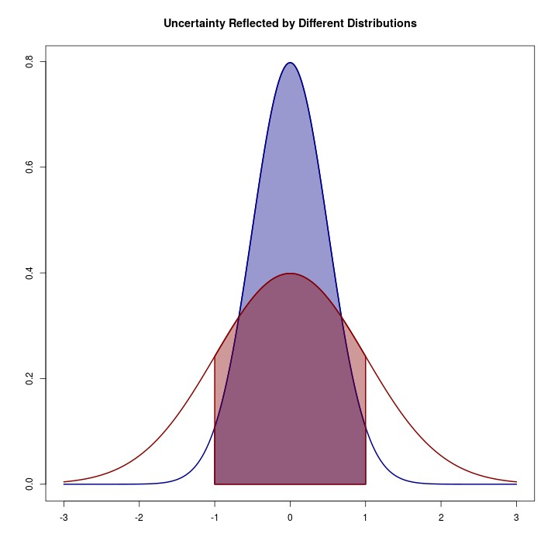
An All-Too-Brief Introduction to Bayesian Inference
Two normal distributions with different standard deviations. The blue distribution is more “precise” than the red one.³
³The connection between curvature and inferential precision is found in classical statistics as well: the Fisher information is a measure of curvature of the likelihood function. The ﬁeld of information geometry uses differential geometry to develop this relationship in much
more generality; see, e.g., [ABNK⁺87] for more.
9

Slide 12
Bayesian Inference
Basically all Bayesian inference problems⁴ are of the canonical form:
Given prior information about an unknown quantity θ, express that information as a probability distribution p(θ), conventionally known as the prior;
Given data observed according to some random process depending on θ, construct an appropriate likelihood p(X|θ);
Using Bayes’ rule, calculate a new distribution of θ, conditioned on the data X; this distribution is conventionally known as the posterior:
p(X|θ)p(θ) (p X|θ)p(θ)
p(X) ∫ p(X|θ)p(θ) dθ
π(θ|X) =
=
(Almost) All inference reduces to taking expectations under π(·).
⁴For an introduction to Bayesian methods see [McE15], [GH06], or [Hof09]; [GCS⁺14] is the Bayesian “Bible” for applied statistics. [Rob07]
is an excellent text on Bayesian foundations.
10

Slide 13
Choosing Priors
The choice of prior has historically been one of the more controversial aspects of Bayesian analysis. Roughly, three classes of priors:
Informative: Provide signiﬁcant information and help guide analysis.
Weakly Informative: Avoid pathologies, but let the data dominate. Similar to weak regularization in non-Bayesian analysis.
Non-Informative. Attempt to provide no information: hard to achieve in practice.⁵
Technical Warning: If you don’t provide a prior, Stan will implicitly use a uniform (ﬂat) prior. For unbounded parameters, this gives an improper distribution and strange things can occur (e.g., [HC96]).
Caveat emptor
⁵See, e.g., [KW96, BBS09].
11

Slide 14
Bayesian Inference
Having deﬁned our posterior distribution
p(X|θ)p(θ) (p X|θ)p(θ)
p(X) p(X|θ)p(θ) dθ
π(θ|X) =
=
∫
we want to actually perform statistical inference (make claims about the unobserved parameters).
Three major tasks:
12

Slide 15
Bayesian Inference
Having deﬁned our posterior distribution
p(X|θ)p(θ) (p X|θ)p(θ)
p(X) p(X|θ)p(θ) dθ
π(θ|X) =
=
∫
we want to actually perform statistical inference (make claims about the unobserved parameters).
Three major tasks:
Point estimation: making a single “best guess” about a value of interest
12

Slide 16
Bayesian Inference
Having deﬁned our posterior distribution
p(X|θ)p(θ) (p X|θ)p(θ)
p(X) p(X|θ)p(θ) dθ
π(θ|X) =
=
∫
we want to actually perform statistical inference (make claims about the unobserved parameters).
Three major tasks:
Point estimation: making a single “best guess” about a value of interest
Set/Interval estimation: selecting a set of values with a high probability of containing the parameter of interest
12

Slide 17
Bayesian Inference
Having deﬁned our posterior distribution
p(X|θ)p(θ) (p X|θ)p(θ)
p(X) p(X|θ)p(θ) dθ
π(θ|X) =
=
∫
we want to actually perform statistical inference (make claims about the unobserved parameters).
Three major tasks:
Point estimation: making a single “best guess” about a value of interest
Set/Interval estimation: selecting a set of values with a high probability of containing the parameter of interest
Prediction: making a guess about future observations
12

Slide 18
Bayesian Inference
Having deﬁned our posterior distribution
p(X|θ)p(θ) (p X|θ)p(θ)
p(X) p(X|θ)p(θ) dθ
π(θ|X) =
=
∫
we want to actually perform statistical inference (make claims about the unobserved parameters).
Three major tasks:
Point estimation: making a single “best guess” about a value of interest
Set/Interval estimation: selecting a set of values with a high probability of containing the parameter of interest
Prediction: making a guess about future observations
In classical statistics, these often require three different sets of tools. In Bayesian statistics, all three can be accomplished using the posterior.
12

Slide 19
Bayesian Inference
Typically, the posterior is actually a pretty difﬁcult distribution to work with directly, so we actually work with samples from the distribution. Historically, obtaining these samples has been the hardest part of Bayesian inference, but new tools like Stan have made it signiﬁcantly easier.
13

Slide 20
Bayesian Inference
Typically, the posterior is actually a pretty difﬁcult distribution to work with directly, so we actually work with samples from the distribution. Historically, obtaining these samples has been the hardest part of Bayesian inference, but new tools like Stan have made it signiﬁcantly easier.
Use of samples as opposed to the distribution itself is the heart of the Monte Carlo method.
13

Slide 21
Bayesian Inference
Typically, the posterior is actually a pretty difﬁcult distribution to work with directly, so we actually work with samples from the distribution. Historically, obtaining these samples has been the hardest part of Bayesian inference, but new tools like Stan have made it signiﬁcantly easier.
Use of samples as opposed to the distribution itself is the heart of the Monte Carlo method.
For point estimation, we typically use the posterior mean or median. With sufﬁcient samples from the posterior, the sample mean and the posterior mean will be essentially the same.
13

Slide 22
Bayesian Inference
Typically, the posterior is actually a pretty difﬁcult distribution to work with directly, so we actually work with samples from the distribution. Historically, obtaining these samples has been the hardest part of Bayesian inference, but new tools like Stan have made it signiﬁcantly easier.
Use of samples as opposed to the distribution itself is the heart of the Monte Carlo method.
For point estimation, we typically use the posterior mean or median. With sufﬁcient samples from the posterior, the sample mean and the posterior mean will be essentially the same.
For set estimation, we simply construct a set that a given fraction of the posterior samples fall into.
13

Slide 23
Bayesian Inference
Typically, the posterior is actually a pretty difﬁcult distribution to work with directly, so we actually work with samples from the distribution. Historically, obtaining these samples has been the hardest part of Bayesian inference, but new tools like Stan have made it signiﬁcantly easier.
Use of samples as opposed to the distribution itself is the heart of the Monte Carlo method.
For point estimation, we typically use the posterior mean or median. With sufﬁcient samples from the posterior, the sample mean and the posterior mean will be essentially the same.
For set estimation, we simply construct a set that a given fraction of the posterior samples fall into.
Slides in the Computation with Stan section explain a bit more about how this is done. For now, we’ll take it as a given.
13

Slide 24
Generalized Linear Mixed Effect Models

Slide 25
Mixed Effects Models
In “standard” linear regression, the error terms are considered to be
independent and identically distributed.
_{ϵ} iid
y_{i} = x^{T}β + ϵ
i
_{i} ∼ N (0, σ²)
i
15

Slide 26
Mixed Effects Models
In “standard” linear regression, the error terms are considered to be
independent and identically distributed.
_{ϵ} iid
y_{i} = x^{T}β + ϵ
i
_{i} ∼ N (0, σ²)
i
For many important problems, this is not reasonable. We may have repeated measurements of the same “unit,” correlated errors, natural groupings that we want to capture in the data, etc..
15

Slide 27
Mixed Effects Models
In “standard” linear regression, the error terms are considered to be
independent and identically distributed.
_{ϵ} iid
y_{i} = x^{T}β + ϵ
i
_{i} ∼ N (0, σ²)
i
For many important problems, this is not reasonable. We may have repeated measurements of the same “unit,” correlated errors, natural groupings that we want to capture in the data, etc..
Mixed-Effects Models let us deal with all of these phenomena. Bayesians use these all of the time, but typically prefer the name “multilevel-” or “hierarchical-” models.
15

Slide 28
Mixed-Effects Models
For mixed-effects models, data is typically arranged in a “hierarchy” of observational units: e.g.
Exams within students within classes within schools within districts within states
16

Slide 29
Mixed-Effects Models
For mixed-effects models, data is typically arranged in a “hierarchy” of observational units: e.g.
Exams within students within classes within schools within districts within states
We model each grouping as an linear/additive effect:
National Baseline State Effect District Effect Exam Speciﬁc Randomness
¸x_{µ}s˛ ¸x_{ν}s_{i} ˛ ¸_{κ}xs_{ij}˛
Score_{ijklm} = + + + · · ·+
^{¸ϵ}i^{x}jk^{s}lm˛
Notation can be a bit overwhelming, but key idea is that we are partitioning observed variance to different layers of the hierarchy
16

Slide 30
Fitting Mixed-Effects Models
In R, mixed-effects models are typically ﬁt with the lme4 and nlme
packages [PB00, BMBW15].
17

Slide 31
Fitting Mixed-Effects Models
In R, mixed-effects models are typically ﬁt with the lme4 and nlme
packages [PB00, BMBW15].
A “drop-in” Stan based replacement is available through the
rstanarm package [Sta16].
17

Slide 32
Fitting Mixed-Effects Models
In R, mixed-effects models are typically ﬁt with the lme4 and nlme
packages [PB00, BMBW15].
A “drop-in” Stan based replacement is available through the
rstanarm package [Sta16].
Let’s try this out an an example of tumor growth data from [HHW⁺04] (example courtesy of Peter Hoff, [Hof09, Section 11.4]):
www.stat.washington.edu/people/pdhoff/Book/Data/XY.tumor
17

Slide 33
Tumor Data
This data records the number of tumors found in different sections of the intestines of 21 different mice. The data follows a natural hierarchy (counts within mice) and suggests a mixed-effect model should be used to capture the “mouse effect”.
If we look at the data, we see that certain mice have higher overall cancer incidence than others, but that there is still a consistent rise near the end of the intestine:
URL = "http://www.stat.washington.edu/people/pdhoff/Book/Data/data/XY.tumor" TUMOR_DATA <- dget(URL)
plot(seq(0.05, 1, by=0.05), colMeans(TUMOR_DATA$Y), col="black", lwd=3, ylim=range(TUMOR_DATA$Y), type="l", main="Tumor Data", xlab="Measurement Site", ylab="Number of Tumors")
for(i in 1:21){
lines(seq(0.05, 1, by=0.05), TUMOR_DATA$Y[i, ], col="grey80")
}

Slide 34
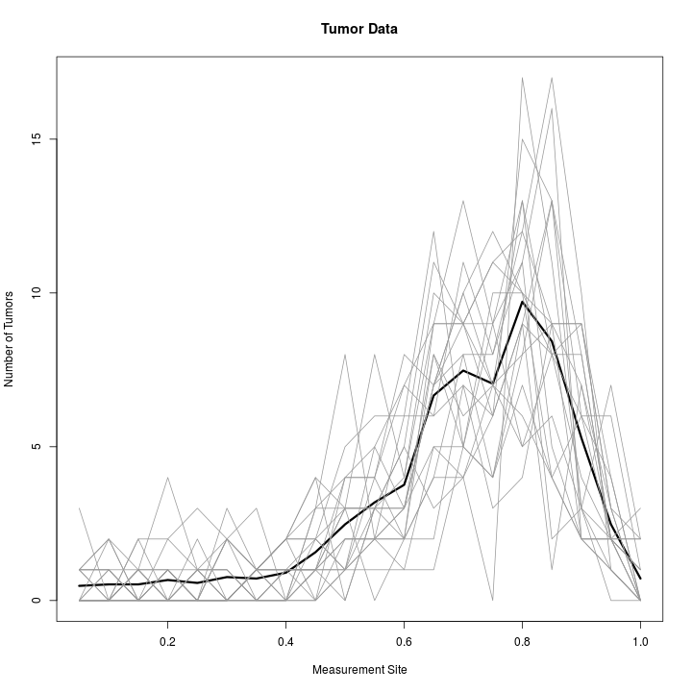
Tumor Data

Slide 35
Poisson GLMM
Since this is count data, we’ll use Poisson regression.
The data is a bit messily formatted, but after some cleaning, we can ﬁt the model with a mouse-effect and a 4th degree polynomial for the location effect using rstanarm as follows:
library(reshape2); library(rstanarm); options(mc.cores=parallel::detectCores()) DATA <- cbind(expand.grid(mouse_id=1:21,
location=seq(0.05, 1, by=0.05)), count=melt(TUMOR_DATA$Y)$value)
M <- stan_glmer(count ~ poly(location, 4) + (1|mouse_id),
family=poisson, data=DATA)
Takes about 15 seconds to get 4000 samples on this data set, which is more than enough for posterior inference.

Slide 36
Poisson GLMM
Say we were interested in the prediction for the “typical” mouse. We make posterior predictions with the mouse-effect set to zero and examine the 5%, 50%, and 95% quantiles of the posterior (giving a 90% prediction interval):
X <- seq(0.05, 1, by=0.05)
PP <- posterior_predict(M, re.form=~0, newdata=data.frame(location=X)) apply(PP, 2, quantile, c(0.05, 0.50, 0.95))
The model appears to ﬁt the data well:

Slide 37
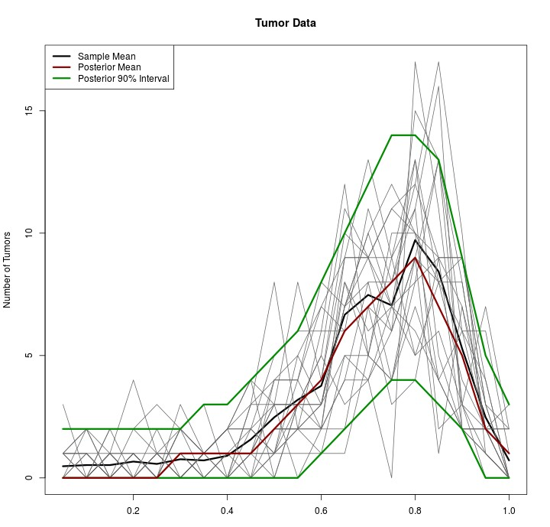
Poisson GLMM

Slide 38
MCMC Convergence and Model Assessment

Slide 39
Checking Model Fit
In our Poisson GLMM example, the model ﬁt the data well and sampling converged rapidly. We are not always so lucky. In general, we should always check convergence diagnostics before proceeding to inference.
24

Slide 40
Checking Model Fit
In our Poisson GLMM example, the model ﬁt the data well and sampling converged rapidly. We are not always so lucky. In general, we should always check convergence diagnostics before proceeding to inference.
The shinystan and bayesplot packages provide tools for visualizing and checking the results of MCMC inference.
24

Slide 41
Demo Time!
launch_shinystan(M)

Slide 42
Computation with Stan

Slide 43
Stan
Stan [Sta15c, CGH⁺, GLG15] is a probabilistic programming language superﬁcially like BUGS or JAGS [LJB⁺03, Plu03]. Unlike BUGS and JAGS, not restricted to Gibbs sampling or conjugate (exponential family graphical) models.
Provides:
Full Bayesian Inference (via Hamiltonian Monte Carlo)
Variational Bayesian Inference (via ADVI [KRGB15, KTR⁺16, BKM16])
Penalized MLE (Bayesian MAP)⁶
Best thought of as a DSL for specifying a distribution and sampling from it.
Named after Stanislaw Ulam, co-author, with N. Metropolis, of The Monte Carlo Method (JASA-1949, [MU49])
⁶Useful for quickly checking results against non-Bayesian software. MAP with uniform priors should recover the MLE (modulo optimization issues for non-convex problems).
27

Slide 44
Stan
Language- and platform-agnostic back-end ([Sta15c, Sta15d]) with a wide range of front-ends:
Shell (“CmdStan”)
R (“RStan”, [Sta15b]) ⋆
Python (“PyStan”, [Sta15a]) ⋆
Matlab (“MatlabStan”, [Lau15])
Stata (“StataStan”, [GS15])
Julia (“JuliaStan”, [Goe15])
⋆: In process interface. The others “simply” wrap CmdStan.
28

Slide 45
Stan Compilation Model
Stan uses a two step compilation process: the user writes a model in pure Stan code⁷ which is then translated to C++ by the stanc compiler. The translated program is then compiled like any other C++ program into a stand alone binary.
Once compiled, the model can be re-run with different inputs / parameters.
Requires a working C++ compiler unlike the (interpreted) BUGS/JAGS to compile new models. Once compiled, the binary can be moved between machines (modulo standard linking and library constraints).
Higher level interfaces (e.g. RStan) can run the compilation in the background.
⁷It is possible to embed Stan directly within a C++ program, but more advanced.
29

Slide 46
Stan Language Building Blocks
Stan provides a wide range of built-in data types:
Data primitives: real, int
Mathematical structures: vector, matrix – can hold real and
int
Programming structures: array – can hold any other Stan type
Constrained structures: ordered, positive_ordered, simplex, unit_vector
Matrix types: cov_matrix, corr_matrix, cholesky_factor_cov, cholesky_factor_corr
30

Slide 47
Stan Language Building Blocks
Constraints on data types are used to transform into an
unconstrained space where Stan performs inference.
real<lower=0> sigma; real<lower=0,upper=1> p;
sigma is log-transformed to be supported on R; similarly p is logit⁻¹-transformed.⁸ Since there is an change of variables in these transforms, Stan automatically adds a Jacobian to the target density. When you perform similar “left-hand-side” transformations, Stan will warn that a manual Jacobian adjustment may be necessary [Sta15d, Chapter 20].
Warning: Because Stan works on a (transformed) R, discrete parameters are not directly supported. (Discrete data is ﬁne.)
⁸Stan has a range of transformations into unconstrained space:
Positivity constraints use a log(·)-transform
Boundedness constraints use a (scaled) logit(·)-transform
Simplex constraints use a stick-breaking transform (R^{K} → R^{K−1} )
Matrix constraints (PD) use Cholesky-based transforms (see [PB96])
31

Slide 48
Stan Language Model
A Stan program is divided into blocks. The key blocks are:
data: Deﬁnes the external data which Stan will read at the beginning of execution
parameters: Deﬁnes the variables which will be inferred
model: Deﬁnes the probability model relating the data and parameters. Both the prior and the likelihood are coded in this block
Additional blocks, e.g., transformed data, generated quantities are useful for performing additional transformations within Stan. Less useful when using Stan through the interfaces.
32

Slide 49
Stan Language Model
Toy example (Beta-Bernoulli):
data{
int<lower=0> N; // Number of observations
int<lower=0,upper=1> y[N]; // observed 0/1 variables
}
parameters{
real<lower=0,upper=1> p; // unknown p
}
model{
p ~ beta(1, 1); // weak prior
y ~ bernoulli(p); // vectorized across elements of y
}
33

Slide 50
Stan Language Model
The “sampling statements” in the model block are syntactic sugar for direct manipulation of the log-posterior.
Equivalent:
data{
int<lower=0> N; // Number of observations
int<lower=0,upper=1> y[N]; // observed 0/1 variables
}
parameters{
real<lower=0,upper=1> p; // unknown p
}
model{
target += beta_log(p, 1, 1); // weak prior
for(i in 1:N){ // likelihood
target += bernoulli_log(p, y[i]);
}
}
34

Slide 51
Bayesian Inference
_{π(θ|X) =} p(X|θ)p(θ)
∫ p(X|θ)p(θ) dθ
The denominator of this quantity (the “partition function”) is often analytically intractable so we are left with
π(θ|X) ∝ p(X|θ)p(θ)
How can we calculate E[F(θ)] for arbitrary (measurable) F(·) when we
can only calculate π up to a normalizing constant?
In theory, we sample from π and invoke the Law of Large Numbers:
N
1
N
∑
n→∞
F(θ ) −→ E[F
(θ)]
i
i=1
In practice, we cannot sample directly from π either.
35

Slide 52
Markov Chain Monte Carlo
Not entirely true. We can (sort of ) sample from π, but not IID. We construct an (ergodic) Markov chain with transition kernel Π
chosen to have the same stationary distribution as π (see, e.g., [Tie94] for details). Then, samples from this Markov chain are samples from π if either:
We initialize the chain with a draw from π;
We run the chain long enough (inﬁnitely long!) so that it converges to π.
The ﬁrst is, again, impossible. Let’s look more closely at the second.
36

Slide 53
Convergence of MCMC
A Markov chain is a map from the space of probability distributions onto itself.
Given an initialization distribution (which may be a point mass) P₀, application of the transition kernel Π gives a new distribution P₁.
Repeated application gives {P_{n}} which tend to π as n → ∞. If P₀ is
“close” to π, the convergence is rapid.
π is the stationary point of Π so Ππ = π.
37

Slide 54
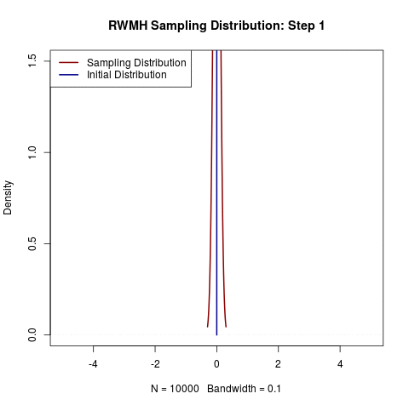
Convergence of MCMC
Example:
P₀ = δ₀;
Π is a Random Walk Metropolis Hastings update (proposal distribution: X_{t} ∼ N (X_{t−1}, 1));
π is N (2, 5²).
38

Slide 55
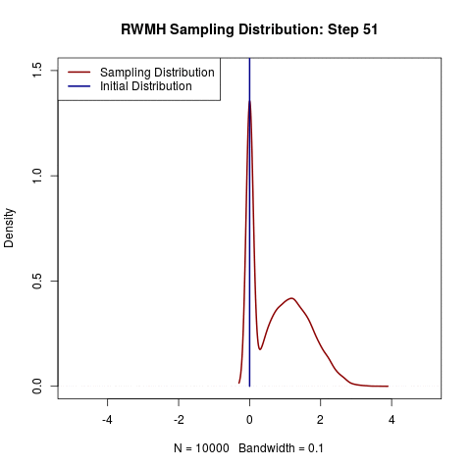
Convergence of MCMC
Example:
P₀ = δ₀;
Π is a Random Walk Metropolis Hastings update (proposal distribution: X_{t} ∼ N (X_{t−1}, 1));
π is N (2, 5²).
39

Slide 56
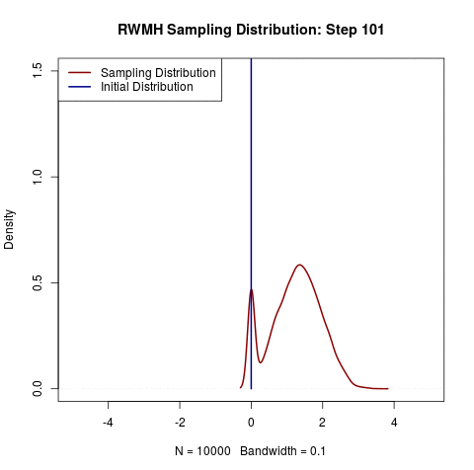
Convergence of MCMC
Example:
P₀ = δ₀;
Π is a Random Walk Metropolis Hastings update (proposal distribution: X_{t} ∼ N (X_{t−1}, 1));
π is N (2, 5²).
40

Slide 57
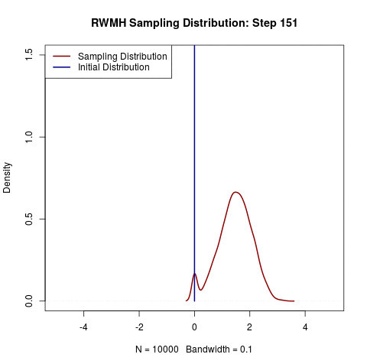
Convergence of MCMC
Example:
P₀ = δ₀;
Π is a Random Walk Metropolis Hastings update (proposal distribution: X_{t} ∼ N (X_{t−1}, 1));
π is N (2, 5²).
41

Slide 58

Convergence of MCMC
Example:
P₀ = δ₀;
Π is a Random Walk Metropolis Hastings update (proposal distribution: X_{t} ∼ N (X_{t−1}, 1));
π is N (2, 5²).
42

Slide 59

Convergence of MCMC
Example:
P₀ = δ₀;
Π is a Random Walk Metropolis Hastings update (proposal distribution: X_{t} ∼ N (X_{t−1}, 1));
π is N (2, 5²).
43

Slide 60
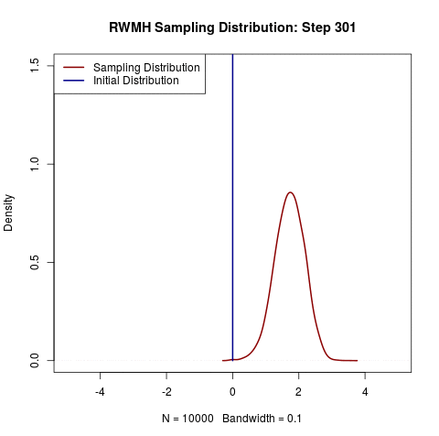
Convergence of MCMC
Example:
P₀ = δ₀;
Π is a Random Walk Metropolis Hastings update (proposal distribution: X_{t} ∼ N (X_{t−1}, 1));
π is N (2, 5²).
44

Slide 61
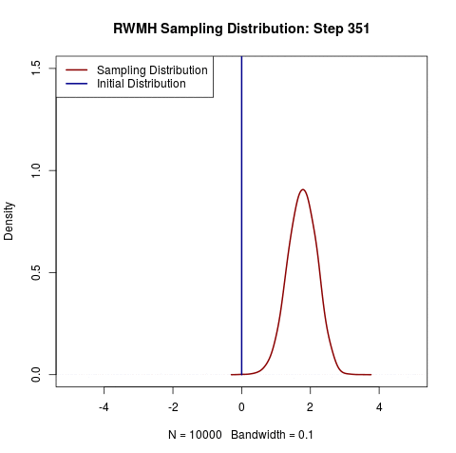
Convergence of MCMC
Example:
P₀ = δ₀;
Π is a Random Walk Metropolis Hastings update (proposal distribution: X_{t} ∼ N (X_{t−1}, 1));
π is N (2, 5²).
45

Slide 62
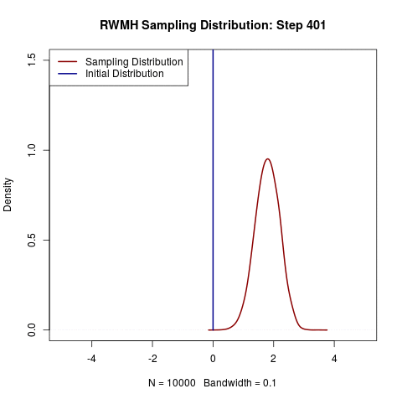
Convergence of MCMC
Example:
P₀ = δ₀;
Π is a Random Walk Metropolis Hastings update (proposal distribution: X_{t} ∼ N (X_{t−1}, 1));
π is N (2, 5²).
46

Slide 63
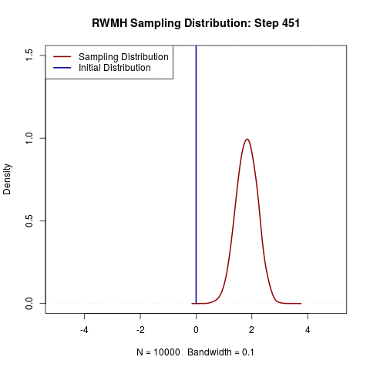
Convergence of MCMC
Example:
P₀ = δ₀;
Π is a Random Walk Metropolis Hastings update (proposal distribution: X_{t} ∼ N (X_{t−1}, 1));
π is N (2, 5²).
47

Slide 64
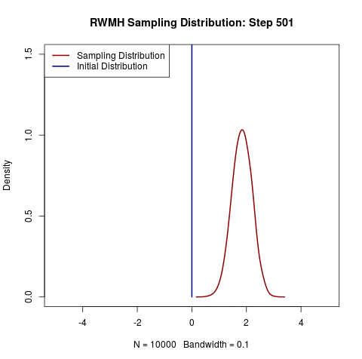
Convergence of MCMC
Example:
P₀ = δ₀;
Π is a Random Walk Metropolis Hastings update (proposal distribution: X_{t} ∼ N (X_{t−1}, 1));
π is N (2, 5²).
48

Slide 65
Accuracy of MCMC: Effective Sample Size
How many samples from π do we need?
Depends what we want to do: let’s take calculating the posterior mean as a typical task.⁹
Two possible sources of variance:
The inherent variance of the posterior;
Additional variance from having a ﬁnite number of draws (“Monte Carlo error”)
The ﬁrst is unavoidable (and a key advantage of the Bayesian approach); the second can be reduced with more samples.
⁹See [Jon04] for a discussion of the Markov Chain Central Limit Theorem; see [RR04] for a discussion of the general conditions required for MCMC convergence.
49

Slide 66
Accuracy of MCMC: Effective Sample Size
If we have n iid samples from π, our Monte Carlo standard error (ratio of total variance to inherent variance) is approximately
√1 + n⁻¹ [GCS⁺14, Section 10.5].
With autocorrelation, we instead look at the effective sample size:¹⁰
ESS = ^{n}
1 + ∑∞_{t=1} ρ_{t}
See [GCS⁺14, Section 11.5] or [KCGN98, Section 2.9] for details.
Technically, there is a different ACF for each E[f(·)] we estimate, but this isn’t usually a big deal in practice.¹¹
10
11
∑
2 n
The exact formula has n /(n + (n − t)ρ ) but for large n this is approximately equal (and faster to calculate).
t=1 t
There is a disconnect between practice and theory here. Theory establishes conditions for accurate inference for all possible f (see,
e.g., [LPW08]), but we usually only care about a few f. Some (very) recent work attempts to establish convergence rates for restricted classes of f [RRJW16].
50

Slide 67
Choice of Markov Kernel
Since ESS controls the quality of our inference, ESS/second is the appropriate metric for comparing samplers.
Different choices of the Markov transition kernel Π can give radically different ESS/second.
Standard Metropolis-Hastings or Gibbs Samplers struggle for complex (hierarchical) and high-dimensional (many parameters) models.
Hamiltonian Monte Carlo ([Nea11]) performs much more efﬁciently for a wide range of problems.¹²
¹²The Markov Chains constructed by HMC can be shown to be geometrically ergodic (quick mixing) under relatively weak conditions [LBBG16].

Slide 68
Hamiltonian Monte Carlo
In its default mode, Stan uses a technique known as Hamiltonian Monte Carlo to sample from the posterior with minimal autocorrelation. These draws are typically more expensive than from other methods, e.g. Gibbs samplers, but the reduced correlation leads to a (much) higher ESS/second.
Very roughly: Metropolis-Hastings methods ([MRR⁺53, Has70]) move around the probability space randomly (without knowledge of the underlying geometry) and use a accept-reject step to adjust probabilities accordingly.
Hamiltonian Monte Carlo gives a particle a random “kick” and samples based on the path of the particle: uses Hamiltonian mechanics to simulate the path of the particle in an energy ﬁeld induced by the target density π.

Slide 69
Hamiltonian Dynamics
Hamiltonian dynamics (a.k.a. Hamiltonian mechanics) is an equivalent formulation of Newtonian mechanics. Let p be the momenta of all particles in the system and q be the position of the particles.
The evolution of the system over time is uniquely deﬁned by:
dp ∂H
= −
dt
∂q
dq ∂H
= −
dt
∂p
where H is the Hamiltonian of the system, a function which
measures the total energy of the system.
Hamiltonian mechanics is easily extended to relativistic systems.
53

Slide 70
Hamiltonian Dynamics
Once the Hamiltonian H and the initial conditions are speciﬁed, the time evolution of the system is known deterministically. In practice, the PDEs cannot be solved explicitly and a numerical integrator must be used.
A common choice of integrator is the leapfrog integrator which has the nice properties of being:
time-reversibility
symplectic (energy conserving)
See [LR05] for details. With step size ϵ (requiring Lϵ steps to integrate over a time interval of length L), the leapfrog integrator has ϵ² error.
54

Slide 71
Hamiltonian Monte Carlo
Hamiltonian Monte Carlo (originally Hybrid Monte Carlo) [Nea11] builds a Hamiltonian system to sample from a target density π.
We let q (the “position”) be the parameters of the target density and add an auxiliary momentum variable p. The joint distribution of p, q can be used to deﬁne a Hamiltonian H:
H(p, q) = − log p(p, q)
= − log p(q|p) − log p(p)
= T(q|p) + V(p)
Kin^{s}eti˛c ¸ene^{x}rgy Poten^{s}ti˛a¸l e^{x}nergy
Solving the Hamiltonian equations for this system, we ﬁnd
dq ∂T
dt ⁼ ∂p
dp ∂V
dt ⁼ ⁻ ∂q
55

Slide 72
Hamiltonian Monte Carlo
We can (approximately) solve these equations using a leapfrog
integrator. To introduce randomness, p₀ is initialized from a N (0, Σ)
matrix where Σ is independent of prior samples and of q₀. Leapfrog integration is then simply:
ϵ ∂V
ρ ← ρ − _{2 ∂q}
θ ← θ + ϵΣp
ϵ ∂V
ρ ← ρ − _{2 ∂q}
repeated L times.
If leapfrog integration were exact, we could directly accept the result of the leapfrog step. In reality, we have to use a Metropolis acceptance step [MRR⁺53] to account for the error. Thus, HMC as implemented is strictly a form of Metropolis MCMC, but with a highly efﬁcient transition kernel Π which moves along the geometric contours of the target distribution π rather than randomly.
56

Slide 73
Euclidean and Riemannian HMC
The form of Σ controls the implicit geometry of the the Hamiltonian dynamics [BS11, BBLG14]. In particular, Σ⁻¹ is the mass matrix of the particle undergoing Hamiltonian evolution.
Fixed Σ (either diagonal or full) corresponds to a Euclidean metric on the parameter space and gives Euclidean Hamiltonian Monte Carlo.
Current research considers changing Σ for each sample: this corresponds to sampling on a Riemannian manifold and gives rise to Riemannian Hamiltonian Monte Carlo [GC11, Bet13]. By varying Σ, RHMC can adapt to the “funnels” found in complex hierarchical variables more efﬁciently [BG13].

Slide 74
The No-U-Turn Sampler (NUTS)
For large L, running HMC to termination is wasteful when the particle begins to retrace its steps. Early termination would save computation time but biases our sampling.
To avoid this, the No-U-Turn Sampler (“NUTS”) enhances HMC by allowing time to intermittently run backwards: see [HG14] for details. The time-reversability of the leapfrog integrator is key for allowing NUTS to work properly.
NUTS is the default sampler used in Stan though “pure” HMC is also available.

Slide 75
AutoDiff
Automatic Differentiation (“AutoDiff”) is a technique for automatically calculating the numerical gradient of a function at a ﬁxed point.
AutoDiff expresses computations in terms of language primitives (addition, multiplication, and function calls) and uses the chain rule to calculate the gradient as part of regular function evaluation.
Stan uses autodiff to efﬁciently calculate the gradients necessary for HMC.

Slide 76
AutoDiff vs Other Gradient Calculation Techniques
AutoDiff is not
Symbolic Differentiation
Numerical Differentiation (ﬁnite difference approximations)
Unlike symbolic differentiation, AutoDiff has no knowledge about the function being evaluated: only the arithmetic primitives.¹³ Unlike numerical differentiation, AutoDiff provides exact gradient calculations with a single function call.
¹³Consequently, AutoDiff provides an exact derivative for an approximation of the function of interest rather than an approximation to the exact function of interest.

Slide 77
AutoDiff in Stan
Stan provides a fully AutoDiff-equipped math library ([CHB⁺15]) built on Boost and Eigen [Sch11, GJ⁺10].
Currently Stan only uses ﬁrst-order AutoDiff but second-order
AutoDiff will be released soon.
Stan’s AutoDiff is reverse-mode which means that it works “down” the function call chain:
∂y ∂y ∂w₁
∂y ∂w₂ ∂w₁
= = = . . .
∂x ∂w₁ ∂x ∂w₂ ∂w₁ ∂x
When computing derivatives of functions f : R^{n} → R^{m}, this is more efﬁcient for m ≪ n; for Stan, m = 1.

Slide 78
Financial Time Series: Stochastic Volatility Models

Slide 79
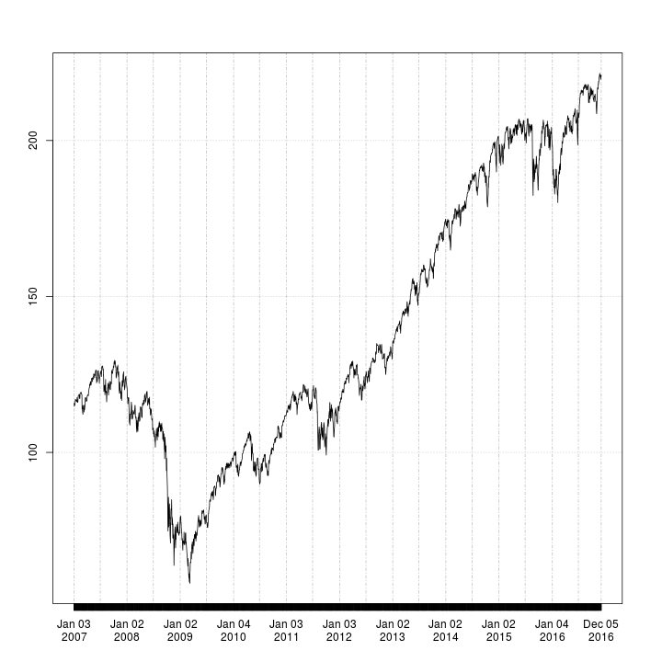

Slide 80
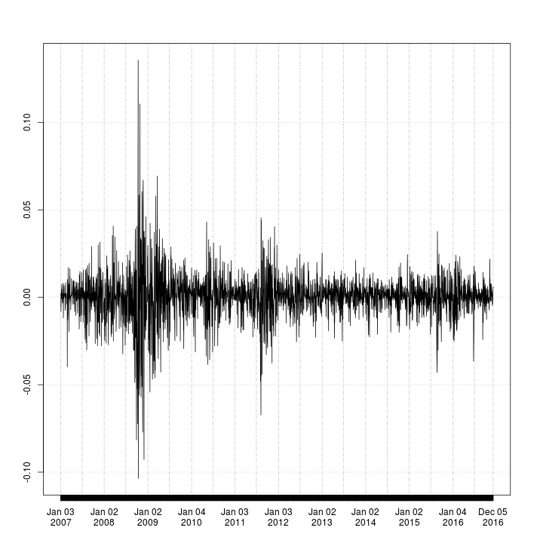

Slide 81
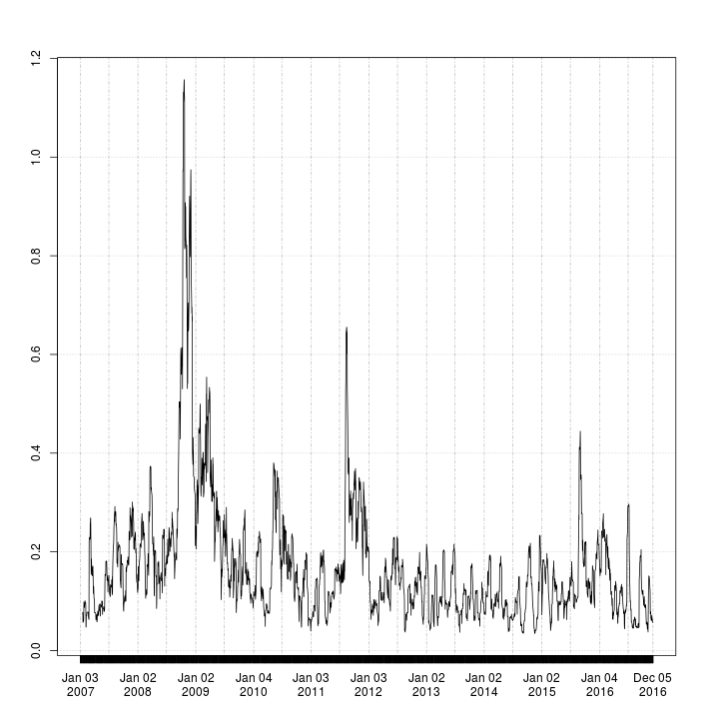

Slide 82
Financial Time Series
Financial time series (e.g. stock market returns) exhibit volatility clustering – that is, there are periods of relative calm (small day-over-day changes) and periods of relative volatility (large day-over-day changes).
66

Slide 83
Financial Time Series
Financial time series (e.g. stock market returns) exhibit volatility clustering – that is, there are periods of relative calm (small day-over-day changes) and periods of relative volatility (large day-over-day changes).
A standard simple model of a ﬁnancial time series is:
_{r} iid
2
t
∼ N (0, σ )
t
where σ² is the “ instantaneous volatility.”
t
66

Slide 84
Financial Time Series
Financial time series (e.g. stock market returns) exhibit volatility clustering – that is, there are periods of relative calm (small day-over-day changes) and periods of relative volatility (large day-over-day changes).
A standard simple model of a ﬁnancial time series is:
_{r} iid
2
t
∼ N (0, σ )
t
where σ² is the “ instantaneous volatility.”
t
We would like to know the instantaneous volatility for each day, but it’s essentially impossible to calculate without further assumptions (or higher frequency data) since we can’t calculate a standard deviation with only a single sample.
66

Slide 85
Financial Time Series
Financial time series (e.g. stock market returns) exhibit volatility clustering – that is, there are periods of relative calm (small day-over-day changes) and periods of relative volatility (large day-over-day changes).
A standard simple model of a ﬁnancial time series is:
_{r} iid
2
t
∼ N (0, σ )
t
where σ² is the “ instantaneous volatility.”
t
We would like to know the instantaneous volatility for each day, but it’s essentially impossible to calculate without further assumptions (or higher frequency data) since we can’t calculate a standard deviation with only a single sample.
Volatility models add additional structure to the time-dynamics of
σ² so that we can estimate it from observed data.
t
66

Slide 86
Stochastic Volatility
The Stochastic Volatility model of [KSC98] models volatility as a latent mean-reverting AR(1) process.
( )
h ∼ N µ + ϕ(h − µ), σ
2
t+1 t
r_{t} ∼ N (0, exp {h_{t}})
Implemented in stochvol package for R [Kas16].
If we want the volatility at each time t, this is a high-dimensional
T
model: quantities–{h } , µ, ϕ, σ–than we have observations.
t
t=1
Normally, this is impossible without further constraints or regularization, but the prior fulﬁlls that role in the Bayesian context.
67

Slide 87
Stochastic Volatility
The Stan manual [Sta15d, Section 9.5] describes how to code this model efﬁciently:
data {
int<lower=0> T; vector[T] y;
}
parameters {
real mu;
real<lower=-1, upper=1> phi; // Stationary volatility
real<lower=0> sigma; vector[T] h_std;
}
(continued)
68

Slide 88
Stochastic Volatility
transformed parameters { vector[T] h;
h = h_std * sigma;
h[1] = h[1] / sqrt(1 - phi * phi); h = h + mu;
for(t in 2:T){
h[t] = h[t] + phi * (h[t-1] - mu);
}
}
69

Slide 89
Stochastic Volatility
model {
// Priors
phi ~ uniform(-1, 1); sigma ~ cauchy(0, 5); mu ~ cauchy(0, 10);
// Scaled Innovations in h process are IID N(0,1)
h_std ~ normal(0, 1);
// Observation likelihood.
// Note exp(h/2) since Stan uses normal(mean, SD)
y ~ normal(0, exp(h/2));
}
70

Slide 90
Stochastic Volatility
Running this model, we can plot the estimated volatility with its conﬁdence interval over time:
library(quantmod)
SPY <- getSymbols("SPY", auto.assign=FALSE)
R <- na.omit(ROC(Ad(SPY)))
SAMPLES <- stan("sv.stan", data=list(y=as.vector(R), T=length(R))) PP <- apply(exp(extract(SAMPLES, "h")[[1]]/2), 2,
quantile, c(0.05, 0.50, 0.95))
71

Slide 91
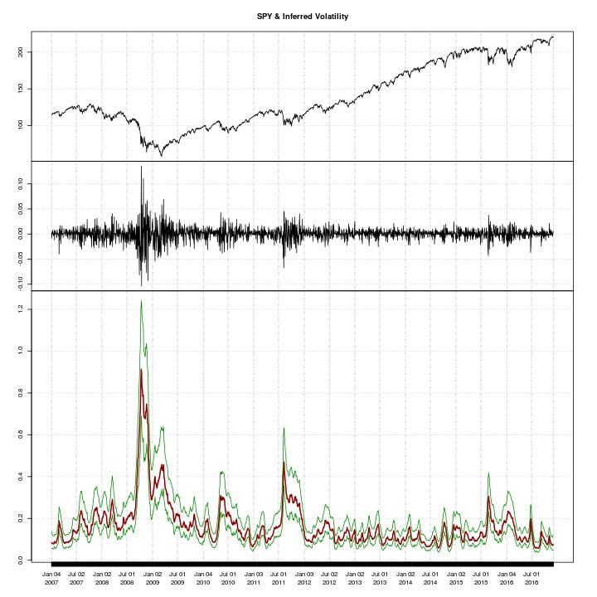

Slide 92
Stochastic Volatility
Once coded-up, adapting the model to use a heavy-tailed or skewed error process is straightforward:
t-errors (inferring the degrees of freedom)
...
real<lower=0> nu;
...
nu ~ cauchy(0, 5);
y ~ student_t(nu, 0, exp(h/2));
...
Skew-normal errors (inferring the skewness parameter):
...
real alpha;
...
alpha ~ cauchy(0, 5);
y ~ skew_normal(0, exp(h/2), alpha);
...
73

Slide 93
Thank you

Slide 94
Learning More!
If you’re interested in learning more, start with Michael Betancourt’s talks to the Tokyo Stan Users’ Group: (Modeling (link) and HMC (link)).
Bob Carpenter’s MLSS-2015 talk (link) is a bit more “hands-on” with the Stan language. (Michael’s talks go into more MCMC and HMC theory)
The Stan manual (link) is remarkably readable.
The stan-users mailing list (link) is a good place to ask for help with more detailed issues.
Pierre-Antoine Kremp built a fully-open source political forecasting model using Stan. Check it out!
75

Slide 95
References

Slide 96
References I
[ABNK⁺87] Shun-ichi Amari, O.E. Barndorff-Nielsen, Robert E. Kass, Steffen L. Lauritzen, and C.R. Rao.
Differential Geometry in Statistical Inference, volume 10 of Lecture Notes-Monograph Series.
Institute of Mathematical Statistics, 1987.
http://www.jstor.org/stable/4355557.
[BBLG14]
Michael J. Betancourt, Simon Byrne, Samuel Livingstone, and Mark Girolami.
The geometric foundations of Hamiltonian Monte Carlo, 2014.
arXiv 1410.5110.
77

Slide 97
References II
[BBS09]
James O. Berger, José M. Bernardo, and Dongchu Sun.
The formal deﬁnition of reference priors.
Annals of Statistics, 37(2):905–938, 2009. https://projecteuclid.org/euclid.aos/1236693154; arXiv 0904.0156.
Michael Betancourt.
A general metric for Riemannian manifold Hamiltonian Monte Carlo.
In Frank Nielsen and Frédéric Barbaresco, editors,
Geometric Science of Information: First International Conference (GSI 2013), volume 8085 of Lecture Notes in Computer Science, pages 327–334. Springer, 2013.
arXiv 1212.4693.
[Bet13]
78

Slide 98
References III
[BG13]
Michael Betancourt and Mark Girolami.
Hamiltonian Monte Carlo for hierarchical models, 2013.
arXiv 1312.0906.
David M. Blei, Alp Kucukelbir, and Jon D. McAuliffe. Variational inference: A review for statisticians, 2016. arXiv 1601.00670.
Douglas Bates, Martin Mächler, Ben Bolker, and Steve Walker.
Fitting linear mixed-effects models using lme4. Journal of Statistical Software, 67, 2015. https://www.jstatsoft.org/article/view/v067i01.
Michael Betancourt and Leo C. Stein.
The geometry of Hamiltonian Monte Carlo, 2011.
arXiv 1112.4118.
[BKM16]
[BMBW15]
[BS11]
79

Slide 99
References IV
[CGH⁺]
Bob Carpenter, Andrew Gelman, Matt Hoffman, Daniel Lee, Ben Goodrich, Michael Betancourt, Marcus Brubaker, Jiqiang Guo, Peter Li, and Allen Riddell.
Stan: A probabilistic programming language.
Journal of Statistical Software.
Forthcoming; preprint available at http://www.stat.columbia.edu/~gelman/research/ published/stan-paper-revision-feb2015.pdf.
Bob Carpenter, Matthew D. Hoffman, Marcus Brubaker, Daniel Lee, Peter Li, and Michael Betancourt.
The Stan math library: Reverse-mode automatic differentiation in C++, 2015.
arXiv 1059.07164.
[CHB⁺15]

Slide 100
References V
[DL12]
Marie Davidian and Thomas A. Louis.
Why statistics?
Science, 336(6077):12, 2012.
Bradley Efron.
Frequentist accuracy of bayesian estimates. Journal of the Royal Statistical Society, Series B, 77(3):617–646, 2015.
Discussion at
https://www.youtube.com/watch?v=2oKw5HHAWs4.
Mark Girolami and Ben Calderhead.
Riemann manifold langevin and hamiltonian monte carlo methods.
Journal of the Royal Statistical Society, Series B,
73(2):123–214, 2011.
[Efr15]
[GC11]

Slide 101
References VI
[GCS⁺14]
Andrew Gelman, John B. Carlin, Hal S. Stern, David B. Dunson, Aki Vehtari, and Donald B. Rubin.
Bayesian Data Analysis.
Texts in Statistical Science. CRC Press, 3rd edition, 2014.
Andrew Gelman and Jennifer Hill. Data Analysis Using Regression and Multilevel/Hierarchical Models.
Analytical Methods for Social Research. Cambridge University Press, 1st edition, 2006.
Gaël Guennebaud, Benoît Jacob, et al. Eigen v3, 2010. http://eigen.tuxfamily.org.
[GH06]
[GJ⁺10]

Slide 102
References VII
[GLG15]
Andrew Gelman, Daniel Lee, and Jiqiang Guo. Stan: A probabilistic programming language for Bayesian inference and optimization.
Journal of Educational and Behavioral Statistics, 40:530–543, 2015.
http://www.stat.columbia.edu/~gelman/research/ published/stan_jebs_2.pdf.
Rob Goedman.
Stan.jl: the Julia interface to Stan, 2015. http://mc-stan.org/julia-stan.html; http://gitub.com/goedman/Stan.jl.
[Goe15]

Slide 103
References VIII
Robert Grant and Stan Development Team. StatStan: the Stata interface to Stan, 2015. http://mc-stan.org/stata-stan.html; http://gitub.com/stan-dev/statastan.
W.K. Hastings.
Monte Carlo sampling methods using Markov chains and their applications.
Biometrika, 57:97–109, April 1970.
http://www.jstor.org/stable/2334940.
[GS15]
[Has70]

Slide 104
References IX
[HC96]
James P. Hobert and George Casella.
The effect of improper priors on gibbs sampling in hierarchical linear mixed models.
Journal of the American Statistical Association, 91(436):1461–1473, 1996.
http://www.jstor.org/stable/2291572.
Matthew D. Hoffman and Andrew Gelman.
The no-U-turn sampler: Adaptively setting path lengths in Hamiltonian Monte Carlo.
Journal of Machine Learning Research, 15:1593–1623, 2014.
http://jmlr.org/papers/v15/hoffman14a.html.
[HG14]

Slide 105
References X
[HHW⁺04]
Kevin M. Haigis, Peter D. Hoff, Alanna White, Alex R. Shoemaker, Richard B. Halberg, and William F. Dove. Tumor regionality in the mouse intestine reﬂects the mechanism of loss of Apc function.
Proceedings of the National Academy of Sciences of the United States of America, 101(26):9769–9773, 2004.
Peter D. Hoff.
A First Course in Bayesian Statistical Methods.
Springer Texts in Statistics. Springer, 1st edition, 2009.
E.T. Jaynes.
Probability Theory: The Logic of Science.
Cambridge University Press, 2003.
[Hof09]
[Jay03]

Slide 106
References XI
Harold Jeffreys.
Theory of Probability.
Ofxford University Press, 3rd edition, 1961.
Galin L. Jones.
On the Markov chain central limit theorem.
Probability Surveys, 1:299–320, 2004.
Gregor Kastner.
Dealing with stochastic volatility in time series using the r package stochvol.
69(5), 2016.
https://www.jstatsoft.org/article/view/v069i05.
[Jef61]
[Jon04]
[Kas16]

Slide 107
References XII
[KCGN98]
Robert E. Kass, Bradley P. Carlin, Andrew Gelman, and Radford M. Neal.
Markov chain Monte Carlo in practice: A roundtable discussion.
The Americal Statistician, 52:93–100, 1998.
http://dx.doi.org/10.1080/00031305.1998.10480547.
John Maynard Keynes.
A Treatise on Probability.
Macmillan & Co., 1921.
Alp Kucukelbir, Rajesh Ranganath, Andrew Gelman, and David M. Blei.
Automatic variational inference in Stan, 2015.
arXiv 1506.03431.
[Key21]
[KRGB15]

Slide 108
References XIII
[KSC98]
Sangjoon Kim, Neil Shephard, and Siddhartha Chib. Stochastic volatility: Likelihood inference and comparison with ARCH models.
The Review of Economic Studies, 65(3):361–393, 1998.
http://www.jstor.org/stable/2566931.
Alp Kucukelbir, Dustin Tran, Rajesh Ranganath, Andrew Gelman, and David M. Blei.
Automatic differentiation variational inference, 2016.
arXiv 1603.00788.
Robert E. Kass and Larry Wasserman.
The selection of prior distributions by formal rules. Journal of the American Statistical Association, 91(435):1343–1370, 1996.
http://www.jstor.org/stable/2291752.
[KTR⁺16]
[KW96]

Slide 109
References XIV
[Lau15]
Brian Lau.
MatlabStan: the Matlab interface to Stan, 2015. http://mc-stan.org/matlab-stan.html; http://gitub.com/brian-lau/MatlabStan.
Samuel Livingstone, Michael Betancourt, Simon Byrne, and Mark Girolami.
On the geometric ergodicity of hamiltonian monte carlo, 2016.
arXiv 1601.08057.
David Lunn, Christopher Jackson, Nicky Best, Andrew Thomas, and David Spiegelhalter.
The BUGS Book: A Practical Introduction to Bayesian Analysis.
Texts in Statistical Science. CRC Press, 1st edition, 2003.
[LBBG16]
[LJB⁺03]

Slide 110
References XV
[LPW08]
David A. Levin, Yuval Peres, and Elizabeth L. Wilmer.
Markov Chains and Mixing Times.
American Mathematical Society, 1st edition, 2008. http://research.microsoft.com/en-us/um/people/peres/ markovmixing.pdf.
Benedict Leimkuhler and Sebastian Reich.
Simulating Hamiltonian Dynamics.
Cambridge Monographs on Applied and Computational Mathematics. Cambridge University Press, 2005.
[LR05]

Slide 111
References XVI
[McE15]
Richard McElreath.
Statistical Rethinking: A Bayesian Course with Examples in R and Stan.
Texts in Statistical Science. CRC Press, 1st edition, 2015. http://xcelab.net/rm/statistical-rethinking/; Early draft available at http://xcelab.net/rmpubs/rethinking/bookOLD.pdf.
Nicholas Metropolis, Arianna W. Rosenbluth, Marshall N. Rosenbluth, Augusta H. Teller, and Edward Teller.
Equation of state calculations by fast computing machines.
Journal of Chemical Physics, 21:1087–1092, 1953. http://scitation.aip.org/content/aip/journal/jcp/21/6/ 10.1063/1.1699114.
[MRR⁺53]

Slide 112
References XVII
[MU49]
Nicholas Metropolis and Stanislaw Ulam.
The Monte Carlo method.
Journal of the American Statistical Association, 44:335–341, 1949.
http://www.jstor.org/stable/2280232.
Radford M. Neal.
MCMC using Hamiltonian dynamics.
Handbooks of Modern Statistical Methods, chapter 5, pages 113–162. Chapman & Hall/CRC, 1st edition, 2011. http://www.mcmchandbook.net/HandbookChapter5.pdf; arXiv 1206.1901.
[Nea11]

Slide 113
References XVIII
[PB96]
Jose C. Pinheiro and Douglas M. Bates.
Unconstrained parametrizations for variance-covariance matrices.
Statistics and Computing, 6:289–296, 1996.
Jose C. Pinheiro and Douglas M. Bates.
Mixed-Effects Models in S and S-PLUS.
Statistics and Computing. Springer, 1st edition, 2000.
Martyn Plummer.
JAGS: A program for analysis of Bayesian graphical models using Gibbs sampling, 2003.
http://mcmc-jags.sourceforge.net/.
[PB00]
[Plu03]

Slide 114
References XIX
[Ram31]
Frank P. Ramsey.
The Foundations of Mathematics and Other Logical Essays.
1931.
Christian Robert.
The Bayesian Choice: From Decision Theoretic Foundations to Computational Implementatin. Springer Texts in Statistics. Springer, 2nd edition, 2007.
Gareth O. Roberts and Jeffrey S. Rosenthal. General state space Markov chains and MCMC algorithms.
Probability Surveys, 1:20–71, 2004.
[Rob07]
[RR04]

Slide 115
References XX
[RRJW16]
Maxim Rabinovich, Aaditya Ramdas, Michael I. Jordan, and Martin J. Wainwright.
Function-speciﬁc mixing times and concentration away from equilibrium, 2016.
arXiv 1605.02077.
Leonard J. Savage. Foundations of Statistics. 1954.
Boris Schling.
The Boost C++ Libraries.
XML Press, 2011.
http://boost.org.
[Sav54]
[Sch11]

Slide 116
References XXI
[Sta15a]
Stan Development Team.
PyStan: the python interface to Stan, version 2.12.0, 2015.
http://mc-stan.org/pystan.html; https://pypi.python.org/pypi/pystan.
Stan Development Team.
rstan: the R interface to Stan, version 2.12.0, 2015. http://mc-stan.org/rstan.html; https://cran. r-project.org/web/packages/rstan/index.html.
Stan Development Team.
Stan: A C++ library for probability and sampling, version 2.12.0, 2015.
http://mc-stan.org/.
[Sta15b]
[Sta15c]

Slide 117
References XXII
[Sta15d]
Stan Development Team.
Stan Modeling Language Users Guide and Reference Manual, Version 2.13.1, 2015.
http://mc-stan.org.
Stan Development Team.
rstanarm: Bayesian applied regression modeling via Stan, 2016.
https://cran.r-project.org/web/packages/ rstanarm/index.html.
Glenn Shafer and Vladimir Vovk.
Probability and Finance: It’s Only a Game!
Wiley Series in Probability and Statistics. Wiley, 2001.
[Sta16]
[SV01]

Slide 118
References XXIII
[Tie94]
Luke Tierney.
Markov chains for exploring posterior distributions. Annals of Statistics, 22(4):1701–1728, 1994. https://projecteuclid.org/euclid.aos/1176325750.

