Slide 1
DRG CLAIMS SYSTEM
Prof. ROSICAR E. ESCOBER, PHD
Data warehouse technology & implementation strategies
OU MSIT 611
August 28, 2025

Slide 2


team
Jheonard L. Cruz
Tiffany Daryl Davila
Role:
System Architecture
Database Engineer
Role:
System Documentation
Database Engineer

Slide 3
Description
The DRG Data Warehousing project integrates healthcare data through ETL processes, stores it using a Snowflake schema, and analyzes it in Power BI. The system aims to track common ICD-10 diagnoses by region and gender, providing actionable insights for healthcare planning and policy.

Slide 4
OBJECTIVE
To identify patterns in disease classification—specifically the most frequent ICD-10 codes per region and gender—and present these insights through interactive dashboards for informed decision-making.

Slide 5
PURPOSE
To enable healthcare institutions and policymakers to monitor and analyze which ICD-10 diagnoses are most prevalent across regions, segmented by gender, improving targeted interventions and resource allocation.

Slide 6
SCOPE
Extraction and transformation of DRG claims data using ETL workflows.
Storage and management of structured data in a Snowflake-based schema.
Development of Power BI dashboards to visualize disease trends by region and gender.
Provide analytics for decision-making on patient demographics and healthcare service optimization.

Slide 7
LIMITATION
Dependent on completeness and accuracy of DRG claims data.
Static dashboards (not real-time).
Potential biases in data collection and reporting.
Limited granularity for socio-economic or comorbidity factors.
External influences (e.g., policy changes, pandemics) not reflected in historical data.

Slide 8
Data flow
DRG Claims Data
ETL (Extract, Transform, Load)
Snowflake DW (fact & dimension tbl)
Power BI: Data integration
Interactive Dashboards
Insights: Common ICD-10 by Region & Gender

Slide 9
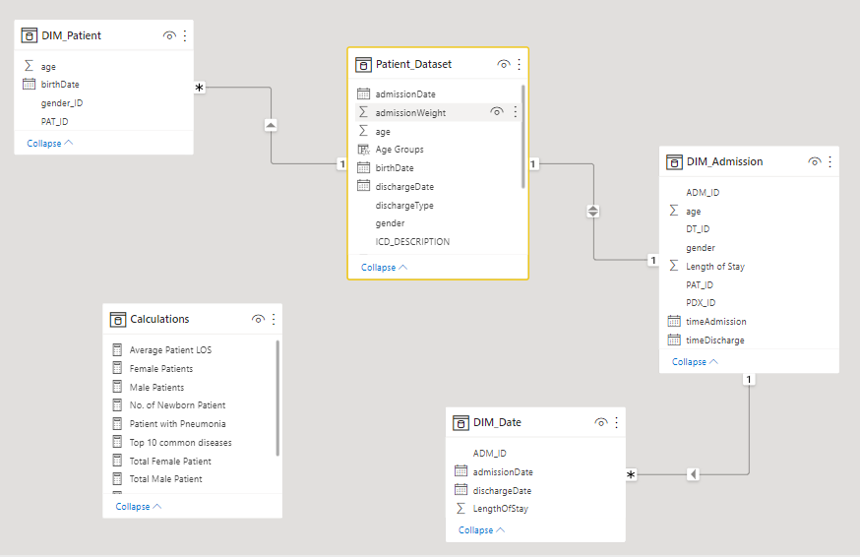
Entity relationship diagram

Slide 10






TECHNOLOGIES

Slide 11
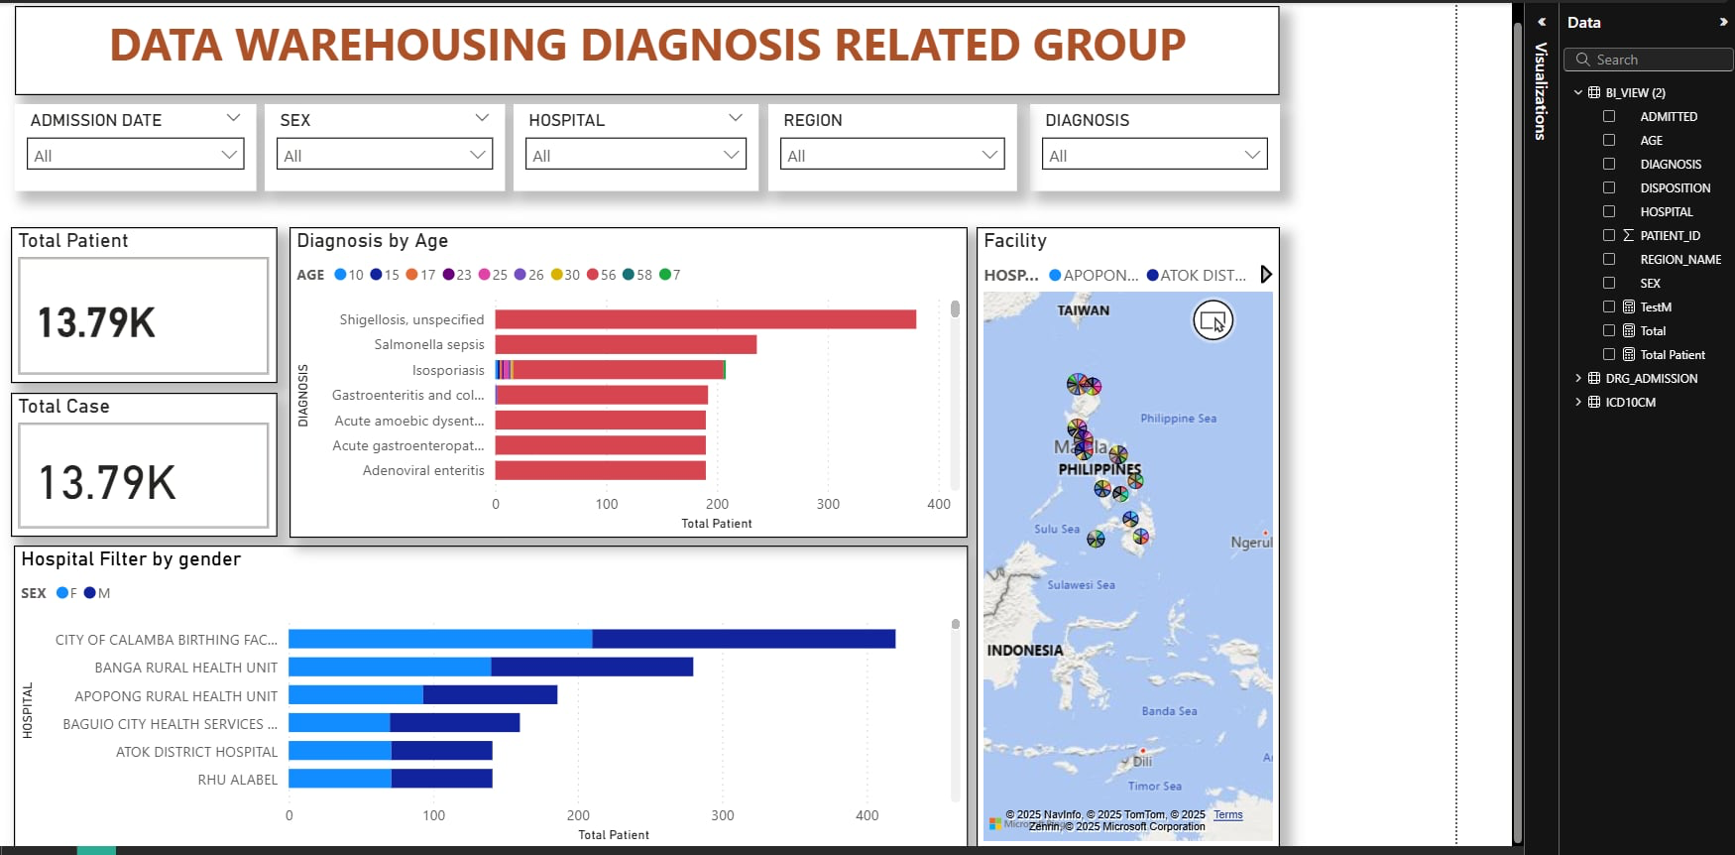
Power bi dashboard

Slide 12
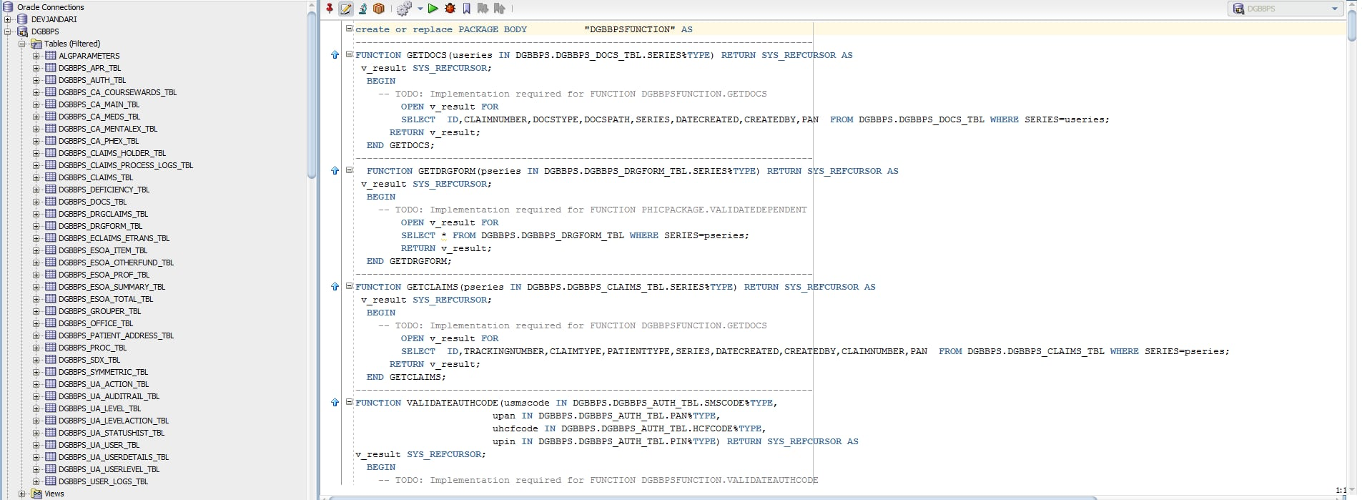
Oracle database

Slide 13
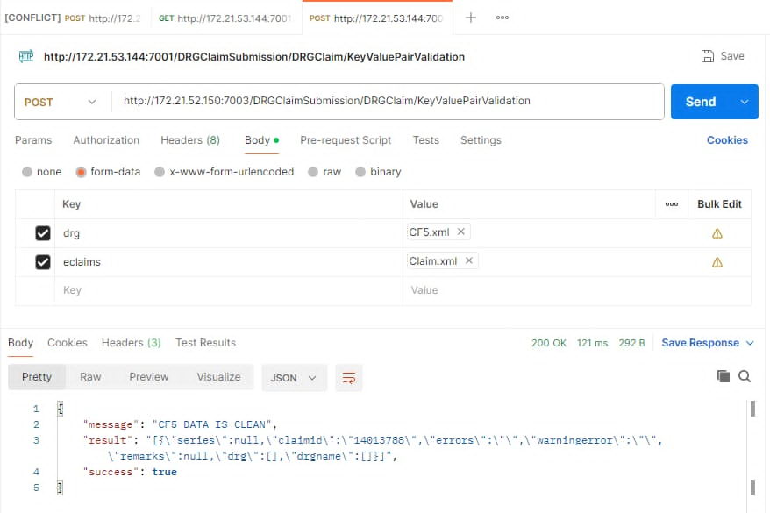
Rest api

Slide 14
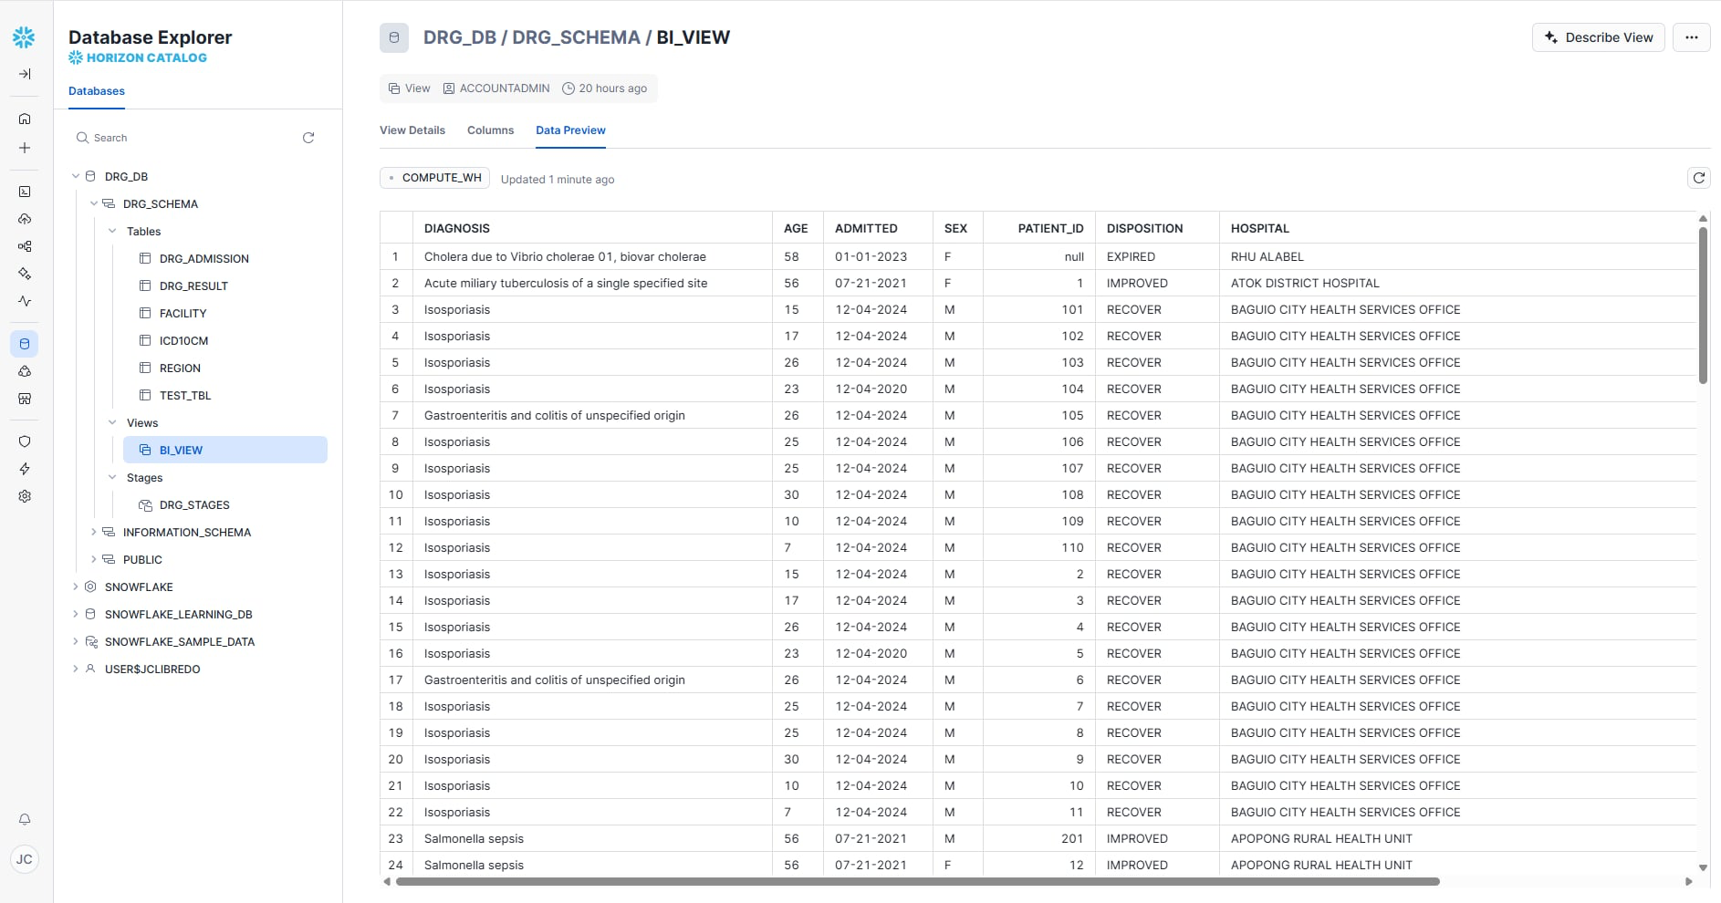
Snow flake

Slide 15
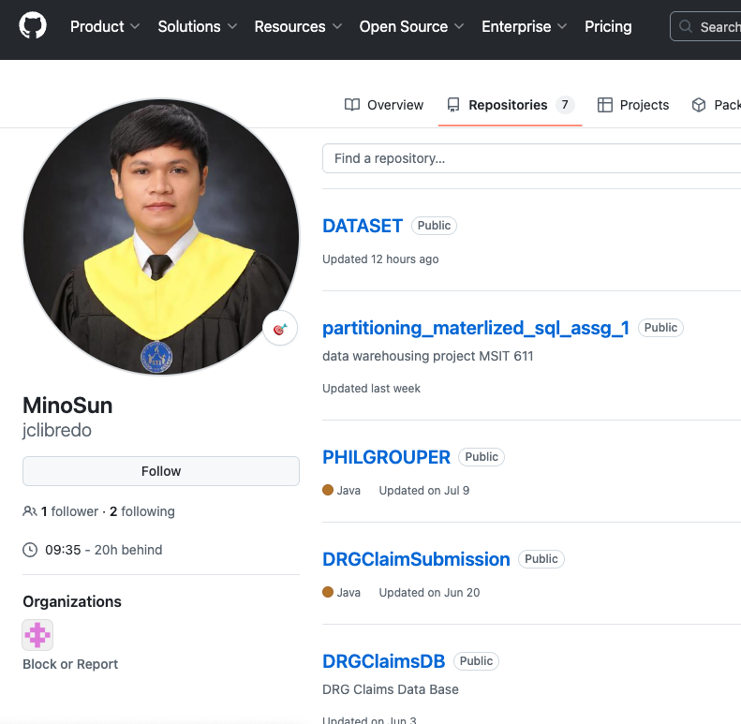
GITHUB REPOSITORY

Slide 16

Team collaboration

Slide 17
Thank you!
NEXT → SYSTEM DEMONSTRATION

