Slide 1
ENGI 301 Plant Tunes Proposal
13 Feb 2023
Janie Lim

Slide 2
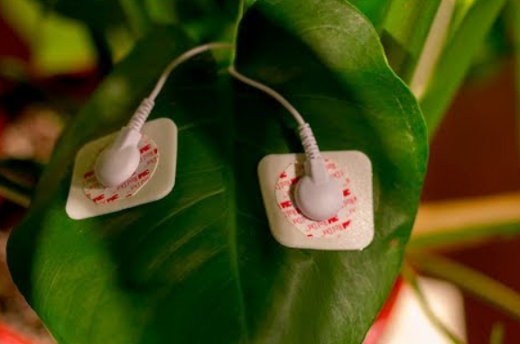
Background Information
Story: Took a freshman class on sounds and nature, and did an activity where we listened to plant music; one of my lab classes works a lot with electrodes this semester
Basic Idea: Place electrodes on plant to measure electrical activity, then convert to sound!
Commercial Ver: https://www.plantwave.com/
Arduino Project: https://www.instructables.com/Singing-plant-Make-your-plant-sing-with-Arduino-/
Arduino Project 2: https://github.com/electricityforprogress/BiodataSonificationBreadboardKit/
Yun Project*: https://www.fastcompany.com/3026612/hacking-house-plants-to-make-music-when-theyre-touched
What improvements / additions over existing project
Adapting to PocketBeagle?
Adding different sensors

Slide 3
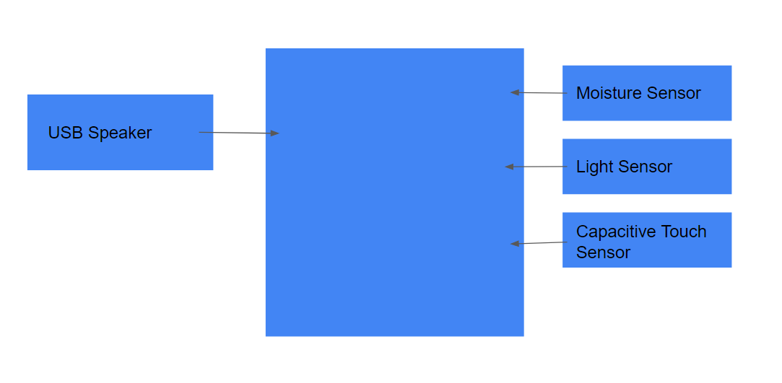
System Block Diagram

Slide 4
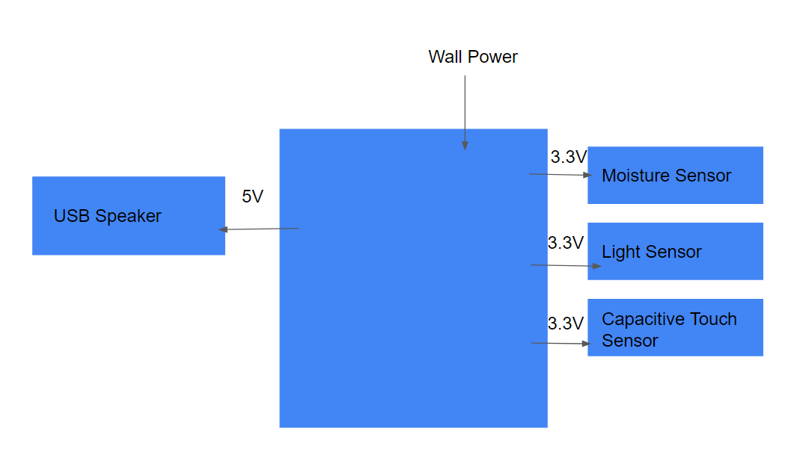
Power Block Diagram

Slide 5
Components / Budget
Component | Need to Buy | Cost ($)
USB Speaker | Y | 16.98
Moisture Sensor | Y | 9.99
Light Sensor | Y | 4.50
Capacitive Touch Sensor* | Y | 7.95
Temp Sensor | Y | 16.99
Resistors, Capacitors, Jumper Cables | N
*not on parts list
Total: 56.41

