Slide 1
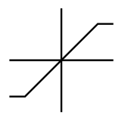





Stiction Offset
0.785
(rads)
6V
(rads)
(rads)
15$∗\frac{z+10}{z+10.5}$
(V)
(V)
(V)
(V)
$\frac{1}{s}∗\frac{0.66538}{0.030541s+1}$
$$θ_{in}$$
+/-
+/+
H
$$θ_{out}$$
-0.785
-6V
(rads)
(V)
(V)
ServoAng $=1.4∗angV+5.895$
S

Slide 2


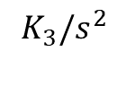

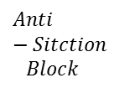
$$Anti−Sitction$$
$$Block$$
(m)
0.417
(m)
(m)
Ball position
ref
+/-
$$C_{2}(s)$$
+/+
Inner Loop
$$K_{2}$$
$$K_{3}/s^{2}$$
(m)
(rads)
Gear angle (rad)
Arm angle (rad)
(rads)
0
(m)
$$BallPosn=0.11∗posV+3.3$$
(V)
(V)
S

