Slide 1
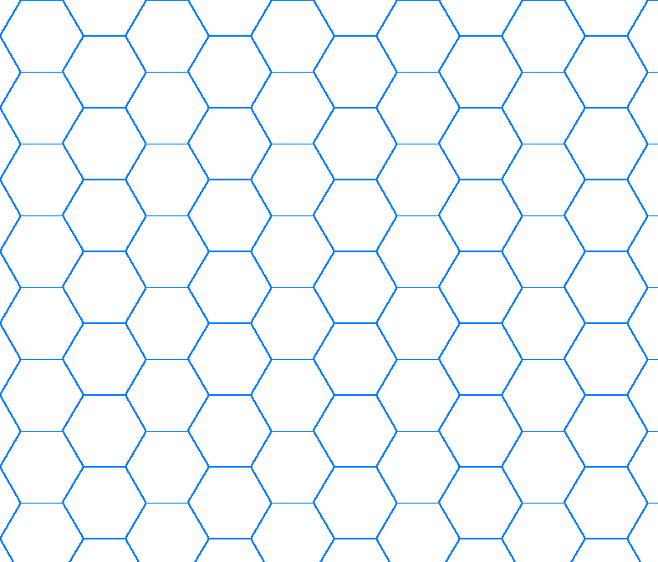
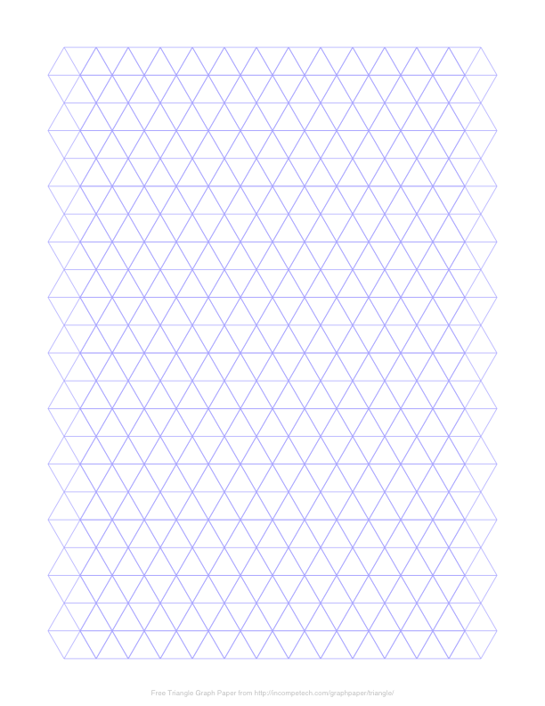
Planets
Stations
Fighters
Freighters
Science Vessel

Slide 2
Planets
Stations
Fighters
Freighters
Science Vessel

Slide 3
Planets
Stations
Fighters
Freighters
Science Vessel

Slide 4
Planets
Stations
Fighters
Freighters
Science Vessel

Slide 5
Planets
Stations
Fighters
Freighters
Science Vessel

Slide 6
Planets
Stations
Fighters
Freighters
Science Vessel

Slide 7
Planets
Stations
Fighters
Freighters
Science Vessel

Slide 8
Planets
Stations
Fighters
Freighters
Science Vessel

