Slide 1
Big Data 230
Emerging Technologies – Final Project
Jean-Claude “JC” MArtin

Slide 2

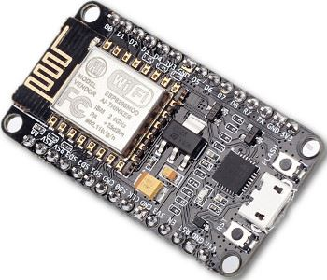
First the Fun stuff… Containers / IoT
Home Automation system:
Cell
MariaDB
Splunk
InfluxDB
Grafana
Location
Transactional DB
Events Tracking
Timeseries DB
Graphical UI
Cell
Location
ESP8266
MQTT
Home Assistant
Multi-Sensor
Messaging Broker
ESP8266
“Brains” of the
Automation
Multi-Sensor

Slide 3
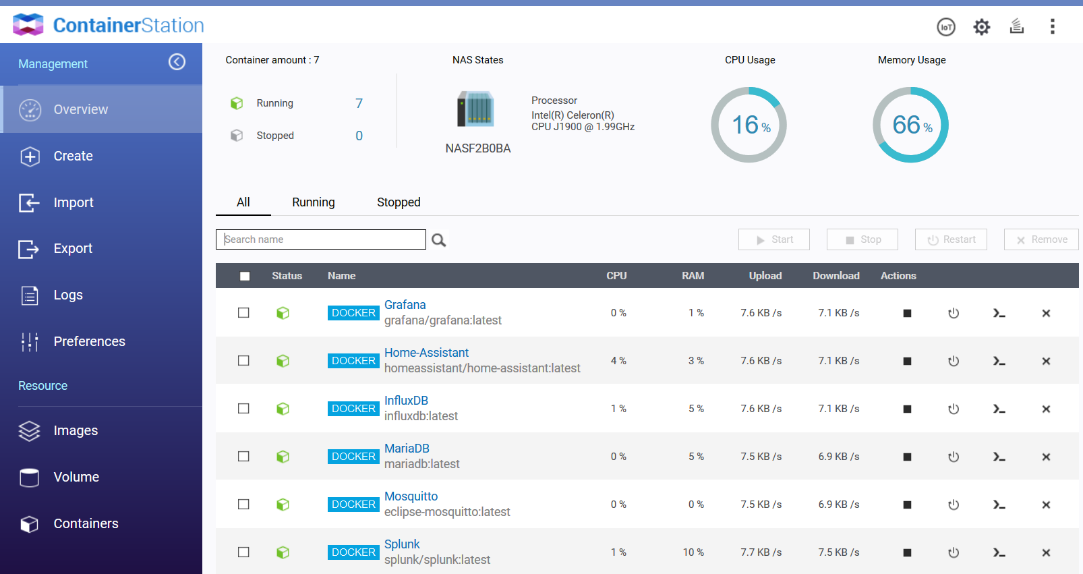

Slide 4
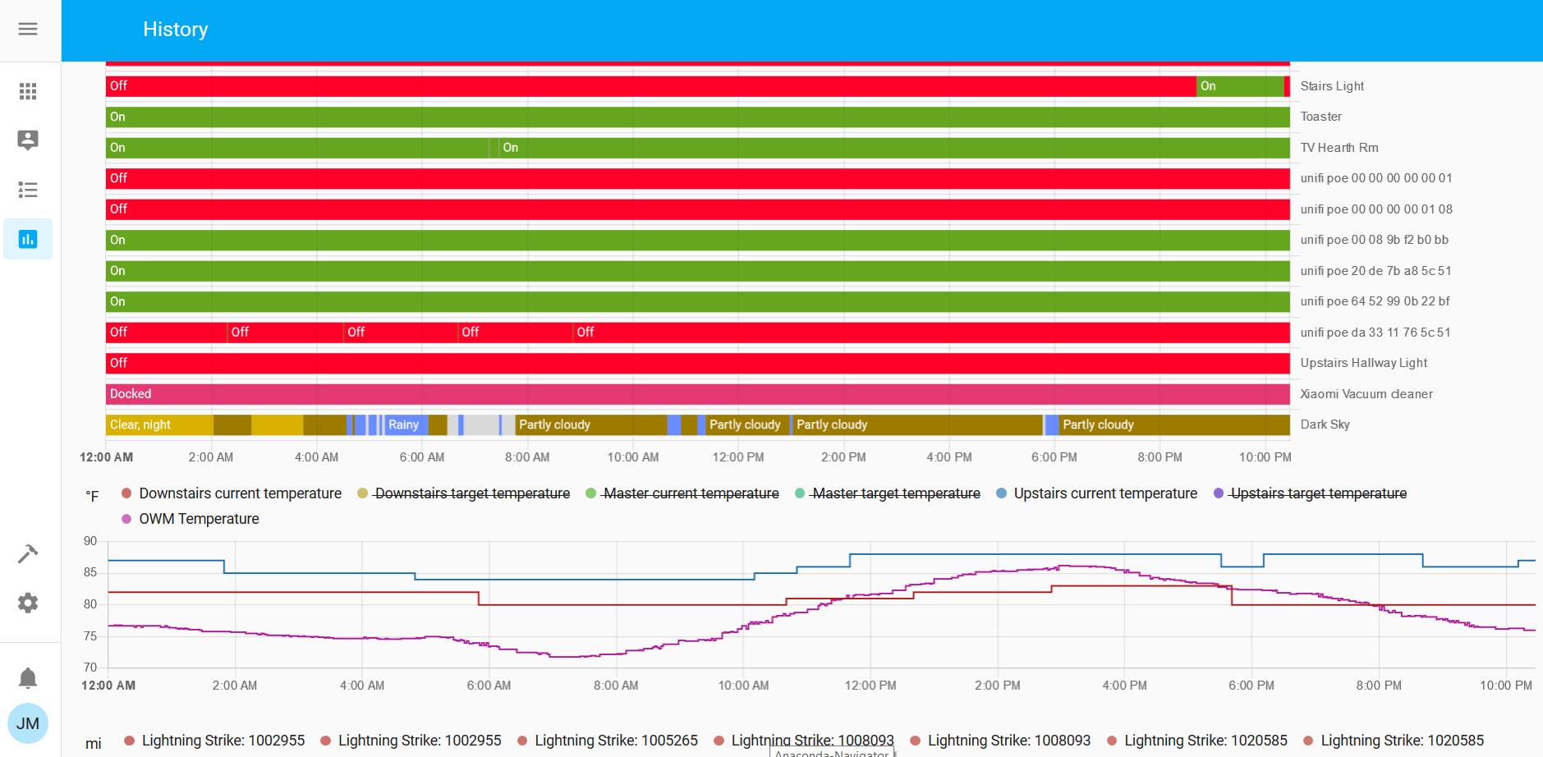

Slide 5
Time Series Analysis
Objective:
Use ts-flint and Hivemall to do timeseries analysis and anomaly detection on databricks
Data Overview:
Control datapoint collected hourly and aggregated daily, kept for ~ 415 days
Individual metrics are identified by a result_key_nbr and have a date column and a respective Actual_Value per day. Thousands of Controls metrics are generated every day.
Anomalies can be present in one individual metric or be system wide.
For simplicity, I started looking at one single metric (result_key_nbr) and expand to others later
Data was manually extracted and uploaded to databricks

Slide 6
1st Library – ts-flint
Accomplishments/Conclusions
ts-flint library was built for timeseries data manipulation and not analysis, so it didn’t fit my use case
Once the data was manipulated using ts-flint, used Linear regression to detect anomalies
Challenges
Wrong library pulled into databricks - Error message wasn’t intuitive, took me a while to figure out why it wasn’t working

Slide 7
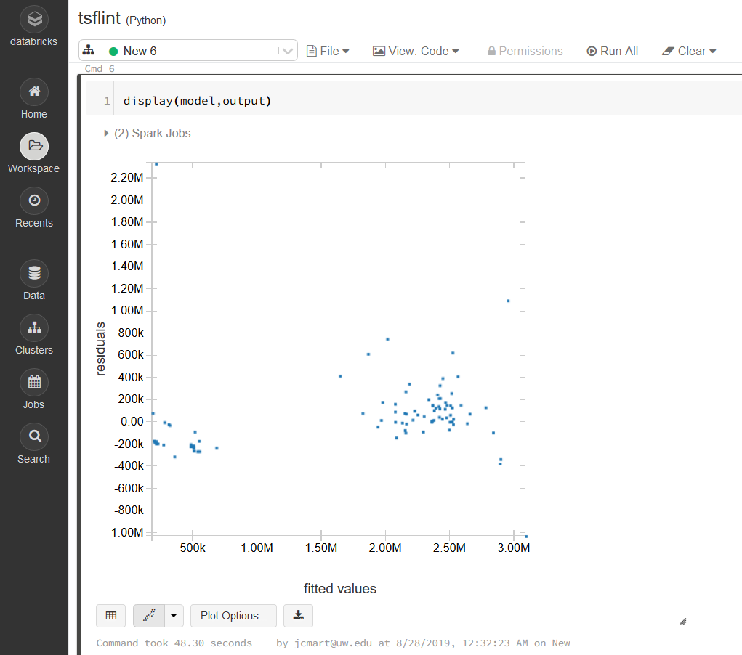
Linear Regression Residual Graph

Slide 8
2nd Library – Hivemall
Accomplishments/Conclusions
Hivemall is a very powerful collection of machine learning algorithms and versatile data analytics functions.
Challenges
Took a long time to find the right library to install
Unable to find any documentation on how to use Hivemall libraries on databricks
Hivemall seems to be focused on Hive functions. Installed Spark library but wasn’t able to use them

Slide 9
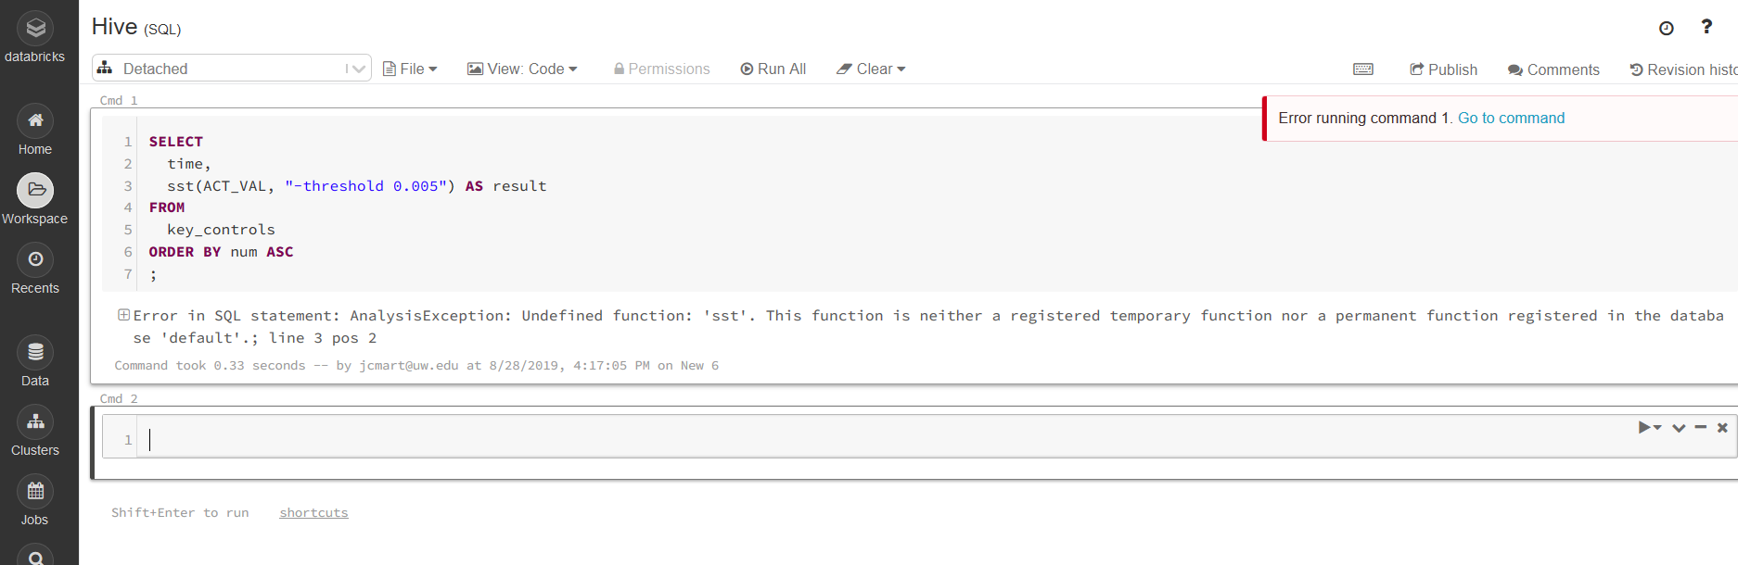

Slide 10
3rd Algorithm – SARIMA
Accomplishments/Conclusions
SARIMA = Seasonal AutoRegressive Integrated Moving Average
Adds seasonality to ARIMA, a widely used timeseries forecasting method
Results were very good once I was able to work around the issues
Challenges
Very complex with multiple parameters to be tuned
Had challenges with library versions to make it work on databricks
Struggled to make the visualizations work due to multiple issues

Slide 11
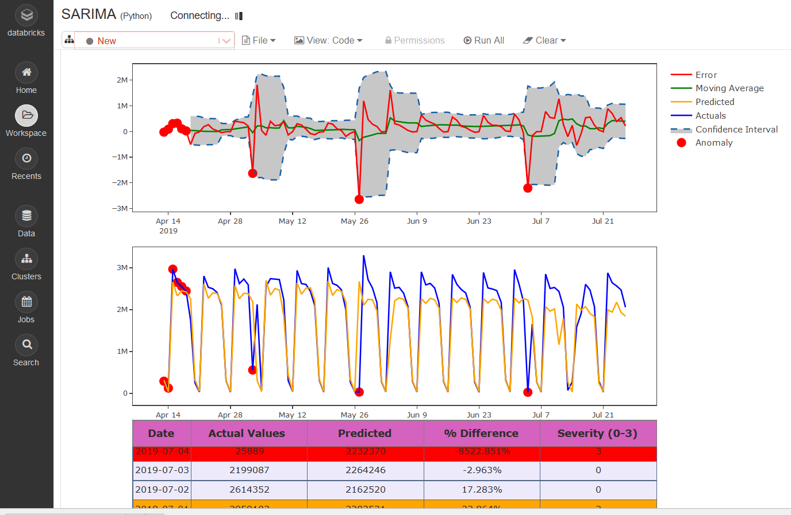
Anomaly detection using SARIMA

Slide 12
4th Algorithm – LSTM
Accomplishments/Conclusions
LSTM = Long Short-Term Memory
Special kind of Recurrent neural networks (RNN)
Challenges
Again, had trouble with libraries
Examples worked fine on local Jupyter notebook (Anaconda) but not on databricks. Probably related to library versions.
Results were not as good as SARIMA algorithm

Slide 13
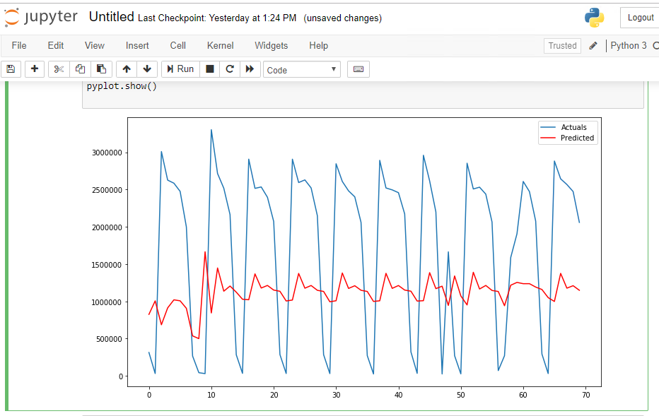
LSTM Actual vs Predicted

Slide 14
Conclusions
Timeseries Analysis was way more challenging than I anticipated.
Library management on databricks was painful
No easy solution for timeseries analysis. Some libraries are available, but they only help partially.
Understanding of advanced timeseries analysis methodologies and respective parameters and some statistical/mathematical background is a must.
Available methodologies require tuning of parameters. One solution doesn’t fit all
Best methodology for my use case was the SARIMA algorithm with manual parameters.

