Slide 1



Contributing Factors to a Movie's
Overall Lifetime Domestic Gross
January 24, 2020 By: Joanna Nachman
Notes:
Project on :
Factors that contribute to a movie’s overall lifetime domestic gross

Slide 2
Motivation & End Goal
Determine the most important factors for predicting a movie’s overall lifetime gross
Where should movie studios put their $$?
Notes:
Wanted to determine the most important factors for predicting a movie’s overall Domestic Inflation Adjusted Box Office
I’m using overall lifetime gross interchangeably with domestic inflation adjusted box office, which is the true Y in this case
- And, hopefully, I can answer the question, “How should movie studio marketing companies allocate their budget?”

Slide 3
Workflow
Gather, scrape, clean movie data The Numbers
Create baseline model, OLS, Regression
Separate data to train, validate, and test
Notes:
Gathered, scraped, cleaned movie data from the Numbers website, which is like imdb or boxoffice mojo, for various features:
Y = All time domestic inflation adjusted box office
Xs or features =
Movie Budget
Release Date – split into year and month
# of theaters
Genre
Franchise
Running Time

Slide 4
Results

Slide 5
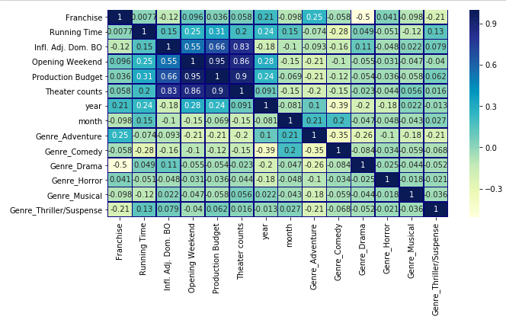
Heat map
Notes:
A lot of high Multicollinearity:
- Opening Weekend, Production Budget

Slide 6
Observations
First iteration of LR:
  R^2 = 0.84
Simple Validation Method: Train / Validation / Test:
  Linear Regression val R^2: 0.907
  Ridge Regression val R^2: 0.915
  Degree 2 polynomial regression val R^2: 1.000
Notes:
Not bad for initial iteration of Rsquared
Broke the data into 3 portions: 60% for training, 20% for validation, 20% for final testing evaluation and standardized the data.
When I did that R^2 increased.
In the example on the screen, random_state was equal to 3.
I also tried changing the random state to 11 and evidence still showed Ridge Regression was the best model.

Slide 7

Observations
Cross-Validation / Test:
  Simple mean cv r^2: 0.677 +- 0.000
  Ridge mean cv r^2: 0.707 +- 0.000
Did better on the same test set:
  Ridge Regression test R^2: 0.833
Notes:
Broke the data into 2 portions: 80% for cross-validated training, and 20% for final testing evaluation.
Focused on LR and Ridge Regression and got rid of 2 polynomial regression, based on the results on the last slide.
Did better on the same test set.

Slide 8

Observations
Feature Engineering:
  Validation R^2 score was: 0.755
  Added interaction terms:
    Production Budget & Franchise
Notes:
Split the data 80% for training and 20% validation. I didn’t add any polynomial terms, because I didn’t see that upward-curved relationship between any of the features.
However, there is a relationship between Franchise and Production Budget. Studios put more money into franchises, because they bank on audiences turning out.

Slide 9
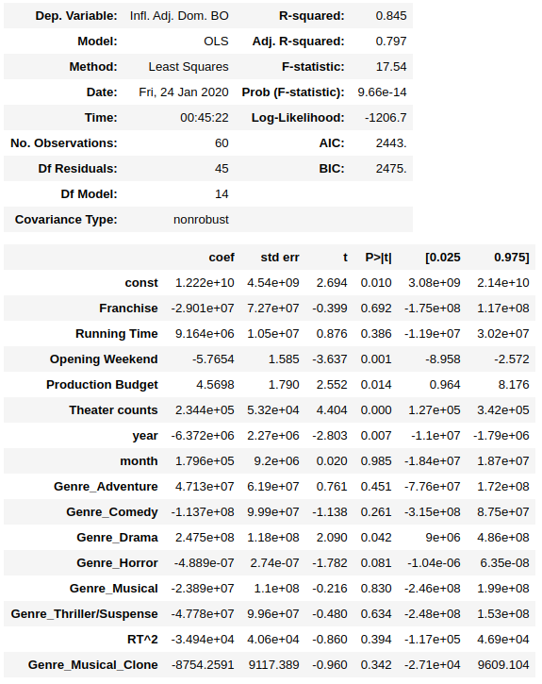
Observations
OLS Regression Results
Important features:
  Theater counts*
  Opening weekend
  Running Time
  Production Budget
  Year
  Genres: Adventure & Drama
Notes:
I did OLS Regression a couple times. First, without touching my features and then again squaring Running Time, based on its results in the pair plot.
Looking at the P values – I saw a lot of consistency when it came to the importance of certain features. Esp:
- Theater counts * which we’ll look at later
- Opening weekend performance
- Running time
- production budget
- year released
- Genres: adventure and drama

Slide 10
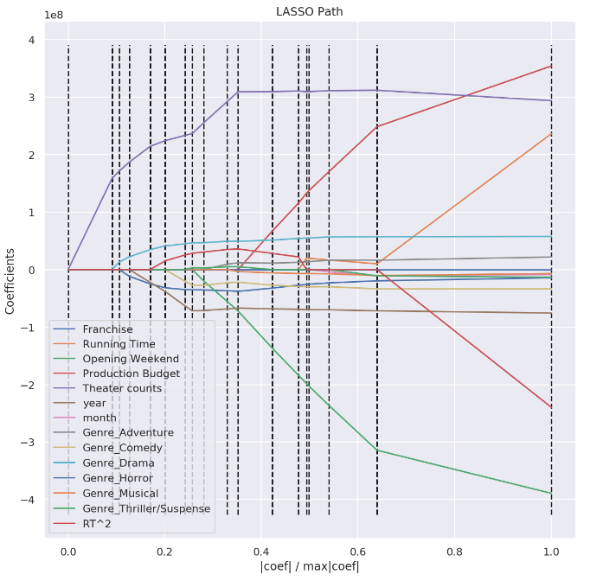
Observations
LARS Path to Study Feature
Importance:
  Theater counts
  Genre: Drama
Notes:
I looked at 3 different models for LARS Path. First, with Budget squared. The second with Run time squared. Third, with just my default columns with no changes applied.
All outputs showed that the most influential feature for predicting a movie’s overall Domestic Inflation Adjusted Box Office was Theater Counts
- Followed by the the Drama Genre

Slide 11

Conclusions/
Recommendations
- Theater counts
- Genres: adventure and drama
- Opening weekend
- Running Time
- Production Budget
Notes:
Based on Ridge and Lasso results, I would recommend the most important factors for predicting a movie’s overall Lifetime Gross are:
Theater counts
Adventure & Drama Genres
Opening weekend
Movie run time
Production budget

Slide 12
Thank you!

Slide 13
References
The Numbers: Movie Budgets. 1997-2020 Nash Information Services, LLC. Retrieved from:
  https://www.the-numbers.com/movie/budgets/all

